Slide 1





My foreign friends
Unit 3
Lesson 2 – Period 3

Slide 2




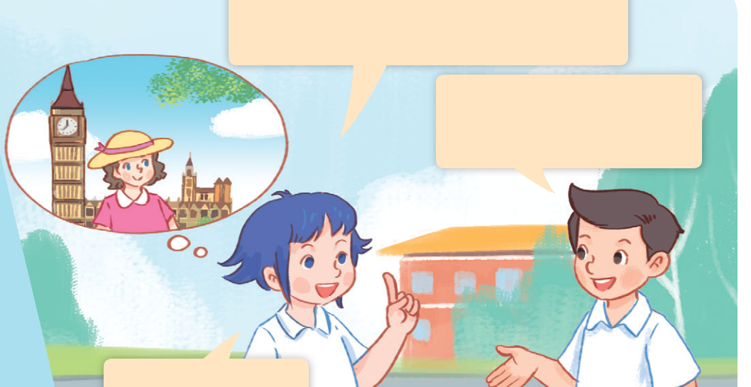


LOOK and SAY.
Notes:
Step 1: Ask pupils to look at Pictures a and b, identify the characters and predict what Lily’s nationality is.

Slide 3


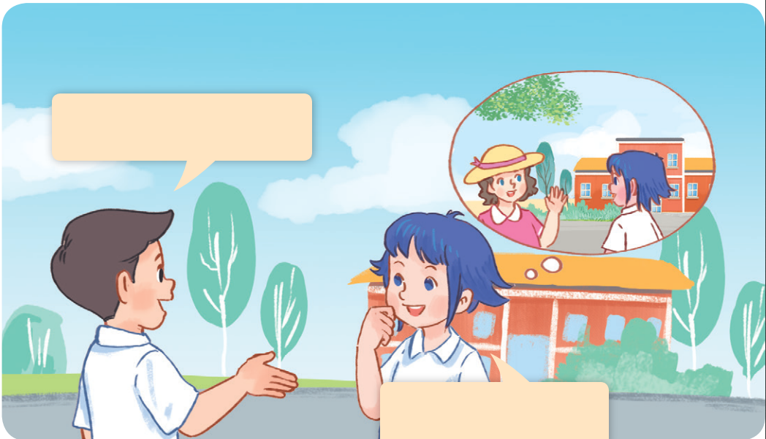


LOOK and SAY.
Notes:
Step 1: Ask pupils to look at Pictures a and b, identify the characters and predict what Lily’s nationality is.

Slide 4



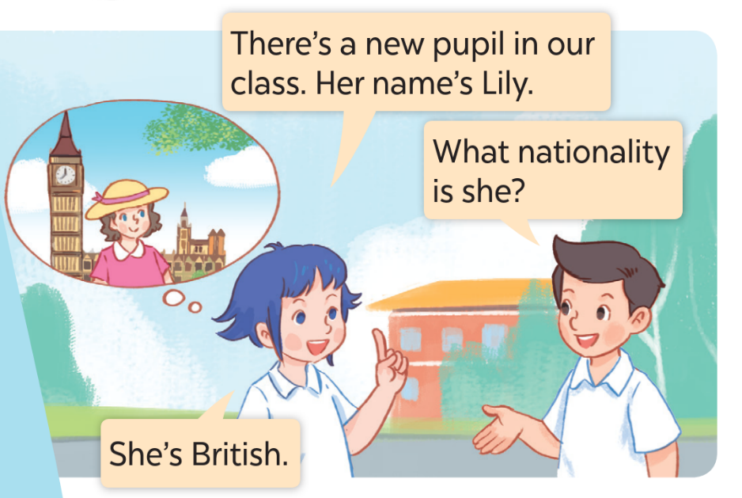
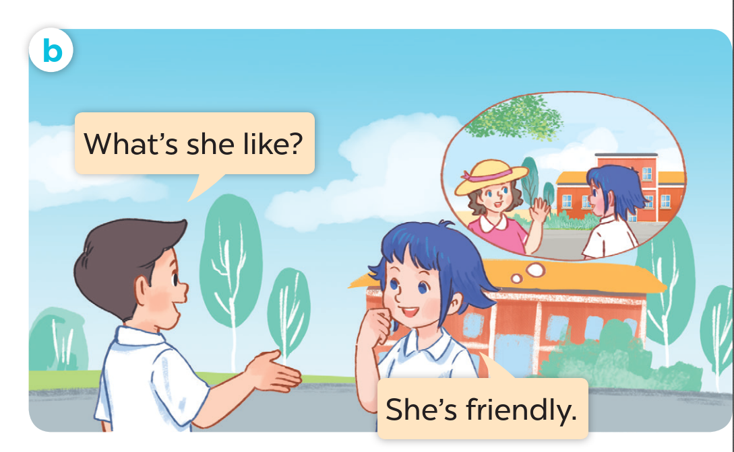


LISTEN and SAY.
Notes:
Step 2: Play the recording for them to listen and check the prediction.

Slide 5
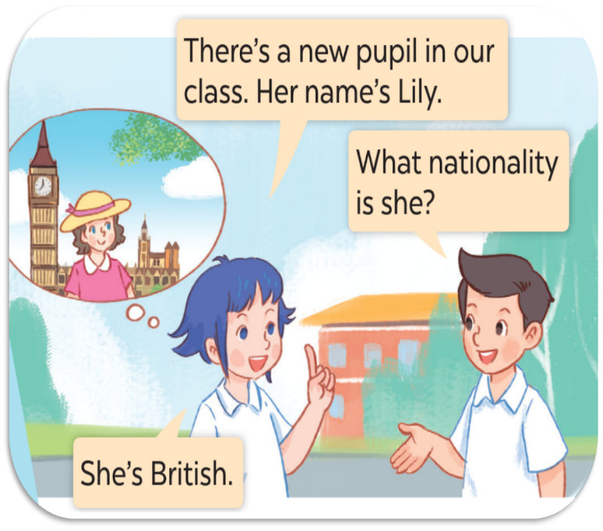
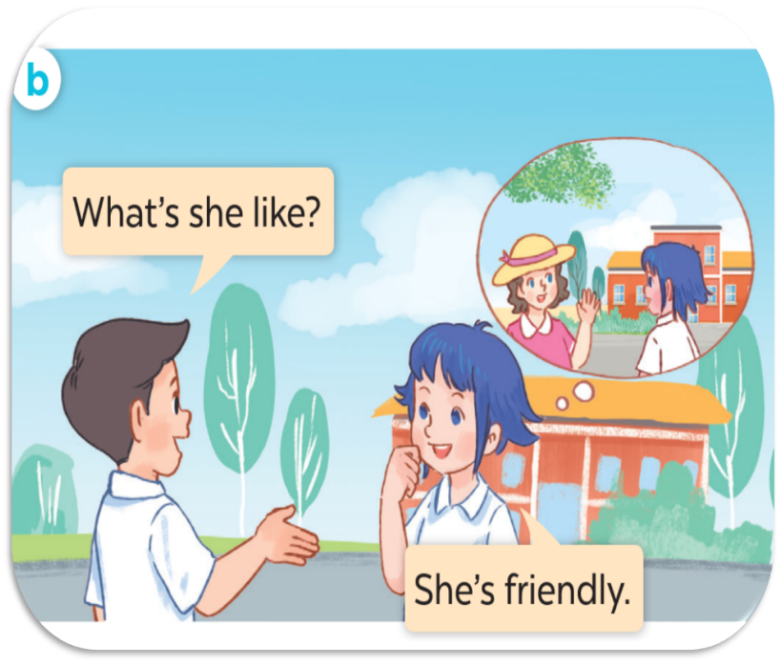

LISTEN and POINT.
Notes:
Step 3: Play the recording again, encourage pupils to point at the characters while listening.

Slide 6
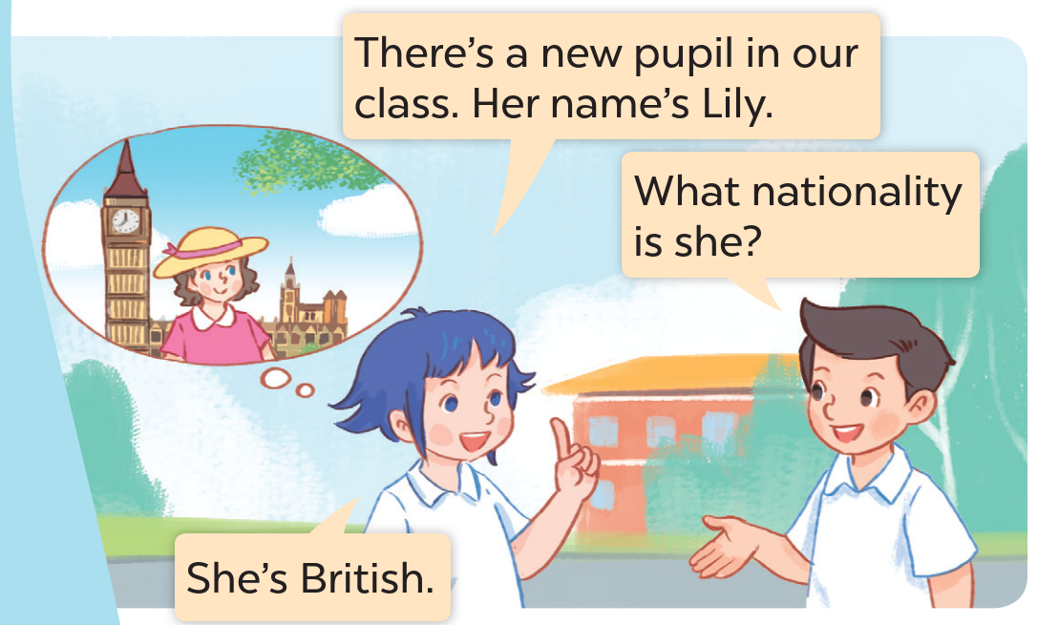

LISTEN, POINT and REPEAT.
Notes:
Step 4: Play the recording again, sentence by sentence, for pupils to listen, point to the sentences and repeat. Correct their pronunciation where necessary.

Slide 7
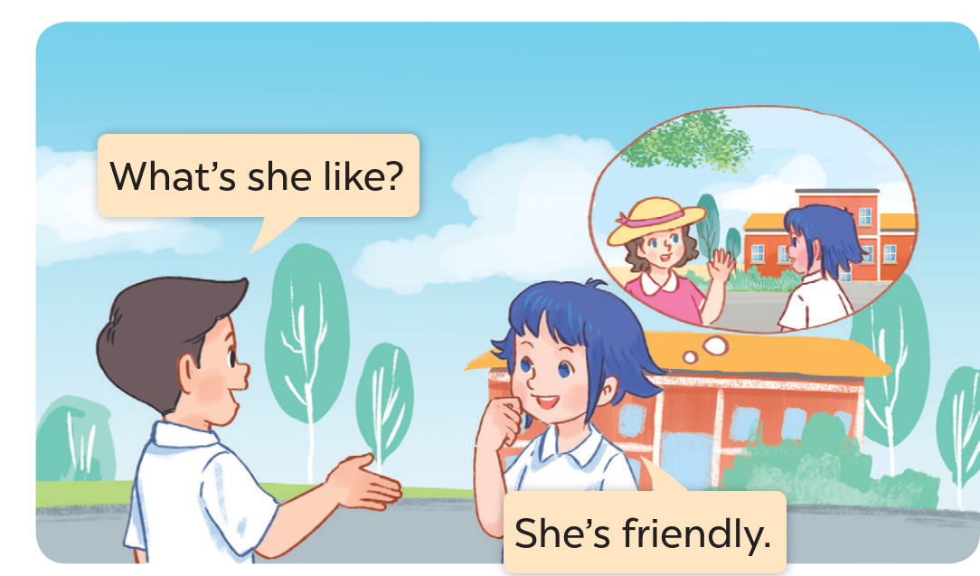
LISTEN, POINT and REPEAT.
Notes:
Step 4: Play the recording again, sentence by sentence, for pupils to listen, point to the sentences and repeat. Correct their pronunciation where necessary.

Slide 8
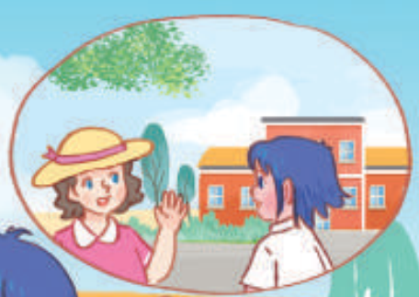
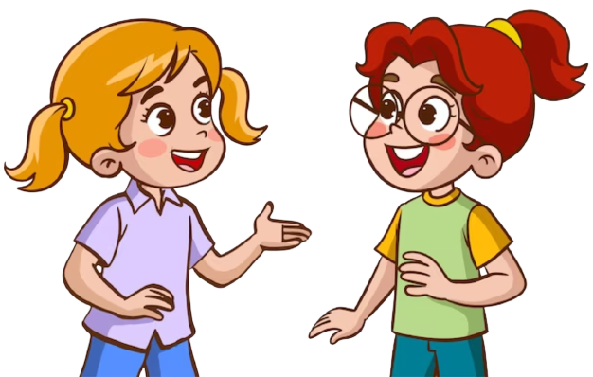
LISTEN and POINT.
What’s she like?
She’s friendly.
Notes:
Step 5: Draw pupils’ attention to the question What’s she like? and the answer She’s friendly. Explain that they are used to talk about someone’s personality.

Slide 9


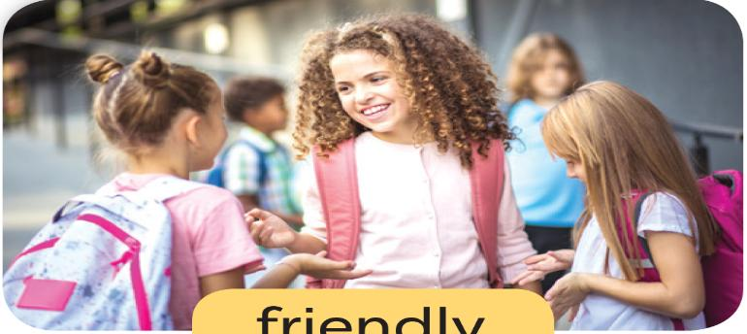





LOOK and SAY.
friendly
helpful
clever
active
Notes:
Step 1: Have pupils look at the pictures, say what they can see in the pictures and identify the countries. Explain the word under each picture is not the name of the country, but it is the nationality.

Slide 10

LISTEN and REPEAT.
Notes:
Step 2: Play the first part of the recording for pupils to listen and repeat the words under the pictures in chorus and individually until they feel confident. Use the flash cards for Australian, Malaysian, American and Japanese to practise the words.

Slide 11

LISTEN and REPEAT.
Notes:
Step 2: Play the first part of the recording for pupils to listen and repeat the words under the pictures in chorus and individually until they feel confident. Use the flash cards for Australian, Malaysian, American and Japanese to practise the words.

Slide 12

LISTEN and REPEAT.
Notes:
Step 2: Play the first part of the recording for pupils to listen and repeat the words under the pictures in chorus and individually until they feel confident. Use the flash cards for Australian, Malaysian, American and Japanese to practise the words.

Slide 13

LISTEN and REPEAT.
Notes:
Step 2: Play the recording for pupils to listen to and repeat the phrases in chorus and individually until they feel confident. Use the flashcards for a friendly girl, a helpful girl, a clever boy, and an active boy to practise the phrases.

Slide 14


LISTEN and REPEAT.
What’s she like?
She’s friendly.
Notes:
Step 3: Draw pupils’ attention to the speech bubbles and elicit the missing words in the question and answer by pointing at Picture a. Play the recording for pupils to listen to and repeat the sentences in both bubbles a few times. Repeat the same procedure with Pictures b, c, and d.

Slide 15

LISTEN and REPEAT.
What’s she like?
She’s helpful.
Notes:
Step 3: Draw pupils’ attention to the speech bubbles and elicit the missing words in the question and answer by pointing at Picture a. Play the recording for pupils to listen to and repeat the sentences in both bubbles a few times. Repeat the same procedure with Pictures b, c, and d.

Slide 16

LISTEN and REPEAT.
What’s he like?
He’s clever.
Notes:
Step 3: Draw pupils’ attention to the speech bubbles and elicit the missing words in the question and answer by pointing at Picture a. Play the recording for pupils to listen to and repeat the sentences in both bubbles a few times. Repeat the same procedure with Pictures b, c, and d.

Slide 17

LISTEN and REPEAT.
What’s he like?
He’s active.
Notes:
Step 3: Draw pupils’ attention to the speech bubbles and elicit the missing words in the question and answer by pointing at Picture a. Play the recording for pupils to listen to and repeat the sentences in both bubbles a few times. Repeat the same procedure with Pictures b, c, and d.

Slide 18

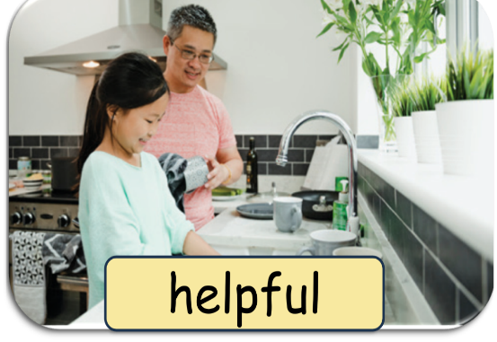


ASK and ANSWER.
Notes:
Step 4: Let pupils point at the pictures and say the sentences in pairs. Go around the classroom to offer help where necessary.

Slide 19
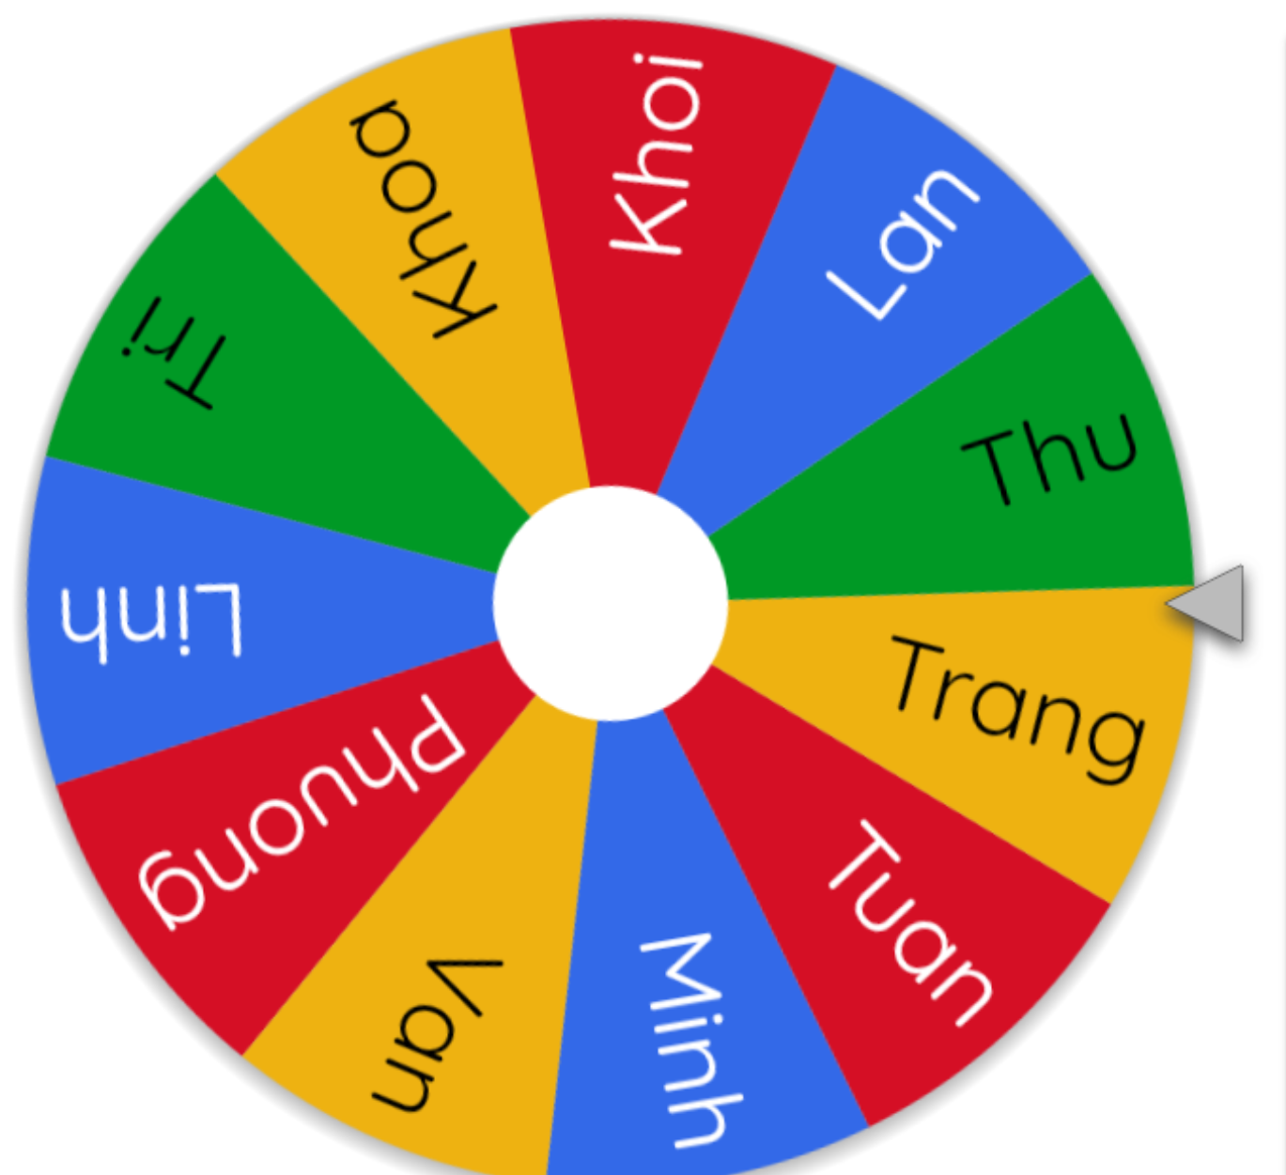
LET’S SPIN!
Notes:
Step 5: Invite a few pairs to act out the exchanges in front of the class.

Slide 20


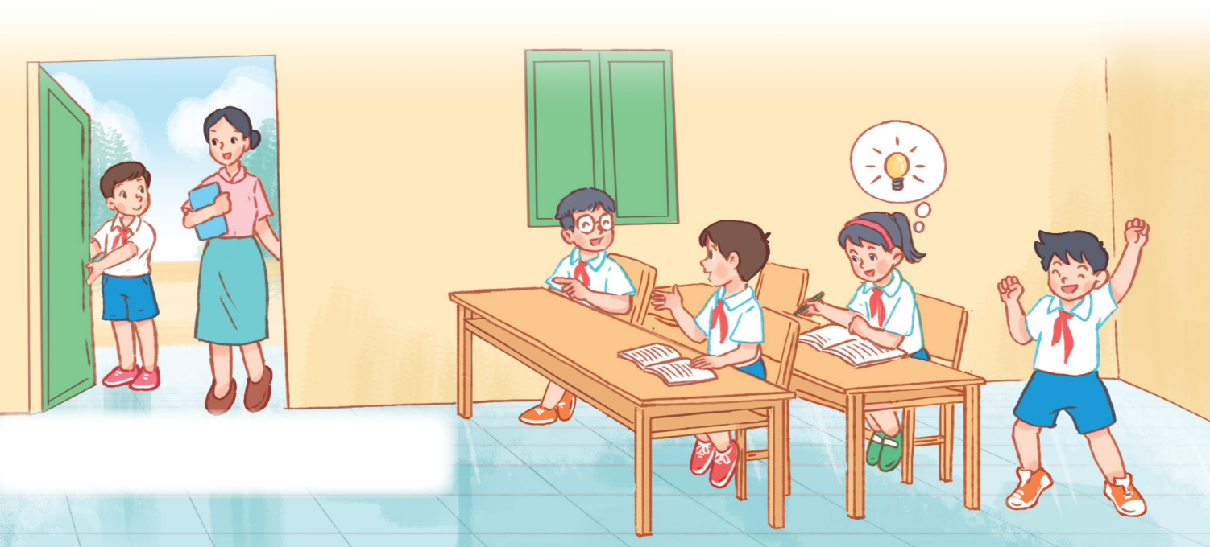
LOOK and SAY.
clever
helpful
friendly
active
Notes:
Step 2: Give pupils time to work in pairs and take turns pointing and asking and answering questions about the personality of each character in the picture. Remind them to look at the activities the characters do.

Slide 21
LET’S SPIN!
Notes:
Step 3: Invite a few pairs to come to the front of the classroom and act out the exchanges.Use this link to choose pupils in random: https://wheelofnames.com/

Slide 22




Slide 23

SWAP YOUR BOOKS
Notes:
Step 3: Get pupils to swap books with a partner and check their answers before checking as a class. Nominate some pupils to write the answers on the board. Check the answers. Ask questions to have pupils explain why they choose the options. For example, for picture B, ask why do you choose Malaysian? - Because there’s a flag of Malaysia.

Slide 25



ROUND 1

Slide 26




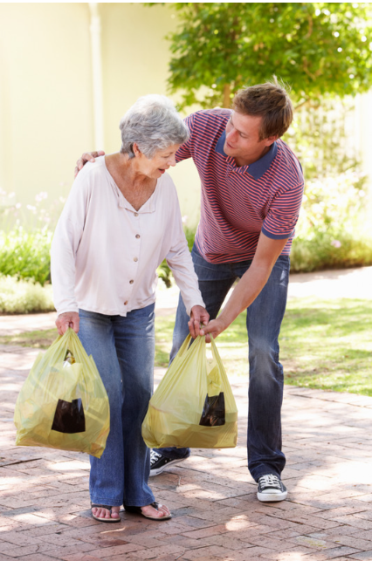


4
3
2
1
Notes:
Prepare pictures or words in paper to show pupils.
Ask pupils to play the game.
Click numbers to show the answer keys.

Slide 27



ROUND 2

Slide 28
4
active
3
friendly
clever
2
1
helpful
Notes:
Prepare letters in paper to show pupils.
Ask pupils to unscramble letters and whisper the correct words.
Click numbers to show the answer keys.

Slide 29



THANK YOU for playing!

