Slide 1



My week
3
LESSON 2 PERIOD 4
SUNDAY
SUNDAY
MONDAY
TUESDAY
WEDNESDAY
THURSDAY
FRIDAY
SATURDAY

Slide 2
Table of contents
Warm-up and review
01
04
02
03
Let’s sing.
Listen and number.
05
Fun corner
& wrap-up
Look, complete and read.

Slide 3
01
Warm-up

Slide 4

MIMING GAME

Slide 5
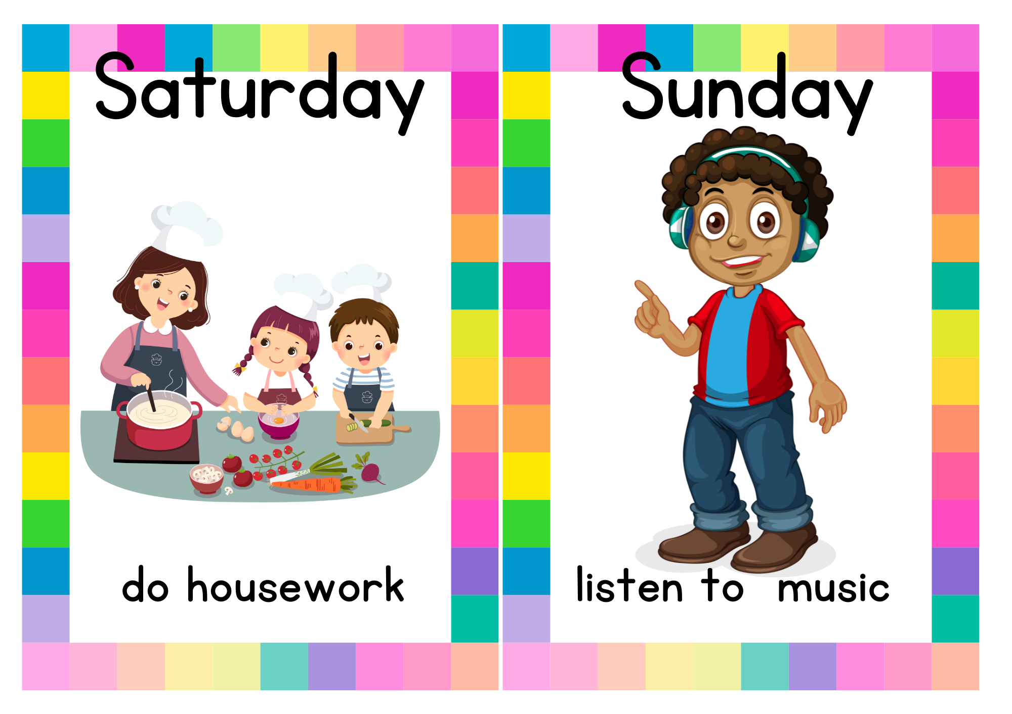
MIMING GAME

Slide 6
MIMING GAME

Slide 7
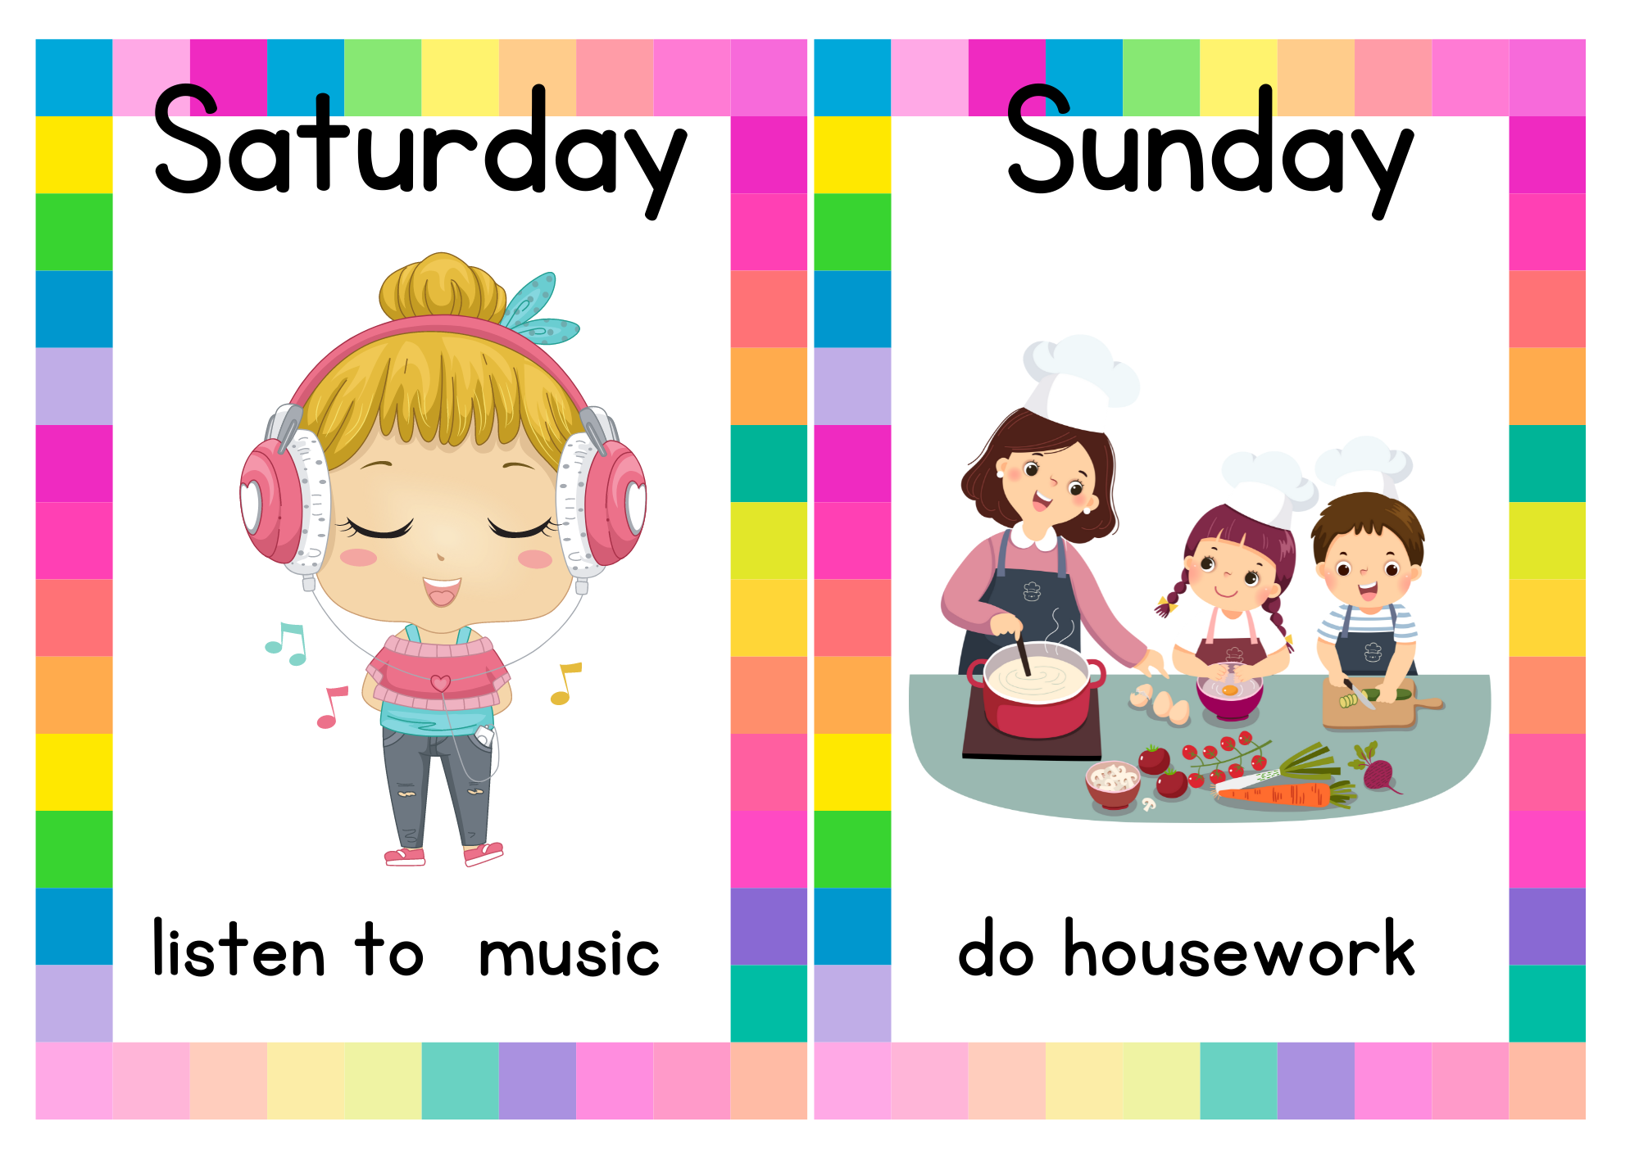
MIMING GAME

Slide 8

MIMING GAME:

Slide 9
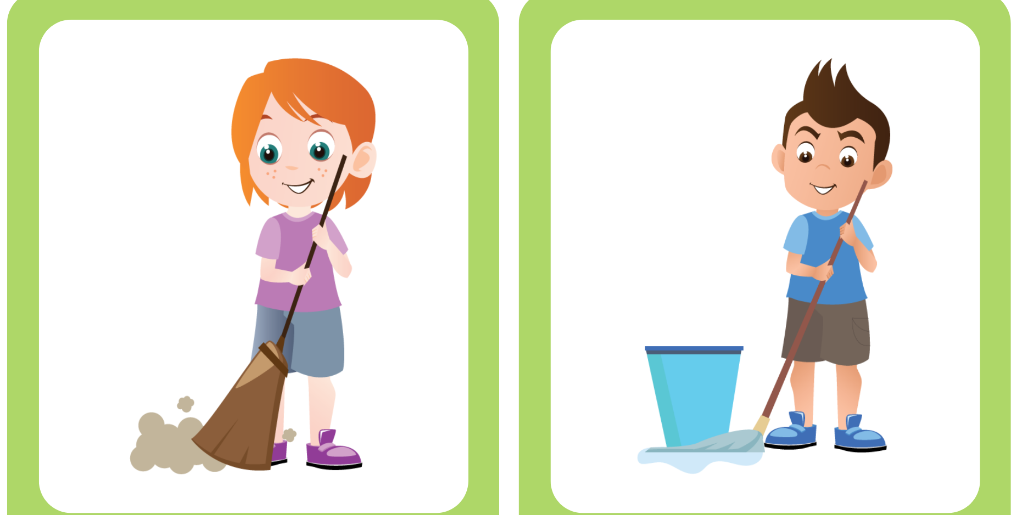
MIMING GAME

Slide 10
02
Activity 4 Listen and number.

Slide 11
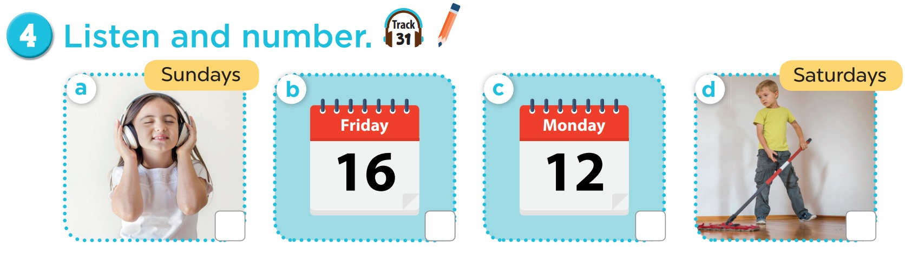

4
3
1
2

Slide 12
03
Activity 5 Look, complete and read.

Slide 13
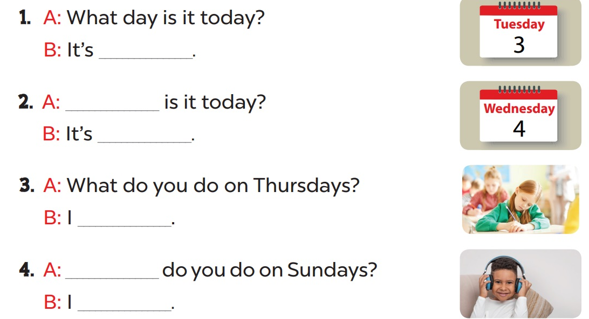
Complete and read aloud.
Tuesday
What day
Wednesday
study at school
What
listen to music

Slide 14
04
Activity 6 Let’s sing.

Slide 15
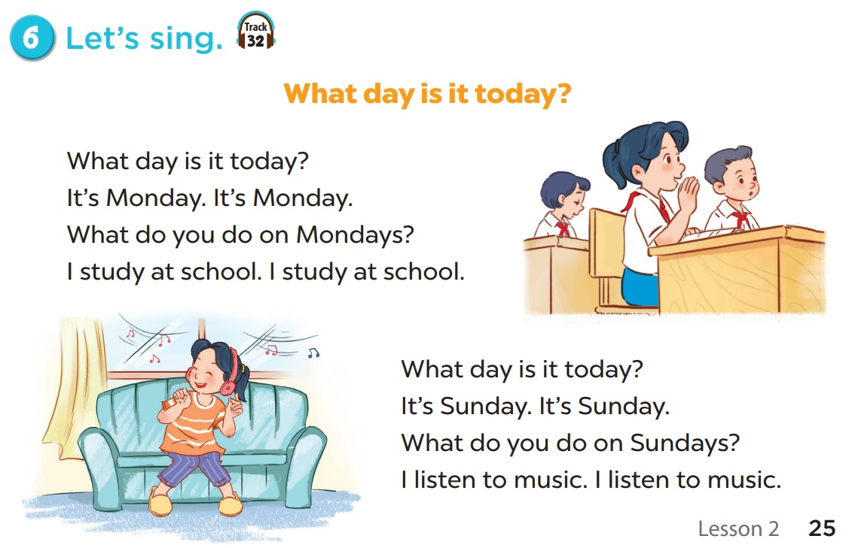
Notes:
Video hoạt hình: https://www.youtube.com/watch?v=YvH0KYru6h0&list=PL8_ETpRL2xNay3h-a-vBjWhplE1wXFpSJ&index=1

Slide 16
Clap and sing.

Slide 17
05
Fun corner & wrap-up

Slide 18
WORD SEARCH
Find the word in puzzle.
Words can go any direction.
Words can share letters as they cross over each other.
7 of 7 words placed.

Slide 19
WORD SEARCH
S | H | R | Y | H | Z | B | J | G | R | T | Q | H | G | Y
H | Z | N | C | A | T | V | Q | E | K | P | L | A | A | M
R | W | Z | X | Z | D | T | W | X | J | R | D | D | R | A
E | T | E | D | N | U | S | E | J | M | E | R | E | A | Y
S | L | I | E | E | W | I | R | K | F | U | X | R | F | A
N | E | E | S | K | Q | P | R | U | T | G | Y | U | G | D
Q | S | D | H | A | U | S | B | A | H | E | F | M | W | I
G | A | W | P | S | N | H | S | Z | K | T | T | V | K | R
Y | M | X | R | U | L | J | M | W | E | R | L | B | T | F
W | X | L | F | Z | Q | D | M | R | G | G | R | A | X | O
Z | I | A | X | T | G | L | O | S | U | N | D | A | Y | V
Z | Y | Y | A | D | S | E | N | D | E | W | R | R | Y | O
K | O | F | X | P | T | J | B | M | L | Z | F | E | I | H
J | B | V | H | Q | X | B | A | G | F | E | I | I | L | H
C | I | V | L | E | P | S | Y | B | M | H | J | S | Z | X

