Slide 1





My foreign friends
Unit 3
Lesson 2 – Period 4

Slide 2



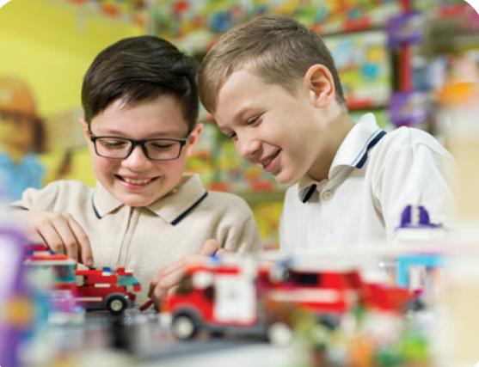
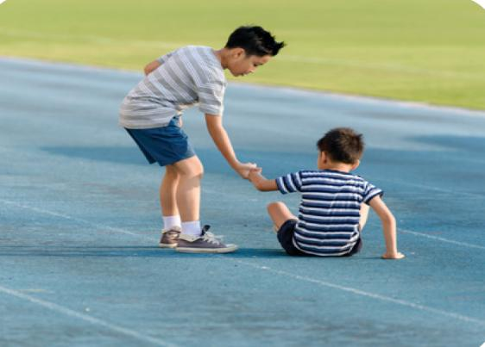


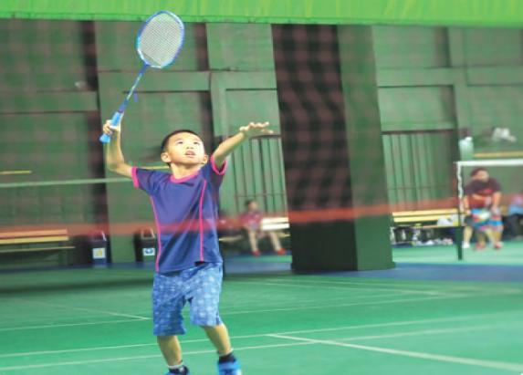


ASK and ANSWER.
Notes:
Step 1: Draw pupils’ attention to the pictures and ask questions to elicit the personalities of the people in the pictures. Remind them to look at the pictures to contrast. Have pupils predict which picture is number 1.

Slide 3



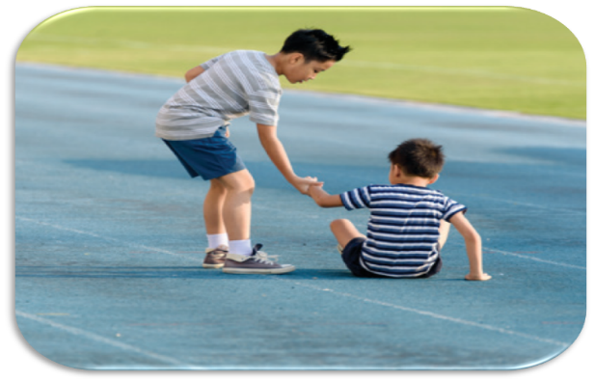

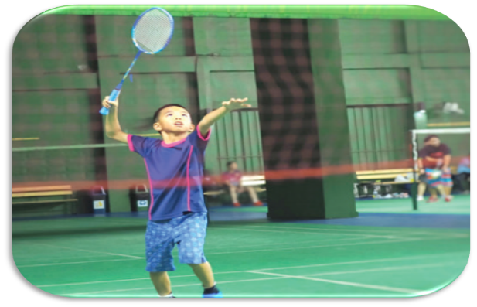


LISTEN and NUMBER.
1
Notes:
Step 2: Play the recording of the first dialogue for pupils to listen and check the prediction. Ask What picture, everyone? Is your prediction correct? What’s Tom like? - He’s very helpful. Why do you choose picture b? - Because the boy is helping a kid. Then play the recording again for pupils to listen and check.

Slide 4

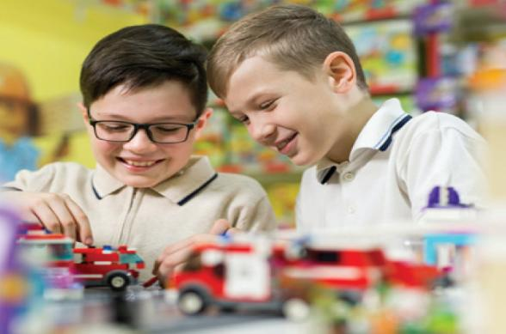
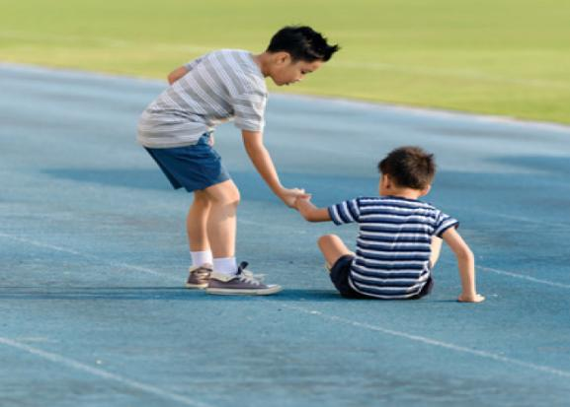

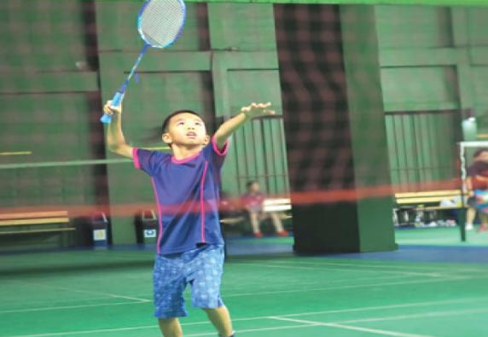
LISTEN and NUMBER.
1
Notes:
Step 3: Play the recordings of dialogues 2, 3 and 4, and have pupils number the pictures.

Slide 5




LISTEN and CHECK.
2
1
4
3
Notes:
*Key: 1. b, 2. a, 3. d, 4. c

Slide 6

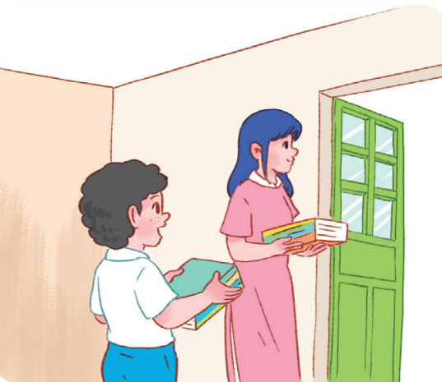



READ and GUESS.
1. A: I have a new friend at school.
He’s Malaysian.
B: Really? I also have a friend from _____________. Is he from Kuala Lumpur?
A: Yes, he is.
B: What’s he like?
A: He’s _________. He likes helping others.
Malaysia
helpful
Notes:
Step 1: Model the first gapped exchange as an example. Have pupils read the dialogue and guess the missing words. Ask What nationality is a new friend? - He’s Malaysian. Where is he from? - He’s from Malaysia. Then draw pupils’ attention to the picture and elicit the words to fill in the gaps, for example, ask What’s the boy doing? - He’s helping the teacher. He’s carrying some notebooks for his teacher. What’s he like? - He’s helpful.

Slide 7

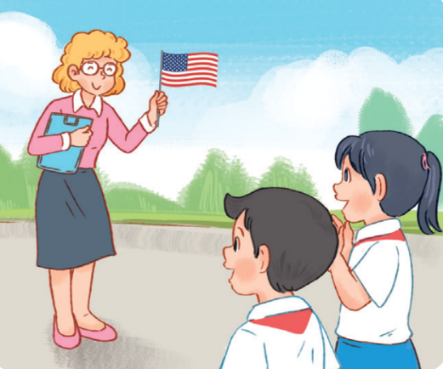


READ and GUESS.
2. A: Do you have a new English teacher?
B: Yes, I do.
A: What nationality is she?
B: She’s ____________ .
A: What’s she _____?
B: She’s friendly.
Notes:
Step 2: Give pupils a time limit to complete the gapped exchange 2 independently. Go around the classroom and help where necessary.

Slide 8
Let’s CHECK.
2. A: Do you have a new English teacher?
B: Yes, I do.
A: What nationality is she?
B: She’s ____________ .
A: What’s she _____?
B: She’s friendly.
American
like
Notes:
*Key: 1. Malaysia, 2. helpful, 3. American, 4. like

Slide 9


True or False
Notes:
Extension (For advanced level): Make some true and false sentences about the conversations. For example, The new maths teacher is from America (False), The new English teacher is friendly (True). Say a sentence and have pupils call out True or False.

Slide 10


The new friend is from America.
False
True
Notes:
Extension (For advanced level): Make some true and false sentences about the conversations. For example, The new maths teacher is from America (False), The new English teacher is friendly (True). Say a sentence and have pupils call out True or False.

Slide 11
False
The new friend is from Malaysia.

Slide 12


The new friend is helpful. He likes helping others.
False
True

Slide 13
True
The new friend is helpful.
He likes helping others.

Slide 14


The new English teacher
is from America.
False
True

Slide 15
True
The new English teacher is from America. She’s American.

Slide 16

The new English teacher
is not friendly.
False
True

Slide 17
False
The new English teacher is friendly.

