Slide 1





My foreign friends
Unit 3
Lesson 3 – Period 5

Slide 2






LISTEN, POINT and REPEAT
‘active
He’s ‘active.
Notes:
Step 1: Have pupils point at the word ‘active’ and the sentence He’s active. Play the recording of the word and sentence for them to listen and repeat in chorus and individually until they feel confident. Correct their pronunciation where necessary.
Step 2: Invite a few pupils to listen and repeat the stressed word and the sentence in front of the class. Praise good pronunciation.

Slide 3
LISTEN, POINT and REPEAT
‘friendly
She’s ‘friendly.
Notes:
Step 3: Repeat Steps 1 and 2 for the word ‘friendly’ and the sentence She’s friendly. Go around the classroom and correct their pronunciation if necessary.

Slide 4



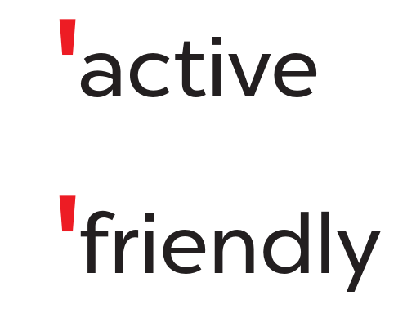
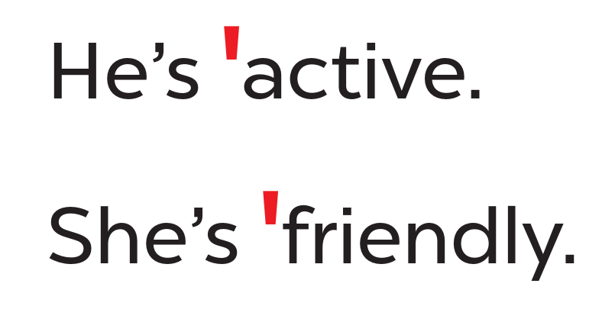


WORK in PAIRS
Notes:
Step 4: Let pupils work in pairs or groups, say the words, and read the sentences until they feel confident.

Slide 5




READ and CIRCLE.
a. friendly
b. fifteen
c. active
a. sixteen
b. eighteen
c. clever
a. helpful
b. about
c. nineteen
Notes:
Step 1: Tell pupils the goal of the activity. Explain that this is an ‘odd one out’ activity. Pupils read three options and circle the word which has a different stress pattern from the other two words.
Step 2: Give pupils a time limit to do the task individually. Have them read the words and odd out the ones that have the stress different from the other two.

Slide 6


SWAP YOUR BOOKS
Notes:
Then get pupils to swap books with a partner to check their answers.

Slide 7
LISTEN and CHECK.
a. friendly
b. fifteen
c. active
a. sixteen
b. eighteen
c. clever
a. helpful
b. about
c. nineteen
Notes:
Step 3: Play the recording and have pupils listen and check the options. Correct the answers where necessary.
- Click to appear the yellow arrow when starting listening.

Slide 8



LOOK and SAY aloud.
friendly
helpful
active
clever
She’s active.
He’s friendly.
He’s clever.
She’s helpful.
Notes:
Step 4: Invite a few pupils to read aloud the words in front of the class. Correct the word stress where necessary.

Slide 9





Slide 10

LOOK and SAY.
play basketball
active
Notes:
Step 1: Have pupils look at the picture and state activity the characters do and the words to show their personality.

Slide 11

LOOK and SAY.
clean the table
helpful
Notes:
Step 1: Have pupils look at the picture and state activity the characters do and the words to show their personality.

Slide 12
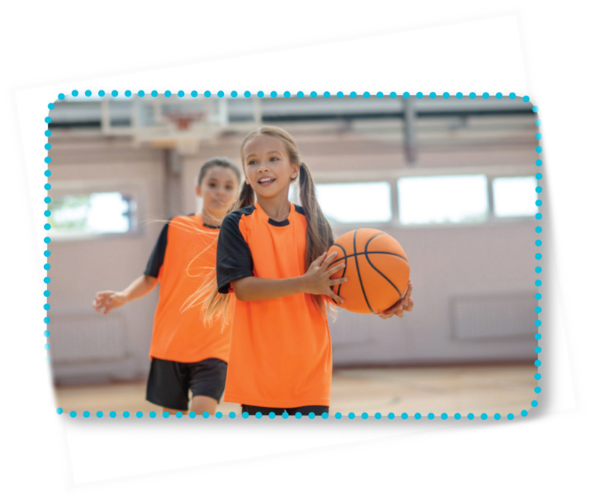

LOOK and READ.
Is she active?
Yes, she is.
Is she friendly?
Yes, she is.
She’s active and friendly.
Notes:
Step 2: Have pupils read the first verse of the chant and draw their attention to the stress of the words active and friendly as in words and in sentences. Check comprehension.

Slide 13
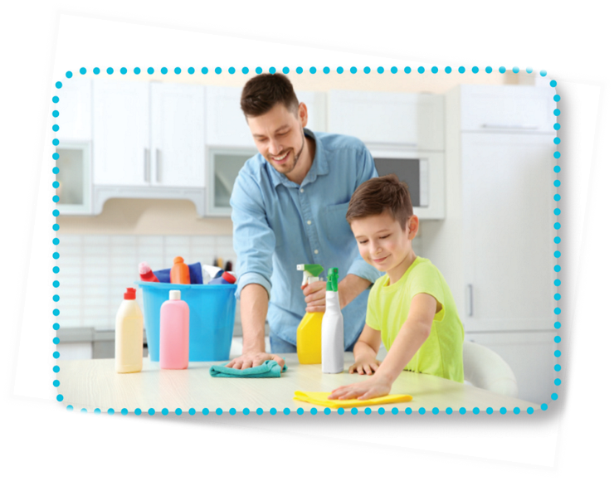
LOOK and READ.
Is he helpful?
Yes, he is.
Is he clever?
Yes, he is.
He’s helpful and clever.
Notes:
Step 2: Have pupils read the first verse of the chant and draw their attention to the stress of the words active and friendly as in words and in sentences. Check comprehension.

Slide 14

LISTEN and POINT.
Is she active?
Yes, she is.
Is she friendly?
Yes, she is.
She’s active and friendly.
Notes:
Step 3: Play the recording of the first verse for pupils to listen. Play it again, line by line, for pupils to listen and repeat. Draw their attention to the rhythm, word stress and pronunciation. Encourage them to clap or do actions while chanting.

Slide 15

LISTEN and POINT
Is he helpful?
Yes, he is.
Is he clever?
Yes, he is.
He’s helpful and clever.
Notes:
Step 2: Have pupils read the first verse of the chant and draw their attention to the stress of the words active and friendly as in words and in sentences. Check comprehension.

Slide 16

LISTEN and REPEAT
Is she active?
Yes, she is.
Is she friendly?
Yes, she is.
She’s active and friendly.
Notes:
Play it again, line by line, for pupils to listen and repeat. Draw their attention to the rhythm, word stress and pronunciation. Encourage them to clap or do actions while chanting.

Slide 17
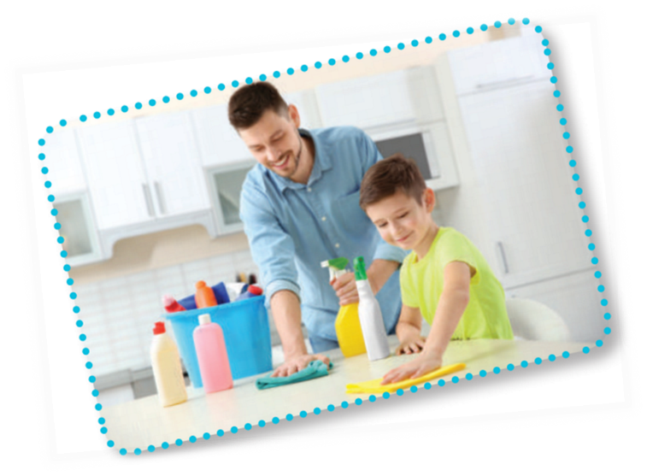
LISTEN and REPEAT
Is he helpful?
Yes, he is.
Is he clever?
Yes, he is.
He’s helpful and clever.
Notes:
Play it again, line by line, for pupils to listen and repeat. Draw their attention to the rhythm, word stress and pronunciation. Encourage them to clap or do actions while chanting.

Slide 18

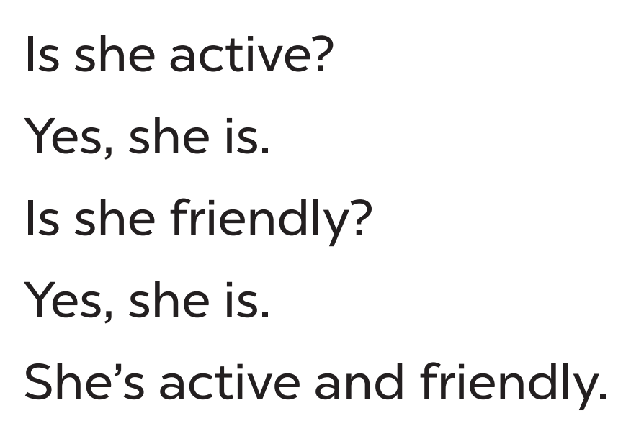
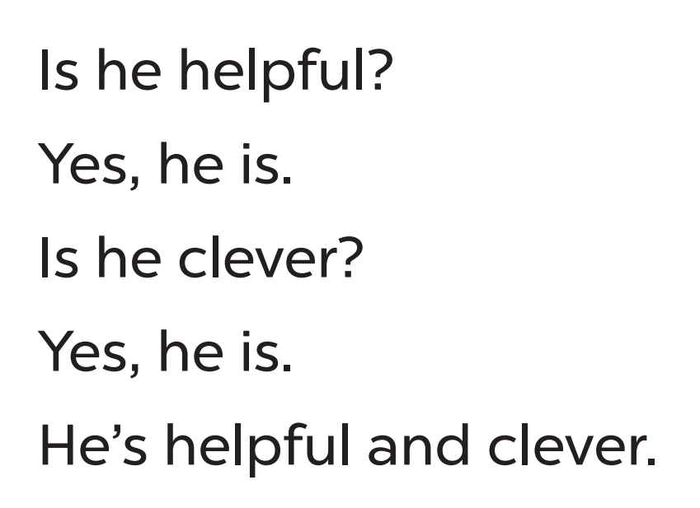
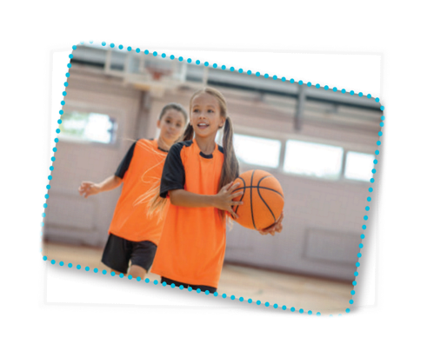
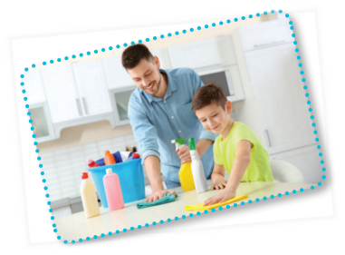
CHANT and CLAP
Notes:
Step 5: Play the recording all the way through for pupils to chant and clap their hands.

Slide 19




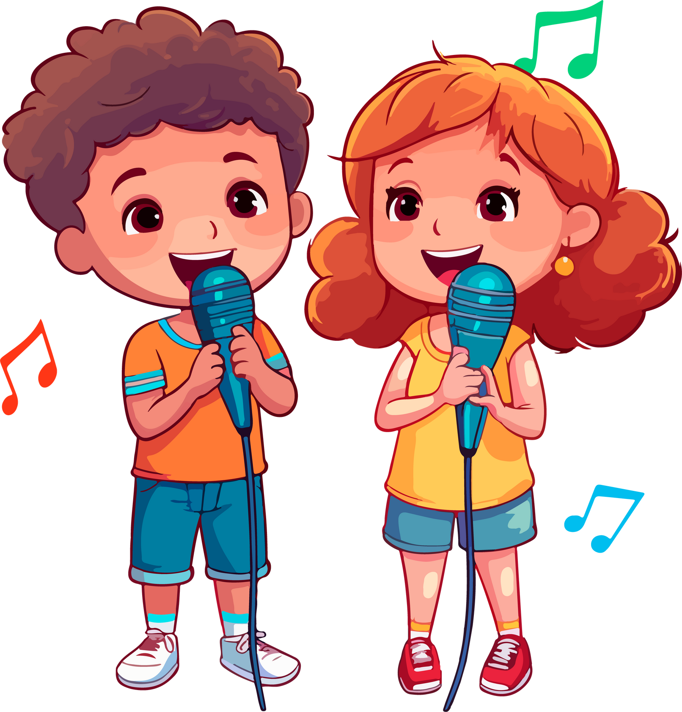


Let’s CHANT in the front.
Notes:
Step 5: Invite a few groups to the front of the class to sing the song. The class may sing along to reinforce the activity.

Slide 20
PRACTICE the new chant.
happy
busy
quiet
tidy
gentle
Is she active?
Is he helpful?
Yes, she is.
Yes, he is.
Is she friendly?
Is he clever?
Yes, she is.
Yes, he is.
She’s active and friendly.
He’s helpful and clever.
Notes:
Extension (For consolidation): Replace two adjectives in the chant with other adjectives which have the stress on the first syllable for example, happy, busy, quiet, tidy, gentle. Have pupils practice the new chant.

