Slide 1



My week
3
LESSON 3 PERIOD 6
SUNDAY
SUNDAY
MONDAY
TUESDAY
WEDNESDAY
THURSDAY
FRIDAY
SATURDAY

Slide 2
Table of contents
Warm-up and review
01
04
02
03
Project
Read and complete.
05
Fun corner
& wrap-up
Let’s write.

Slide 3
01
Warm-up

Slide 4
What day is it today?
It’s …
What do you do on …?
I go to school.
I study at school.
Notes:
…. the day…

Slide 5
02
Activity 4
Read and complete.

Slide 6
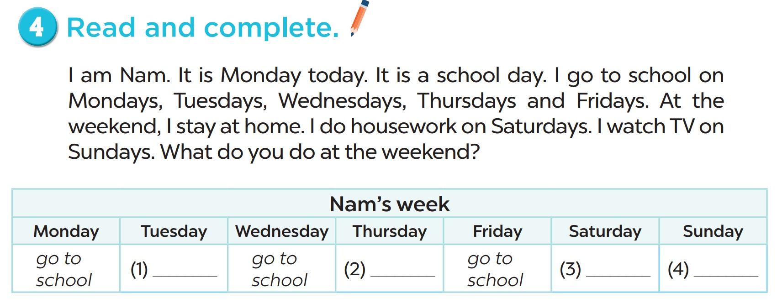

Slide 7
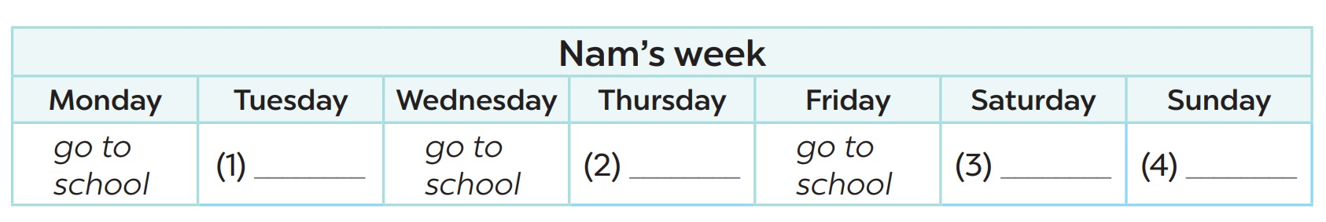
go to school
go to school
watch TV
do housework

Slide 8
I am………….., I go to school on……..……
I do housework on………..…… On Sundays, I……………..What do you do at the weekend?

Slide 9
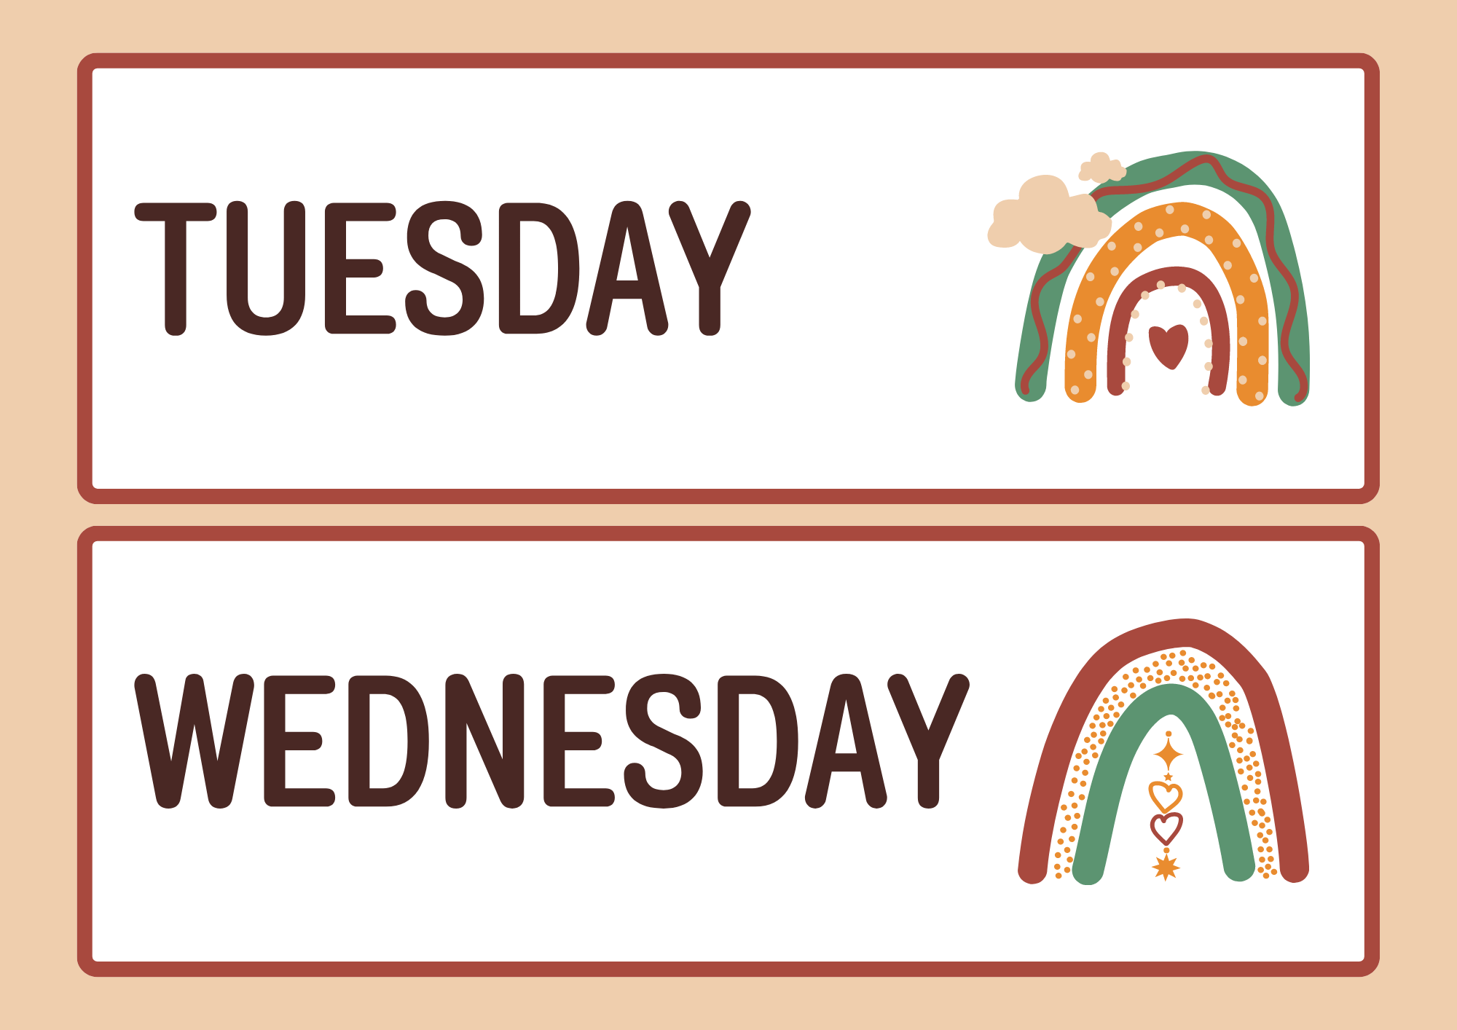

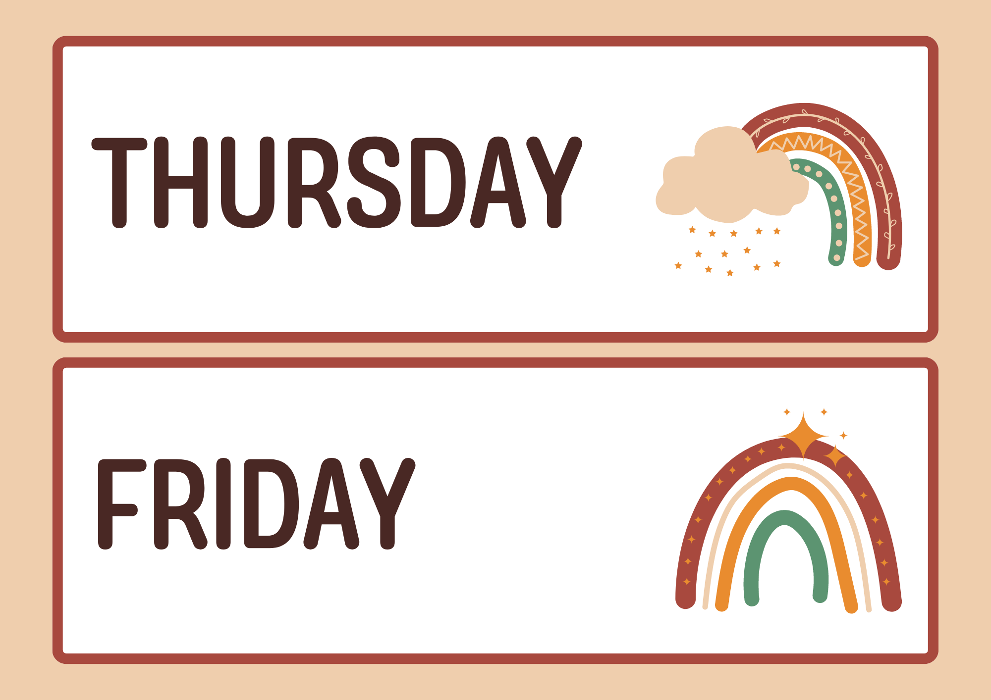

Slide 10
03
Activity 5
Let’s write.

Slide 11
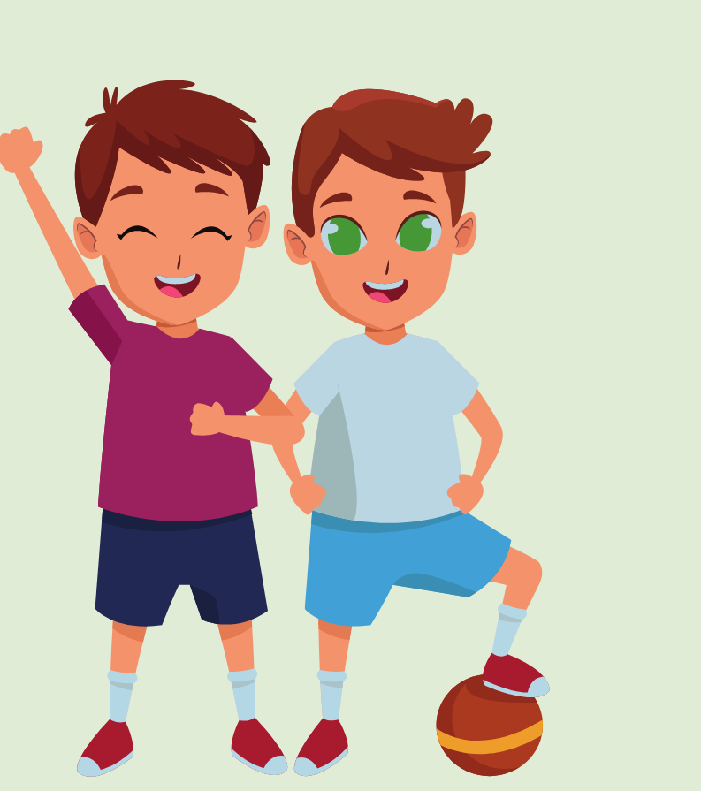

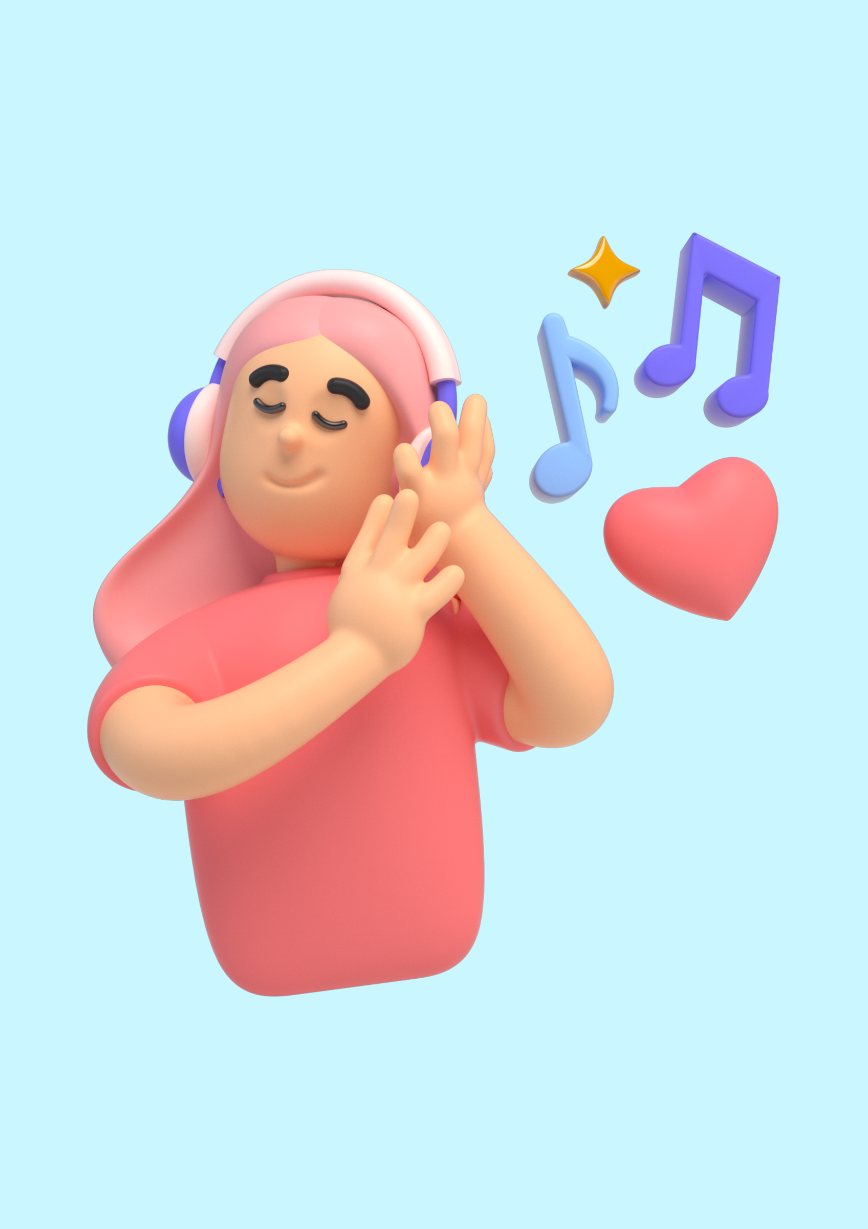

Slide 12
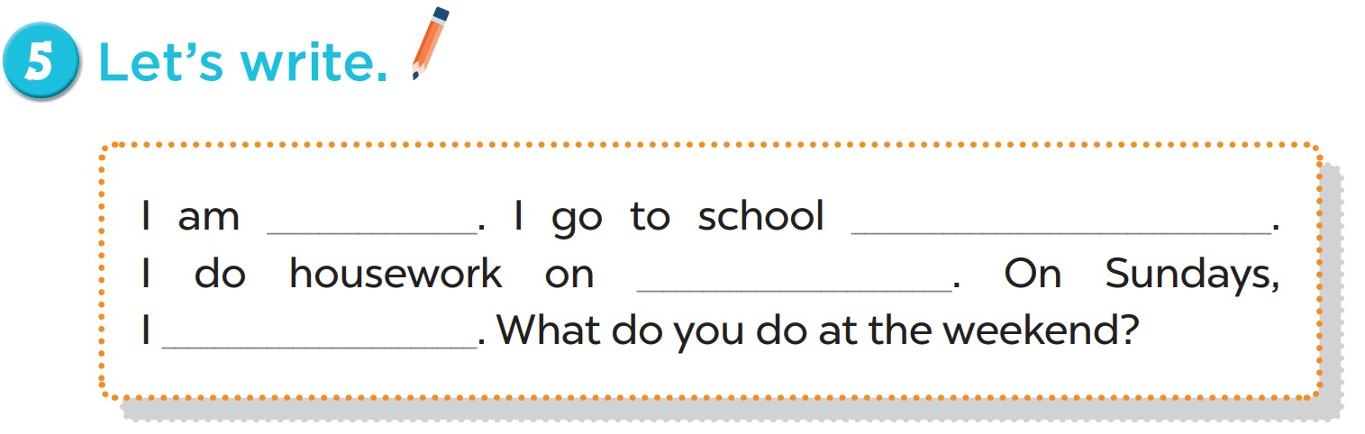

Slide 13
I am……Lan…….., I go to school on……Monday..…… I do housework on……Sunday…..…… On Sundays, I……listen to music………..What do you do at the weekend?

Slide 14
04
Activity 3
Project

Slide 15
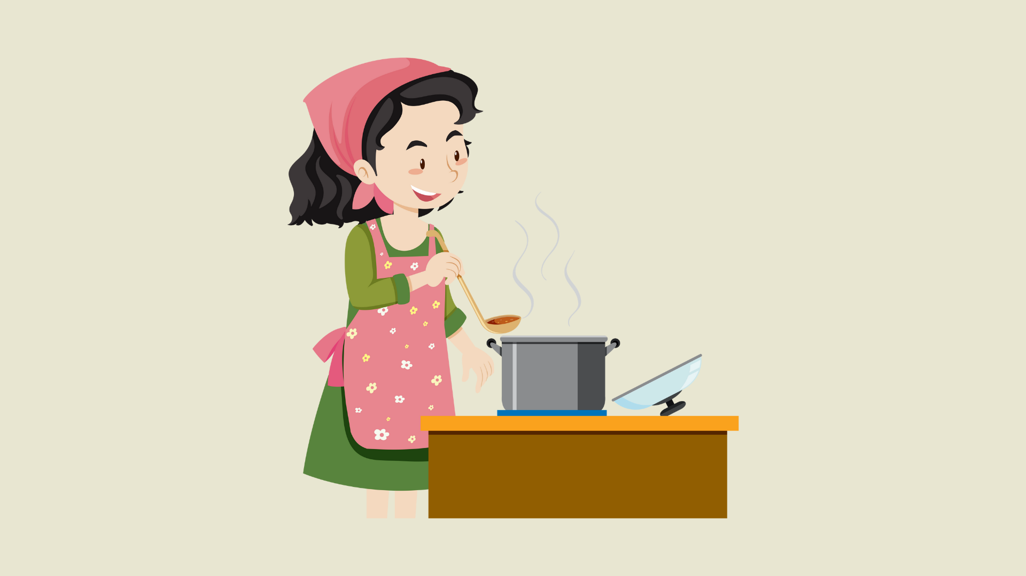

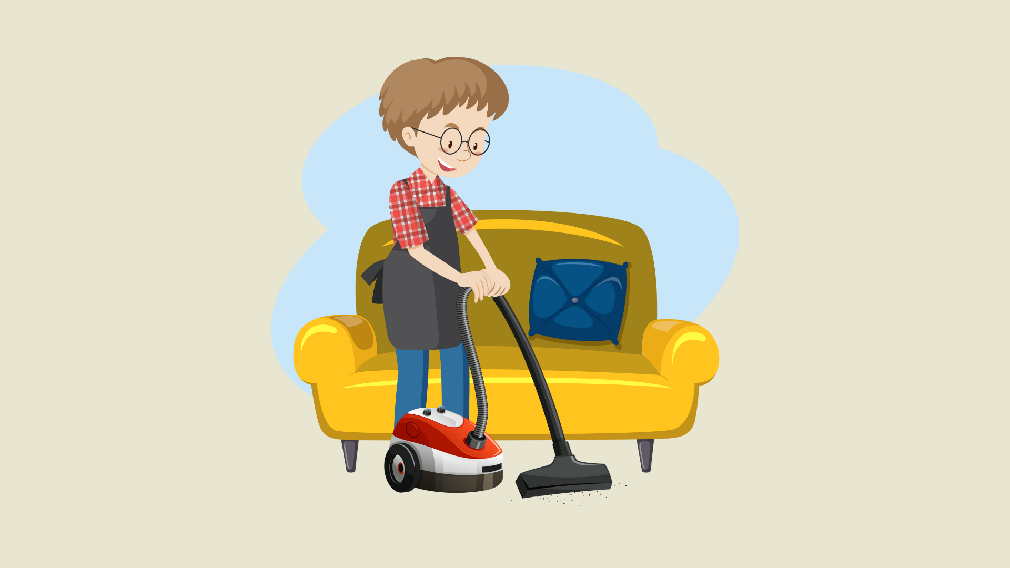

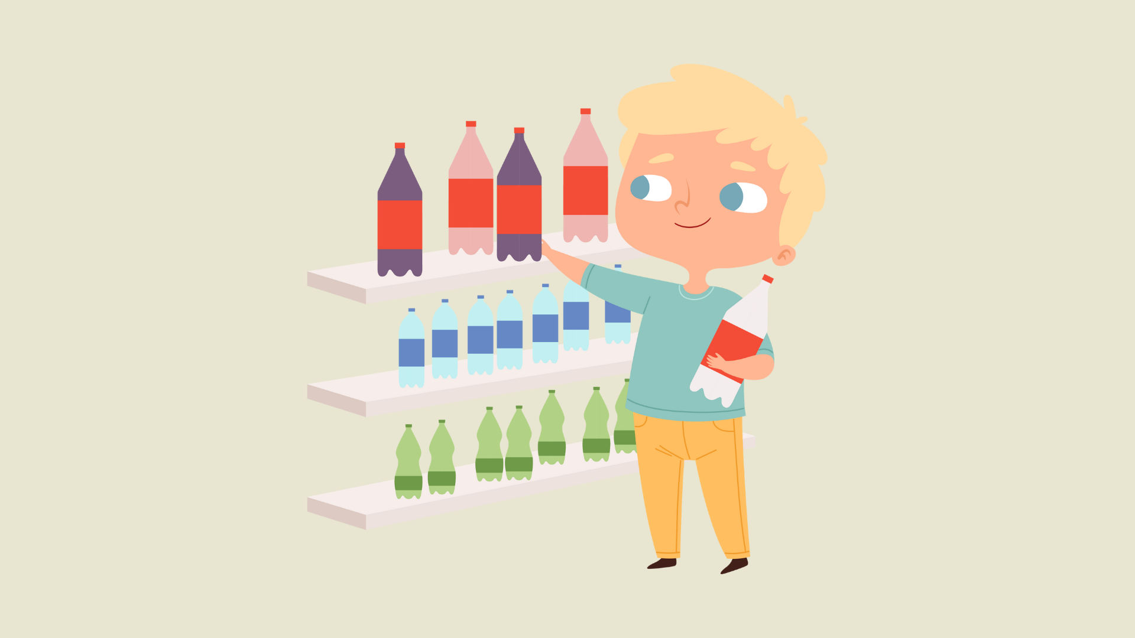
Notes:
Note: Teacher may use the pictures to help pupils review all the learnt words/ phrases before having them present their products.

Slide 16
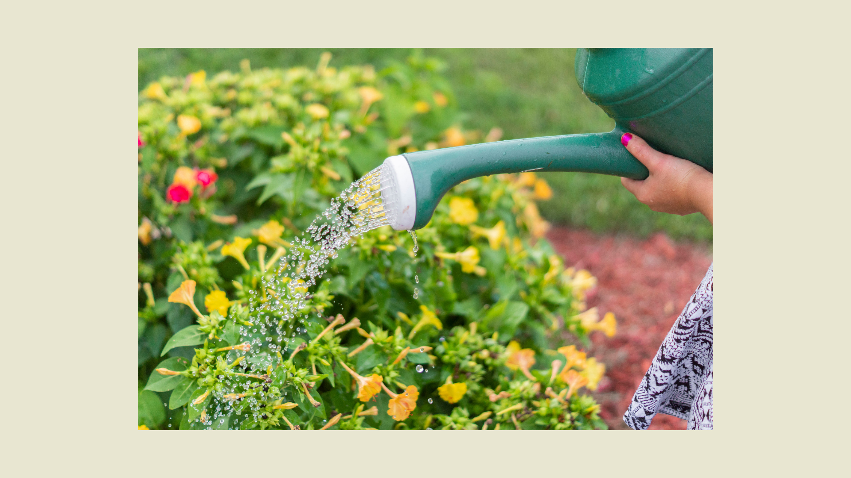
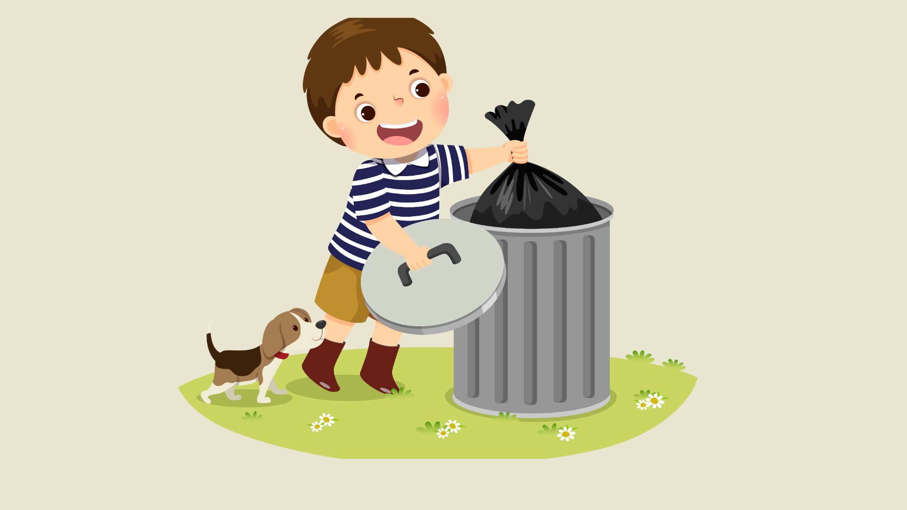
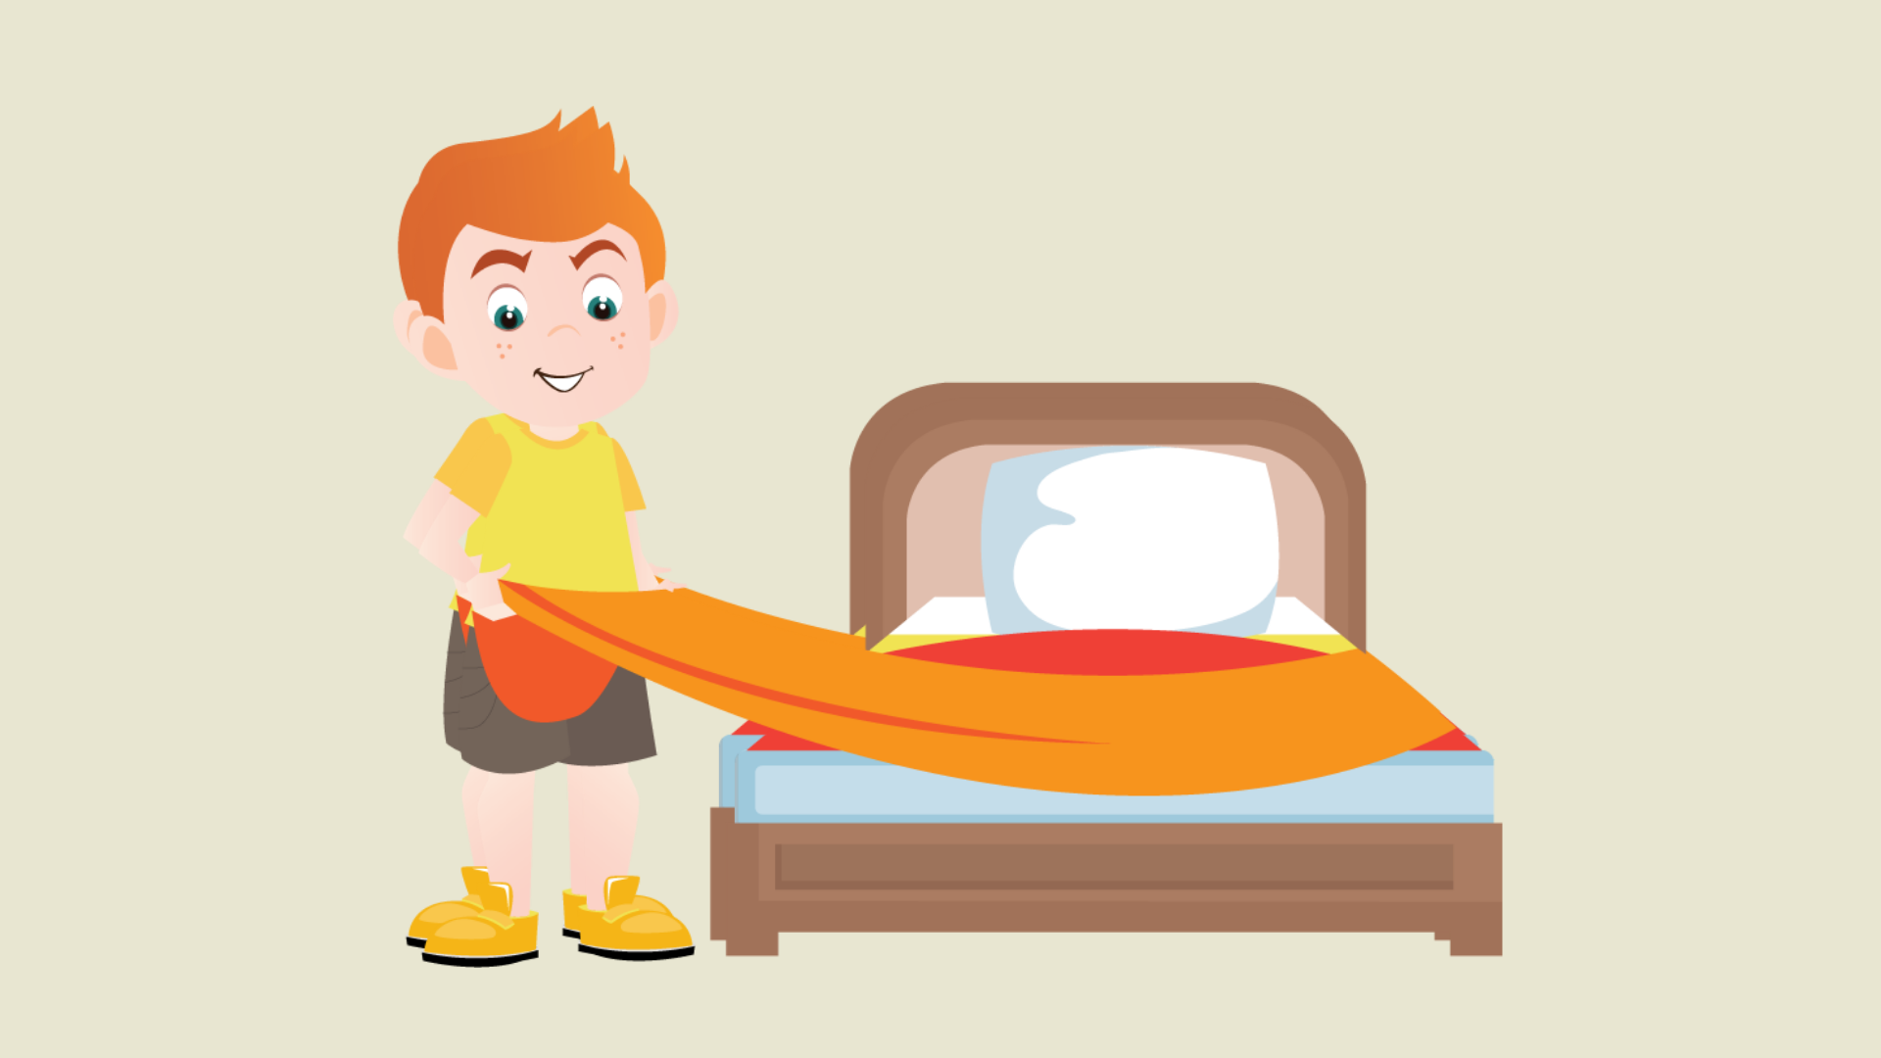

Slide 17

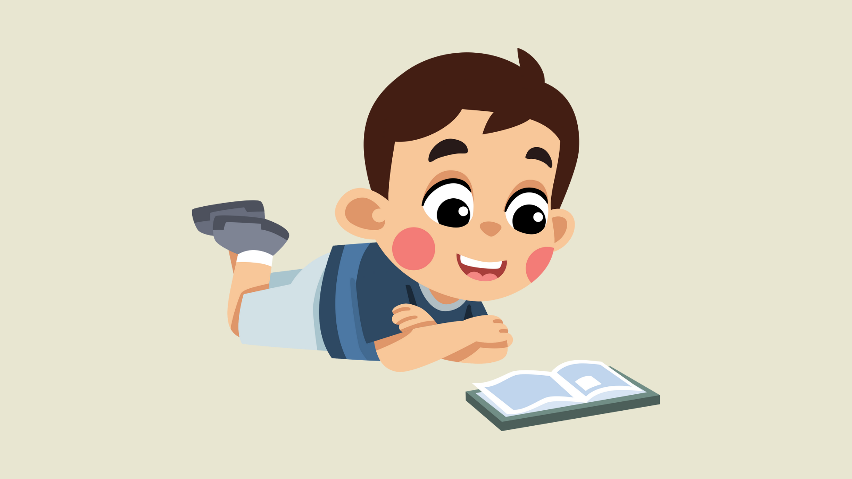

Slide 18
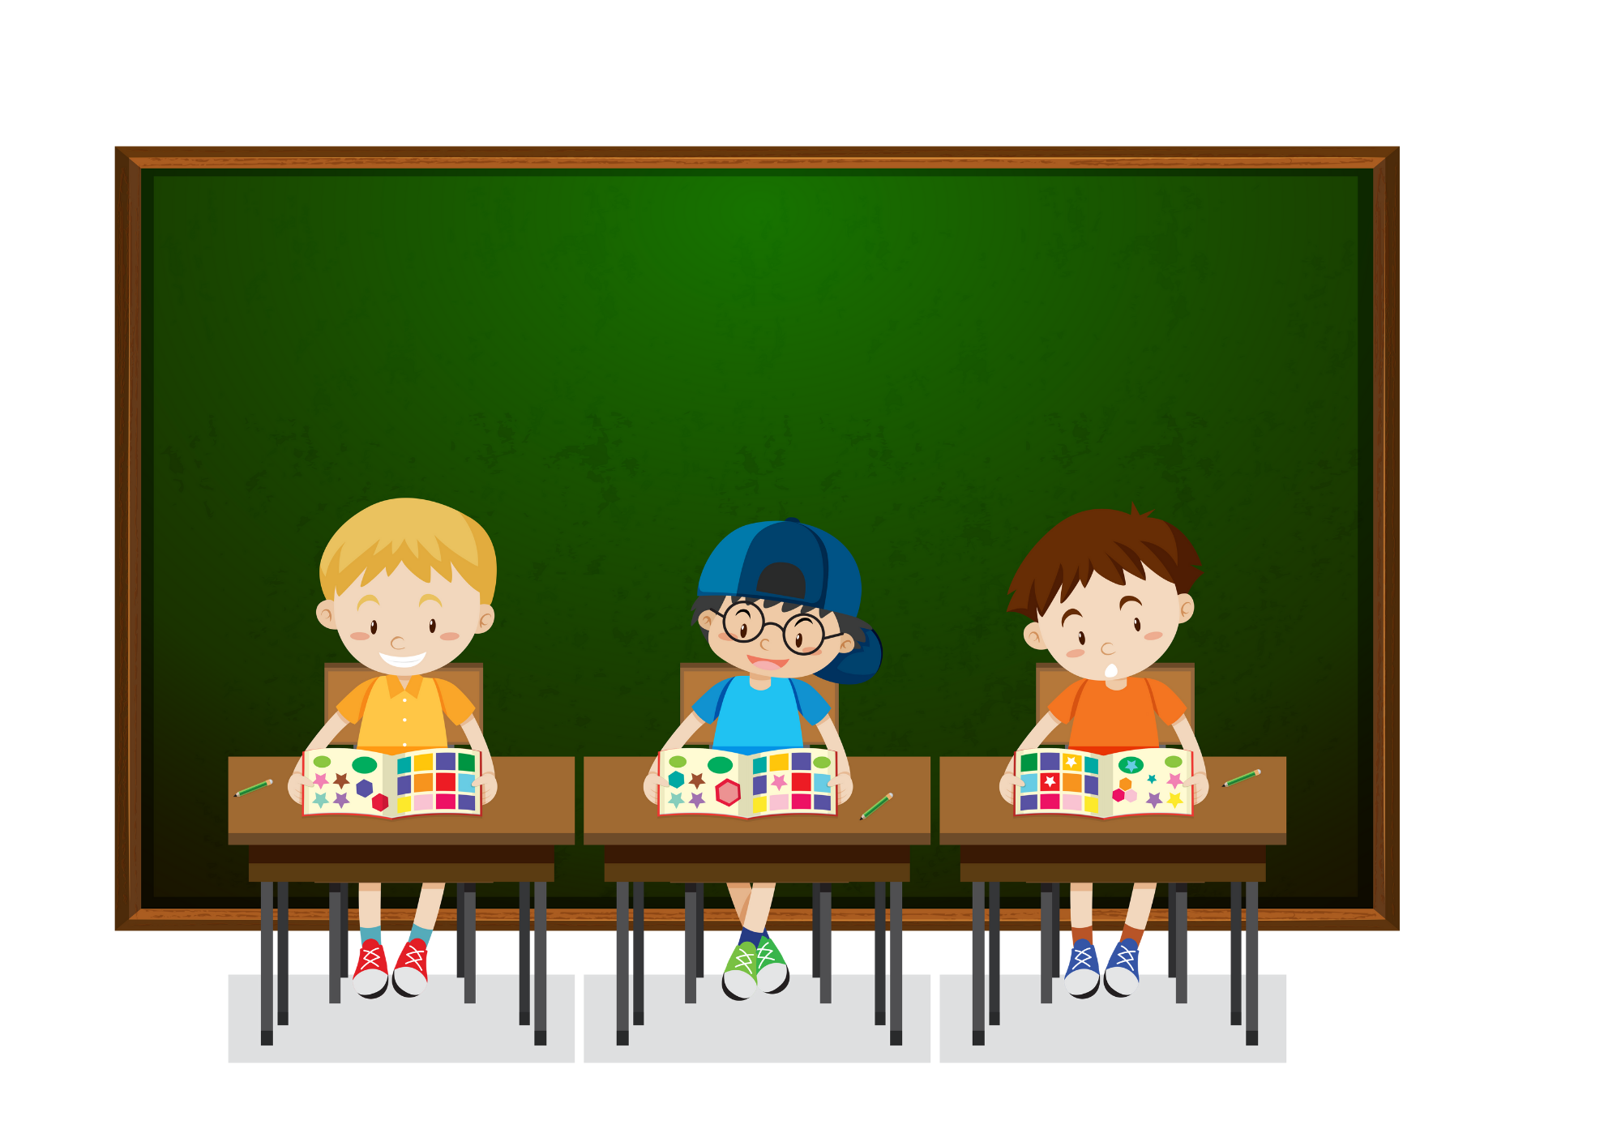
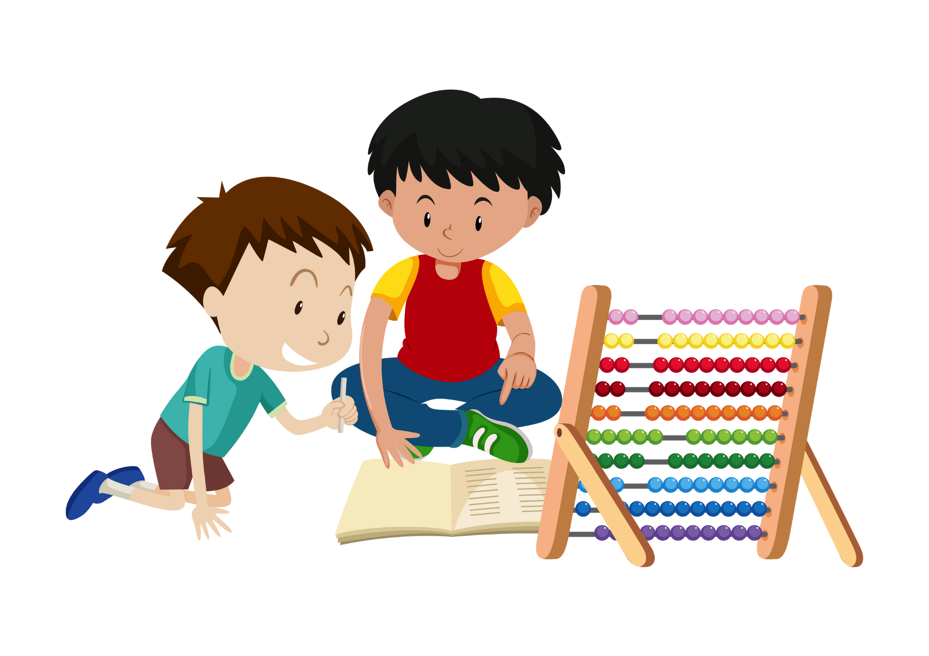
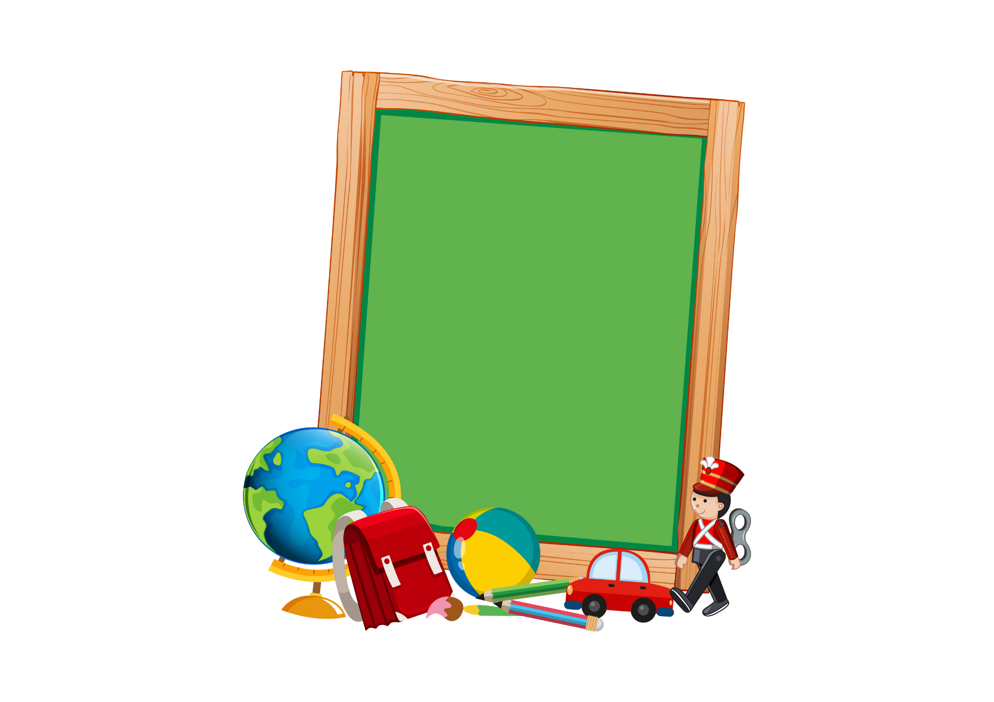


Slide 19



Slide 20


Slide 21

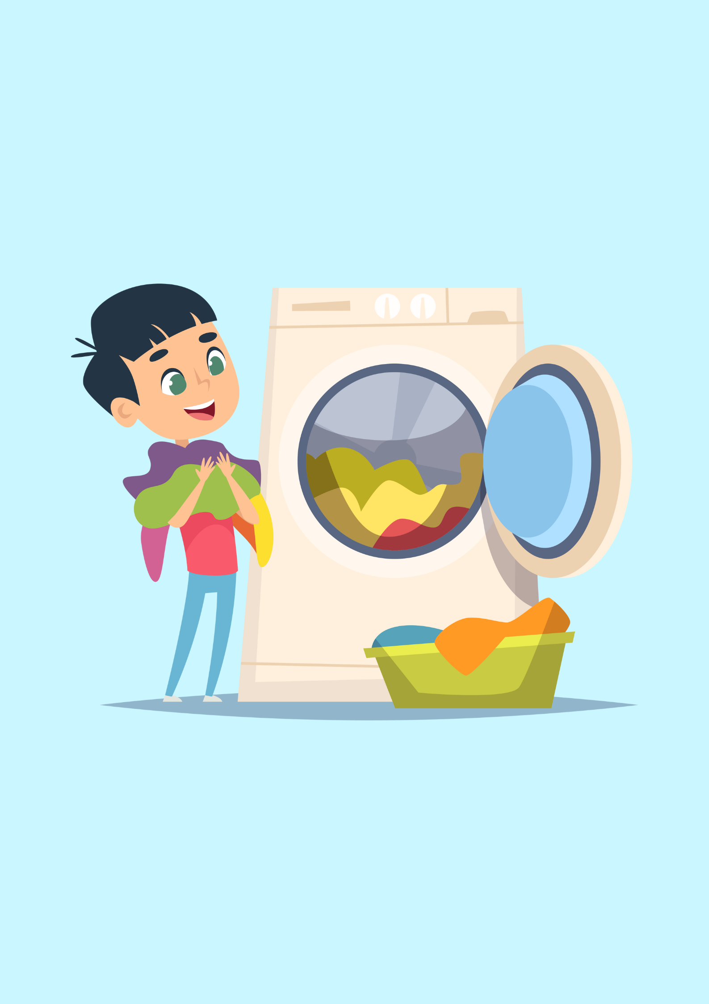
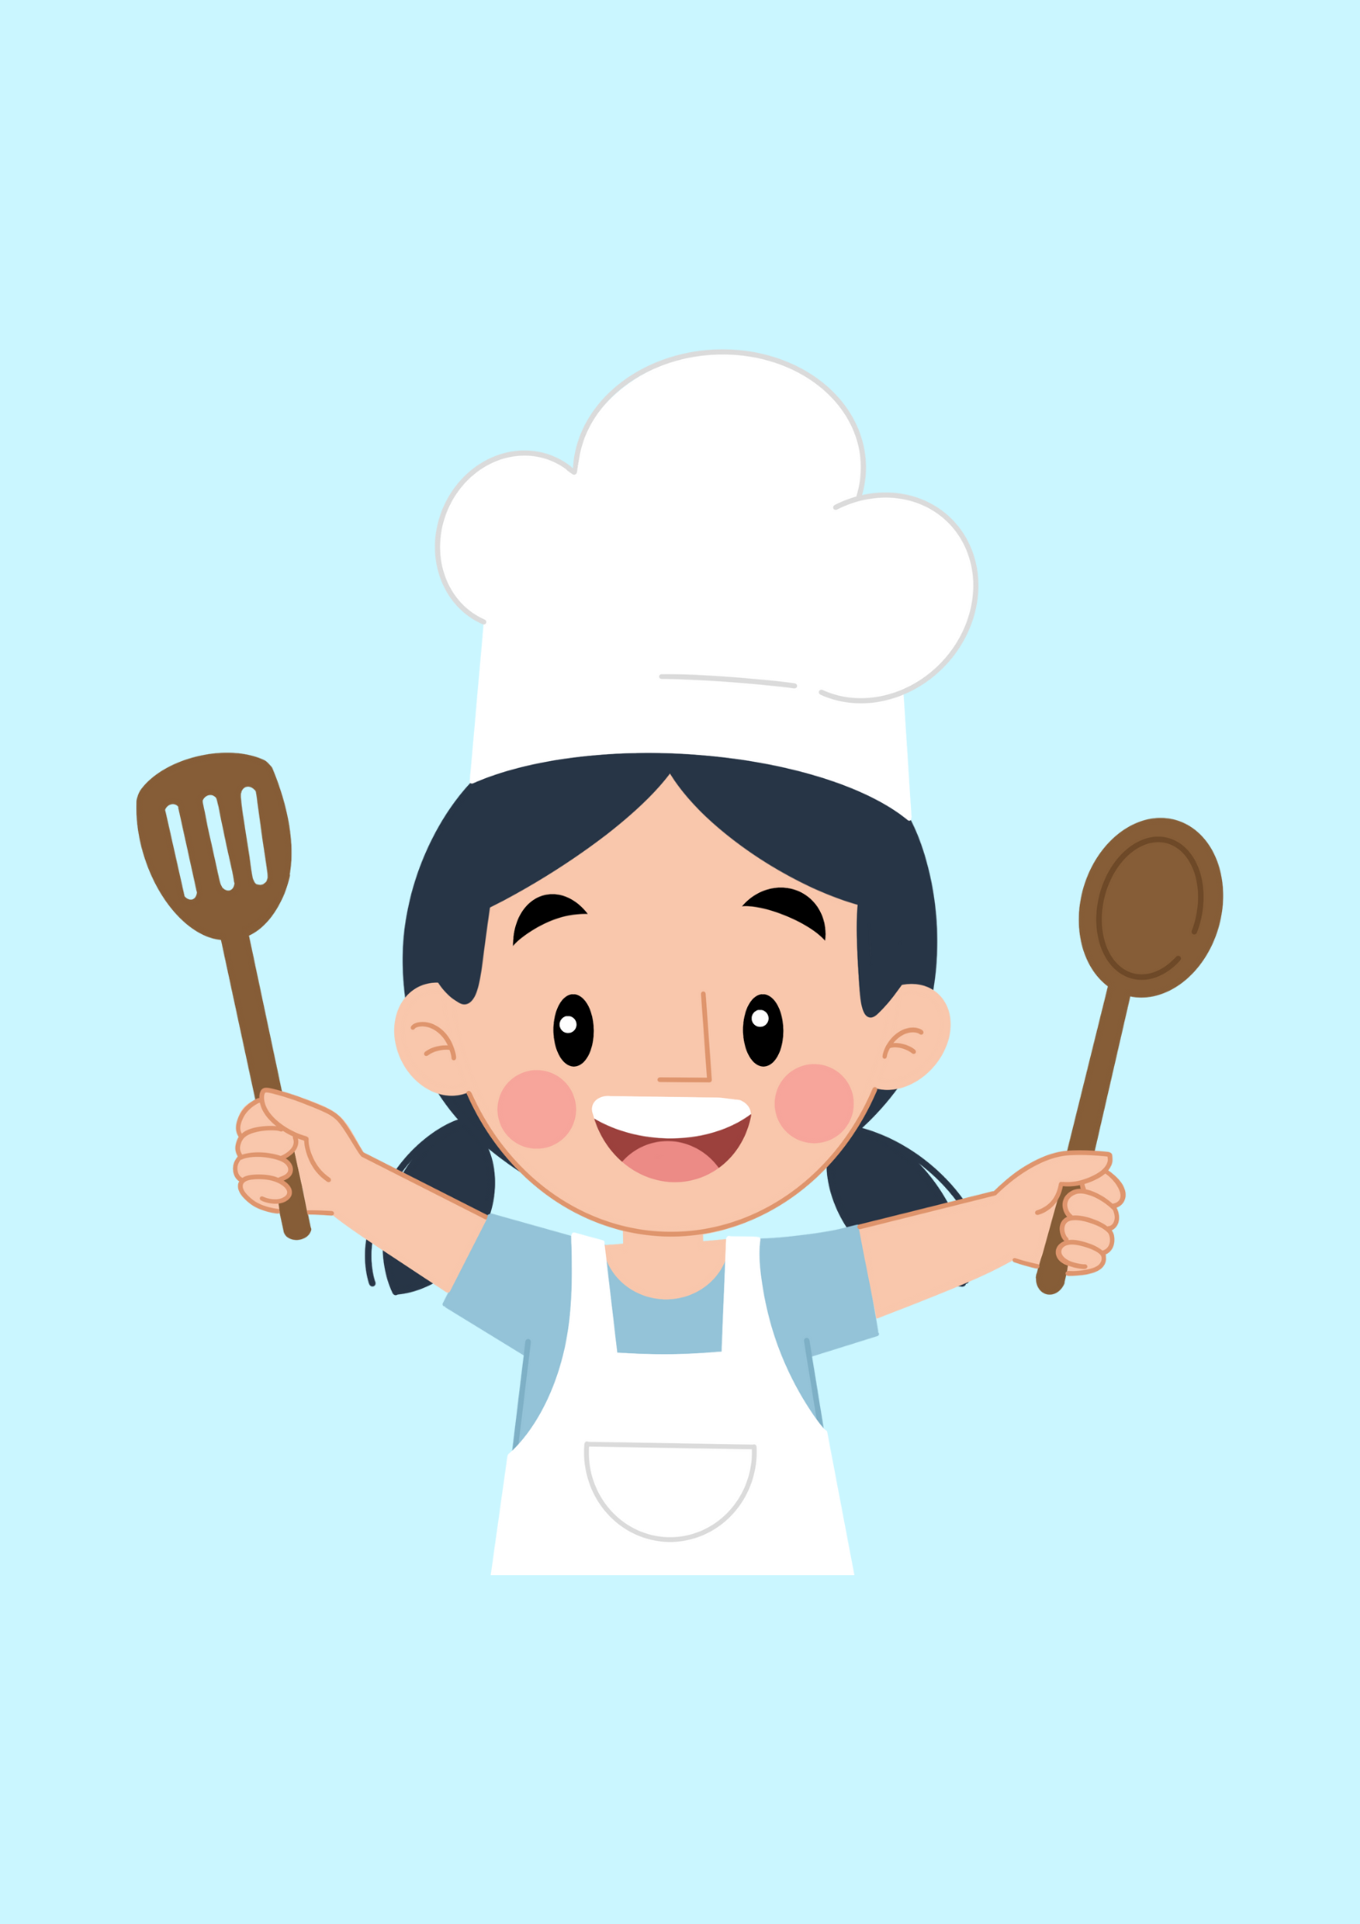


Slide 22
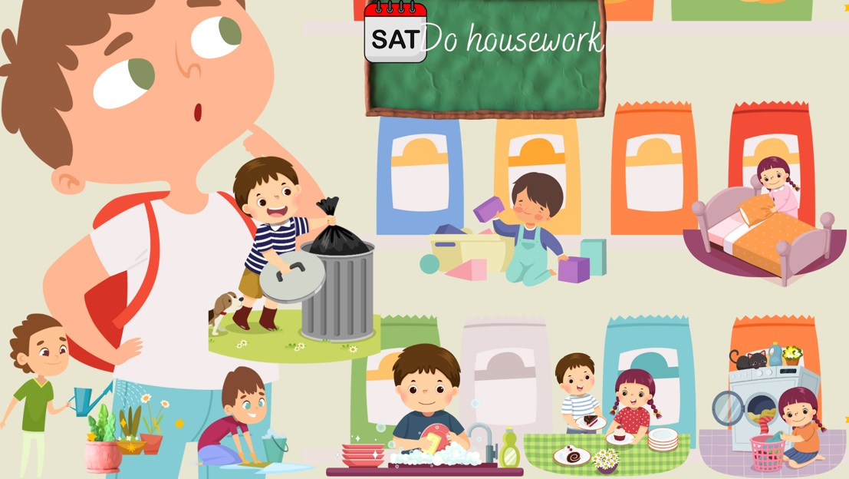

Slide 23
05
Fun corner & wrap-up

Slide 24
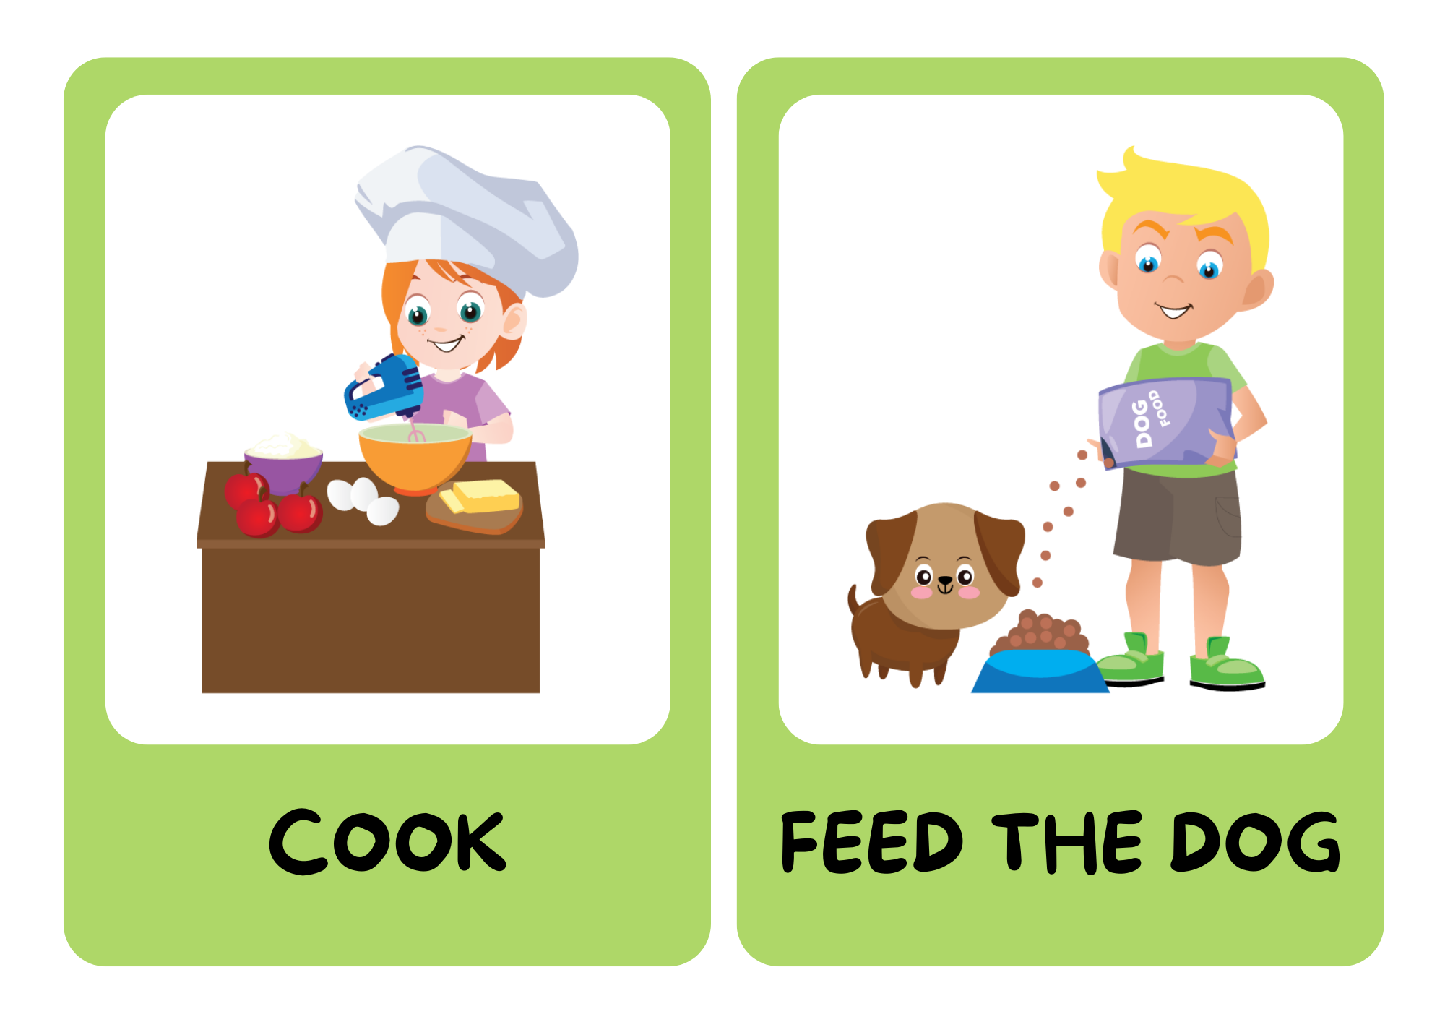

BE A CHANT COMPOSER!

Slide 25

BE A CHANT COMPOSER!
Music, music, music.
I listen to music on Sundays.
Football, football, football.
I play football on Sundays.
Notes:
listen to the chant to get the rythm
make their own chants

Slide 26
Fridays, Fridays, Fridays.
What do you do on Fridays?
I do housework on Fridays.
Notes:
give picture cues

Slide 27
Mondays, Mondays, Mondays.
What do you do on Mondays?
I do homework on Mondays.
Tuesdays, Tuesdays, Tuesdays.
What do you do on Tuesdays?
I do homework on Tuesdays.

