Slide 1



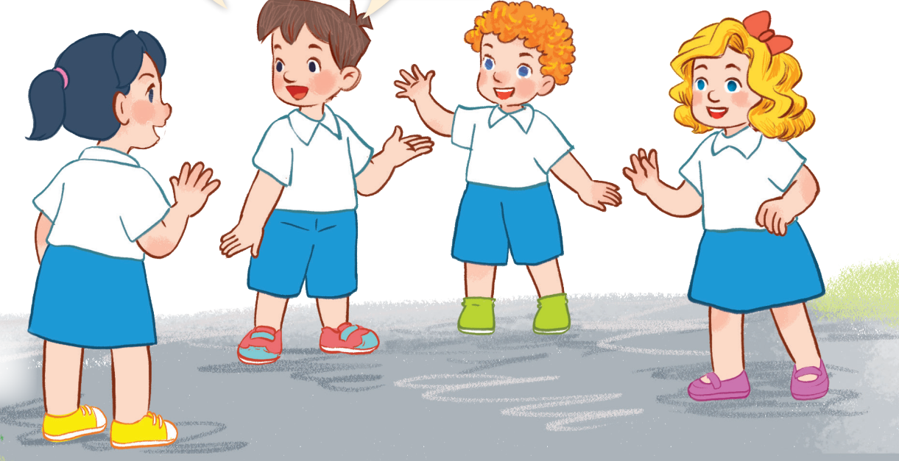
3
Our friends
LESSON 1 – PERIOD 2

Slide 2


CONTENTS
1
Warm up & Review
2
Listen and tick.
3
Look, complete and read.
4
Let’s sing.
Fun corner & Wrap-up
5
Next
Notes:
G

Slide 3




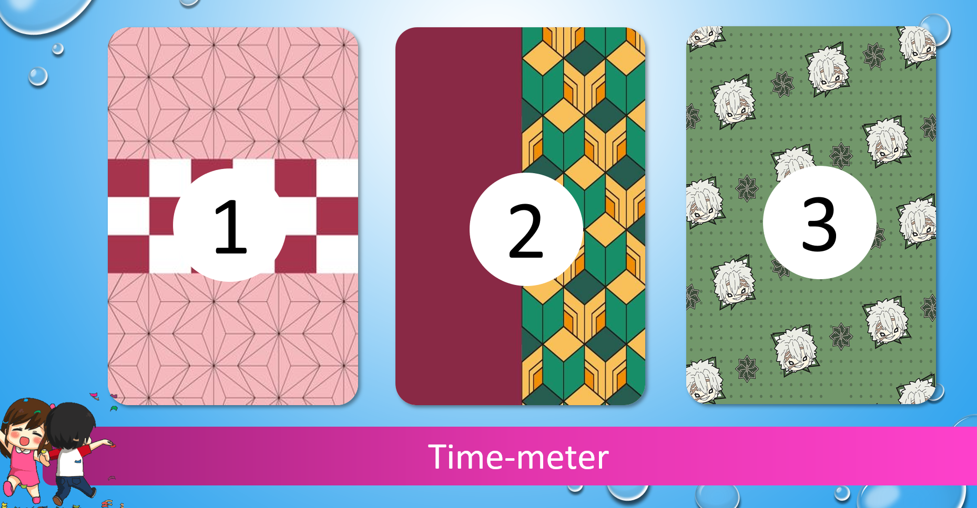




1
Warm-up & Review
A
0
1
2
3
4
5
6
7
8
9
0
1
2
3
4
5
6
7
8
9
0
1
2
3
4
5
6
7
8
9
B
0
1
2
3
4
5
6
7
8
9
0
1
2
3
4
5
6
7
8
0
9
1
2
3
4
5
6
7
8
9
1
2
Notes:
- Divide the class into 2 teams standing in lines.
- Have a pupil in the front row choose a number. The pupil MUST give the answer before the time’s up. If they answer correctly, they will get stars. If their answer is wrong or given after the time meter goes off, they will have to go to the back of the line.
- How to use time-meter: After clicking a number, simply click on the time meter to start it.
- Click the STAR at the corner to turn back to the Select Menu.
- Give points to the pupils (corresponding to the stars on the pictures).

Slide 4











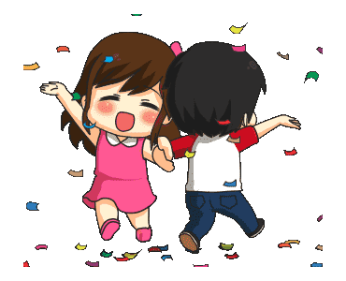
What’s your name?
How are you?
Good morning.
1
2
3
Time-meter

Slide 5






….. is Mary
….. is Lucy
….. is Ms Hoa
1
2
3
Time-meter

Slide 6






This …. Mr Long.
That…. Mai.
This is …. Linh
1
2
3
Time-meter

Slide 7










Look and say.
1
2
3
Time-meter

Slide 8
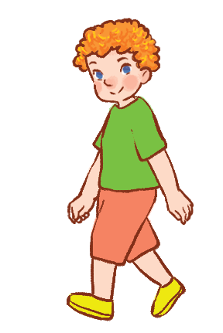
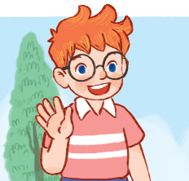
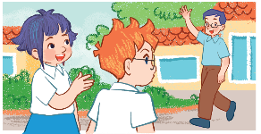
Look and say.
1
2
3
Time-meter

Slide 9






….. is Mr Long.
….. is Minh
….. is Ben.
1
2
3
Time-meter

Slide 10




….. is Bill
….. is Mary.
….. is Mai..
1
2
3
Time-meter

Slide 11



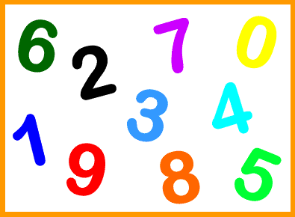

How do you spell your name?
How old are you?
Good afternoon.
1
2
3
Time-meter

Slide 12


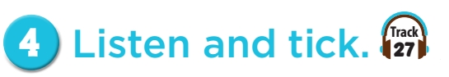
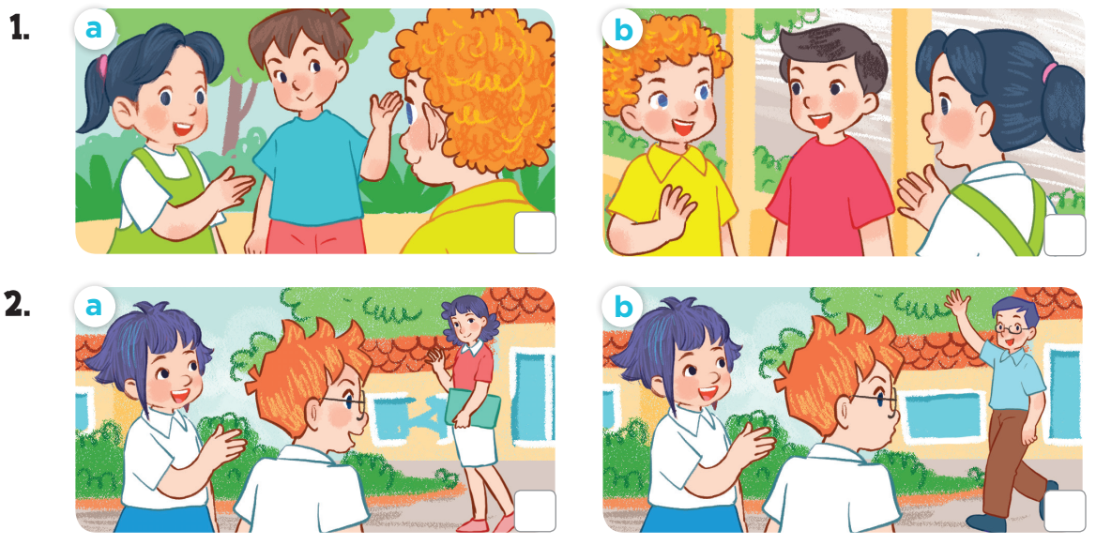


Slide 13
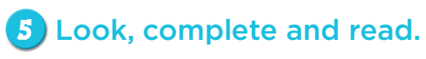
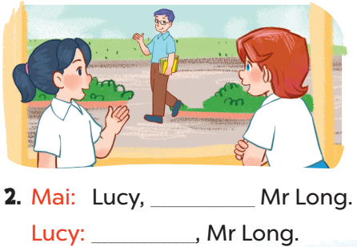
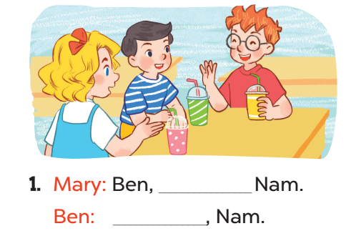
that’s
this is
Hello
Hi/Hello

Slide 14
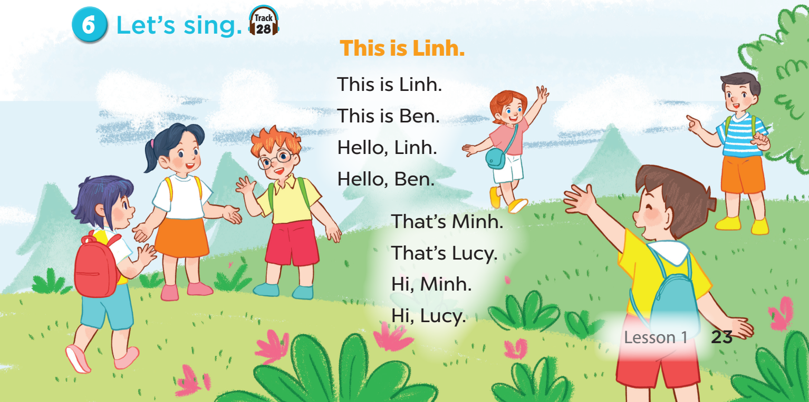

Slide 15
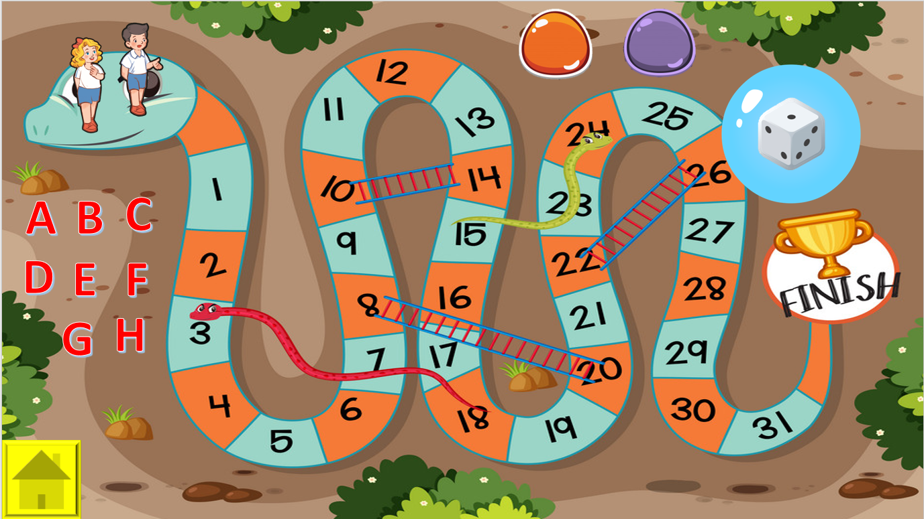
Fun corner & Wrap-up
5
3
1
2
Next
Notes:
1. GV chia cả lớp thành hai đội, mỗi đội chọn một nhân vật (Nam hoặc Mary) làm đại diện
3. HS chọn chữ cái mình thích để đi đến câu hỏi.
2. Nếu HS trả lời đúng, GV cho HS quay về Menu và chọn quân xúc xắc quay lấy điểm để đi ( như trò cá ngựa)
3. Nhấn vào nút màu tương ứng với nhân vật (tương ứng với số chấm trên xúc xắc) để cho nhân vật đi.
4. Đội nào về đích trước sẽ thắng.

Slide 16
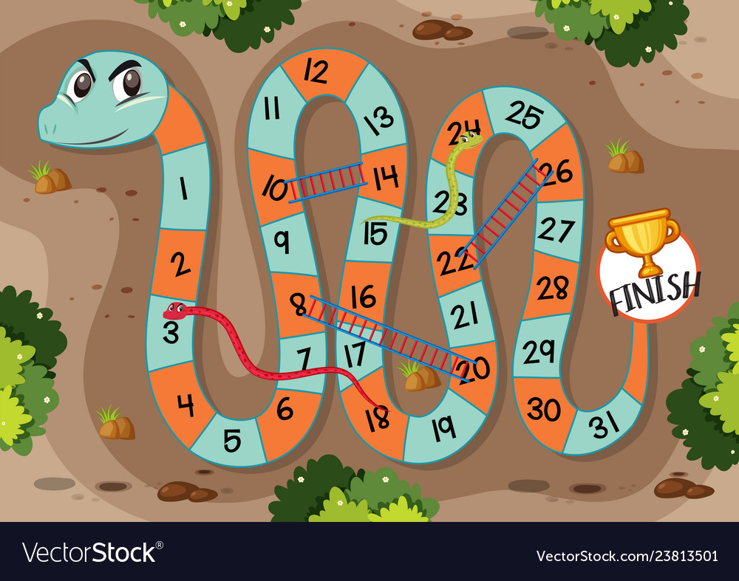










A
B
C
D
E
F
G
H

Slide 17
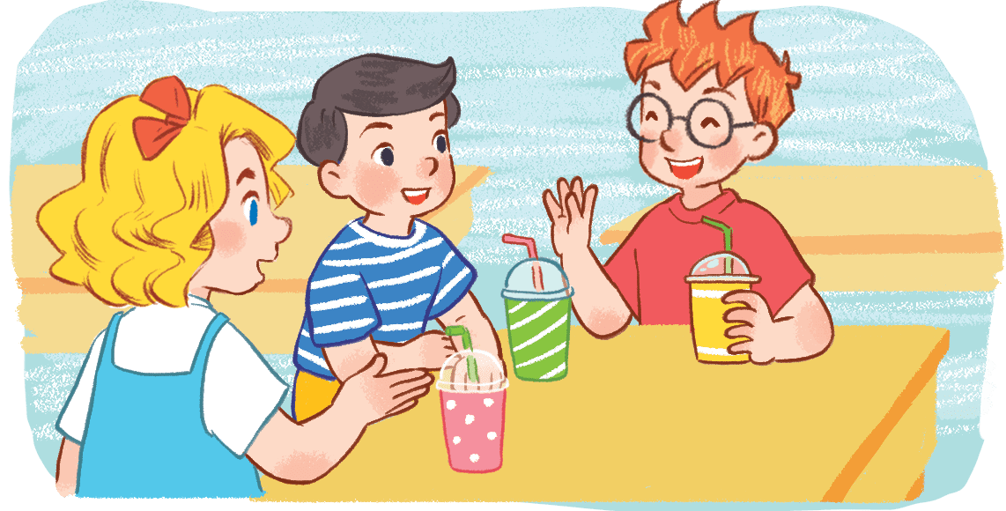



Mary: Ben, __________Nam.
Ben: __________, Nam.
A
This is/ this
B
This is/ Hi
C
This is/ that
MENU
Notes:
Hs chọn đúng, GV mời 2 bạn trong đội hội thoại

Slide 18
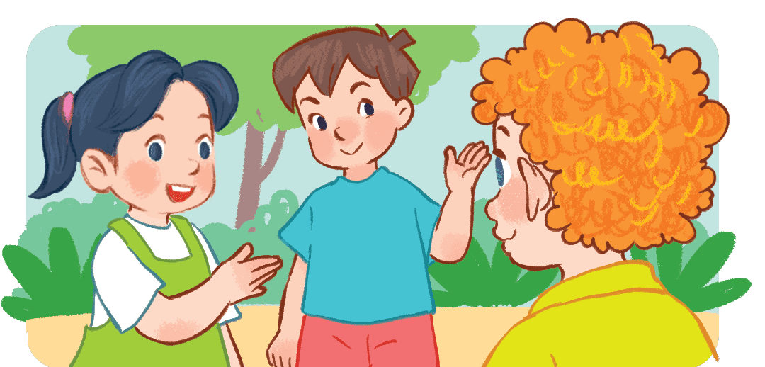
Mai: Bill, __________Minh.
Bill: __________, Minh.
B
this is/ Hello
A
this is/ this
C
this is/ that
MENU

Slide 19
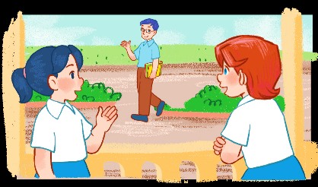

Mai: Lucy, __________Mr Long.
Lucy: __________, Mr Long.
A
that is/ Hi
C
that is/ Bye
B
that is/ Good morning
MENU

Slide 20
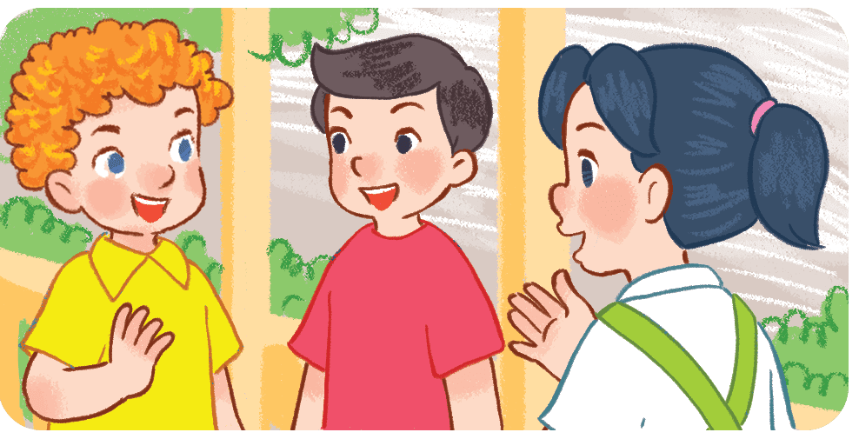
Mai: Bill, __________Nam.
Bill: __________, Nam.
A
this is/ this
B
this is/ Hi
C
this is/ that
MENU

Slide 21
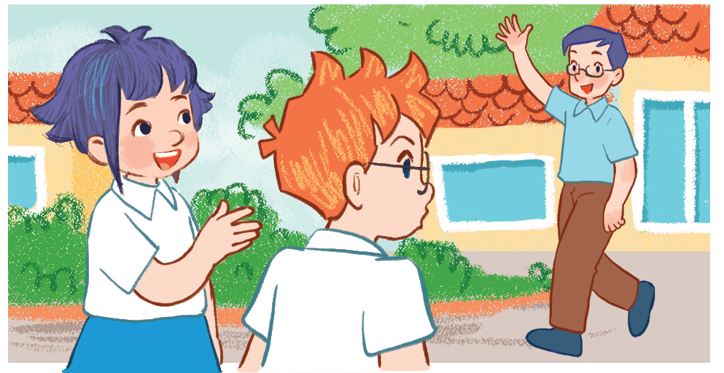
Linh: Ben, __________Mr Long.
Ben: __________, Mr Long.
B
that is/ Good morning
A
that is/ Good bye
C
that is/ Bye
MENU

Slide 22
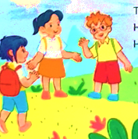
Mai: Ben, __________Linh.
Ben: __________, Linh.
A
this is/ this
B
this is/ Hi
C
this is/ that
MENU

Slide 23
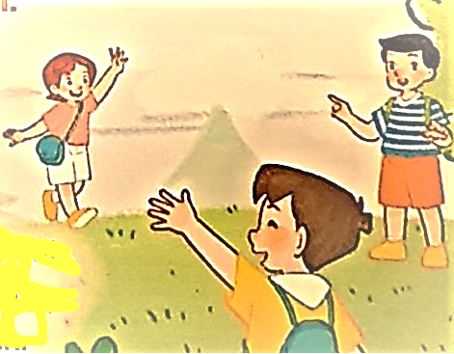

Nam: Minh, __________Lucy.
Minh: __________, Lucy.
B
that is/ Hello
A
that is/ Bye
C
that is/ Good bye
MENU

Slide 24
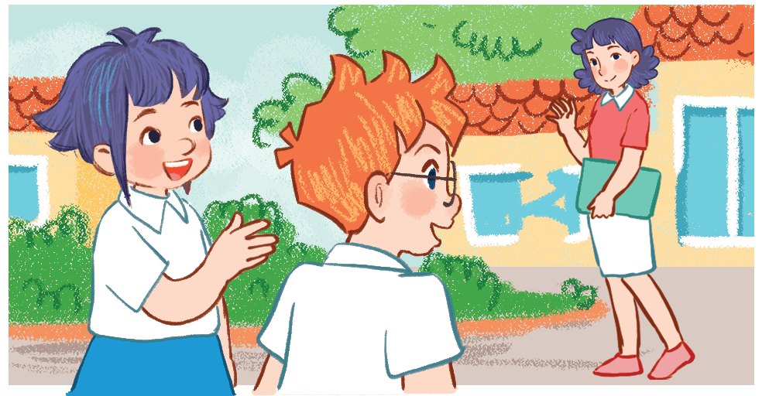
Mai: Lucy, __________Ms Hoa.
Lucy: __________, Ms Hoa.
A
that is/ Bye.
C
that is/ Good bye.
B
that is/ Good morning
MENU

