Slide 1









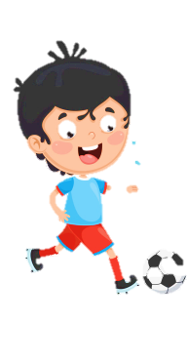


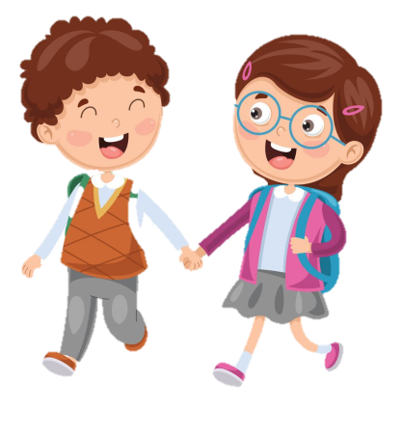



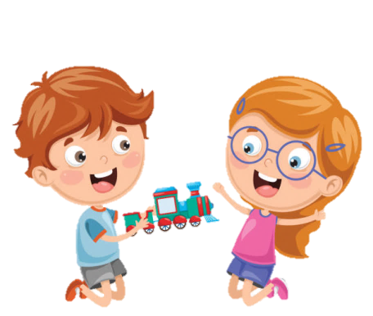
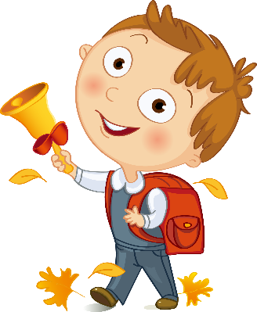





Slide 2
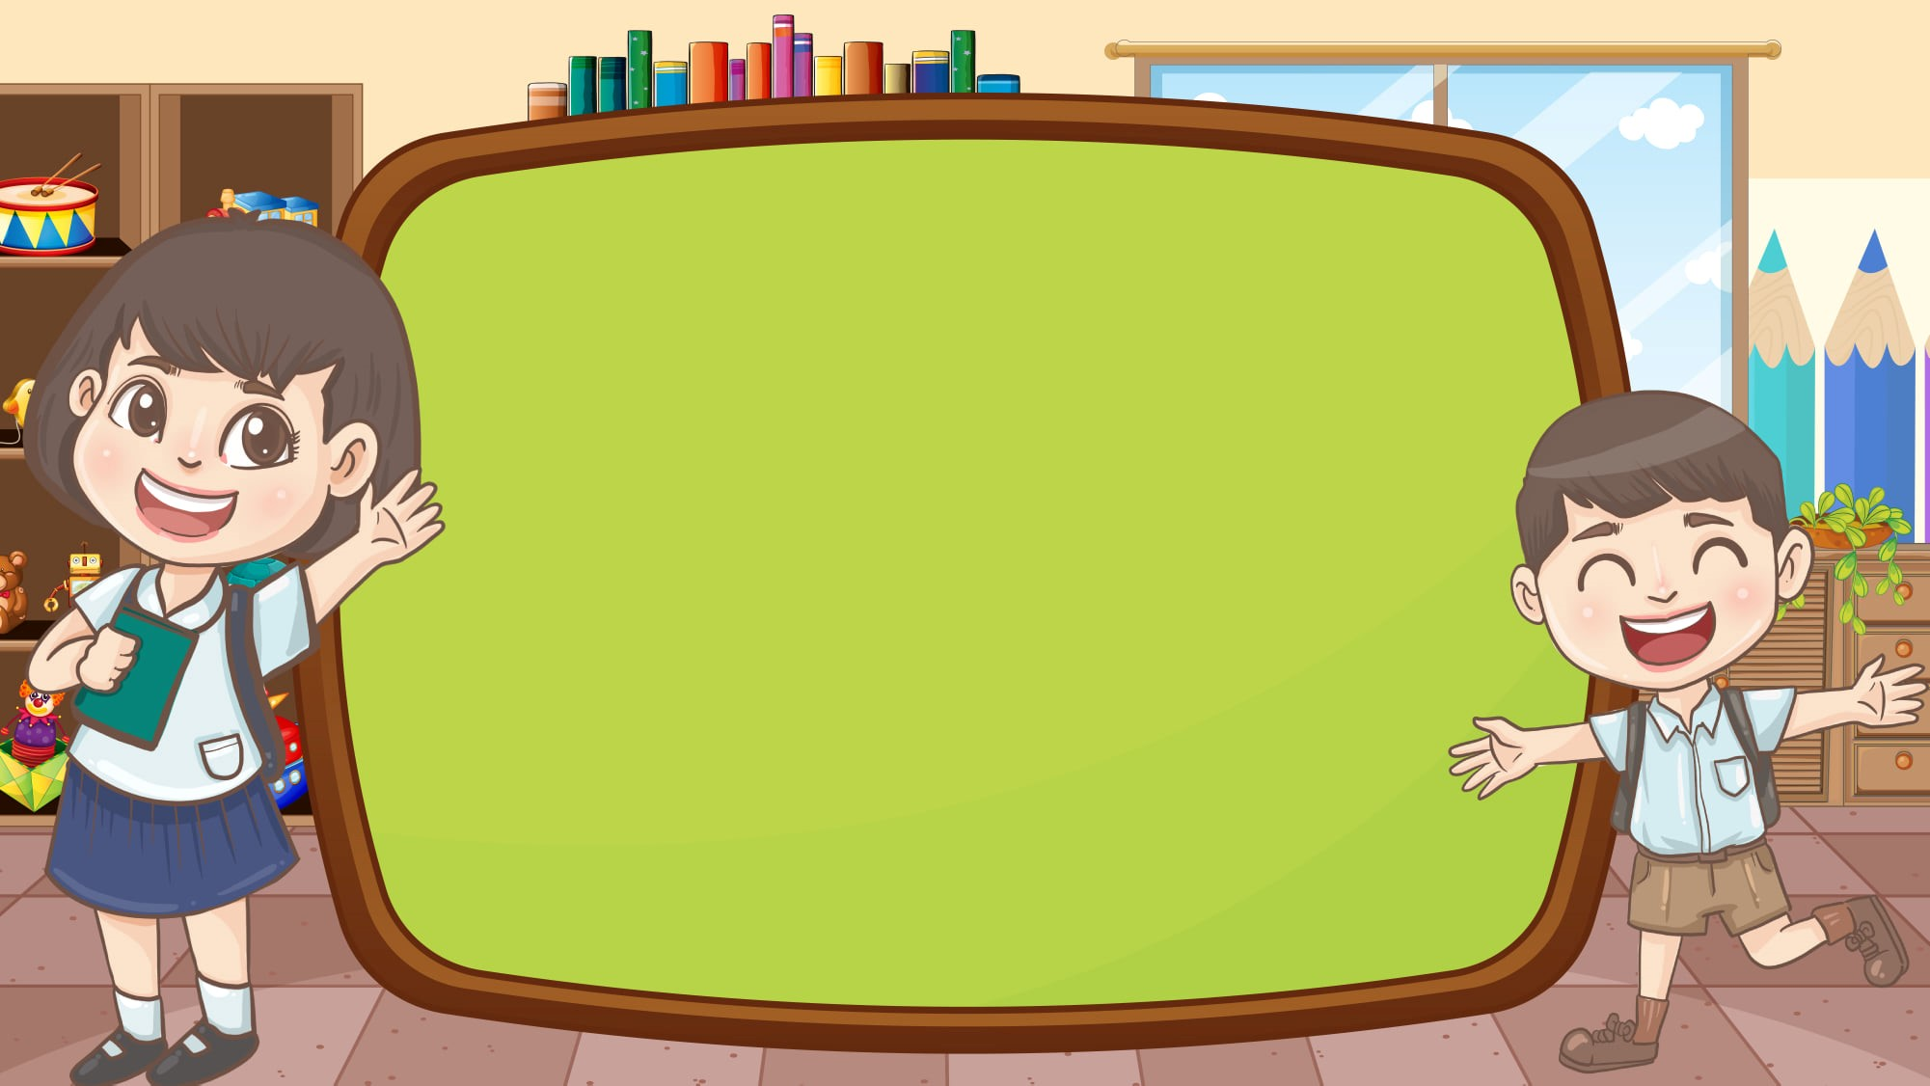
Unit 3 School life
FUN TIME & PROJECT

Slide 3





Table of contents
01
02
Review
Warm - up
05
04
Production
Wrap-up & Assessment
03
Practice

Slide 4
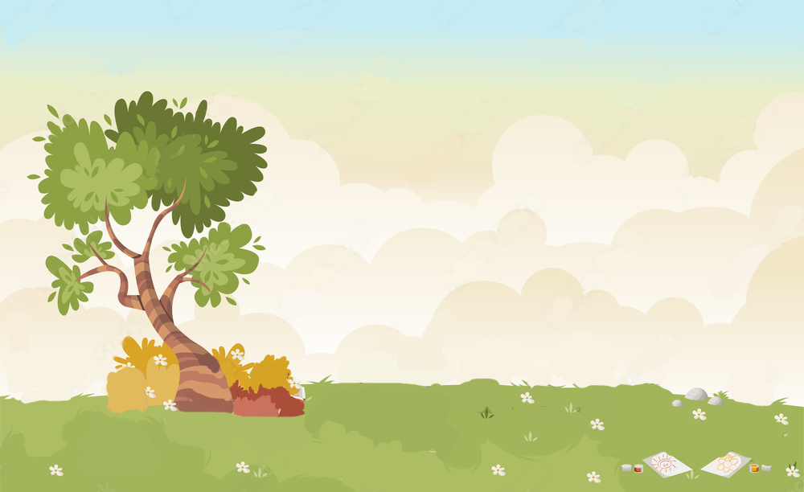











WARM UP
Let’s play “Memory game”

Slide 5



REMEMBER THAT!
You have 30 seconds to look at the picture.
Try to remember what you see and write down on the board. The first member of the team has run and write one word and comeback and continue with other people in team.
1 point for each item.
Notes:
Students see a bundle of pictures for 30 seconds, they then have 2 minutes to write down everything they can remember.

Slide 6

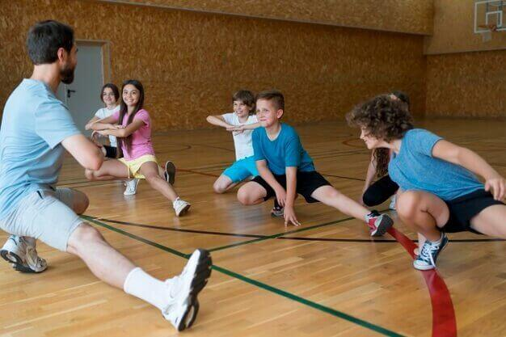
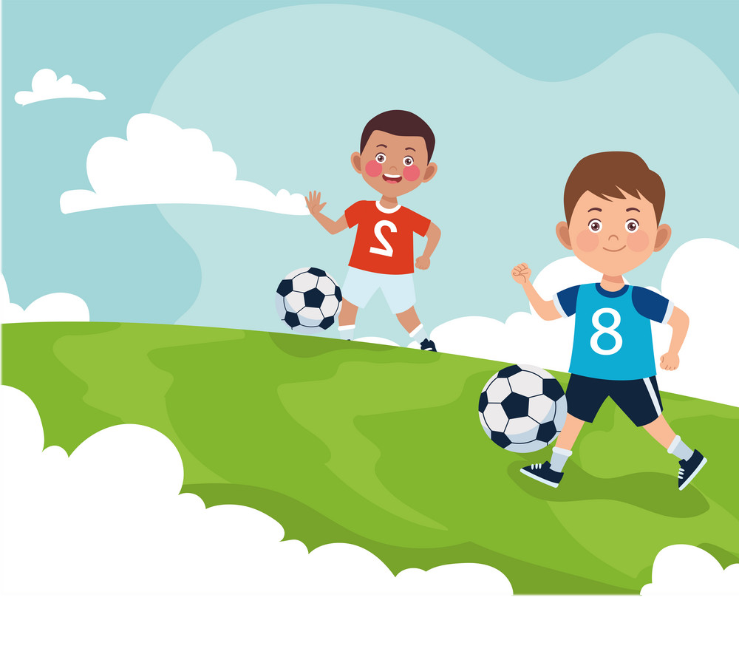
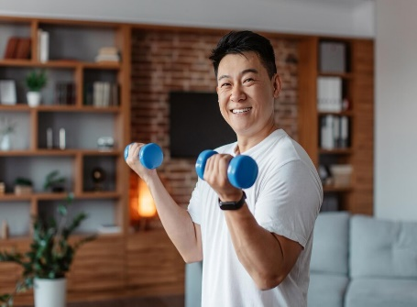
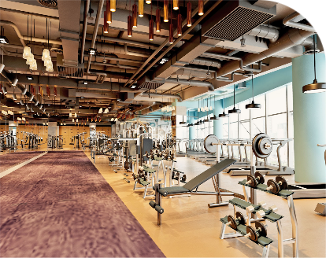

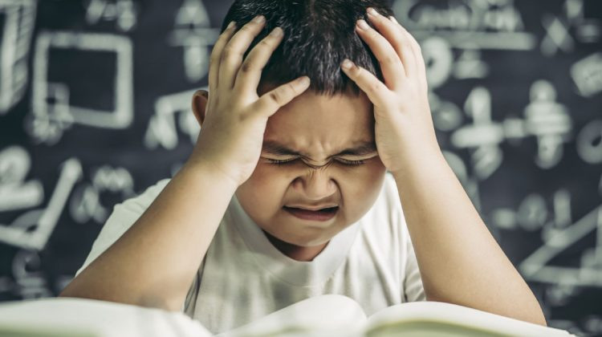
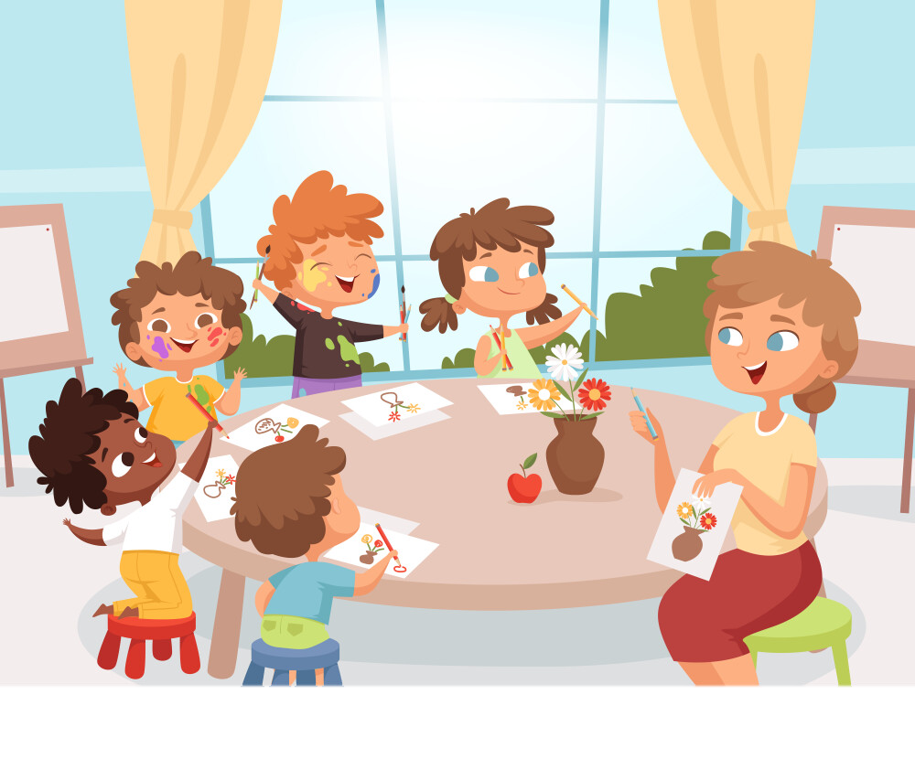

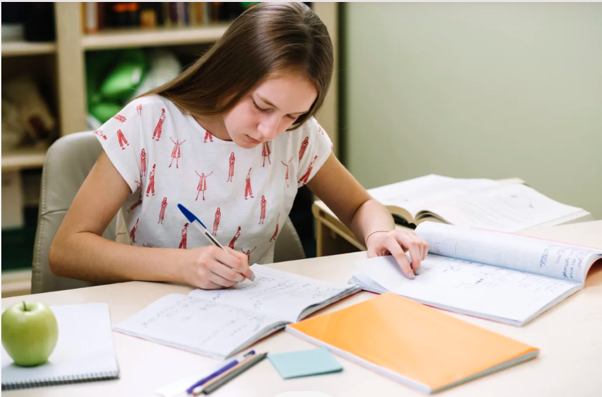
30 seconds

Slide 7


Slide 8
exercise
play football
practise
fitness centre
study English
problem
have art class
solution
do homework

Slide 9
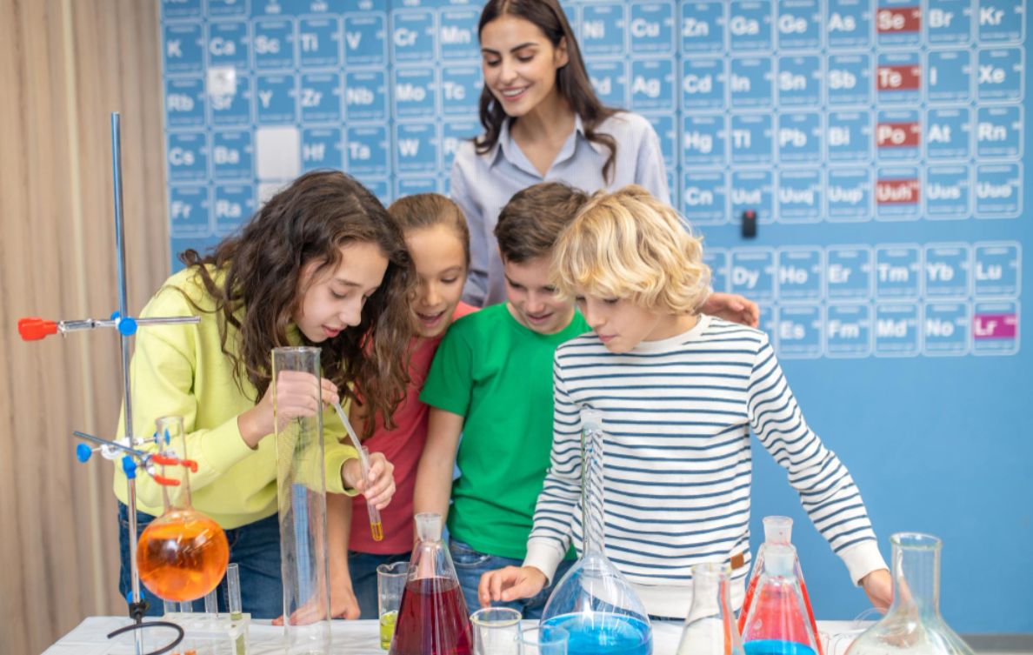
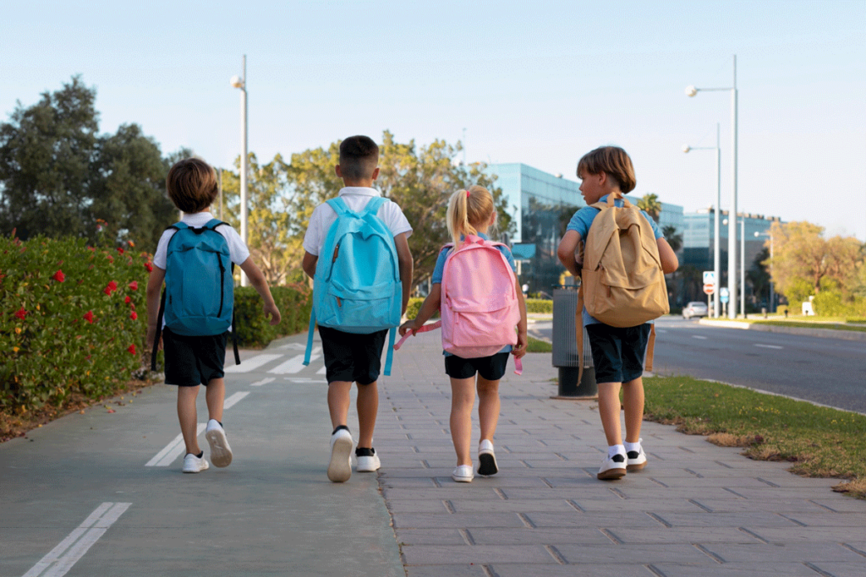
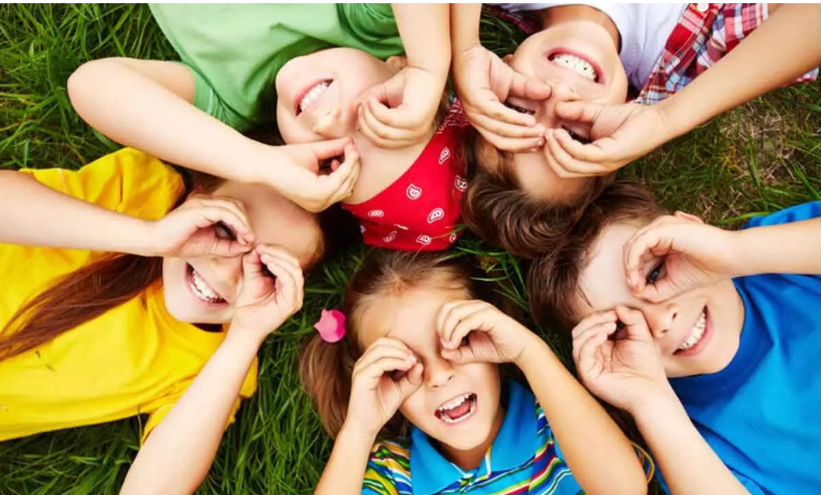
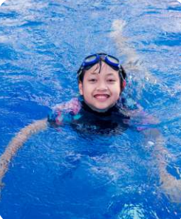
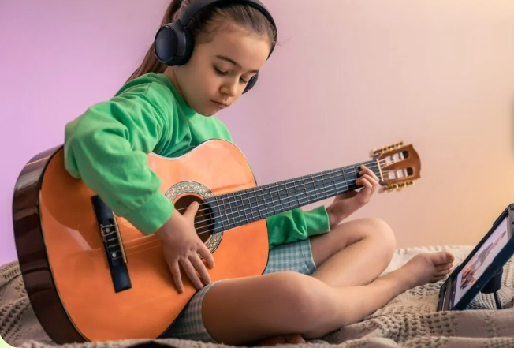
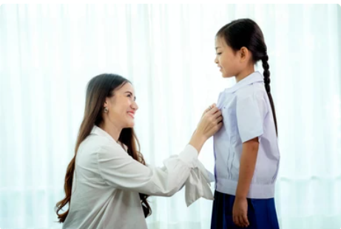
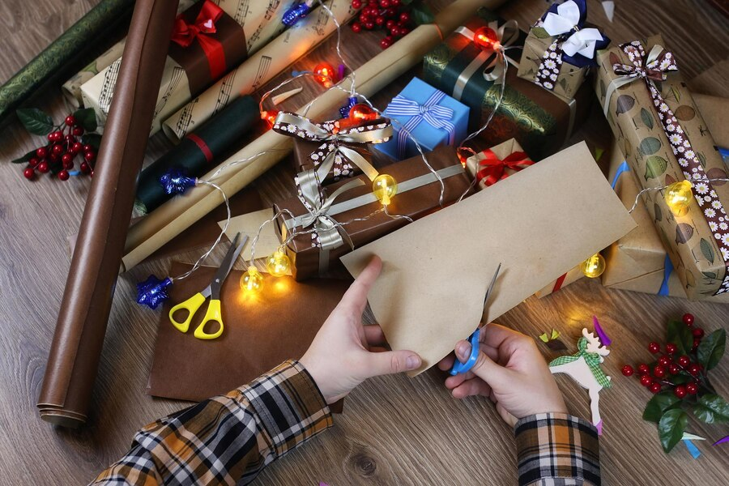
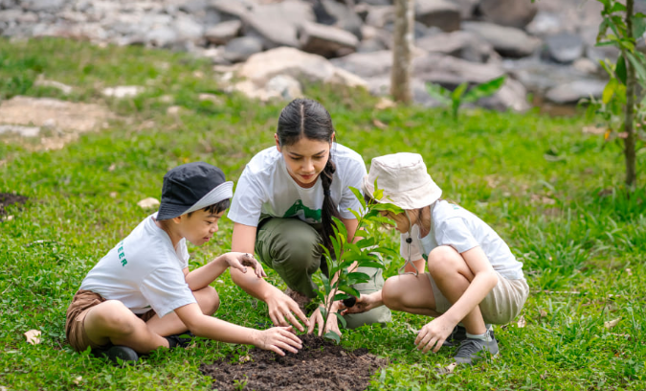
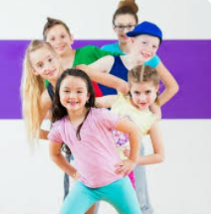
30 seconds

Slide 11
go to science clubs
walk to school
have fun
play a musical instrument
wear a uniform
go swimming
do arts and crafts
take care of plants
dance

Slide 12

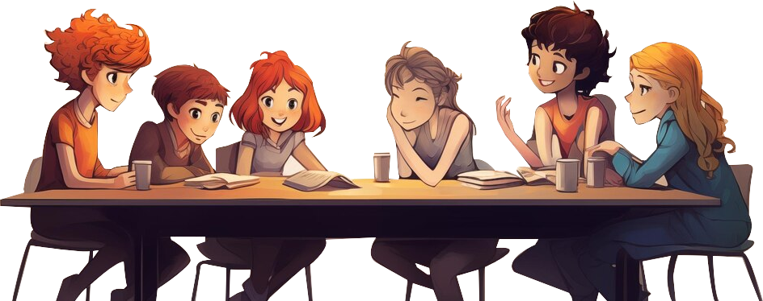
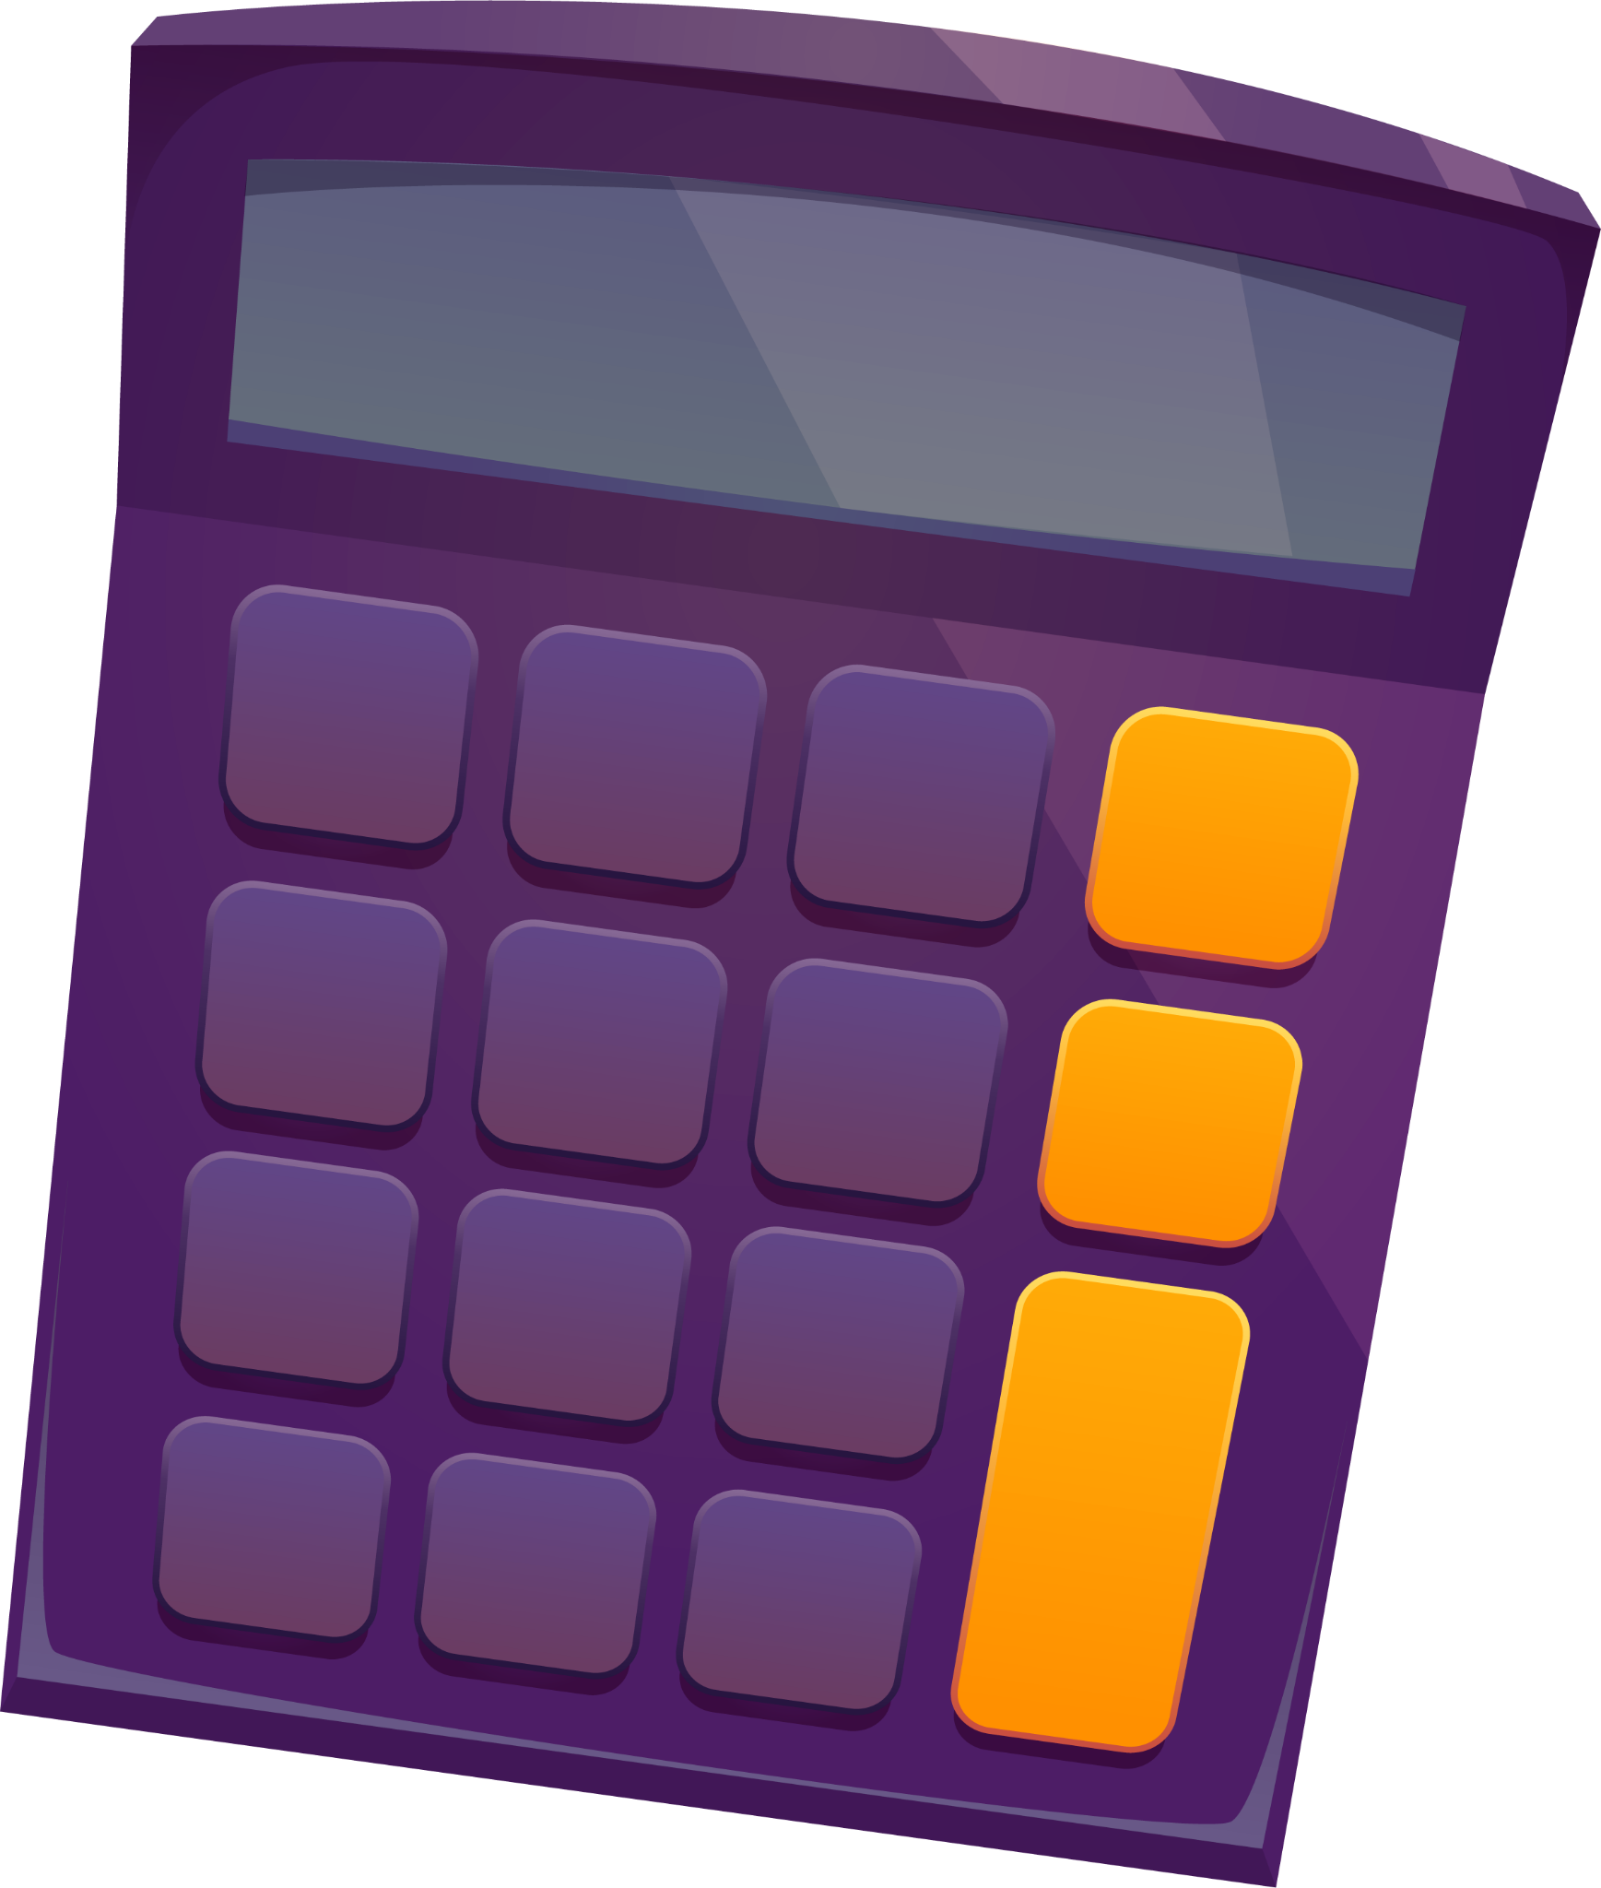

2. REVIEW

Slide 13
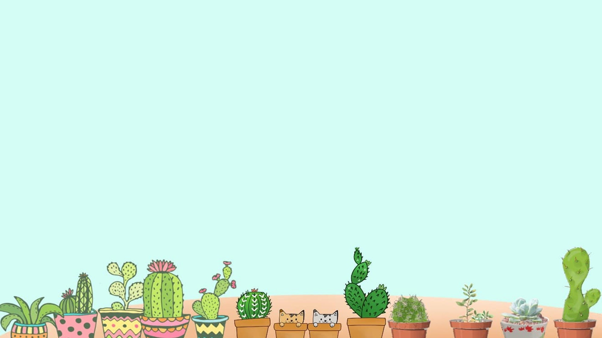

- … do you do in the morning?
- I always do morning exercise.
When
Where
What

Slide 14
- … do you walk to school?
How often
Does
What

Slide 15
- … Dara have English on Monday?
- Yes, She does.
Do
Does
When

Slide 16

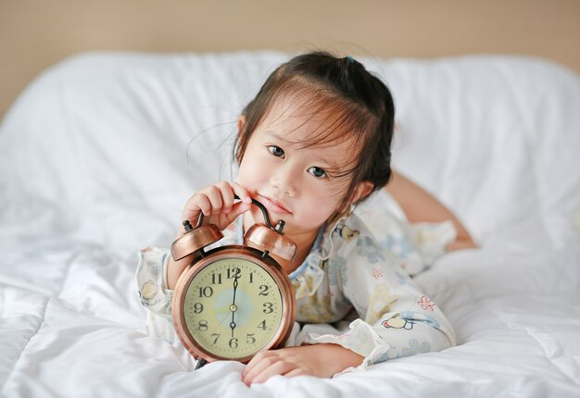
Read and choose the correct answers.
I get up at 6 o’clock.
a. usually
100 %
b. sometimes
c. always

Slide 17
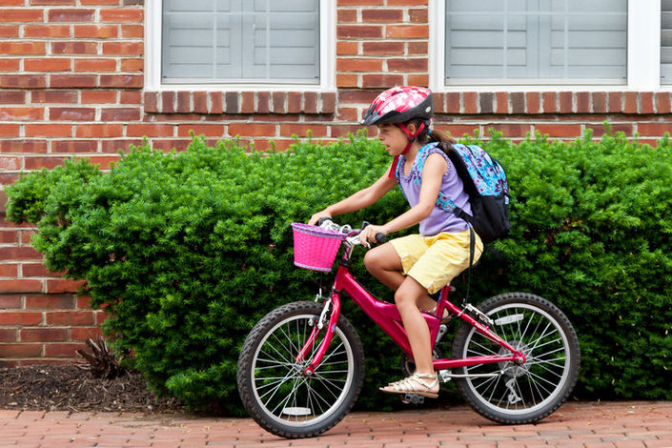
Read and choose the correct answers.
Ann rides her bike to school.
a. sometimes
50 %
b. always
c. often

Slide 18
Read and choose the correct answers.
Doug goes to any science clubs.
a. often
0 %
b. usually
c. never

Slide 19
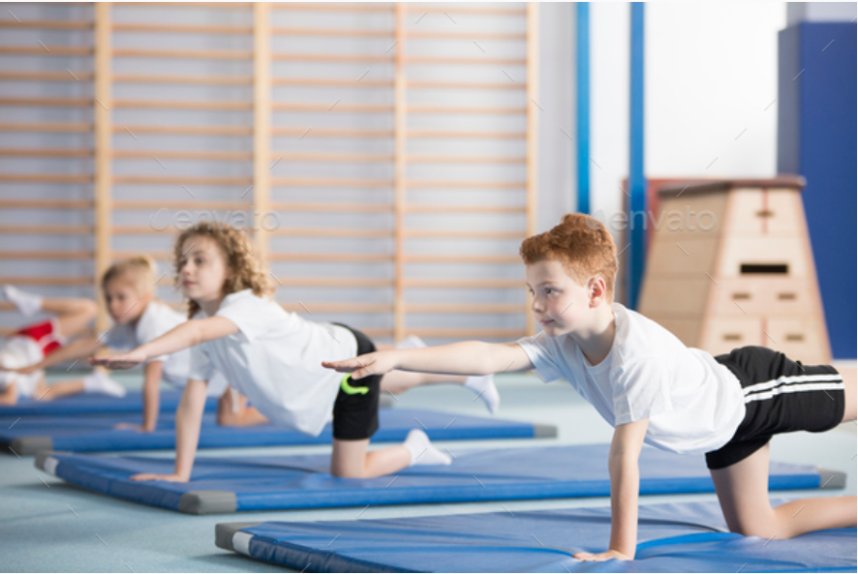
Read and choose the correct answers.
I practise sport.
a. usually
70 %
b. often
c. sometimes

Slide 20
3. PRACTICE

Slide 21





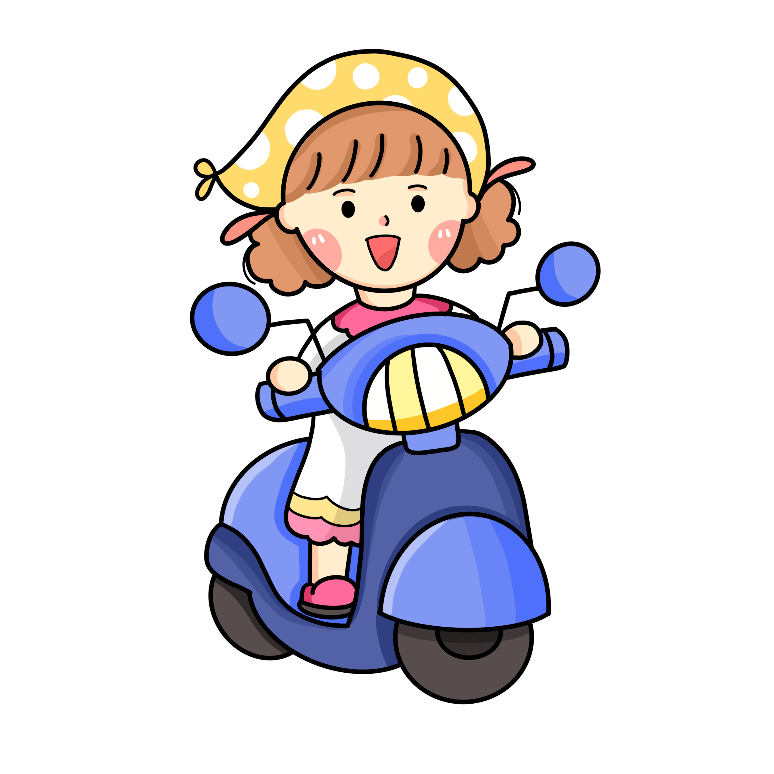

4. Ask and answer about your activities at school.
8 a.m.
9 a.m.
12 p.m.
2 p.m.
4 p.m.
What do you often do at school at 8 a.m.?
At 8 a.m., I start my lessons.

Slide 22
4. PROJECT

Slide 23
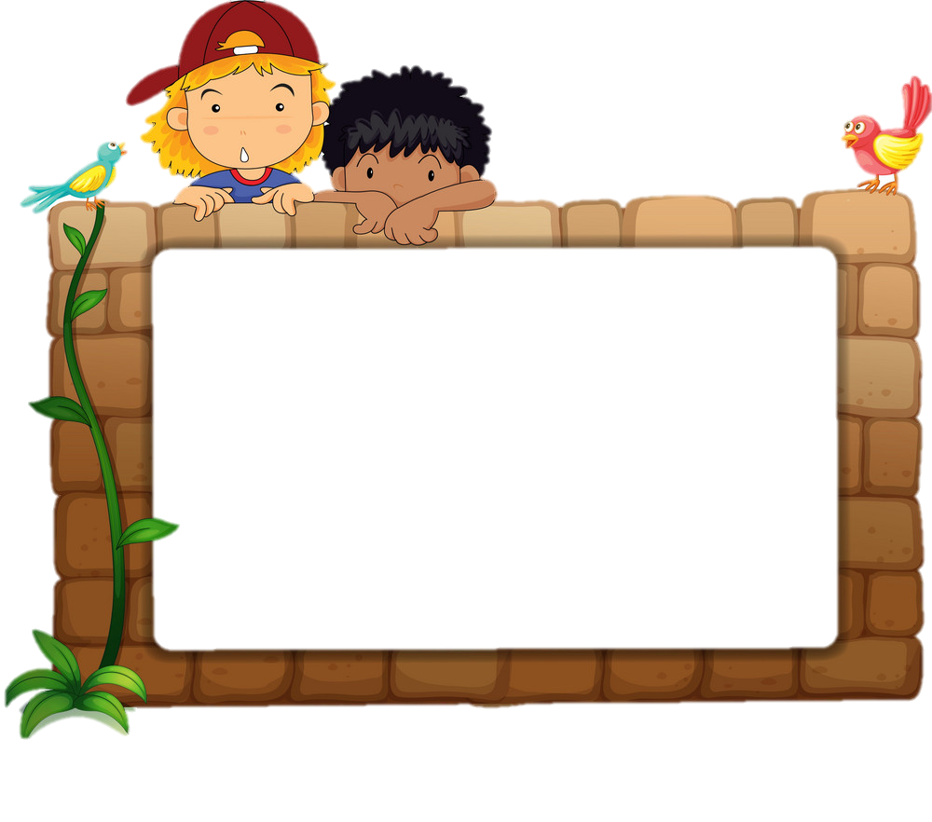
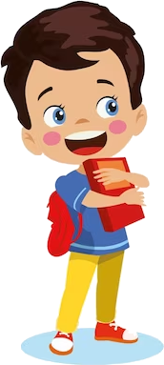
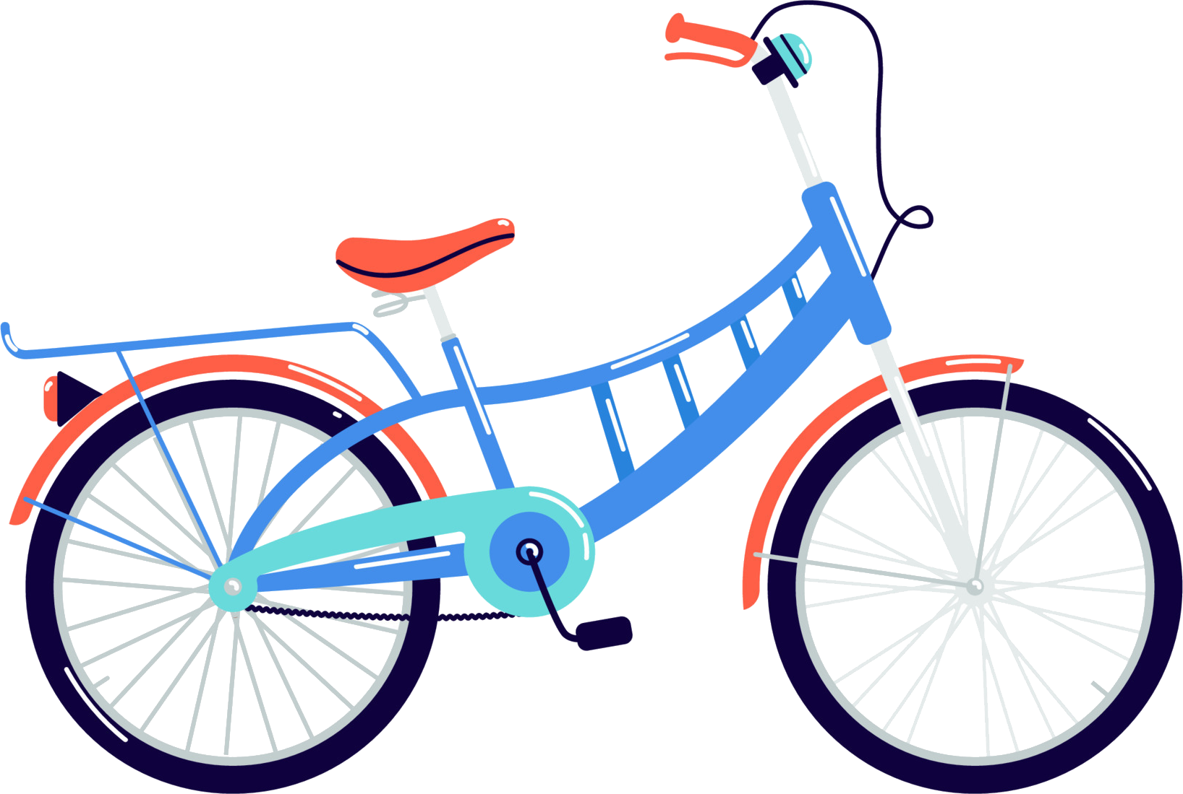
6. Do a class survey and report.
Monday is my favourite school day. At 7.30 a.m, I start my lesson. At 9 a.m, I have an English lesson. I have lunch and
rest at 11.30 a.m. At 2.30 p.m, I play badminton with my
friends. I go home at 4.00 p.m. I like that day because it has
English lessons. I love English very much.
Name | Favourite school day | Favourite suject
Mai
Hoa
Minh
Notes:
- Ask Ss to talk to their friends about favourite school day.
- Find out Who has got the same favourite school day as you?

Slide 24
4. Do a class survey and report.
Minh has got the same favourite school day as me. He likes……
Name | Favourite school day | Favourite suject
Mai | Monday | Maths
Hoa | Friday | English
Minh | Wednesday | Music

Slide 25
5. WRAP-UP & ASSESSMENT

Slide 26

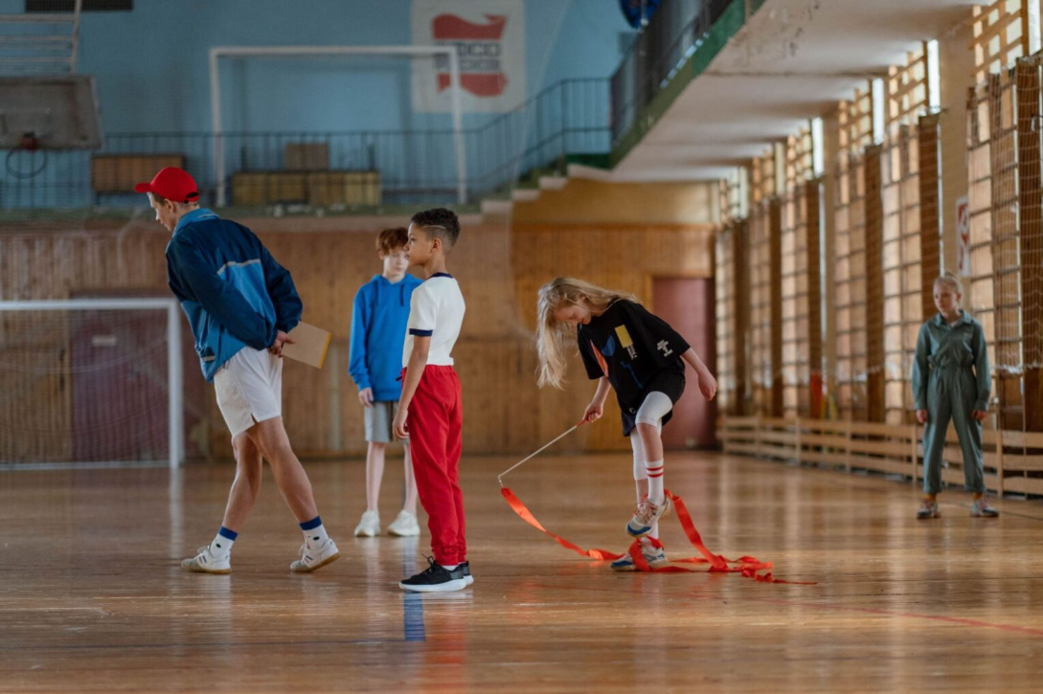
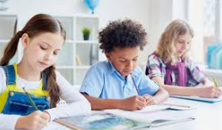
… is my favourite school day. At..., I usually ...

Slide 27

Thank you
& goodbye!

