Slide 1

UBND HUYỆN CÁT HẢI
TRƯỜNG TH&THCS HÀ SEN
Giáo viên: Phạm Thị Sân Thương

Slide 2

Unit
9
NATURAL DISASTERS
LESSON 2: A CLOSER LOOK 1
VOCABULARY
PRONUNCIATION
Unit
HOBBIES

Slide 3
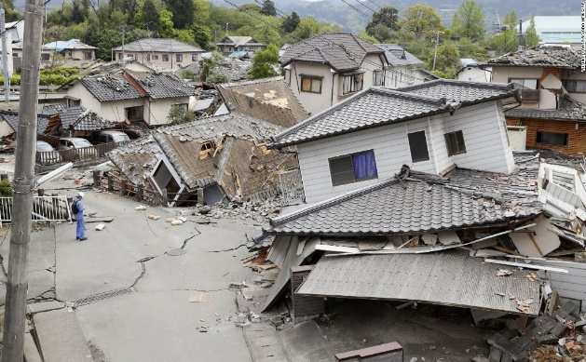
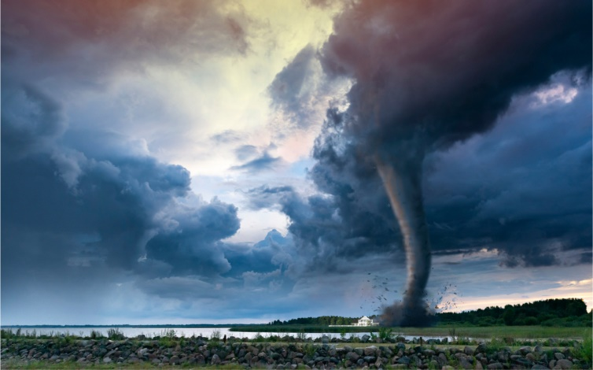
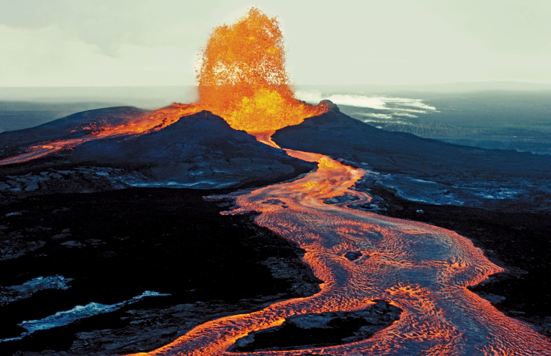
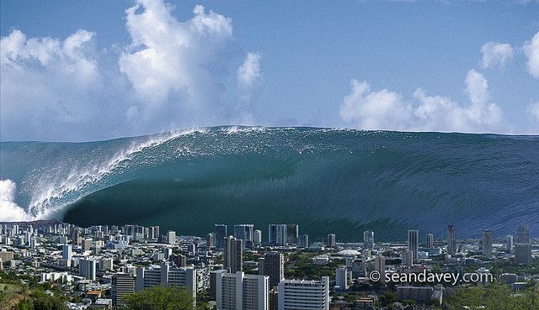
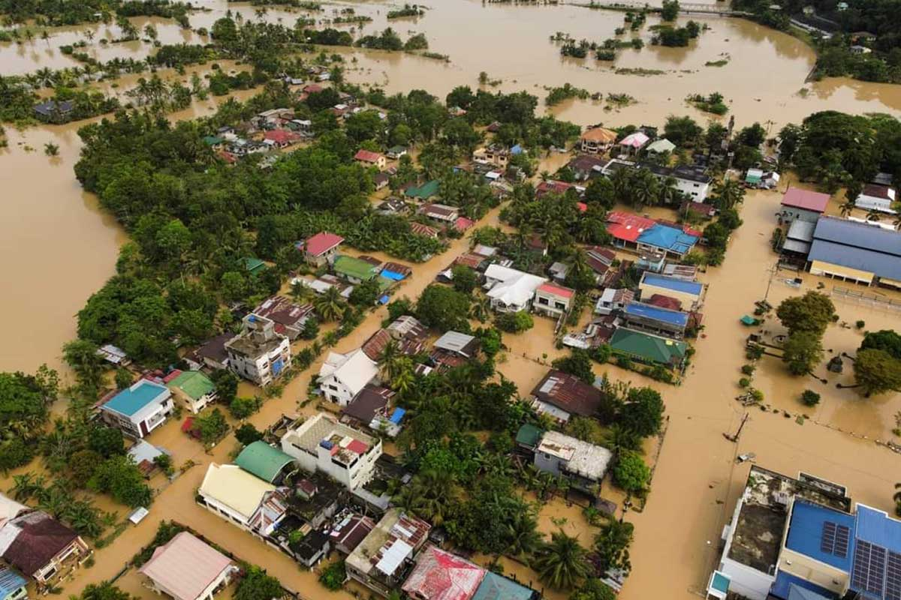
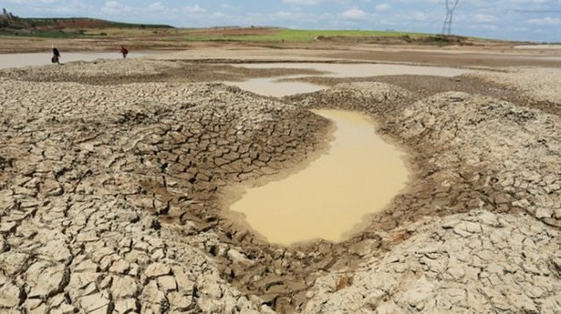
WARM-UP

Slide 4


WARM-UP
Earthquake: động đất
Tornado: lốc xoáy
/tɔːˈneɪ.dəʊ/
Volcano: núi lửa
/vɒlˈkeɪ.nəʊ/
Tidal wave/ tsunami: sóng thần
/su.na.mi/
Flood: lũ lụt
/flʌd/
Drought /draʊt/: hạn hán

Slide 5
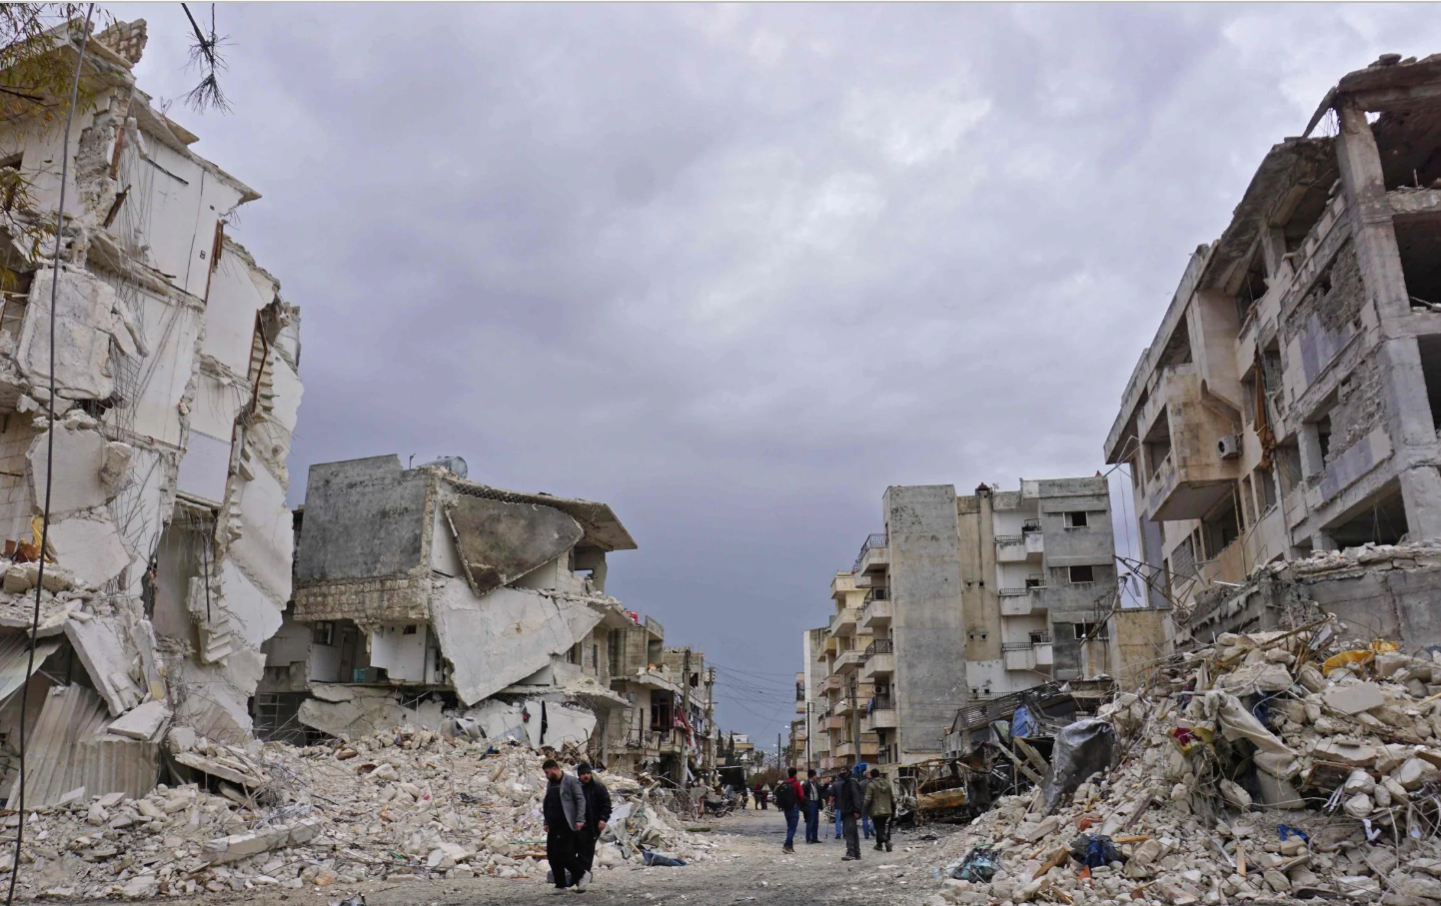

VOCABULARY
destroy (v)
/dɪˈstrɔɪ/
phá hủy

Slide 6
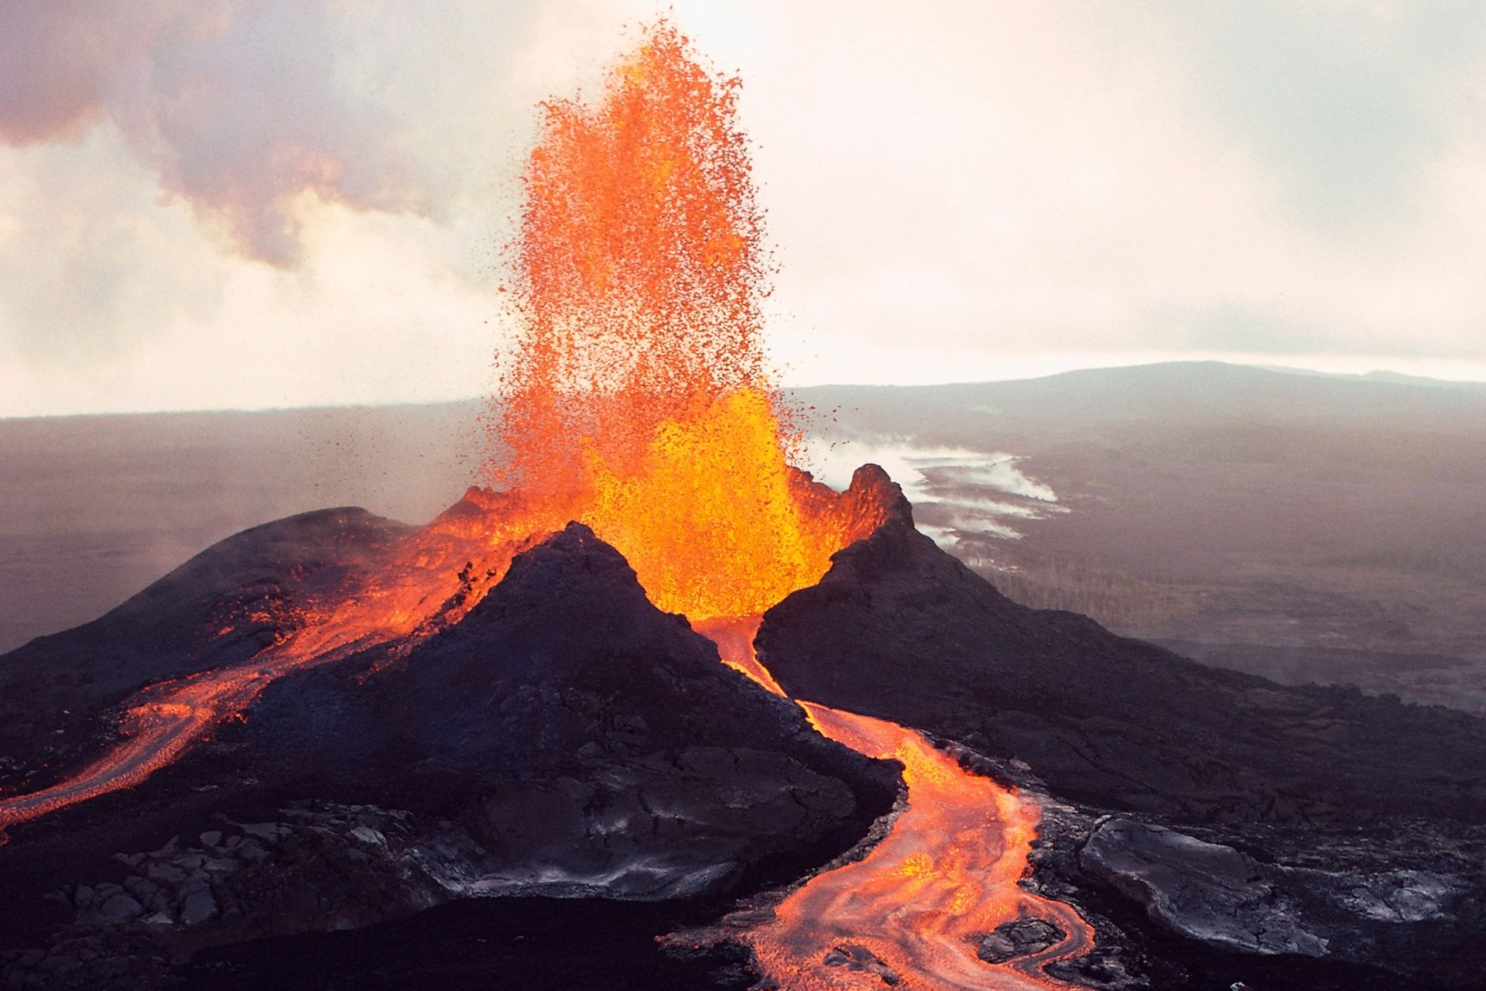
VOCABULARY
erupt (v)
/ɪˈrʌpt/
phun trào

Slide 7

VOCABULARY
predict (v)
/prɪˈdɪkt/
dự đoán

Slide 8
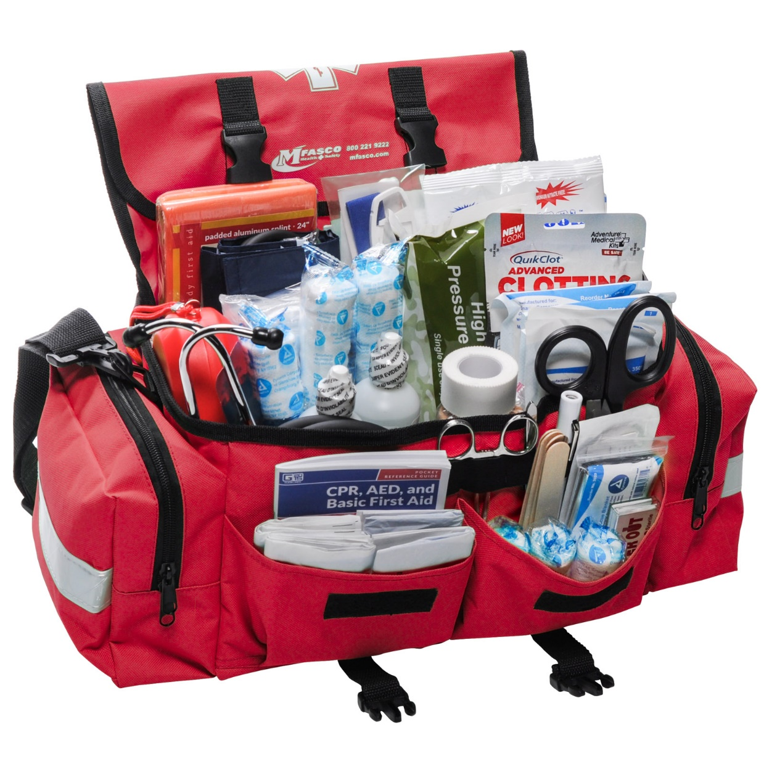
VOCABULARY
emergency kit (n)
/ɪˈmɜːdʒənsi kit/
bộ dụng cụ dùng trong trường hợp khẩn cấp

Slide 9
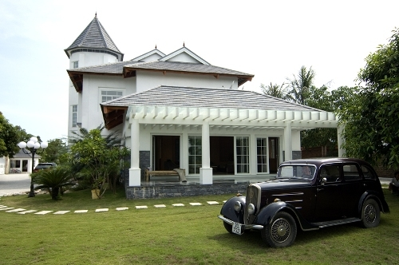
VOCABULARY
property (n)
/ˈprɒpəti/
của cải, nhà cửa

Slide 10
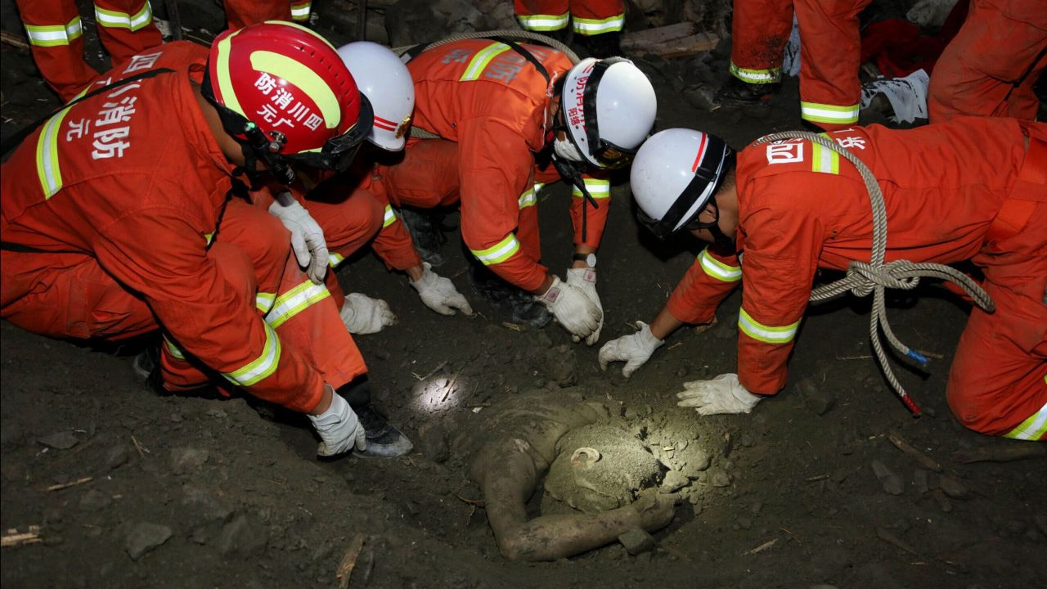
VOCABULARY
rescue worker (n)
/ˈreskjuːˈwɜːkər /
nhân viên cứu hộ

Slide 11
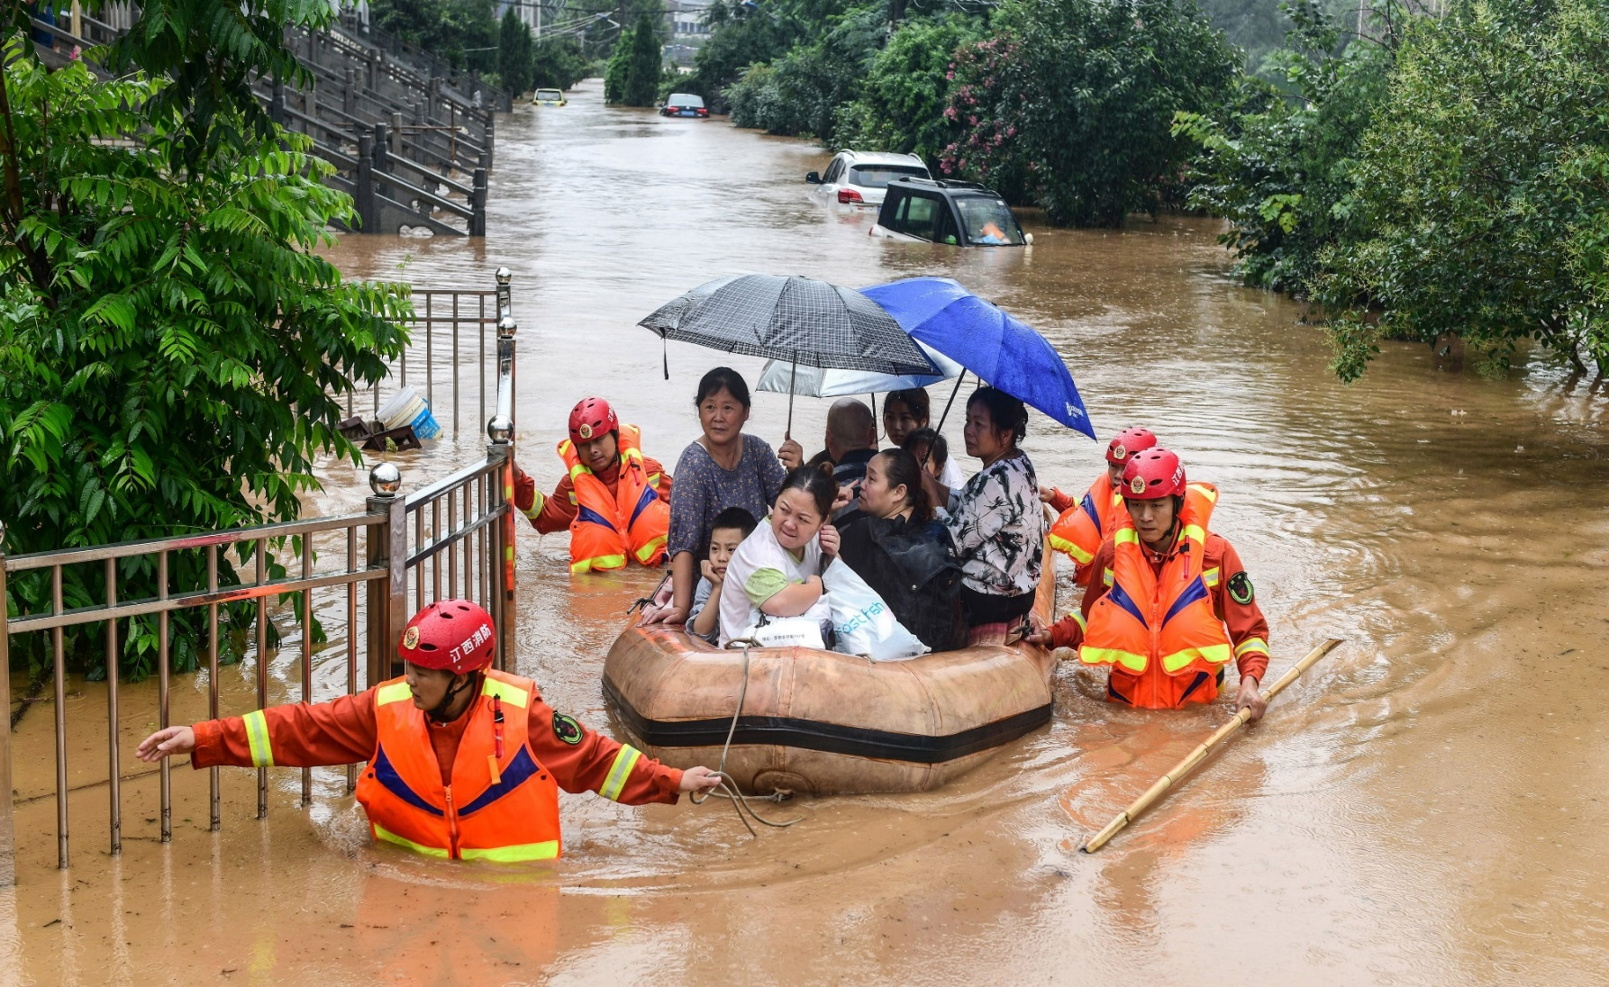
VOCABULARY
victim (n)
/ˈvɪktɪm/
nạn nhân

Slide 12
VOCABULARY
New words | Pronunciation | Meaning
1. destroy (v) | /dɪˈstrɔɪ/ | phá hủy
2. erupt (v) | /ɪˈrʌpt/ | phun trào
3. predict (v) | /prɪˈdɪkt/ | dự đoán
4. emergency kit | /ɪˈmɜːdʒənsikit/ | bộ dụng cụ dùng trong trường hợp khẩn cấp
5. property (n) | /ˈprɒpəti/ | của cải, nhà cửa
6. rescue worker | /ˈreskjuːˈwɜːkər / | nhân viên cứu hộ
7. victim (n) | /ˈˈvɪktɪm/ | nạn nhân

Slide 13
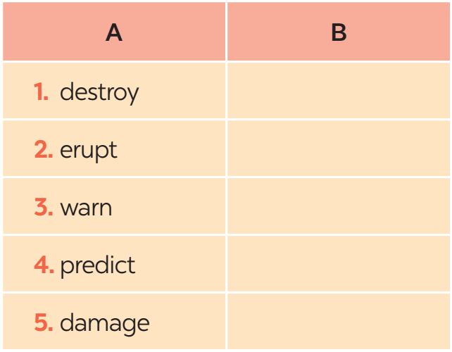
VOCABULARY
1
In column B, write the noun forms of the verbs in column A.
destruction
eruption
warning
prediction
damage

Slide 14

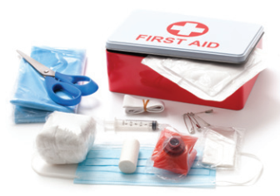
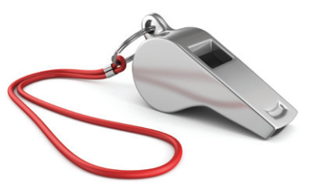
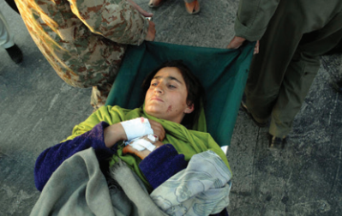
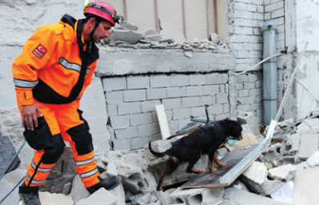
VOCABULARY
2
Write a word or phrase from the box under the correct picture.
emergency kit victim rescue worker property whistle
whistle
emergency kit
1. ____________
2. _____________
3. _____________
property
5. _____________
victim
rescue worker
4. _____________

Slide 15
VOCABULARY
3
Fill in each blank with a word or phrase from the box.
warning predict property damage emergency kit
1. Natural disasters can cause serious ________ to human life.
2. Local authorities gave a flood ________ yesterday, so today people are moving to safer places.
3. To prepare for a natural disaster, we should make a(n) ___________.
4. It’s hard to believe that we cannot _______ when earthquakes will happen.
5. They lost all of their ________ because of the volcanic eruption.
damage
warning
emergency kit
predict
property

Slide 16
PRONUNCIATION
4
Listen and repeat the words. Pay attention to the word stress.
musical dangerous
national humorous
practical poisonous
personal marvellous

Slide 17
PRONUNCIATION
5
Listen and repeat the sentences. Mark the stress in the underlined words.
‘
1. The flood victims are collecting their personal property.
2. Avoid dangerous places, such as windows or bookcases, during an earthquake.
3. There are numerous tropical storms in this area every year.
4. Some natural disasters, such as landslides, usually happen in mountainous areas.
5. She gave us practical tips about treating poisonous wastes.
‘
‘
‘
‘
‘
‘
‘

Slide 18
CONSOLIDATION
1
Wrap-up
VOCABULARY
PRONUNCIATION

Slide 19

CONSOLIDATION
2
Homework
- Learn the new words by heart .
- Do exercises in the workbook.
- Prepare for Lesson 3 - A closer look 2.

Slide 20

Website: hoclieu.vn
Fanpage: facebook.com/tienganhglobalsuccess.vn/

