Slide 1
Unit 4. Remembering the past
Lesson 2. A closer look 1

Slide 2

Objectives
01
Use the lexical items related to the topic Remembering the past
02
Pronounce the sounds /m/ and /l/ in words and sentences correctly.

Slide 3

I
Vocabulary

Slide 4


I. Vocabulary
promote (v)
/prəˈməʊt/
thúc đẩy
to encourage people to like, buy, use, do, or support something.

Slide 5
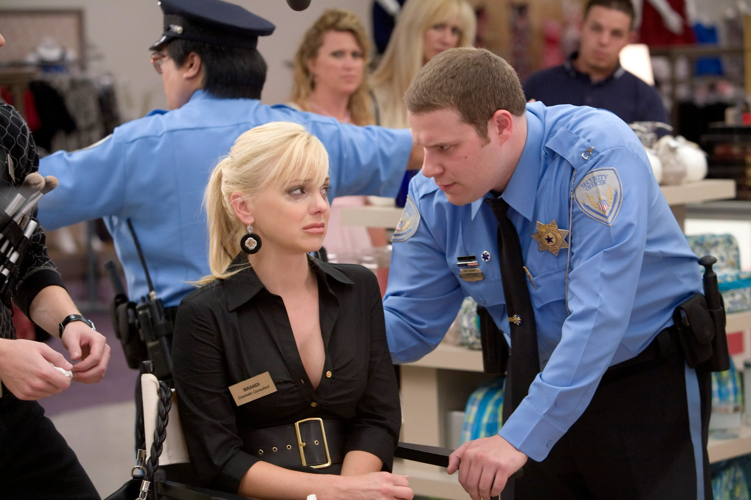
I. Vocabulary
You have to obey the rules.
observe (v)
/əbˈzɜːv/
duy trì,
tuân theo
Notes:
To obey

Slide 6

I. Vocabulary
recognise (v)
/ˈrekəɡnaɪz/
công nhận
He was recognised for his outstanding achievements in science.
Notes:
To obey

Slide 7
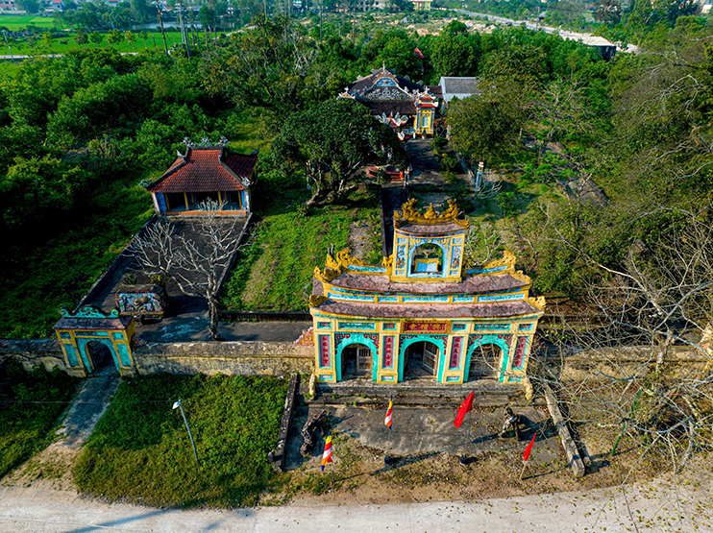
I. Vocabulary
Items and locations from ancient times to the present
cultural relic (n)
/ ˈkʌl.tʃər ˈrelɪk/
di tích văn hoá
Notes:
To obey

Slide 8
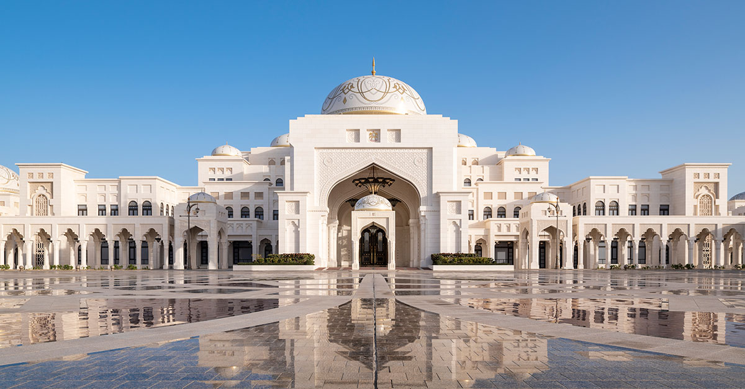
I. Vocabulary
magnificent (adj)
/mæɡˈnɪfɪsnt/
tráng lệ
What does the castle look like?
Notes:
To obey

Slide 9

I. Vocabulary
Many students benefit from self-study.
benefit (v)
/ˈben.ɪ.fɪt/
giúp ích
Notes:
To obey

Slide 10
Can you list endings of noun?
-er / or
- Ist
- ian
- ment
- ness
- tion / sion/ ion
- ity / ty
- ance / ence
- ship
- hood
- age
- ism

Slide 11
Ex 1 (p 42). Complete the following table. There is one example.
Verb
Noun
ex
protect
protection
1
promote
promotion
1
recognise
recognition
1
contribute
contribution
1
observe
observation
1
preserve
preservation
1
occupy
occypation

Slide 12
Ex 2 (p 42). Complete the sentences, using the correct forms of the words from Ex 1.
1. People in these mountainous areas still _____________ their local customs and traditions.
2. The invention of the seat belt made a good _____________ to road safety.
3. We believe that _________________________ of these old structures will benefit the community in many ways.
preserve
S + V + O
contribution
a good + singular noun
preservation/ protection
that + clause (S+V+O)

Slide 13
Ex 2 (p 42). Complete the sentences, using the correct forms of the words from Ex 1.
4. The aim of the culture festival is the ___________ of friendship and tourism.
5. In 2006, Duong Lam became the first village that was ____________ as a national historic and cultural relic.
promotion
the + N
recognised
Passive voice in past simple:
S + was + Vp2

Slide 14
Ex 3 (p 42). Complete the following sentences with the words from the box.
magnificent
takeaway
heritage
generations
structures
1. Stonehenge, England, one of the oldest stone _______ in the world, is about 5,000 years old.
2. If you are busy, you can get a _______ from one of these restaurants.
3. It's our duty to keep our customs and traditions alive for future _______.
4. Windsor Castle is about a thousand years old but it's absolutely _______.
5. We need a lot of effort to safeguard and preserve our _______.

Slide 15
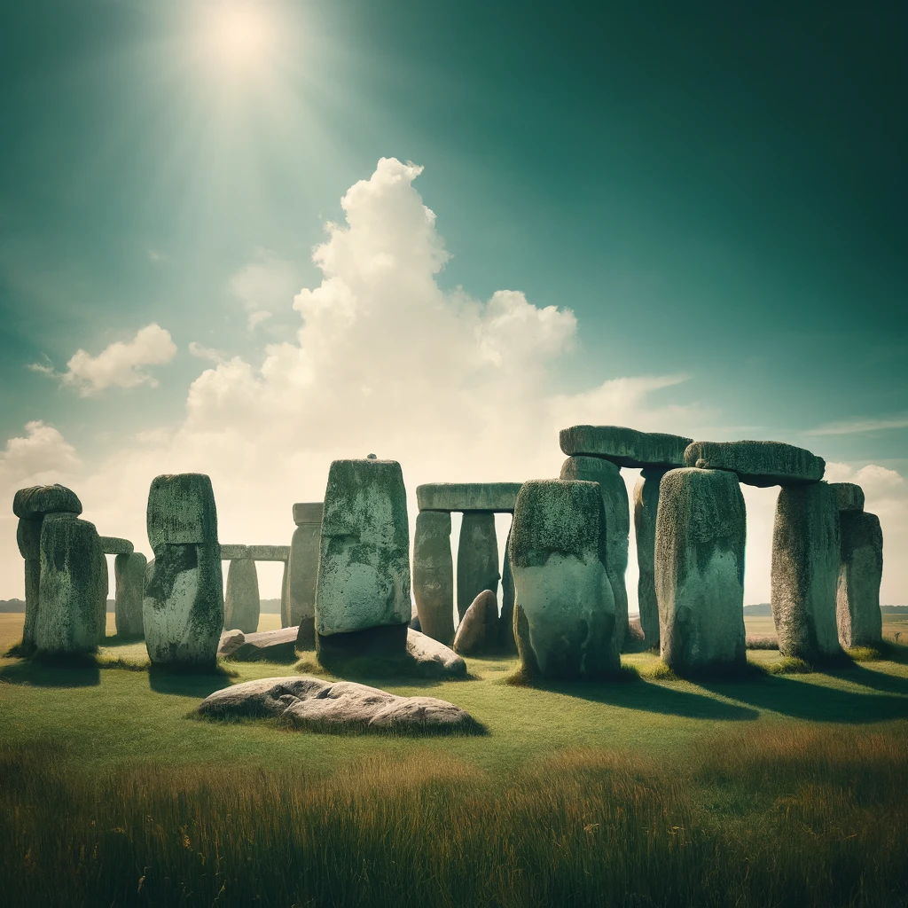
Ex 3 (p 42). Complete the following sentences with the words from the box.
magnificent
takeaway
heritage
generations
structures
1. Stonehenge, England, one of the oldest stone ______________ in the world, is about 5,000 years old.
One of the oldest stone + N

Slide 16

Ex 3 (p 42). Complete the following sentences with the words from the box.
magnificent
takeaway
heritage
generations
2. If you are busy, you can get a _____________ from one of these restaurants.
A + singular noun

Slide 17
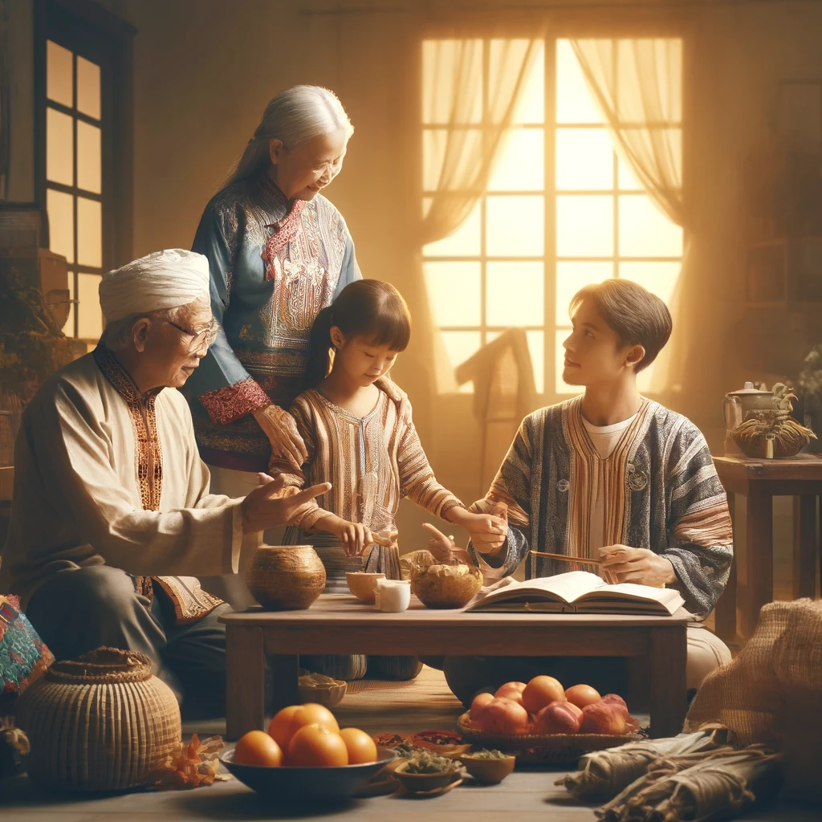
Ex 3 (p 42). Complete the following sentences with the words from the box.
magnificent
heritage
generations
3. It's our duty to keep our customs and traditions alive for future ______________.

Slide 18
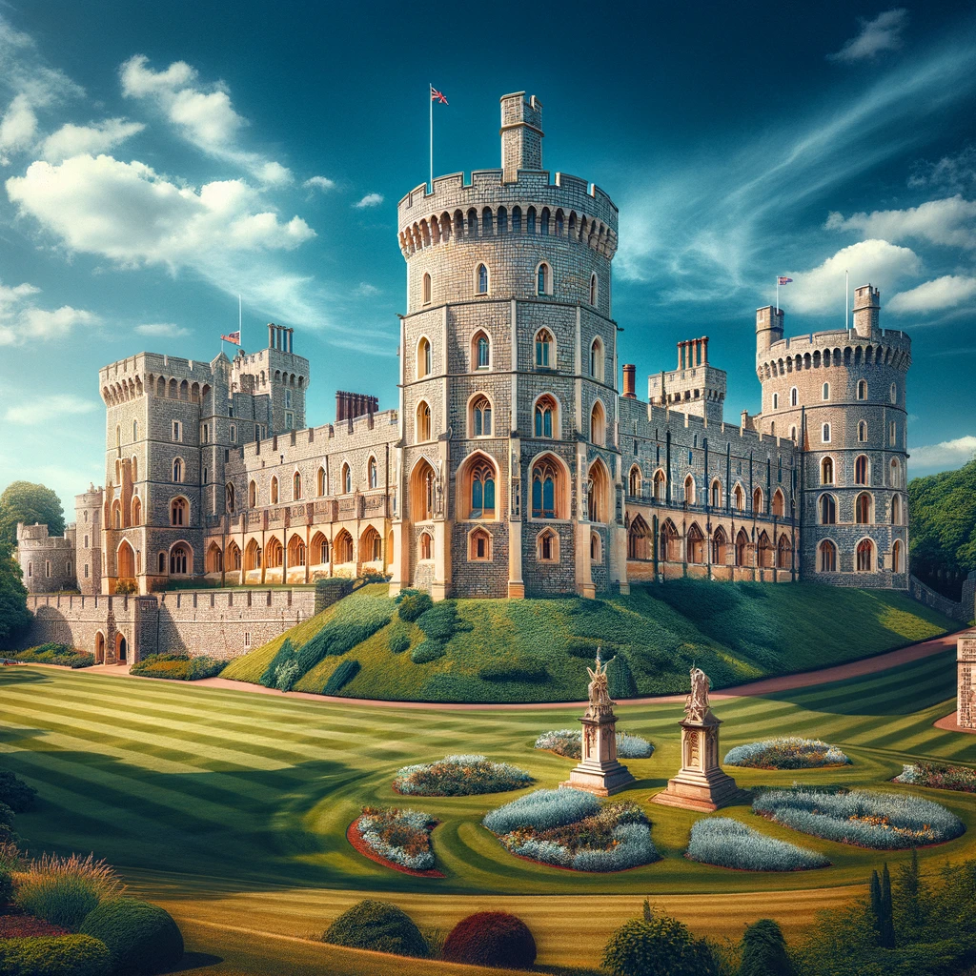
Ex 3 (p 42). Complete the following sentences with the words from the box.
magnificent
heritage
4. Windsor Castle is about a thousand years old
but it's absolutely _______________.
it’s absolutely + adj

Slide 19

Ex 3 (p 42). Complete the following sentences with the words from the box.
heritage
5. We need a lot of effort to safeguard and preserve our __________________.

Slide 20
II
PRONUNCIATION
/m/ & /l/

Slide 21

Ex 4 (p 42). Listen and repeat the words. Pay attention to the sounds /m/ and /l/.
/m/ | /l/
monument
magnificent
programme
custom
grandma
landscape
celebrate
value
cultural
national

Slide 22
Remember!
There are two types of sound /l/: light /l/ and dark /l/.
- Light /l/ comes before a vowel sound: light, holiday,...
- Dark /l/ appears after a vowel sound or at the end of a word: milk, castle,...

Slide 23
Identify the /l/ sound in each sentence.
landscape
national
celebrate
cultural
value
Light sound | Dark sound
in the middle of the word, before a consonant and at the end of the word
at the beginning of the word, clearly pronounced
at the end of the word, before a consonant
in the middle of the word, before a vowel
in the middle of the word, before a vowel

Slide 24
Ex 5 (p 42). Listen and repeat the sentences. Pay attention to the underlined words.
1. The collection includes objects of the Middle Ages.
2. You should be careful when shopping in this mall.
3. This monument is small but magnificent.
4. They maintain these windmills as working museums.
5. David fell off his bike and hurt his ankle.

Slide 25
Stop the bus
- Look at the picture and guess meaning
- Contain /m/ or /l/ sound in each answer
- Say “stop the bus” to answer

Slide 26
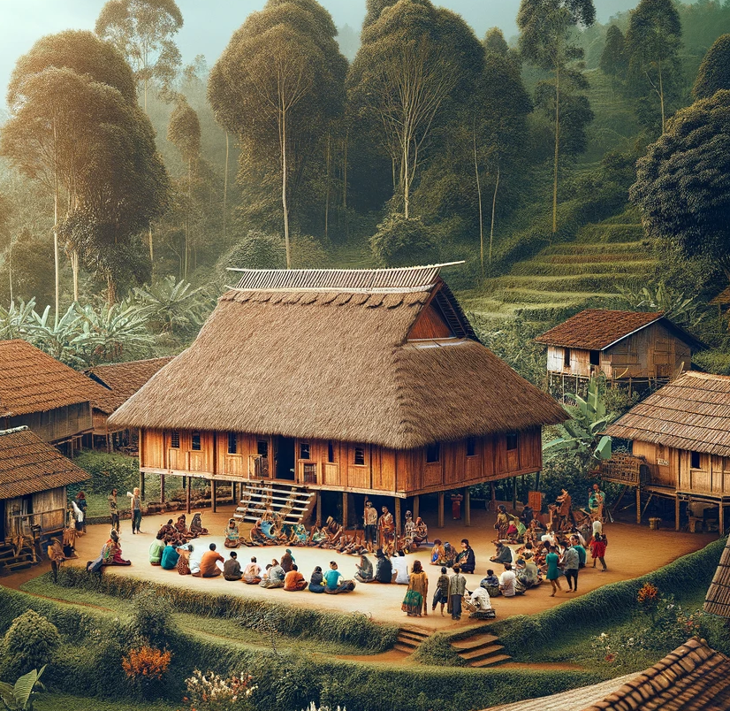
Where does the village chief often gather people?
Communal house

Slide 27
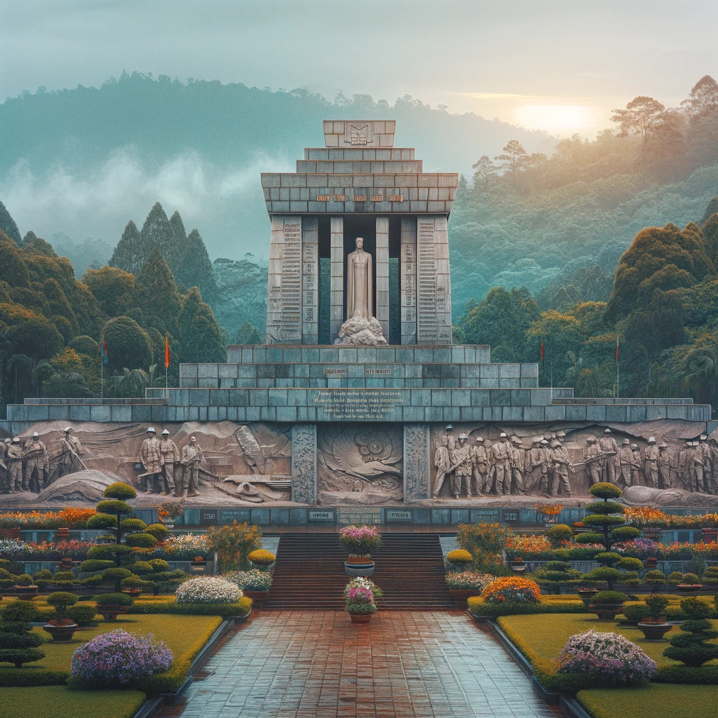
A place to commemorate the soldiers
Monument

Slide 28
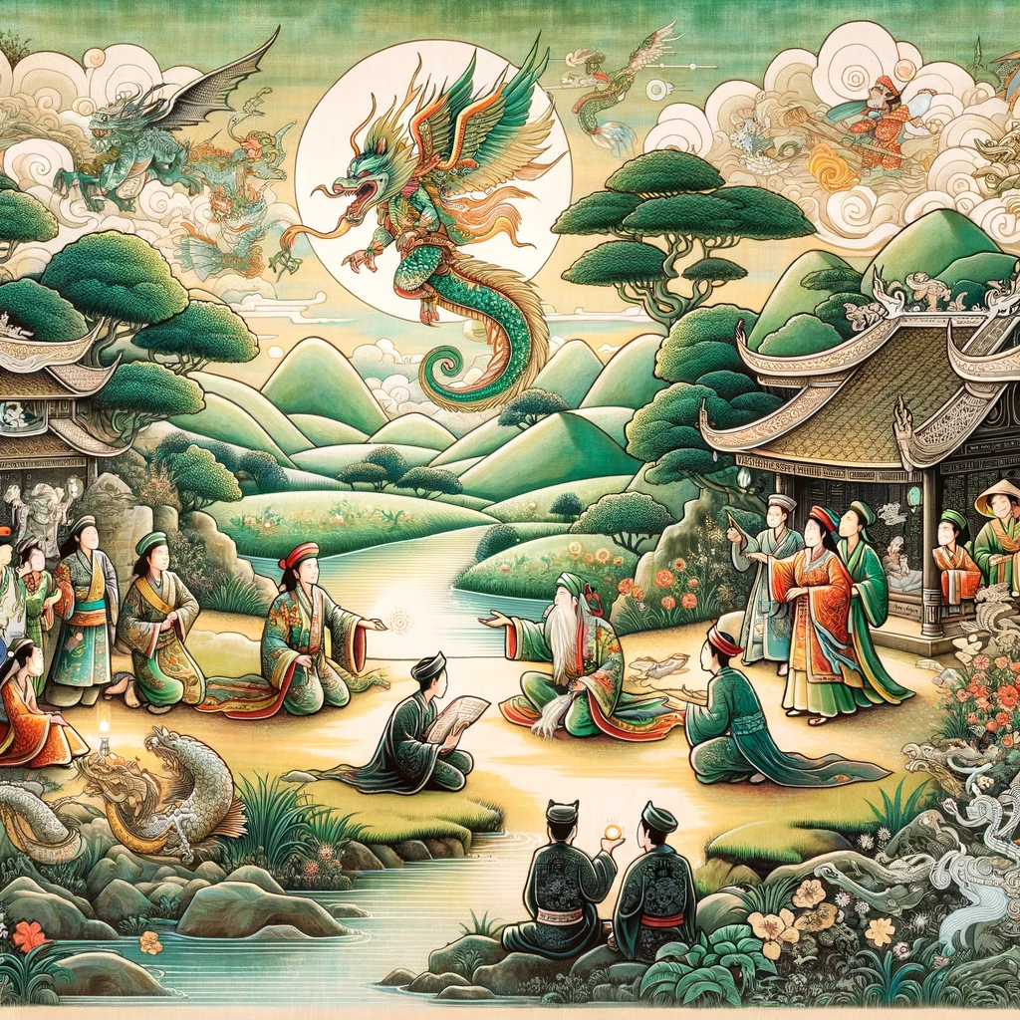
The story that originates in the oral tradition of a culture and is passed down through generations.
Folk tale

Slide 29
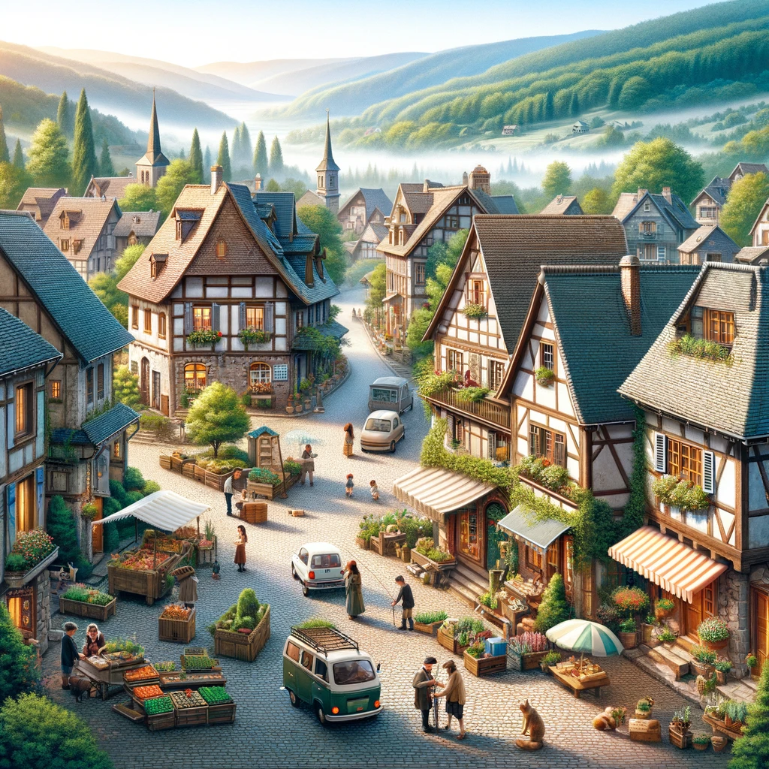
A small community or group of houses in a rural area.
Village

Slide 30
RECAP
I have learnt:
1. New words related to the topic. 2. Practicing the ending of nouns.
3. Sounds: /m/, /l/
and dark /l/ & light /l/.
What have you learnt in this lesson?

Slide 31
Thank you
Do you have any question?

