Slide 2


Unit 7
In the kitchen
Lesson 2- Period 2

Slide 3
TABLE OF CONTENTS
1
Warm-up and Review
2
Acyivity 3: Listen and chant.
3
Activity 4: Listen and tick.
4
Activity 5: Look and write.
5
Fun corner and Wrap-up

Slide 4
01
Warm-up and Review

Slide 5



j
____
u
____
i
c
____
e
9
10
8
7
6
5
4
3
2
1
0

Slide 6
j
____
a
m
9
10
8
7
6
5
4
3
2
1
0

Slide 7
m
i
____
l
____
k
9
10
8
7
6
5
4
3
2
1
0

Slide 8
y
j
____
____
l
e
____
l
9
10
8
7
6
5
4
3
2
1
0

Slide 9
____
a
t
e
____
r
w
____
9
10
8
7
6
5
4
3
2
1
0

Slide 10
p
a
____
s
t
a
____
9
10
8
7
6
5
4
3
2
1
0

Slide 11
p
____
i
z
z
____
a
____
9
10
8
7
6
5
4
3
2
1
0

Slide 12
p
o
p
c
o
r
____
____
____
____
n
9
10
8
7
6
5
4
3
2
1
0

Slide 13


Slide 14
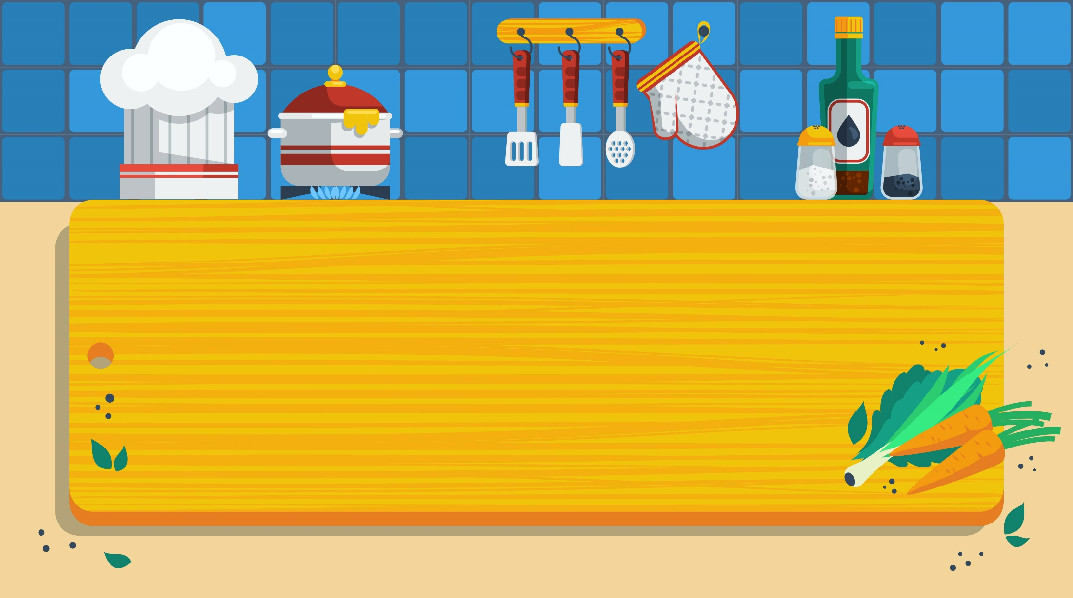
02
Activity 3
Listen and chant.

Slide 15
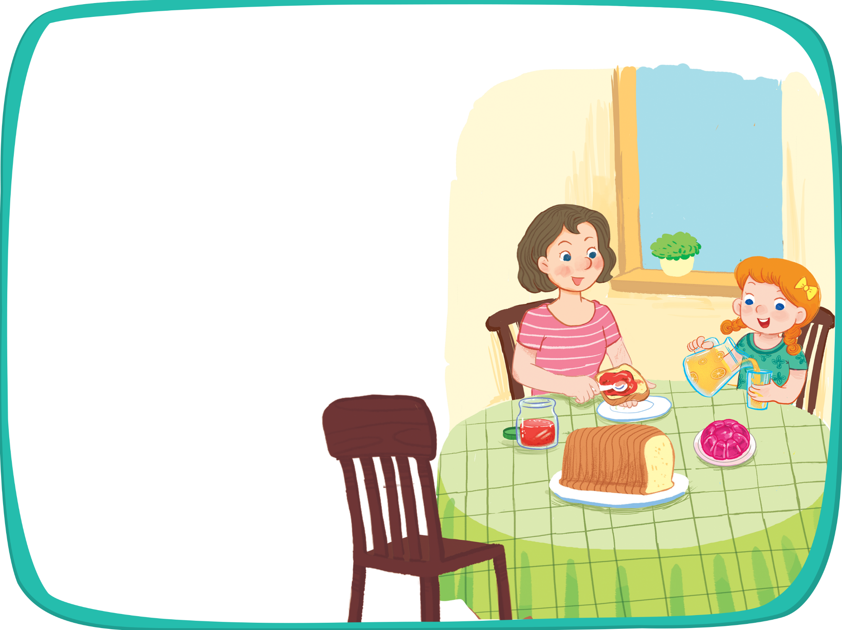


Listen and chant.
J, j, jam.
J, j, jam.
J, j, jam.
J, j, jam.
I like jam.
I like jam.
I like jam.
I like jam.
J, j, juice.
J, j, juice.
J, j, juice.
J, j, juice.
I like juice.
I like juice.
I like juice.
I like juice.
J, j, jelly.
J, j, jelly.
J, j, jelly.
J, j, jelly.
I like jelly.
I like jelly.
I like jelly.
I like jelly.

Slide 16
03
Activity 4
Listen and tick.

Slide 17




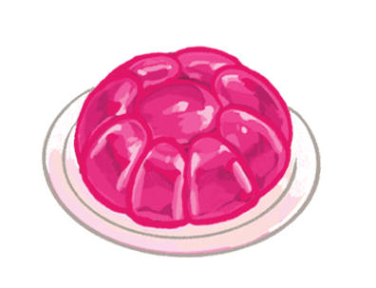

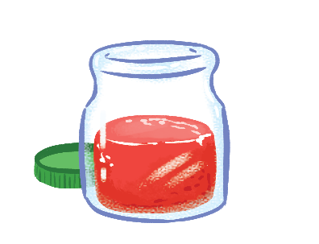


Listen and tick.
1
2

Slide 18
Listen and tick.
1


Slide 19
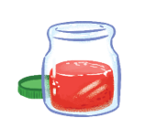

Listen and tick.
2


Slide 20
04
Activity 5
Look and write.

Slide 21
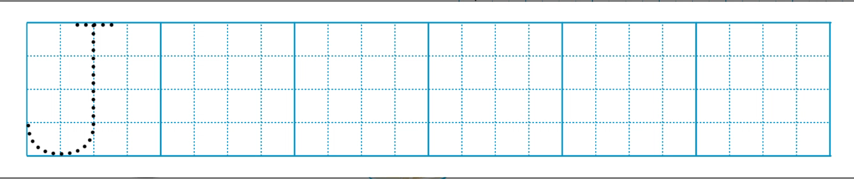
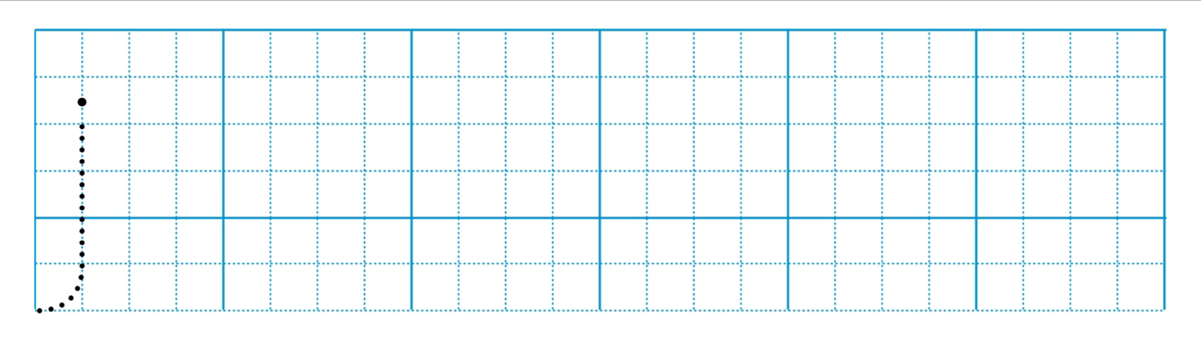

Slide 22


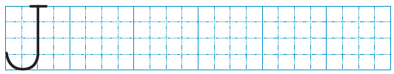
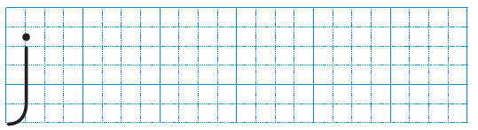
Look and write
j
elly
j
uice
j
am

Slide 23
05
Fun corner
and
Wrap-up

Slide 24


Option 1
Option 2

Slide 25




START
20
19
18
17
16
15
14
13
12
11
10
9
8
7
6
5
4
3
2
1
20
0
19
18
17
16
15
14
13
12
11
10
9
8
7
6
5
4
3
2
1
0
1
2
3
4
5
Notes:
- GV cho HS xem tranh sau đó che hình lại để HS nói truyền tin.
- Sau khi truyền tin đến HS cuối cùng GV click vào hình dấu chấm hỏi để check đáp án.

Slide 26
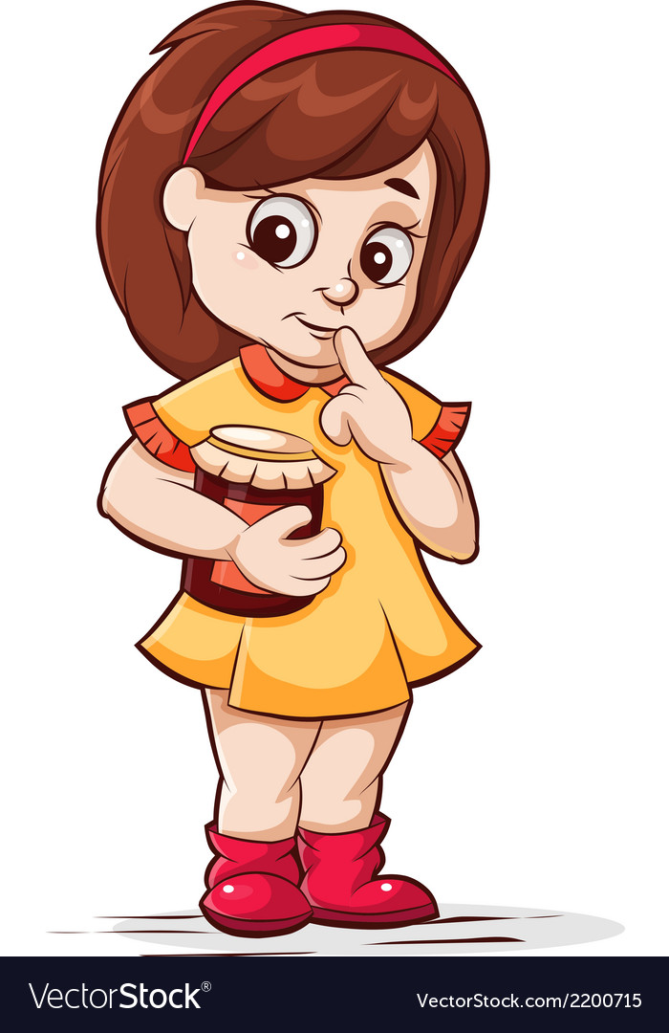

?
I like jam.

Slide 27

?
I like juice.

Slide 28

?
I like jelly.

Slide 29

?
I like cake.

Slide 30

?
I like milk.

Slide 31


Slide 32
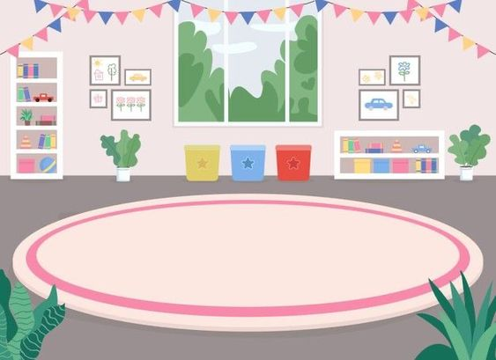





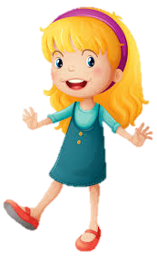

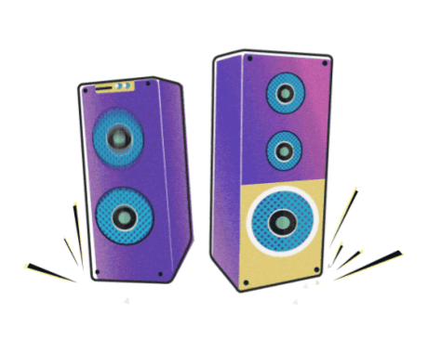

1
2
PASS THE TEDDY BEAR
3
5
4
Notes:
- GV click vào biểu tượng loa để phát nhạc . HS vừa nghe nhạc và chuyền gấu đến khi GV bấm dừng ở đoạn nhạc bất kỳ HS sẽ đọc lại câu tương ứng với các nhân vật.
- Click vào hình các nhân vật để chuyền chú gấu bông và đi đến các câu hỏi tương ứng.

Slide 33
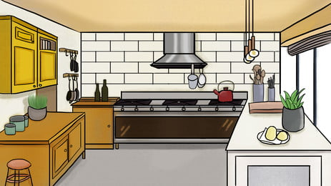
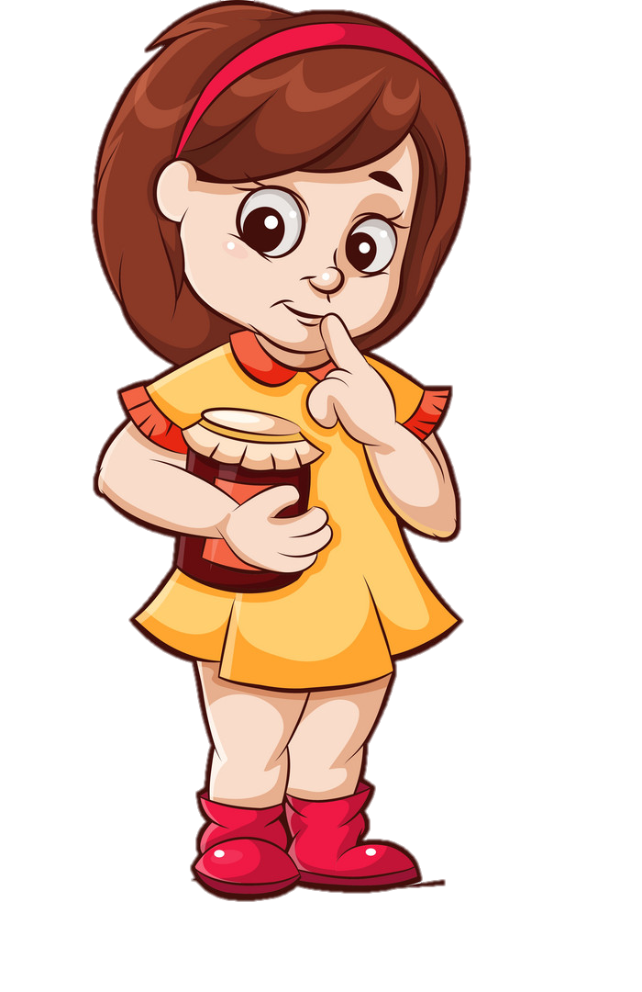
I like jam.

Slide 34

I like juice.

Slide 35
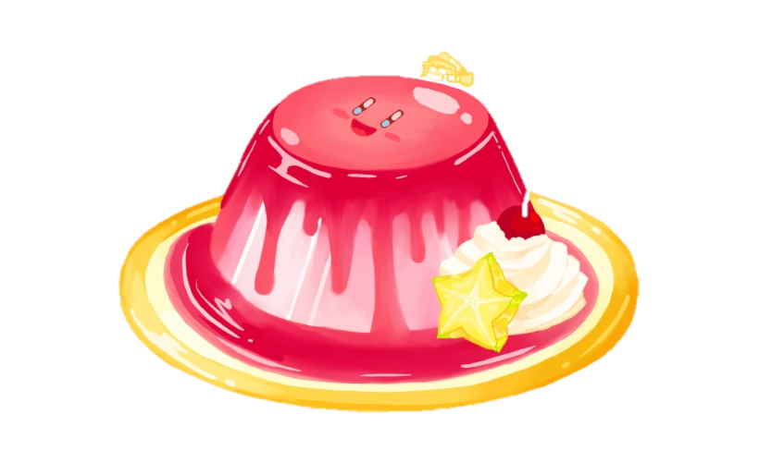

I like jelly.

Slide 36
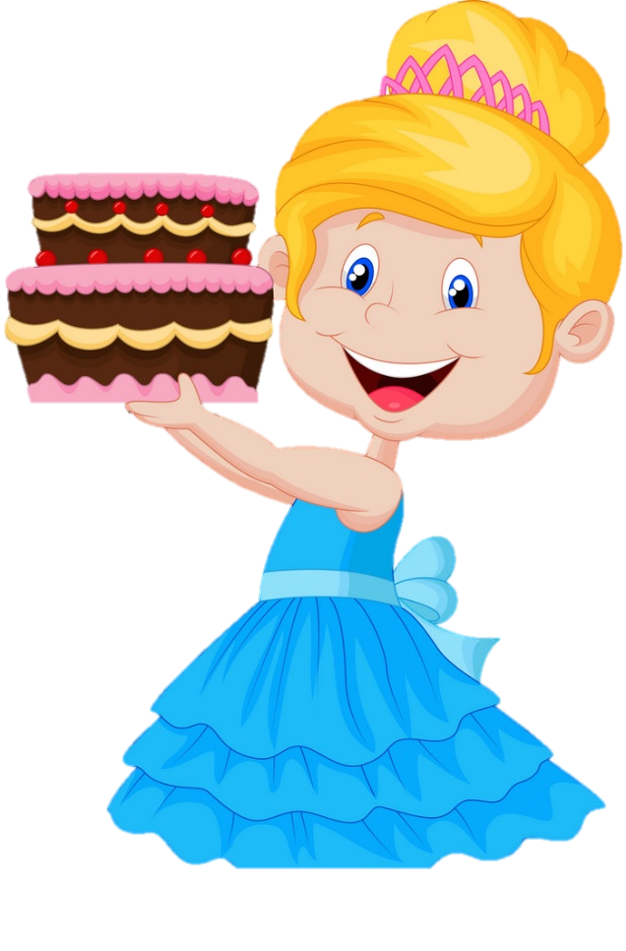
I like cake.

Slide 37

I like milk.

Slide 39

Time to say goodbye!
j

Slide 40
Website: hoclieu.vn
Fanpage: https://www.facebook.com/tienganhglobalsuccess.vn/

