Slide 1
Unit 11: My home
Lesson 1 - period 2

Slide 2
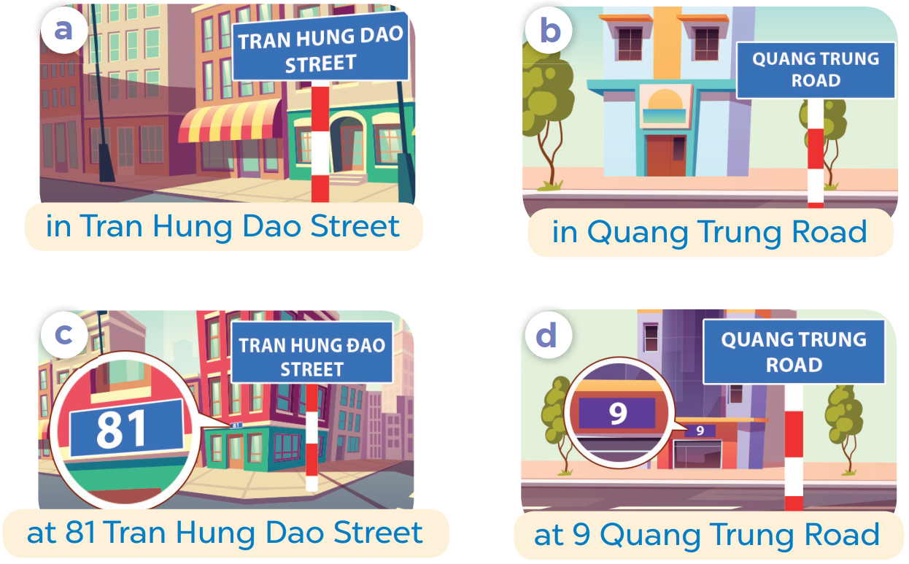
SLAP THE BOARD

Slide 3
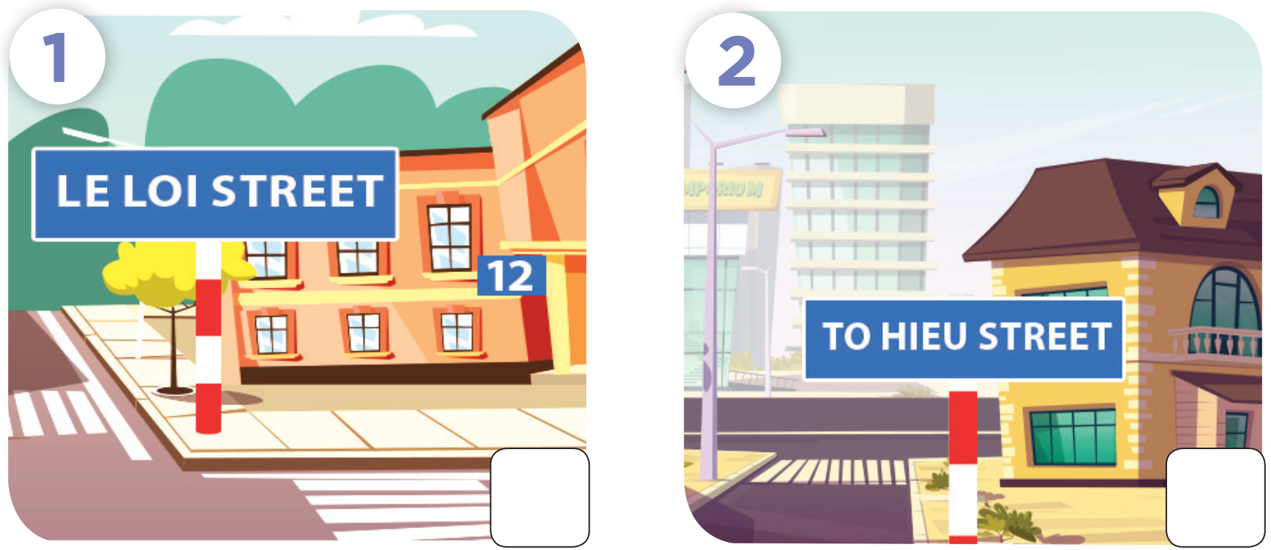

Slide 4
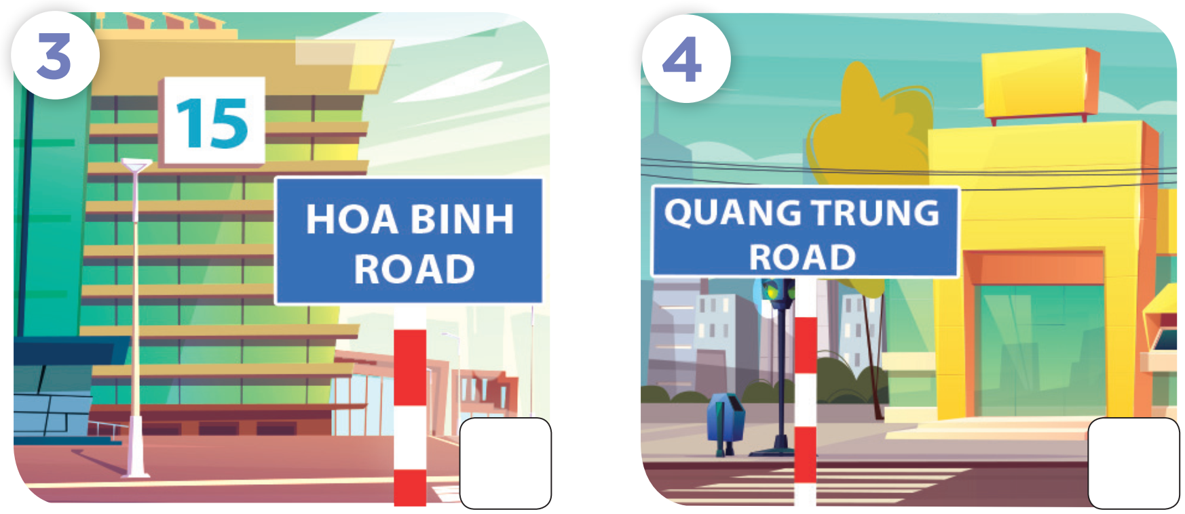

Slide 5
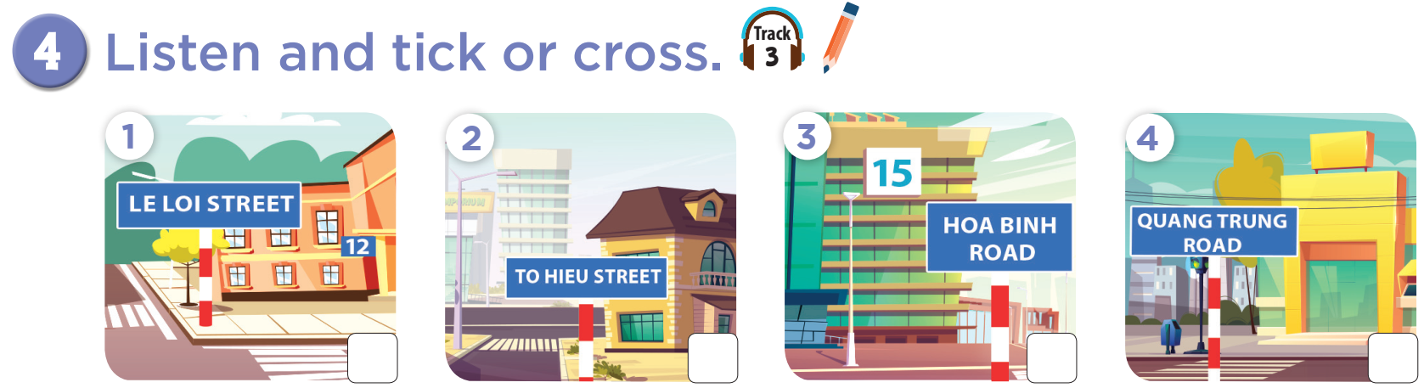




Slide 6

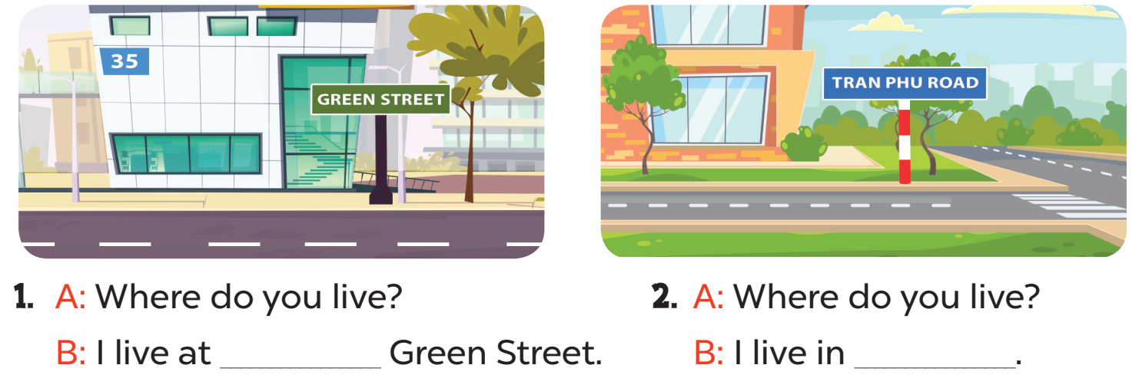
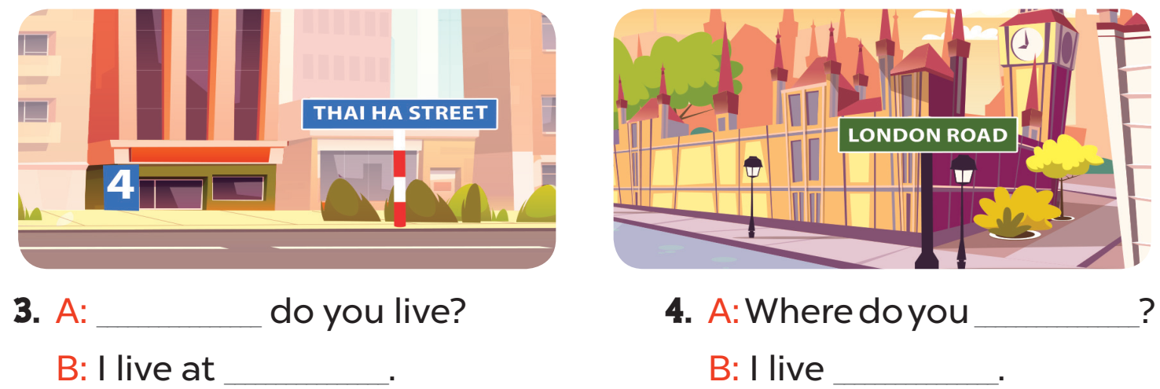

Slide 7
35
Tran Phu Road
Where
live
4 Thai Ha Street
at London Road

Slide 8
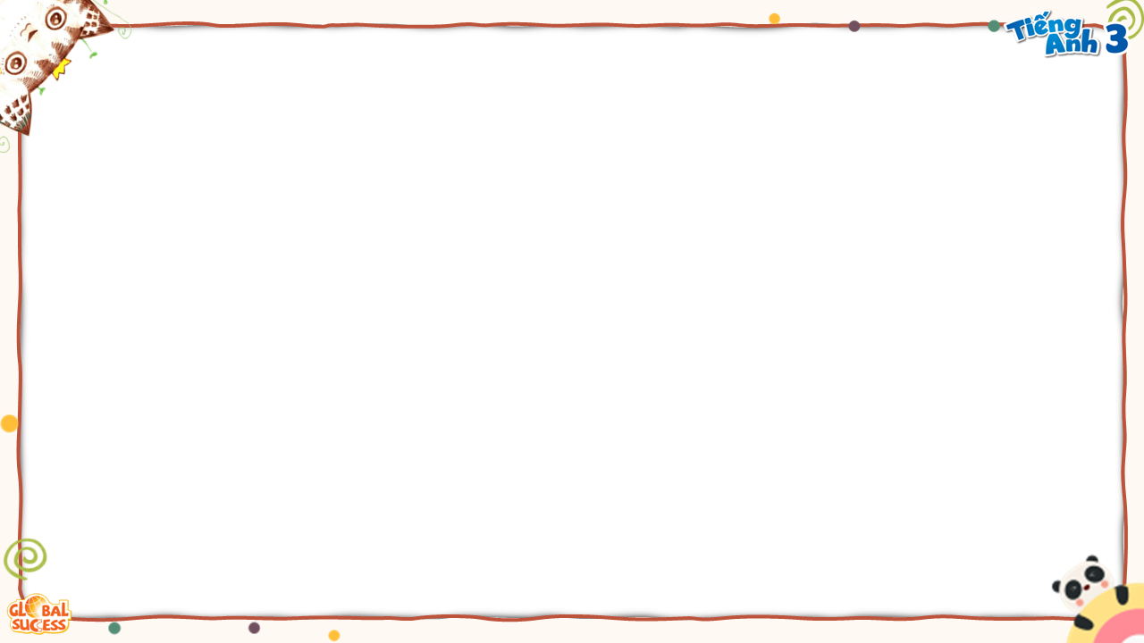



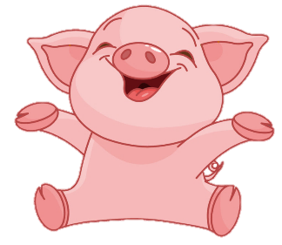
BOMBSTAR
PLAY

Slide 9












-1
-1

Slide 10
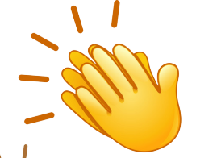
+1
Back

Slide 11



- ____________________?
- I live in Van Phuc Village.
Where do you live?
Where’s do you live?
Where you live?

Slide 12
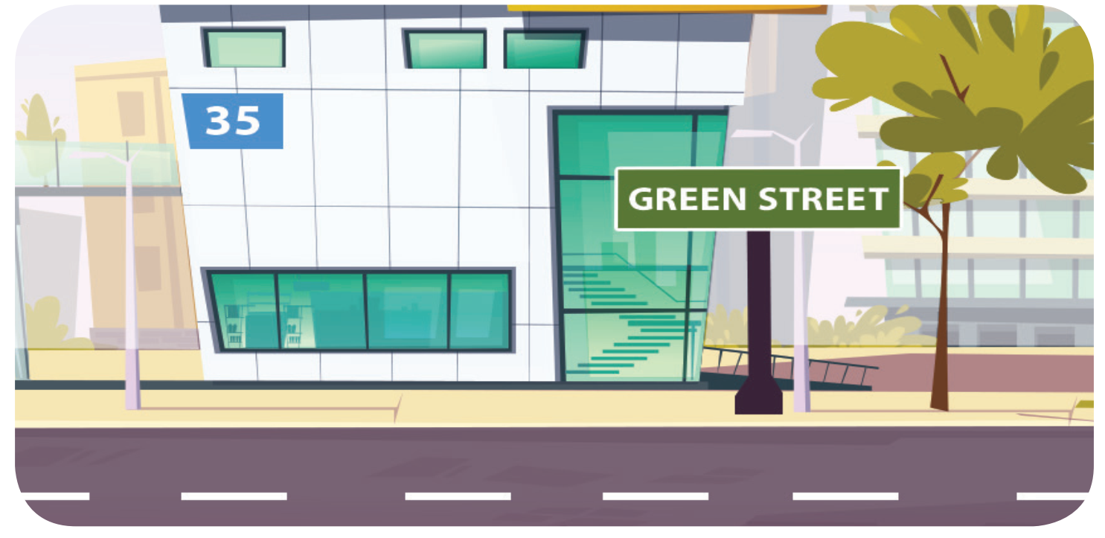
Where do you live?
_____________
I live 35 Green Street.
I live at 35 Green Street.
I live in 35 Green Street.

Slide 13
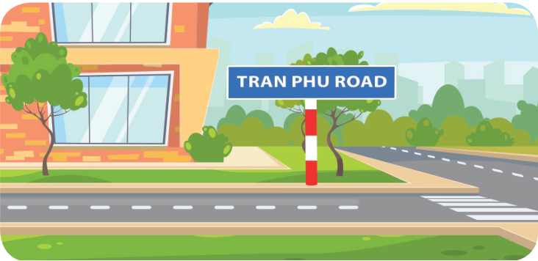
Where do you live?
She lives in Tran Phu Road.
I live in Tran Phu Street.
I live in Tran Phu Road.

Slide 14
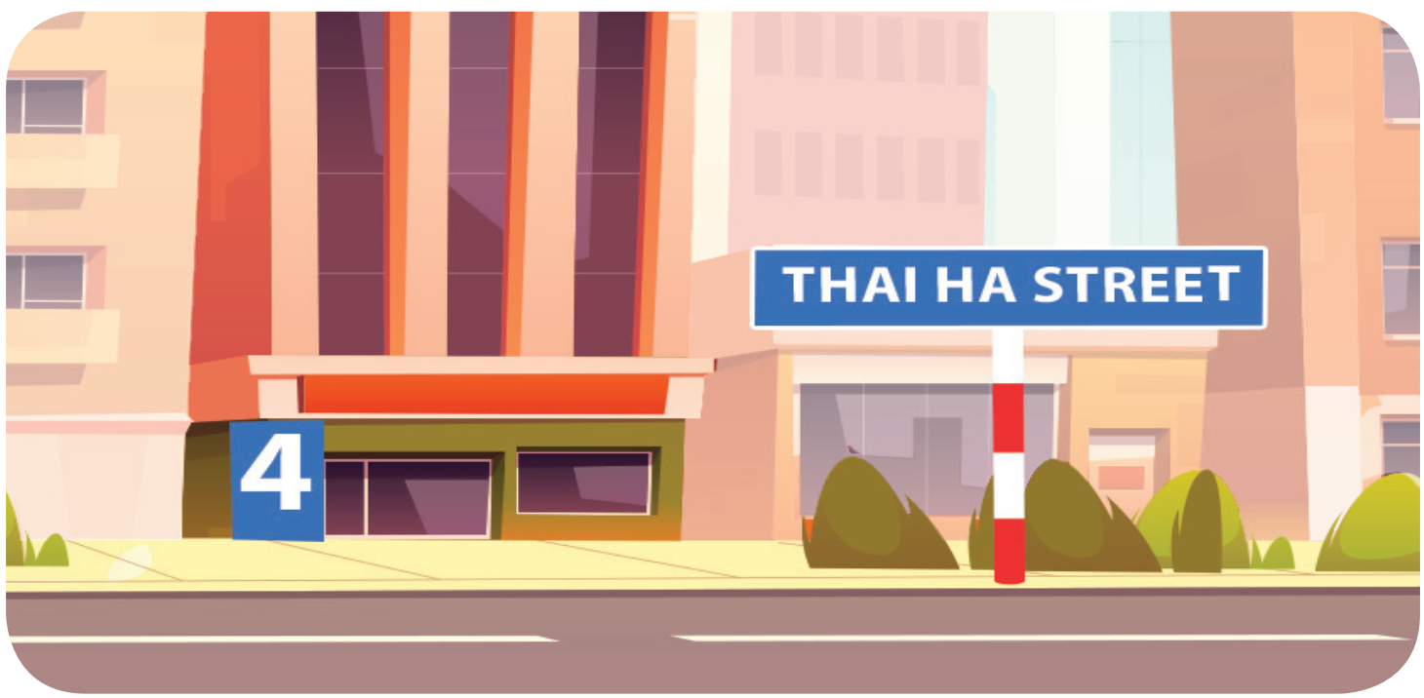
Where do you live?
I live at 4 Thai Ha Street.
I live in Thai Thinh Street.
I live at Thai Ha Street.

Slide 15
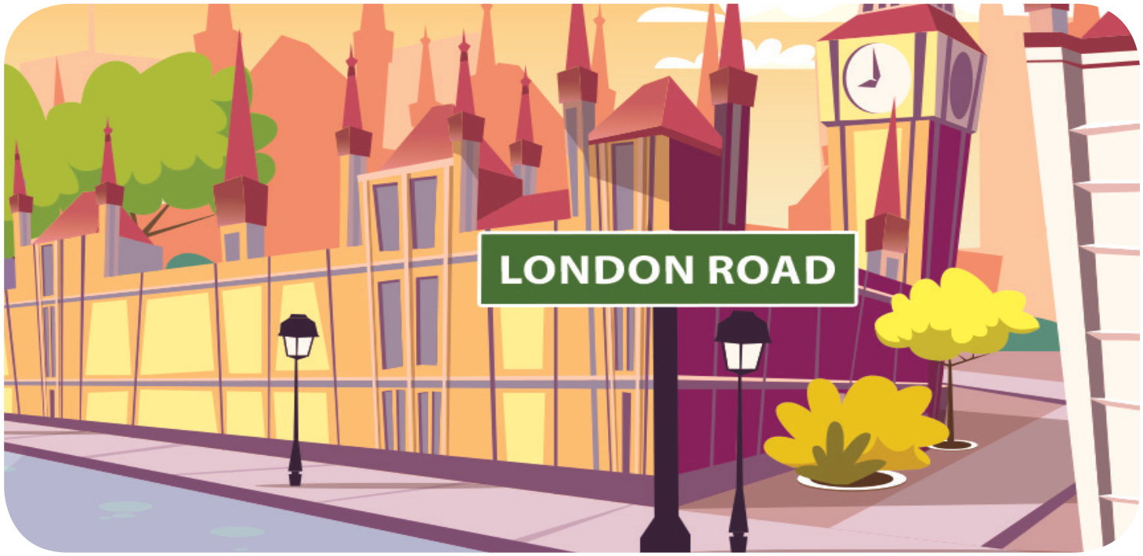
Where do you live?
I live London Road.
I live in London Road.
I live at London Road.

Slide 16
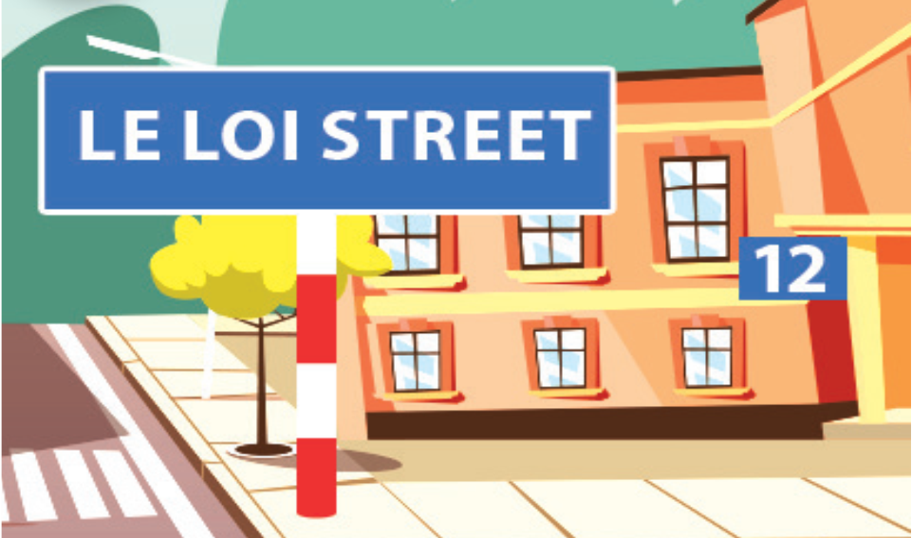
Where does he live?
He lives on Le Loi Street.
He lives in Le Loi Road.
He lives at 12 Le Loi Street.

Slide 17
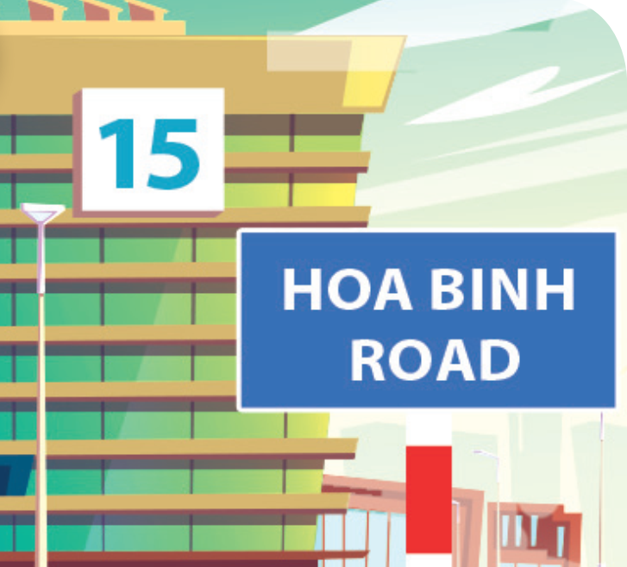
Where does she live?
She lives in 15 Hoa Binh Road.
She lives at 15 Hoa Binh Road.
She lives at 15 Hoa Binh Street.

