Slide 1
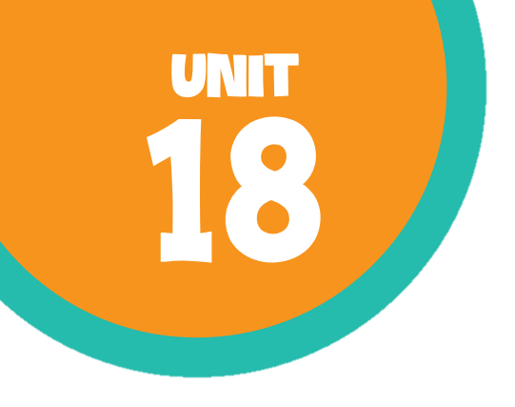
At the shopping centre Lesson 1 - Period 1

Slide 2
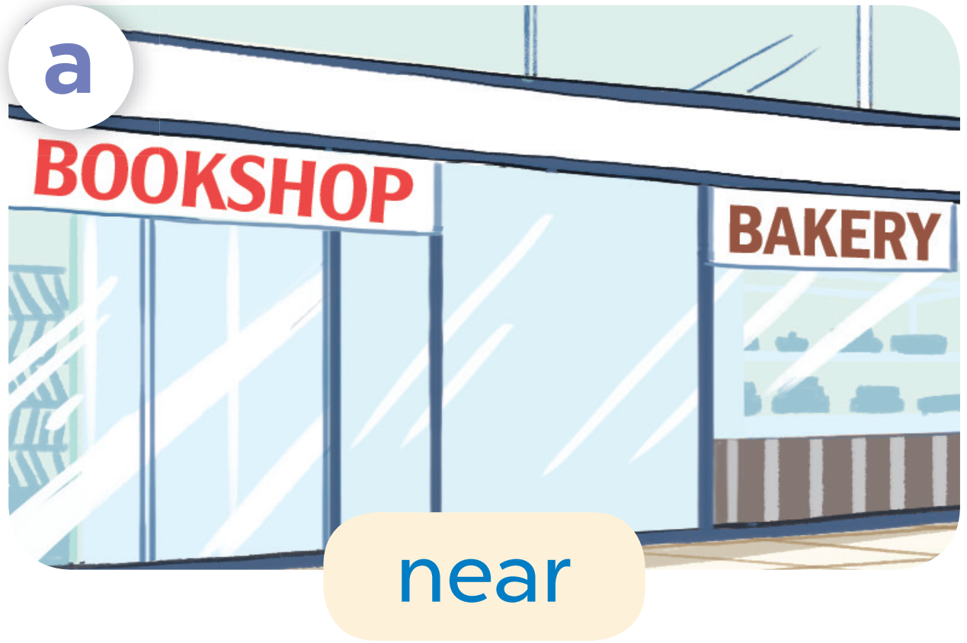
near

Slide 3
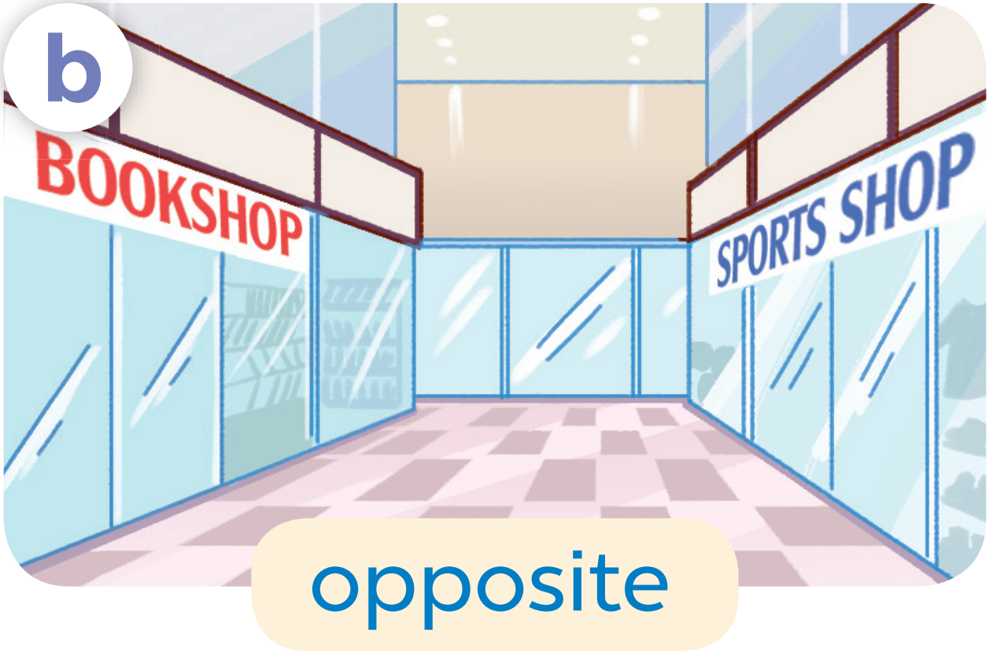
opposite

Slide 4
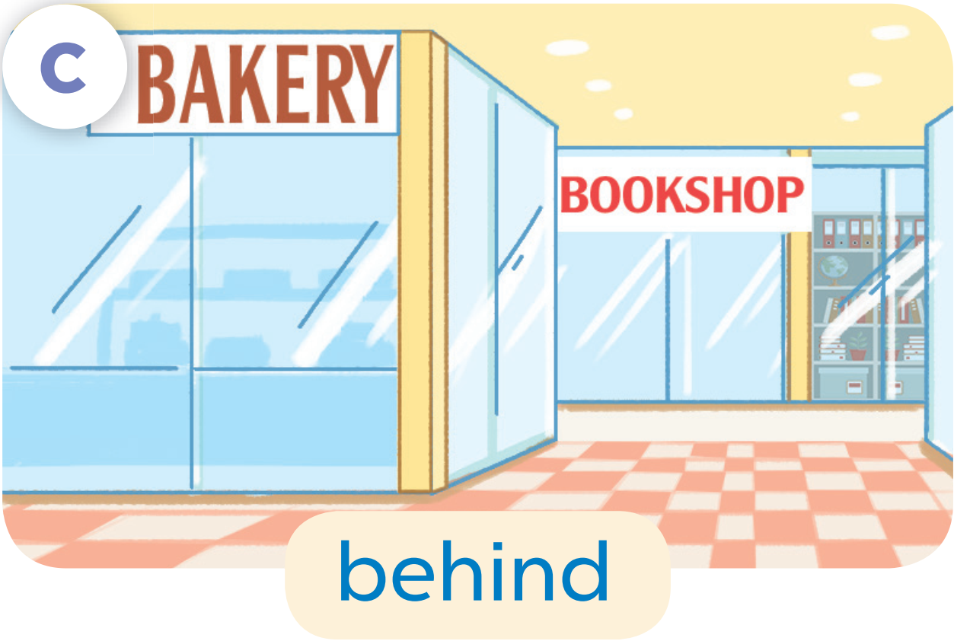
behind

Slide 5
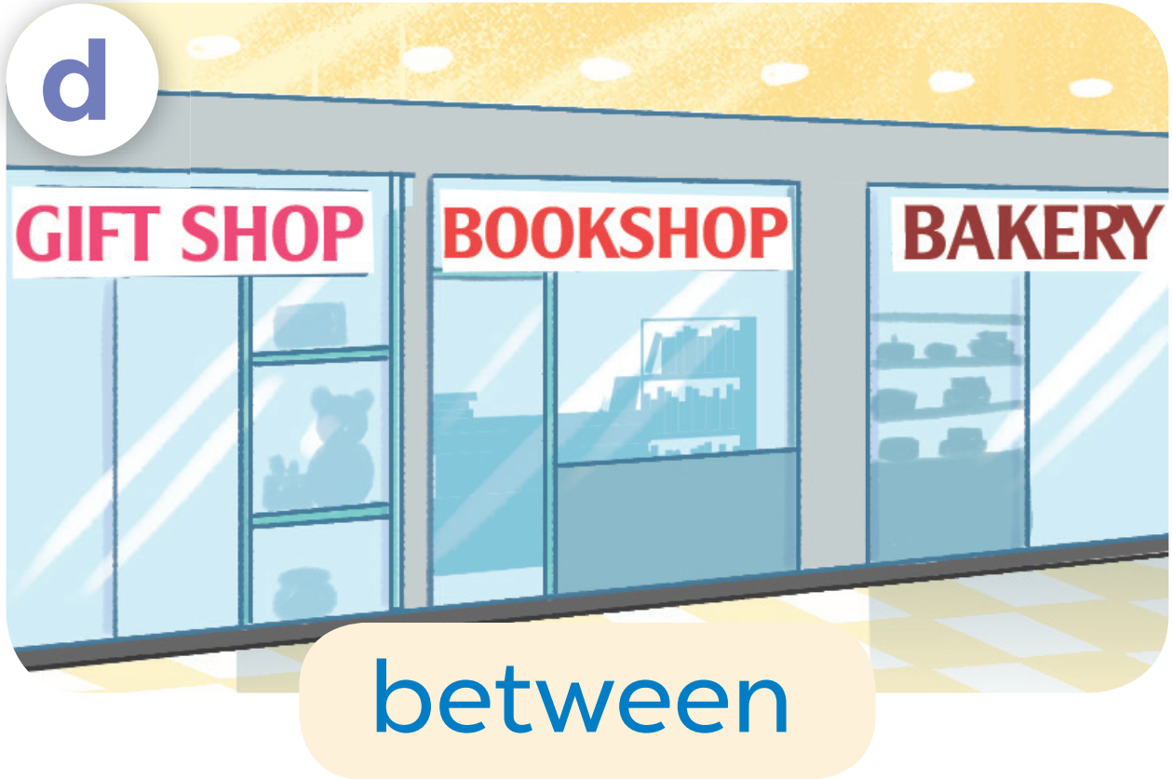
between

Slide 6
Let’s practise!

Slide 7
05
Fun corner

Slide 8



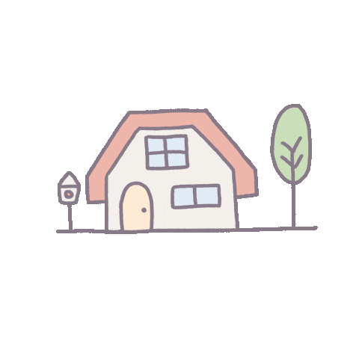
= 10 points
= - 20 points
= 50 points

Slide 9









TEAM 1
TEAM 2
TEAM 3

Slide 10
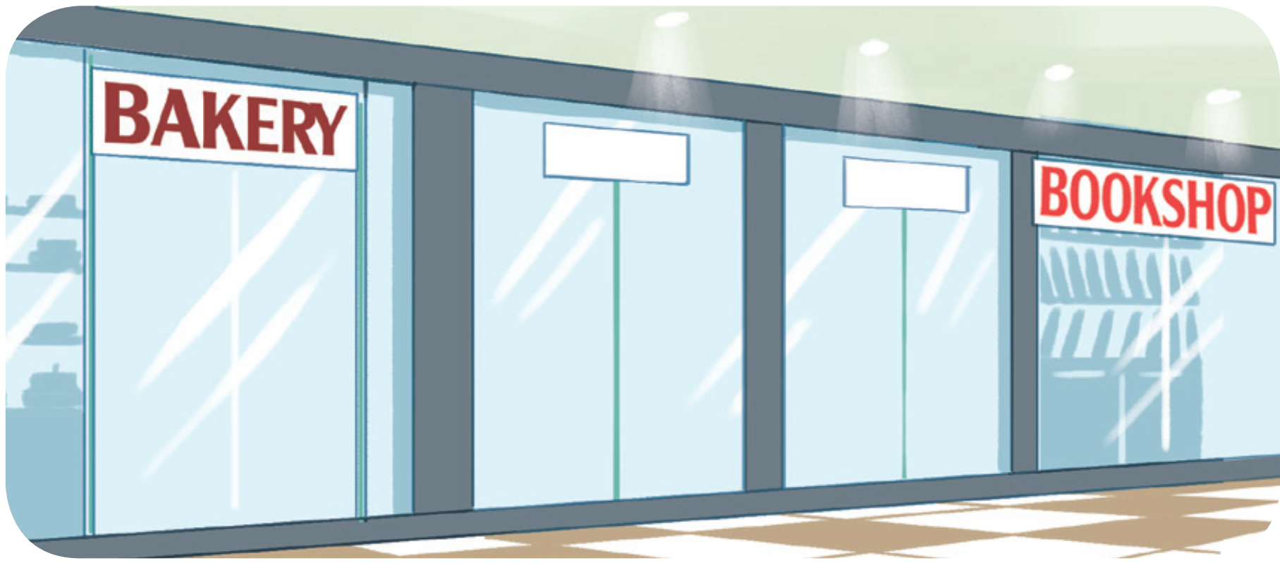
Where’s the bookshop?
It’s near the bakery.

Slide 11
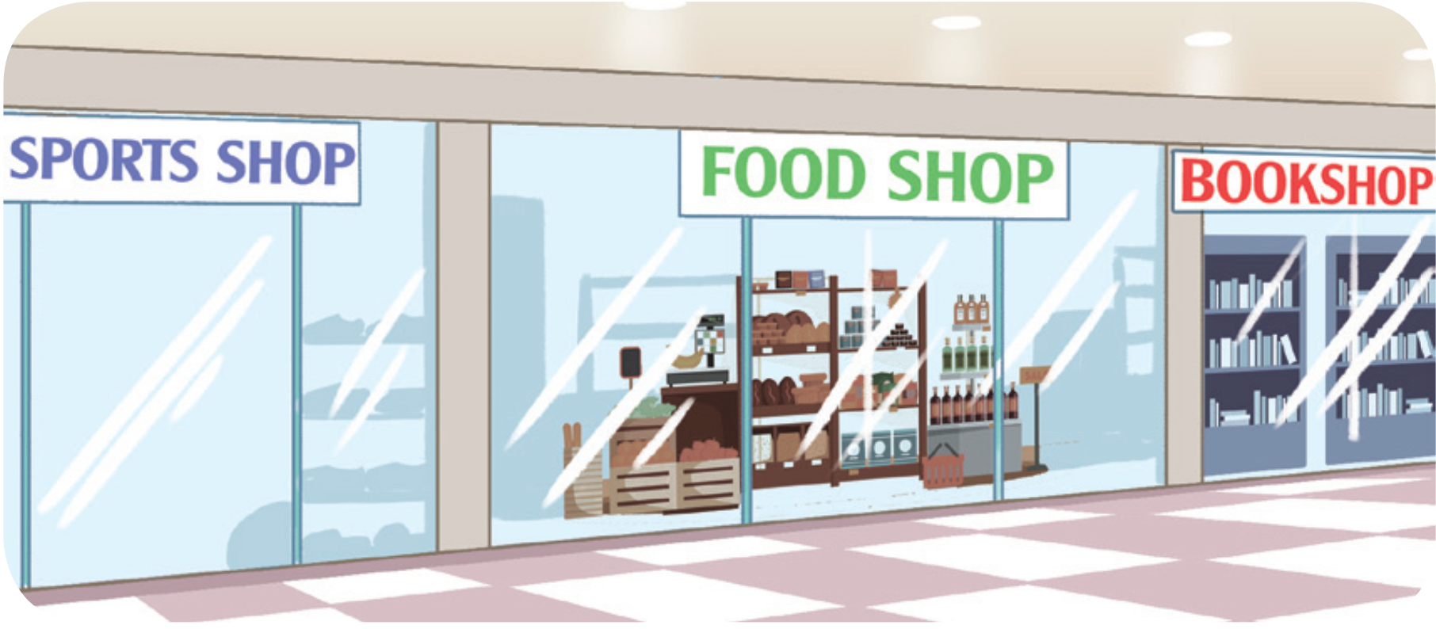
Where’s the food shop?
It’s between the sports shop and the bookshop.

Slide 12
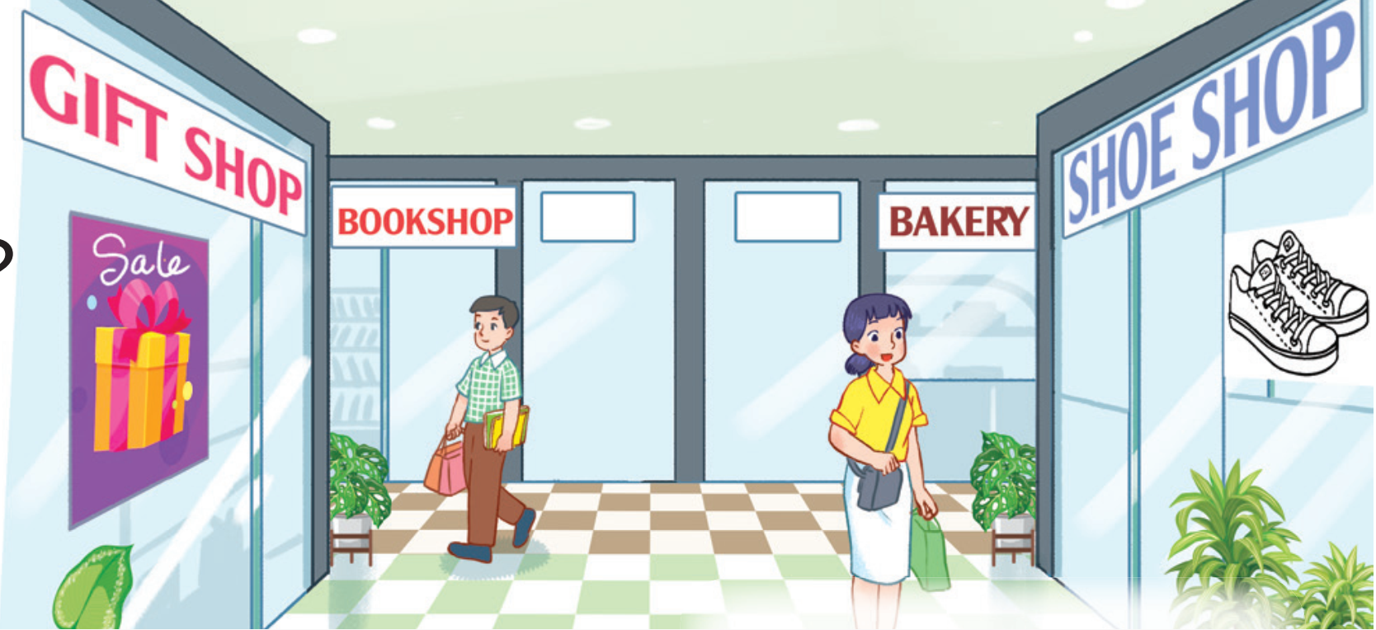
Where’s the shoe shop?
It’s opposite the gift shop.

Slide 13
Where’s the bakery?
It’s near the bookshop.

Slide 14
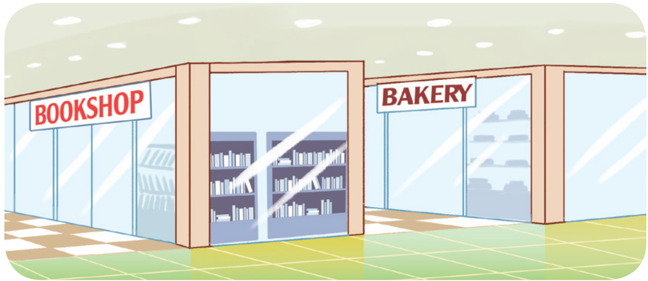
Where’s the bakery?
It’s behind the bookshop.

Slide 15
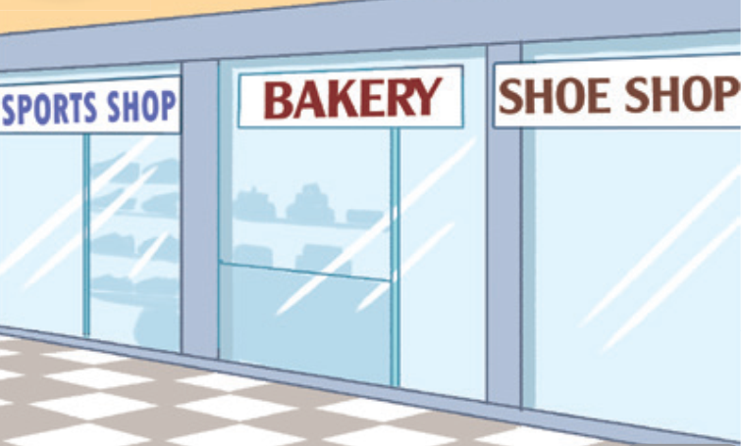
Where’s the bakery?
It’s between the sports shop and the shoe shop.

Slide 16
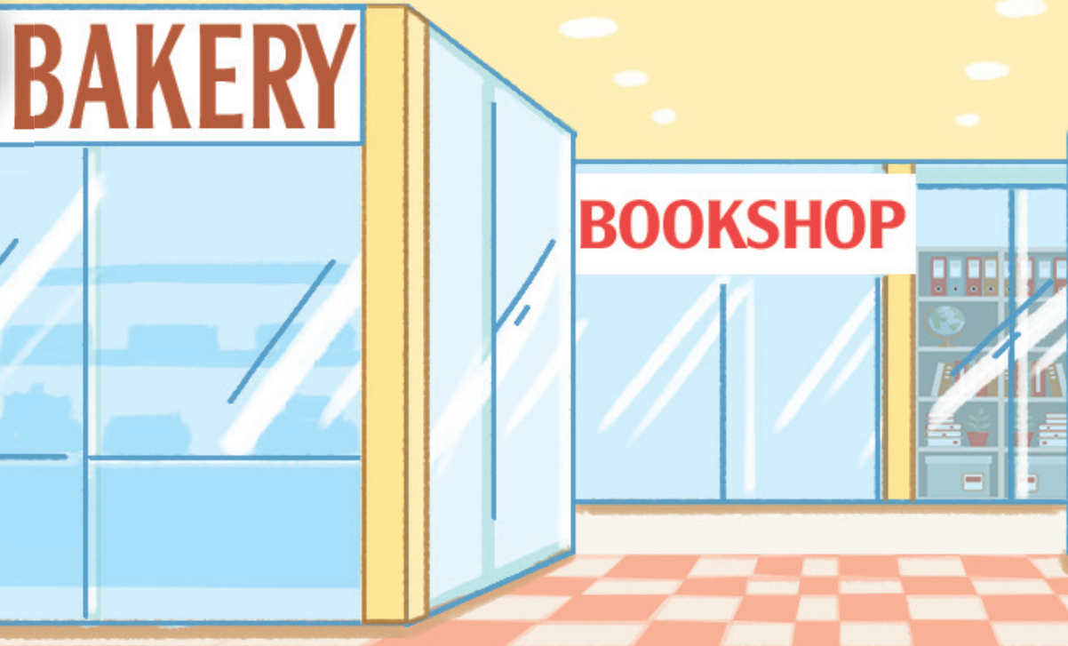
Where’s the bookshop?
It’s behind the bakery.

Slide 17
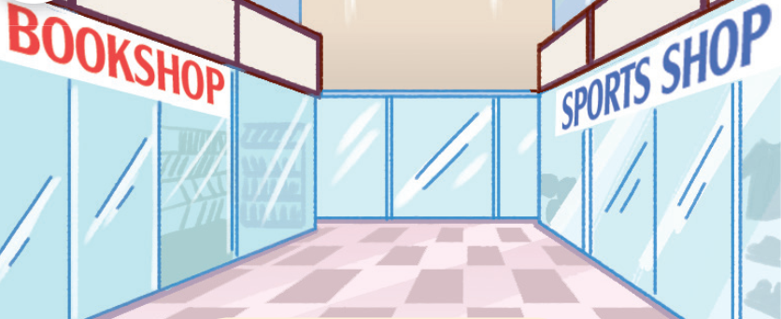
Where’s the sports shop?
It’s opposite the bookshop.

Slide 18
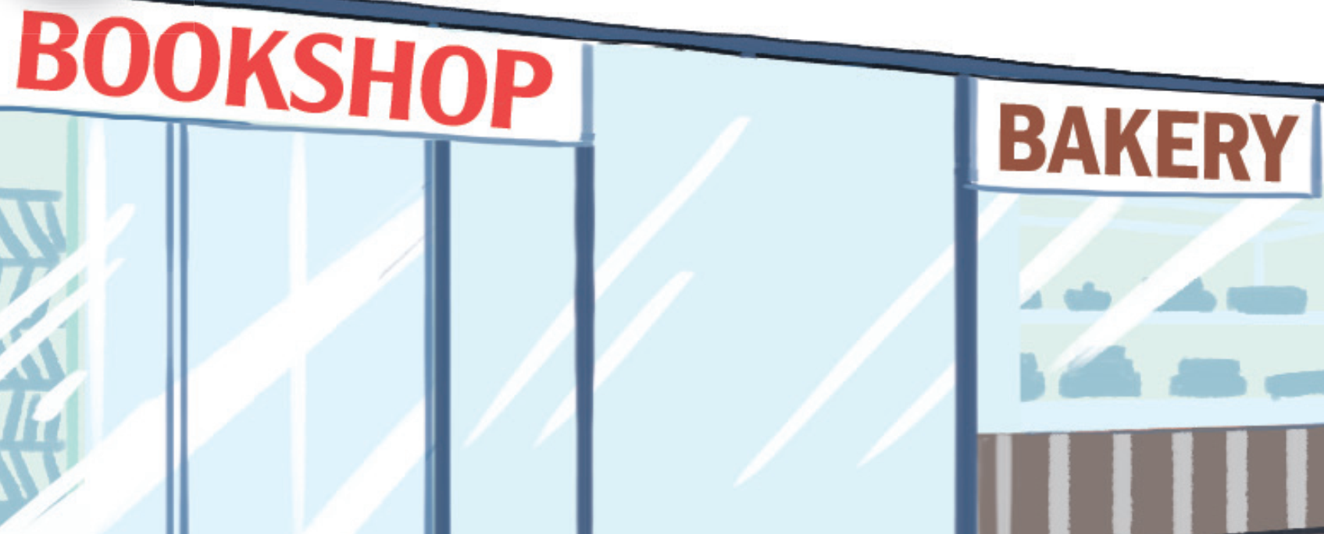
Where’s the bookshop?
It’s near the bakery.

