Slide 2

Unit 6 – Lesson 1 In the classroom
Notes:
By the end of the unit, pupils will be able to:
- pronounce the sound of the letter E/e in isolation and in the words bell, pen, pencil, red.
- say the sound of the letter E/e and the words pen, pencil, red in a chant.
- recognize the words in different situations when listening.
- use It’s a red _____. to introduce things.
- trace the letter E/e.
- sing a song focusing on the structures I have _____, He has _____ and It’s a red _____.
Lesson 1
Goals: By the end of the lesson, pupils will be able to:
pronounce the sound of the letter E/e in isolation and in the words bell, pen, pencil, red.
point to the letter E/e, the things and the colour (pencil, pen, bell, red) in the picture and say the sound of the letter E/e and the words bell, pen, pencil, red.

Slide 3

Warm-up
Notes:
Goals:
- Help pupils feel happy at the beginning of the lesson.
- Review vocabulary of previous lesson
Time limit: 5 mins
Teacher shows on slide a picture disappearing quickly in a few seconds.
Pupils look and guess the word.

Slide 4
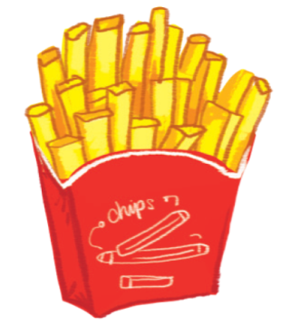
chips

Slide 5
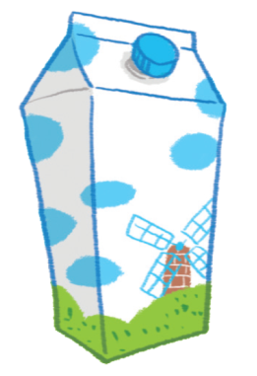
milk

Slide 6
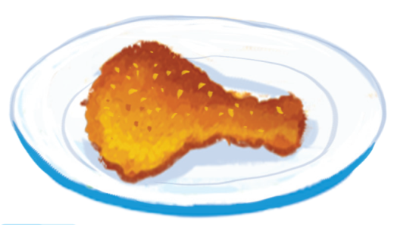
chicken

Slide 7
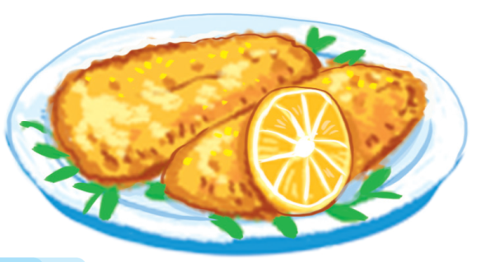
fish

Slide 8



Notes:
Goal:
- Pupils will be able to pronounce the sound of the letter E/e in isolation and in the words bell, pen, pencil, red.
Step 1: Lead-in
Time limit: 3 mins
Goal: pupils are able to identify and pronounce sound /e/.
- Teacher shows letter “e” on slide and asks pupils What letter is this? and What sound does this make?
- Teacher pronounces sound /e/. Pupils listen and repeat. (as a class/ teams)
- Teacher says: Today we are going to learn 4 words that have the sound /e/.

Slide 9

e

Slide 10
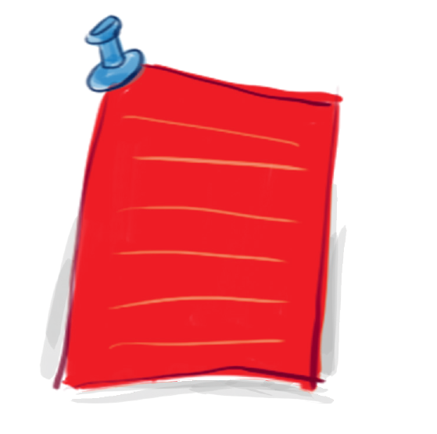
red
Notes:
Step 2: Listen and repeat vocabulary
Time limit: 5 mins
Goal: pupils are able to identify and pronounce 4 words: pen, pencil, desk, bell
- Teacher shows pictures on slide and says the words. (Teacher may pronounce each sound of the word separately, for example p – e – n).
- Pupils listen to Teacher and repeat.

Slide 11
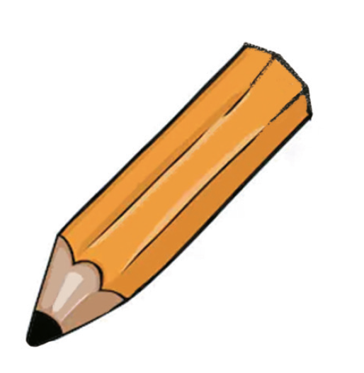
pencil

Slide 12
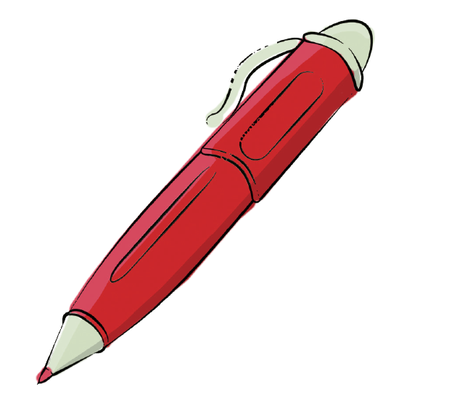
pen

Slide 13
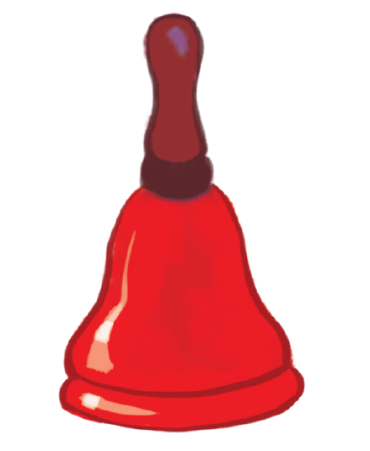
bell
Notes:
Step 3: Quick check
Time limit: 4 mins
- Teacher checks pronunciation (as teams).
- Teacher sticks flashcards and word cards on the board randomly. Teacher has pupils go to the board and put word cards under the matching flashcards.
- Teacher checks pronunciation individually. Teacher points to a picture and has a student say the word.

Slide 14



Notes:
Goal:
- Pupils will be able to point to the letter E/e, the things and the colour (pencil, pen, bell, red) in the picture and say the sound of the letter E/e and the words bell, pen, pencil, red.
Step 1: Listen, point and repeat
Goal: Pupils are able to point to the correct picture and pronounce the words.
Time limit: 3 mins
Teacher plays the audio.
1st time: pupils listen and point only.
2nd time: pupils listen, point and repeat.
Pupils repeat the words as a class and teams.
Step 2: Listen, point and repeat (in pairs)
Time limit: 3 mins
Pupils work in pairs: 1 pupil points, 1 pupil says the words.
Teacher goes around the class and gives feedback on pupils’ pronunciation.

Slide 15

Slap the board
Notes:
Step 3: Quick check
Time limit: 5 mins
Game: Slap the board
Teacher sticks flashcards and word cards on the board.
Teacher draws a circle under each picture.
Teacher says a word, pupils slap the corresponding circle.
Teacher may have pupils say the words.

Slide 16
Game
Notes:
Game: Find the treasure
Time limit: 6 mins
Teacher shows game slides and instructions.
Pupils pick a picture and read the word. If correct, pupils can open the picture. If there’s no treasure under, pupils get 1 star. If there’s a treasure, pupils get 5 stars.

Slide 17





Slide 18
Goodbye
Notes:
Teacher shows the vocabulary of the lesson on slide.
Pupils say goodbye.

Slide 19
Goodbye

Slide 20
Goodbye

Slide 21

Goodbye

Slide 22
Website: hoclieu.vn
Fanpage: facebook.com/www.tienganhglobalsuccess.vn

