Slide 1

In the city
Lesson 1 - Period 1

Slide 2

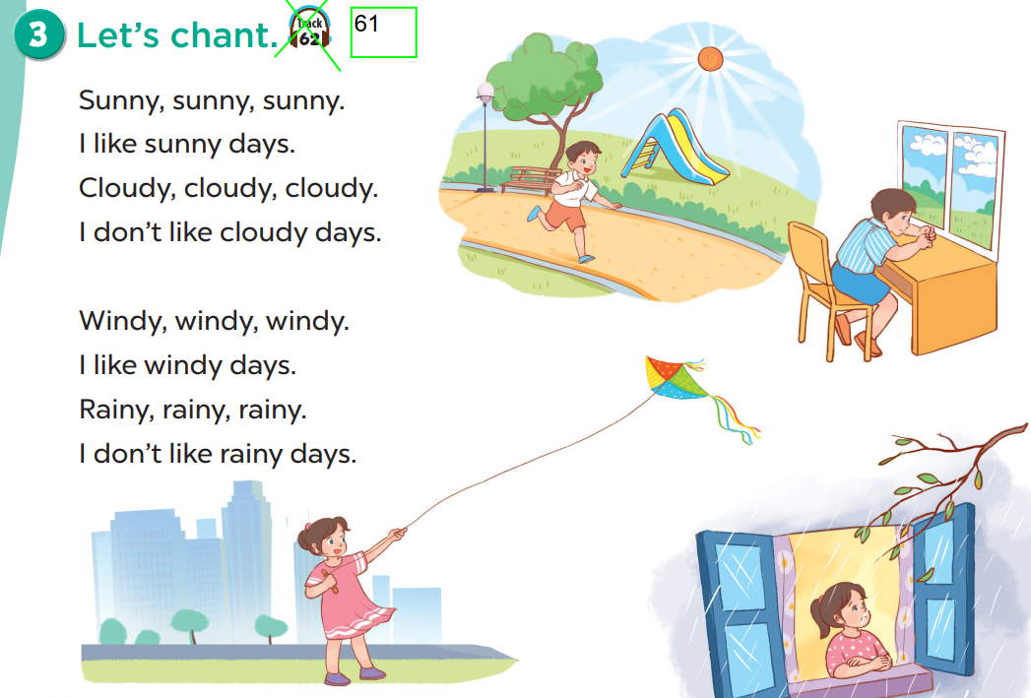
Let’s chant!

Slide 3
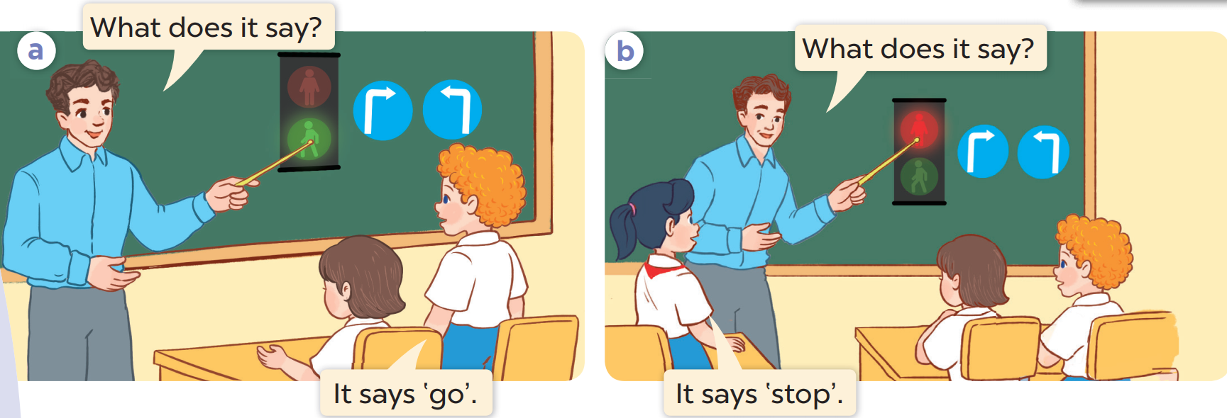
What is this?
Who are they?

Slide 4
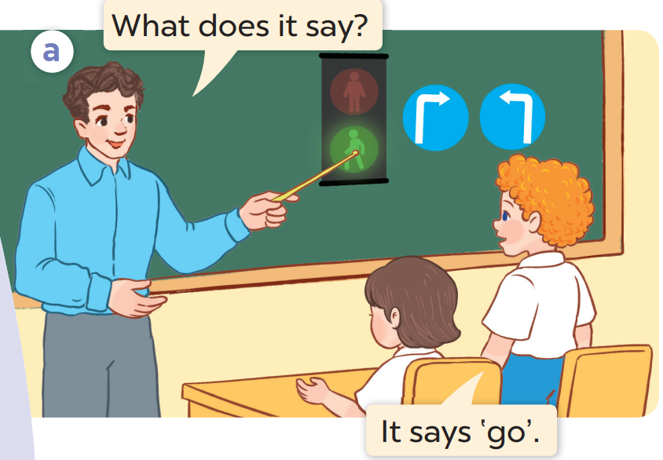
Listen and repeat.

Slide 5
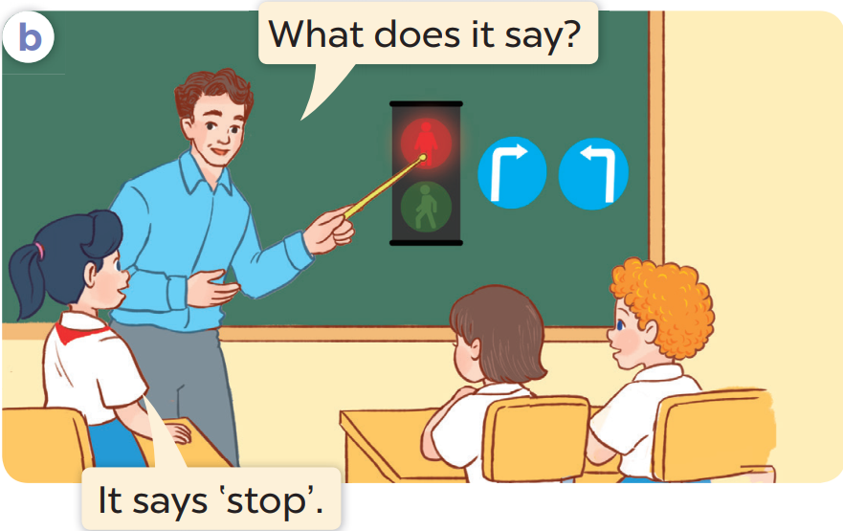
Listen and repeat.

Slide 6
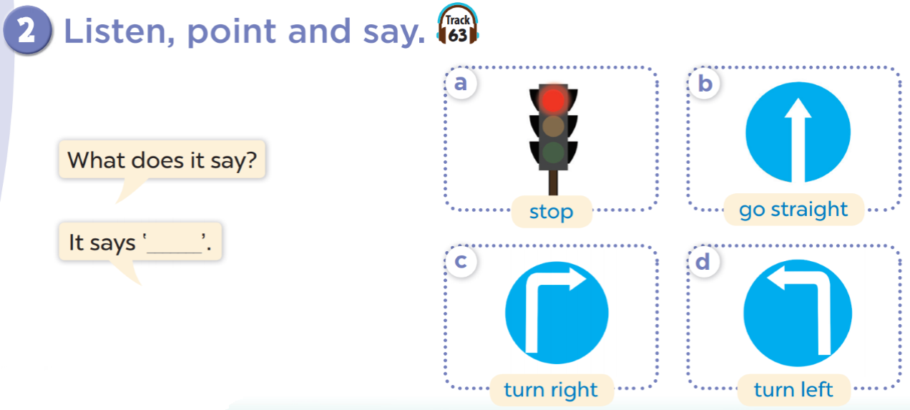
Work in pairs. Practise.
Listen, point and say.

Slide 7

go

Slide 8

stop

Slide 9

go straight

Slide 10

turn left

Slide 11

turn right

Slide 12
Look and guess!

Slide 13
go straight

Slide 14
stop

Slide 15
turn right

Slide 16
go

Slide 17
turn left

Slide 18


What does it say?
stop
It says ‘____________’.

Slide 19
What does it say?
go straight
It says ‘____________’.

Slide 20
Let’s talk!
04
Activity 3

Slide 21
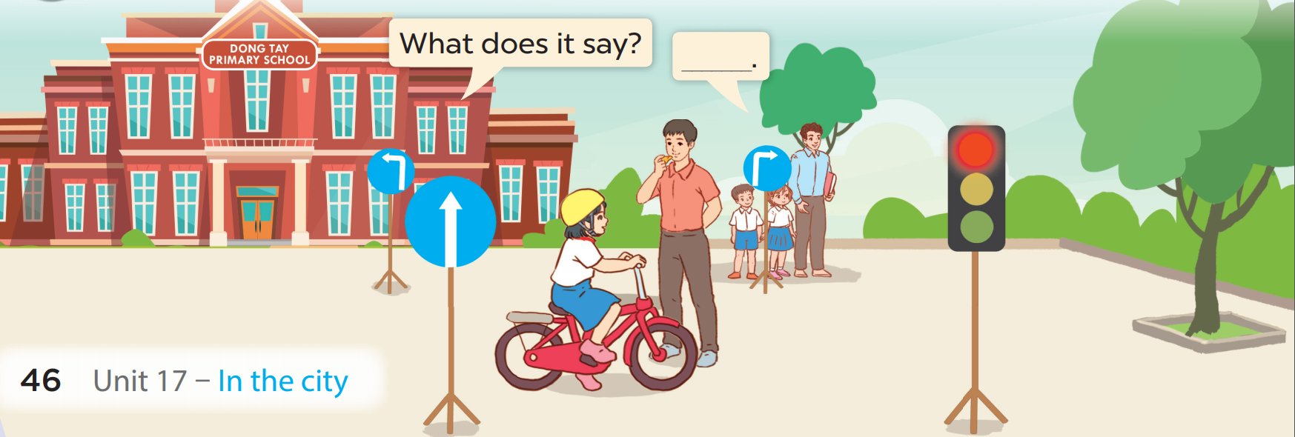


Slide 22
Fun corner
05
Lucky number

Slide 23
LUCKY NUMBER
1
2
3
4
5
6

Slide 24

What does it say?
Next
go
It says ‘____________’.

Slide 25
What does it say?
Next
turn left
It says ‘____________’.

Slide 26
What does it say?
Next
stop
It says ‘____________’.

Slide 27

Next
+ 5 points

Slide 28
What does it say?
Next
turn right
It says ‘____________’.

Slide 29
What does it say?
Next
go straight
It says ‘____________’.

