Slide 1




LE KHAC CAN PRIMARY & SECONDARY SCHOOL
ENGLISH 9
Welcome all Teachers to our class 9B
TEACHER : NGUYEN THI HIEN
Notes:
1

Slide 2
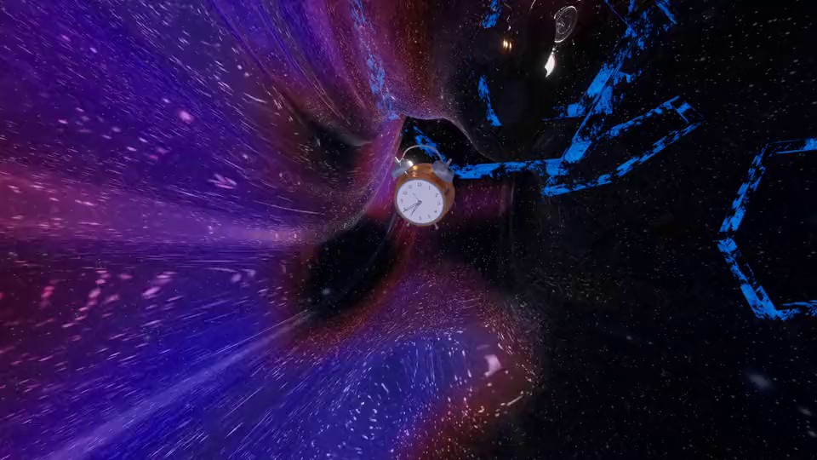


Unit
4
LESSON 1: GETTING STARTED
AT AN ENGLISH LESSON

Slide 3

VOCABULARY
complex (n)
involving a lot of different but related parts
/ˈkɒmpleks/
khu phức hợp, quần thể

Slide 4
VOCABULARY
relating to, or involved with religion, or living and worshiping according to the beliefs of a particular religion.
religious (adj)
/rɪˈlɪdʒəs/
Ex: He's deeply religious and goes to church twice a week.
thuộc tôn giáo

Slide 5
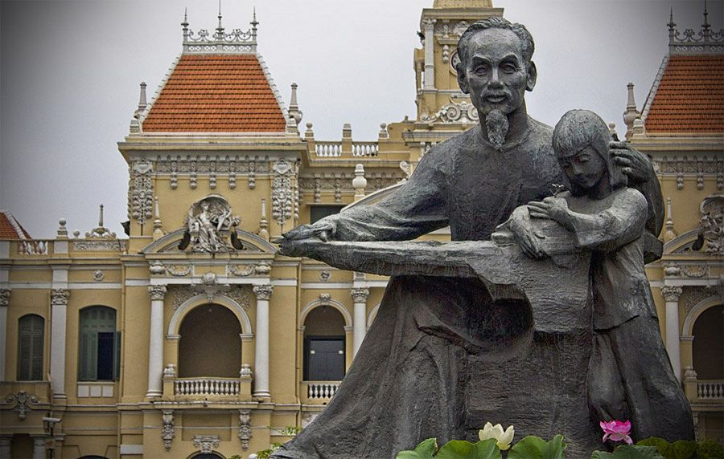
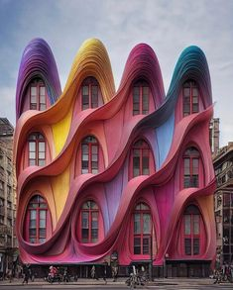
VOCABULARY
a structure or building that is built to honour a special person or event.
monument (n)
/ˈmɒnjumənt/
tượng đài

Slide 6
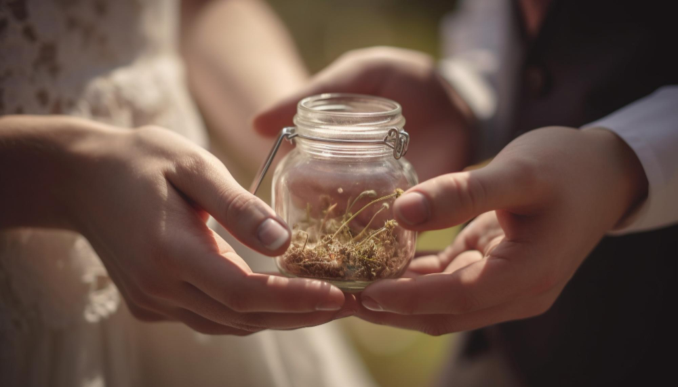
VOCABULARY
very good, beautiful, or deserving to be admired.
magnificent (adj)
/mæɡˈnɪf.ɪ.sənt/
tráng lệ

Slide 7
to keep something as it is.
preseve (v)
/prɪˈzɜːv/
bảo tồn

Slide 8
VOCABULARY
features belonging to the culture of a particular society, such as traditions, languages, or buildings, that were created in the past and still have historical importance.
heritage (n)
/ˈher.ɪ.tɪdʒ/
Ex: The historic building is as much part of our heritage as the paintings.
di sản

Slide 9
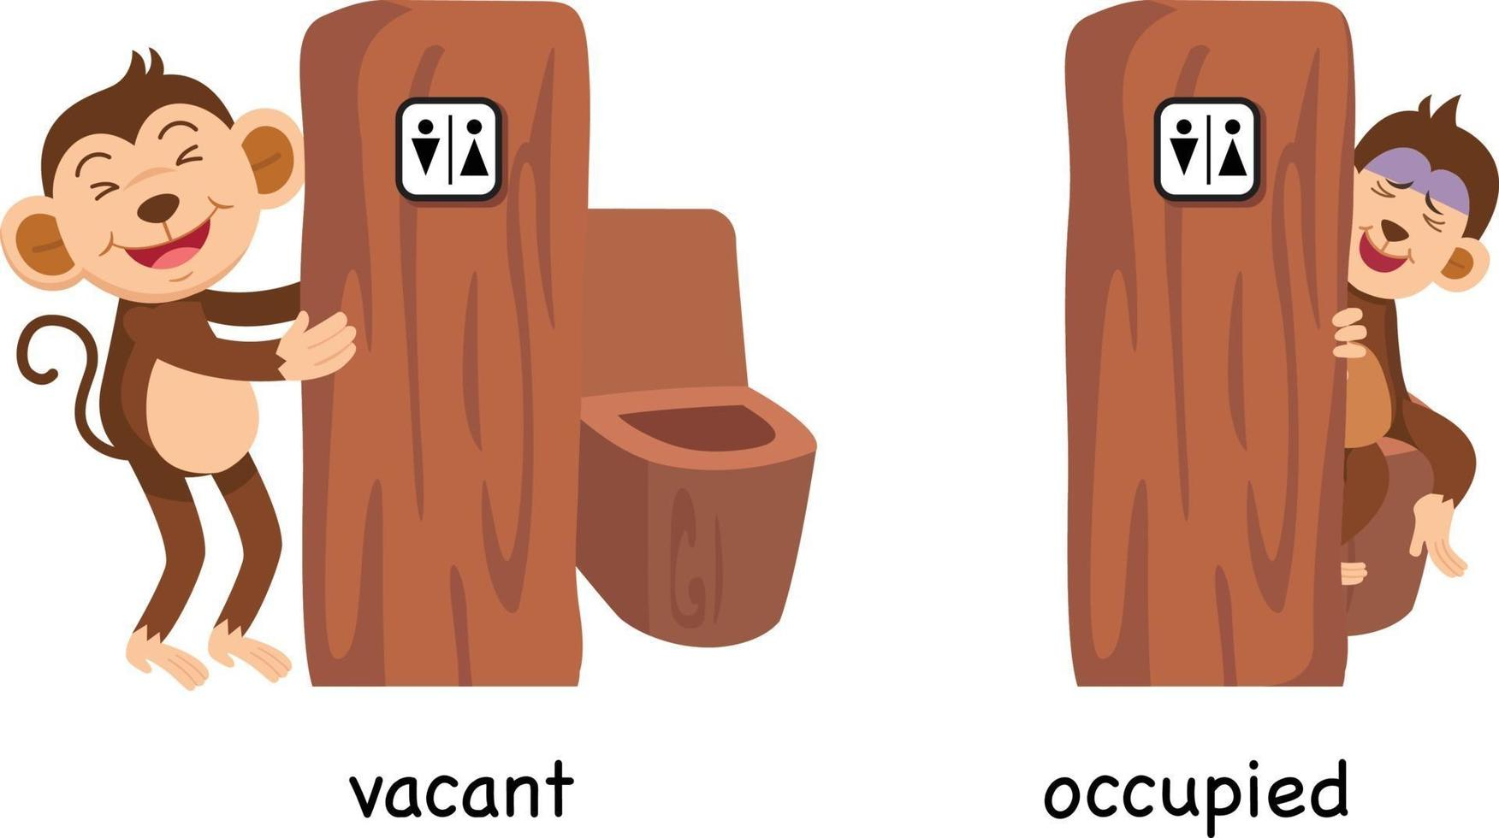
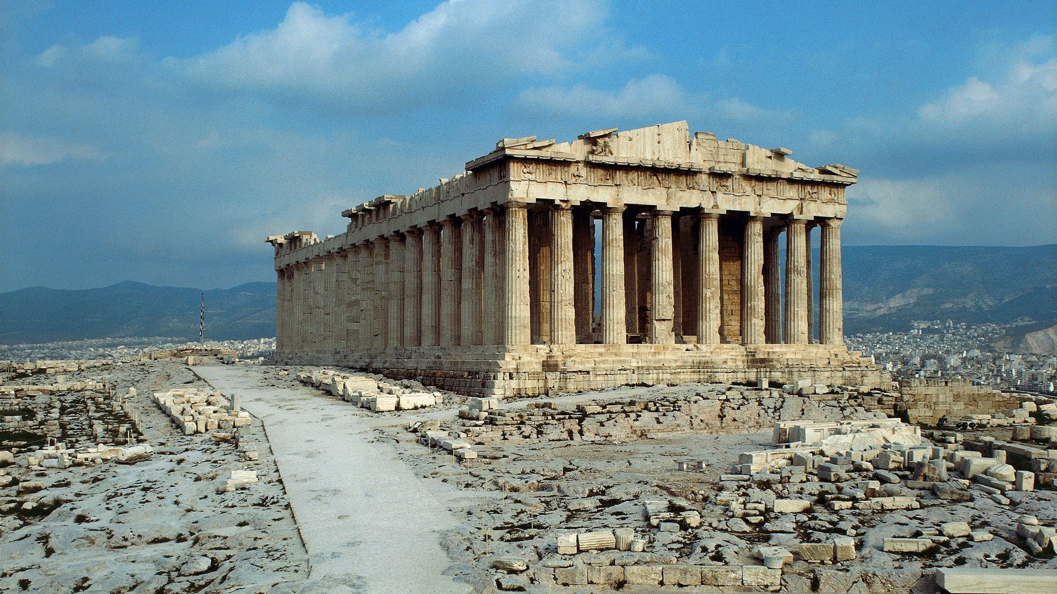
PRESENTATION
being used by someone or with someone in it.
occupied (adj)
/ˈɒkjupaɪd/
có người ở

Slide 10
VOCABULARY
New words | Pronunciation | Meaning
1. complex (n) | /ˈkɒmpleks/ | khu phức hợp, quần thể
2. religious (adj) | /rɪˈlɪdʒəs/ | (thuộc) tôn giáo
3. monument (n) | /ˈmɒnjumənt/ | tượng đài
4. magnificent (adj) | /mæɡˈnɪf.ɪ.sənt/ | tráng lệ
5. preserve (v) | /prɪˈzɜːv/ | bảo tồn
6. heritage (n) | /ˈher.ɪ.tɪdʒ/ | di sản
7. occupied (adj) | /ˈɒkjupaɪd/ | có người ở

Slide 11
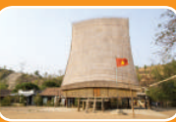
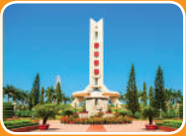


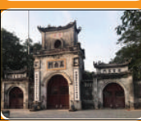
PRACTICE
4
Look at the pictures and complete the sentences.
2. The ______ house has a significant meaning in the Bahnar community.
3. In the square, there is a ________ dedicated to the people killed in the war.
1. This is a standard serving of __________ with a slice of lemon.
communal
fish and chips
monument

Slide 12
PRACTICE
4
Look at the pictures and complete the sentences.
5. In Nam Dinh City, there is a complex of three _______where people worship the Tran Dynasty’s Kings and royal family members.
4. They have decided to rebuild the _______ which was damaged in the disaster
temples
castle

Slide 13
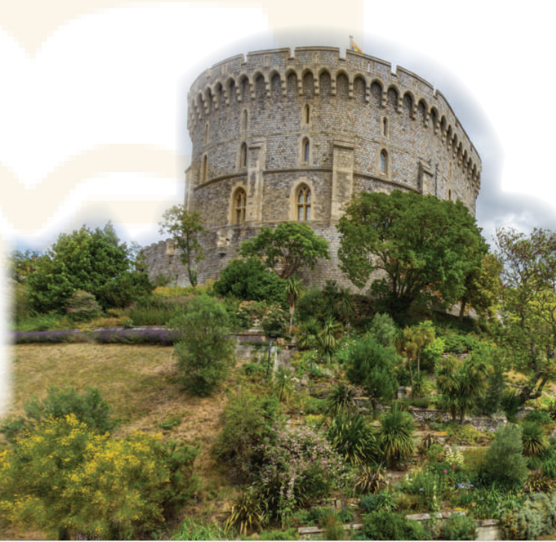

PRACTICE
- Look at the title of the conversation. Then look at the picture
What do you think they are discussing?
What do you see in the picture(s)?
What do you know about it / them?

Slide 14
PRACTICE
1
Listen and read.
Teacher: Now let’s look at what you’ve done on your projects. Group one first, please.
Mi: OK. ThiTeacher:s is Angkor Wat in Cambodia. It’s a temple complex, the largest religious monument in the world.
Teacher: Fantastic! When did people build it?
Mi: They built it in the 12th century. It’s a World Heritage Site. Millions of visitors go there every year
Teacher: Thank you. I wish I could go there one day too. And now group two, please.

Slide 15
PRACTICE
1
Listen and read.
Nam: Our project is about Dinh Bang Communal House in Bac Ninh Province - a national historic site. People were building it for 36 years, and it’s about 300 years old!
Teacher: Great! It’s quite magnificent! Now group three, please.
Lan: Well, this is Windsor Castle in England. It was built about a thousand years ago. It’s been the home for about 40 English kings and queens.
Teacher: Yeah. It’s the oldest and largest occupied castle in the world.
Mi & Nam: Amazing! So we need to preserve our heritage for future
generations.
Teacher: Right. Thanks to preservation efforts, we know a lot about our history and life in the past.

Slide 16
PRACTICE
Questions:
- What are they talking about?
They are talking about historic buildings / our history / the past / life in the past …
- Tell me some words in the text that they think are related to the unit’s topic.
Cambodia, complex, monuments, build, communal, …

Slide 17
PRACTICE
2
Read the conversation again and answer the questions
1. How old is Angkor Wat?
About 900 years old/ Nearly a thousand years old.
2. What is Dinh Bang Communal House like?
It’s magnificent.
3. Where is Windsor Castle?
In England.
4. What helps us know about our history and life in the past?
preservation
1. The best way to preserve our cultural ___________ is to share it with others.
2. Vietnamese people take great pride in their culture which has been ________________for thousands of years.
3. The foreign tourists gave a _____________performance of the Vietnamese folk songs and dances

Slide 18
PRACTICE
3
Complete each sentence with a word or a phrase from the box
occupied magnificent thanks to
heritage well preserved
heritage
1. The best way to preserve our cultural ___________ is to share it with others.
2. Vietnamese people take great pride in their culture which has been ________________for thousands of years.
well preserved
magnificent
3. The foreign tourists gave a _____________performance of the Vietnamese folk songs and dances
5. Many beautiful old castles are no longer ____________.
4. ___________ your kind contribution, we were able to save the ancient monument.

Slide 19
PRACTICE
3
Complete each sentence with a word or a phrase from the box
occupied magnificent thanks to
heritage well preserved
Thanks to
4. ___________ your kind contribution, we were able to save the ancient monument.
5. Many beautiful old castles are no longer ____________.
occupied

Slide 20
PRODUCTION
5
1. Who decided to move our capital from Hoa Lu to Dai La (Thang Long) in 1010?
King Ly Thai To (Ly Cong Uan).
2. When did Columbus discover the Americas?
In 1492
3. When was the United States founded?
In 1776.

Slide 21
PRODUCTION
5
4. When did Nguyen Ai Quoc first go abroad?
In 1911.
5. What happened in world history in 1914?
World War I started/ broke out.
6. Who was the last king of Viet Nam?
King Bao Dai (1913 – 1997)

Slide 22

1
Wrap-up
What have we learnt in this lesson?
Use the words related to the topic remembering the past.
Gain vocabulary to talk about some historical places.

Slide 23

CONSOLIDATION
2
Homework
- Do exercises in the workbook.

Slide 24
CONSOLIDATION
2
Homework
- Prepare for the Project of the unit
- Open book p.49, look at the picture and say what the topic of the project is
- Work in groups to design a poster.
- You will show and present in Lesson 7 – Looking back and Project.

Slide 25
CONSOLIDATION
2
Homework
Step 1: Collecting information (asking your grandparents and / or old people, searching the Internet, reading books / magazines, brainstorming ideas, etc.)
Step 3: Practising explaining their posters and answering questions about the content
Step 2: Organising ideas and visuals, and designing the posters

Slide 26
CONSOLIDATION
2
Homework
Step 1: Collecting information (asking your grandparents and / or old people, searching the Internet, reading books / magazines, brainstorming ideas, etc.)
Step 3: Practising explaining their posters and answering questions about the content
Step 2: Organising ideas and visuals, and designing the posters

Slide 27
CONSOLIDATION
2
Homework
Step 1: Collecting information (asking your grandparents and / or old people, searching the Internet, reading books / magazines, brainstorming ideas, etc.)
Step 3: Practising explaining their posters and answering questions about the content
Step 2: Organising ideas and visuals, and designing the posters

Slide 28
Website: hoclieu.vn
Fanpage: facebook.com/www.tienganhglobalsuccess.vn/

