Slide 1




LE KHAC CAN PRIMARY & SECONDARY SCHOOL
ENGLISH 6
Welcome all Teachers to our class
TEACHER : NGUYEN THI HIEN
Notes:
1

Slide 2

Tuesday , November 12th,2025
UNIT 4
MY NEIGHBOURHOOD
PERIOD 28: LESSON 2 : A CLOSER LOOK 1

Slide 3


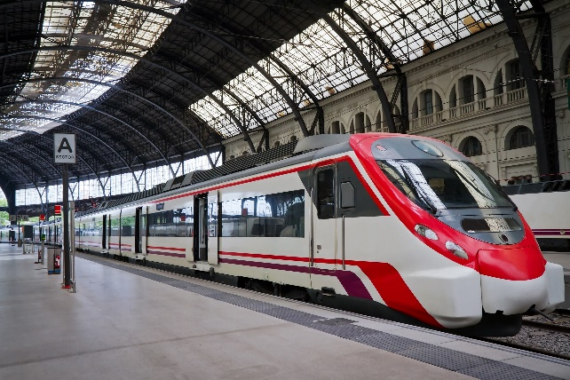
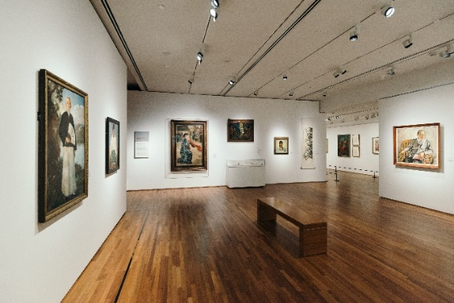
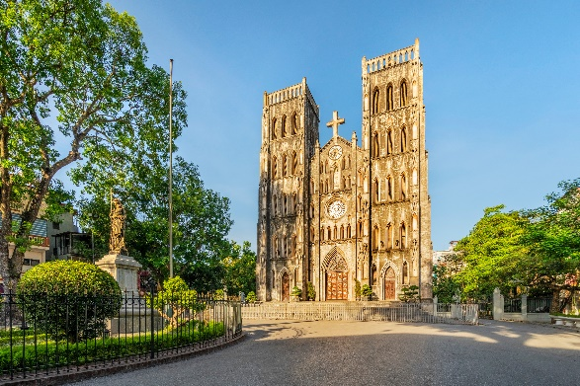
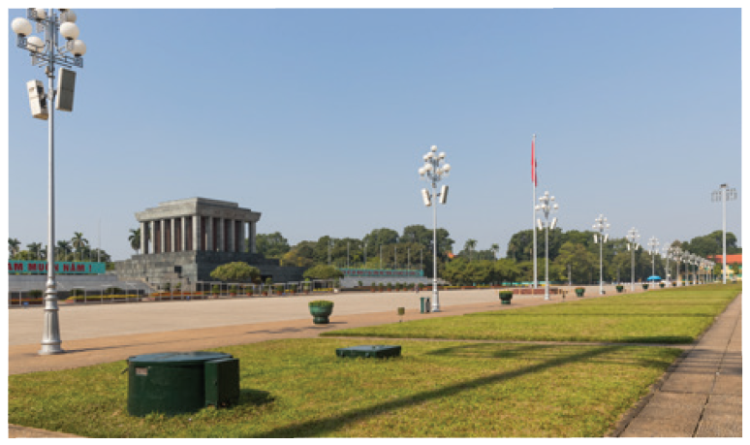
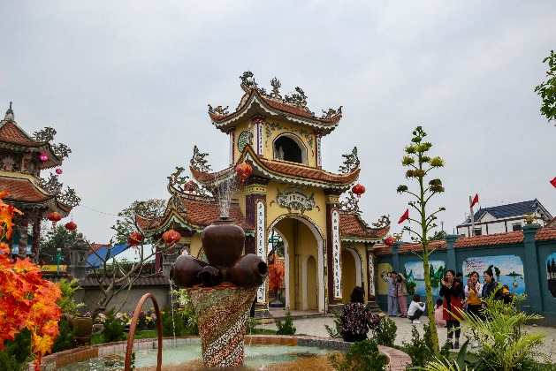

UNIT 4: MY NEIGHBOURHOOD
Lesson 2: A closer look 1
I. VOCABULARY
- railway station (n)
: ga tàu
- square (n)
: quảng trường
- cathedral (n)
: nhà thờ lớn
- temple (n)
: đền, miếu
- art gallery (n)
:phòng triển lãm tranh

Slide 4
EX1.Match the places below with the pictures.. Then listen, check and repeat the words
1. square
a
a
b
b
2. art gallery
3. cathedral
4. temple
4. temple
4. temple
5. railway station
5. railway station
5. railway station
c
d
e
1. square
3. cathedral
2. art gallery
Name some other places in your neighbourhood.

Slide 5
II. PRACTICE

Slide 6
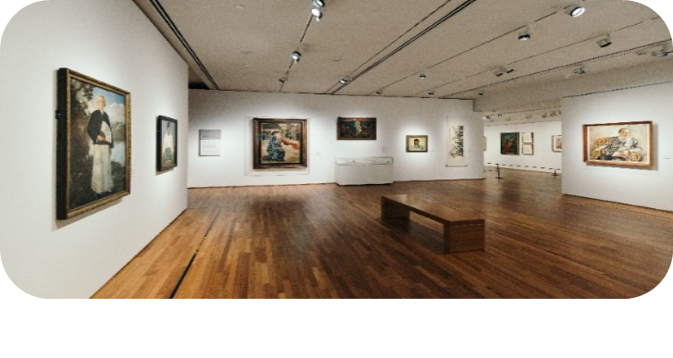
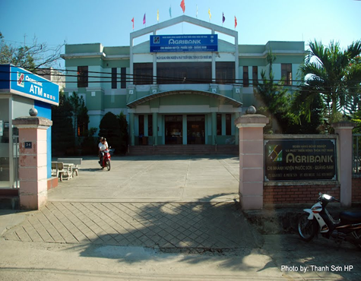
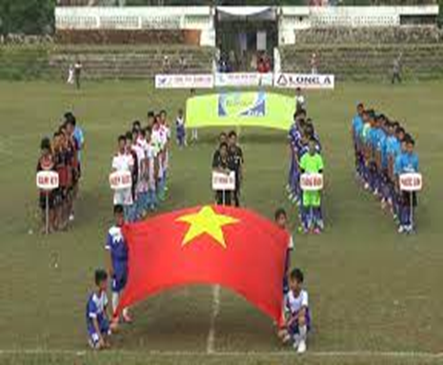
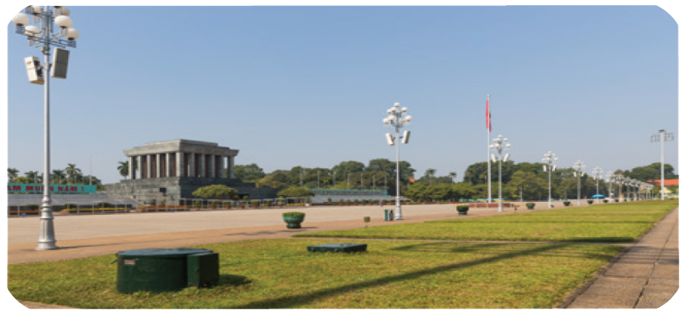
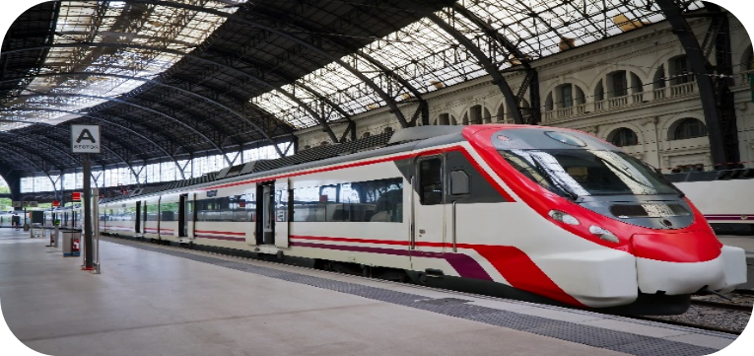
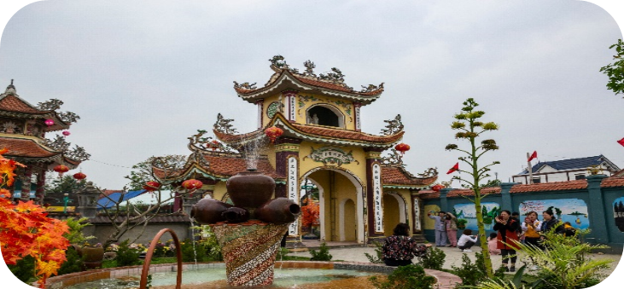
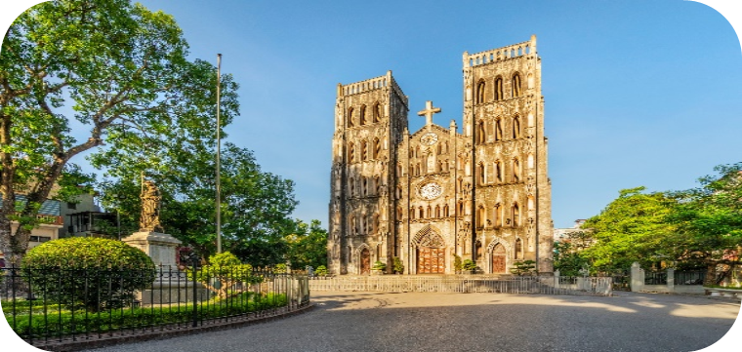
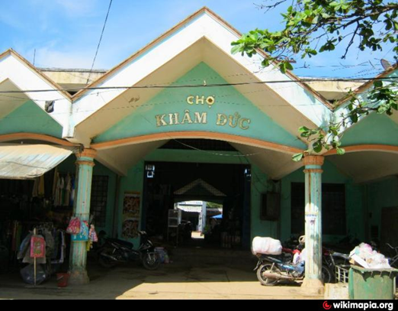
EX2. Work in pairs. Ask and answer questions about where you live.
railway station
Ex:
A: Is there a ..................... in your neighborhood ?
B: Yes, there is./ No, there isn’t
square.

Slide 7
*Matching
noisy
yên tĩnh
quiet
ồn ào
busy
đông đúc
crowded
bận rộn
modern
buồn chán
boring
hiện đại
peaceful
xinh đẹp
beautiful

Slide 8






3. Work in pairs. Ask and answer questions about your neighbourhood. You can use the adjective below.
Example:
peaceful
A: Is your neighbourhood ..................?
B: Yes, it is/ No, it isn’t.
Yes. It’s .................. / No. It’s .............
peaceful
noisy.
busy

Slide 9
III. Pronunciation
Long vowel /i:/
(Nguyên âm dài /i:/)
Short vowel /ɪ/
(Nguyên âm ngắn /ɪ/)
/I/ | /i:/
he | cathedral
she | tea
live | street

Slide 10

Listen and repeat the words. Pay attention to the sounds /ɪ/ and /i:/.
noisy
exciting
expensive
clean
peaceful
convenient
cheap
friendly
Now, in pairs put the words in the correct column.
/ɪ/ | /i:/

Slide 11

5. Listen and practice with the chant
My city is very busy
There are lots of buildings growing
The people here are funny
It’s a lovely place to live in.
My village is very pretty.
There are lots of places to see.
The people here are friendly.
It’s a fantastic place to be.

Slide 12

Picking lucky apples
1
2
8
7
5
3
4
9
6

Slide 13

Lucky apple
Lucky apple

Slide 14


Lucky apple

Slide 15

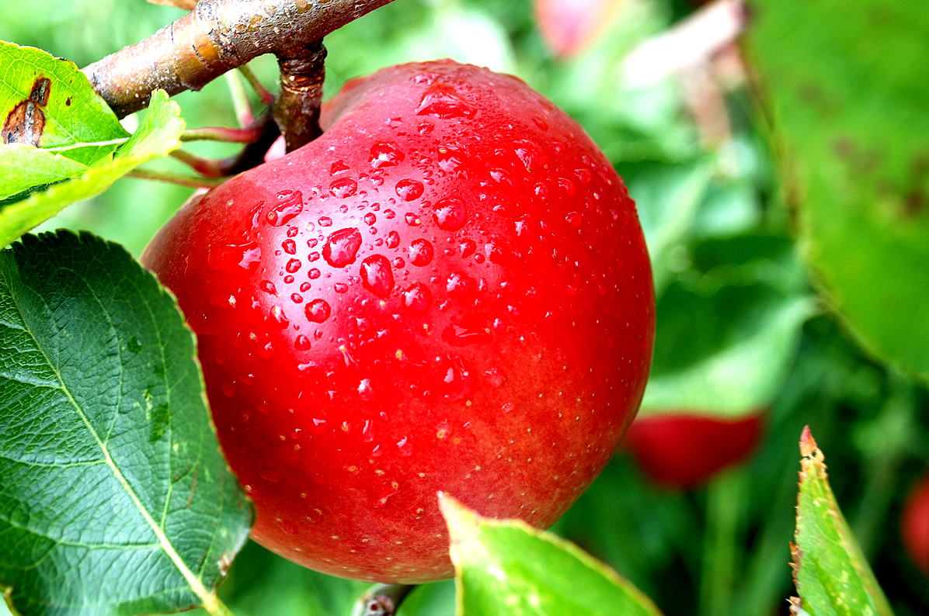
Lucky apple

Slide 16

cathedral
Is there a ......................... in your neighbourhood ?

Slide 17

* Choose the word which underlined part pronounced differently from others:
A. cheap B. tea C. expensive

Slide 18
* Find an opposite word
Noisy # ....................
Quiet/ peaceful

Slide 19
* Choose the word which underlined part pronounced differently from others:
A. peaceful B. friendly C. exciting

Slide 20
* Fill in a suitable word:
Is your neighbourhood ............................?
→ No, it isn’t. It’s noisy.
peaceful/ quiet

Slide 21
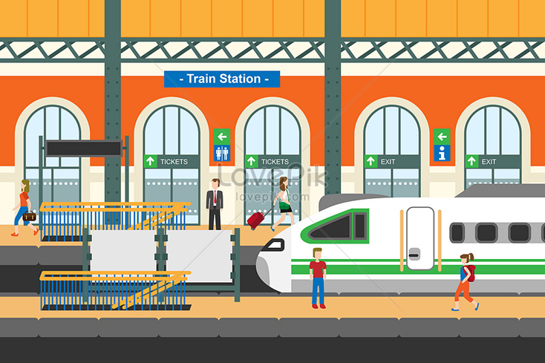
Is there..a ..................... In your neighbourhood ?
railway station

Slide 22
5. Listen and practice with the chant
My city is very busy
There are lots of buildings growing
The people here are funny
It’s a lovely place to live in.
My village is very pretty.
There are lots of places to see.
The people here are friendly.
It’s a fantastic place to be.

Slide 23
I. VOCABULARY:
II. PRACTICE:
III. PRONUNCIATION:
IV. HOMEWORK:
- Make sentences for the vocabulary in box 1 and box 2
- Practice the sounds: /i:/ and /I/ and find more words with the sounds above

Slide 24

Thanks for your attention !
GOOD BYE
See You Later.

