Slide 1




LE KHAC CAN PRIMARY & SECONDARY SCHOOL
ENGLISH 6
Welcome all Teachers to our class
TEACHER : NGUYEN THI HIEN
Notes:
1

Slide 2

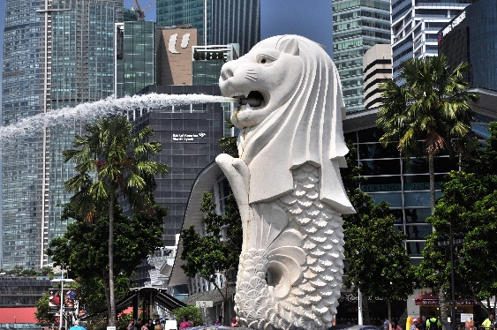
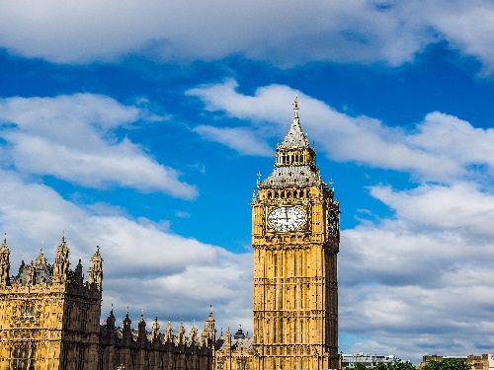
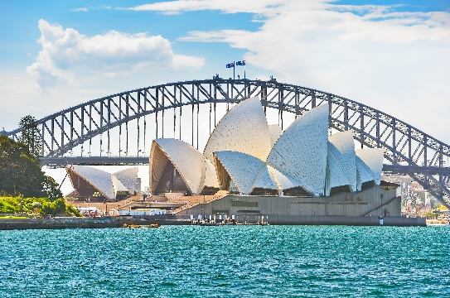
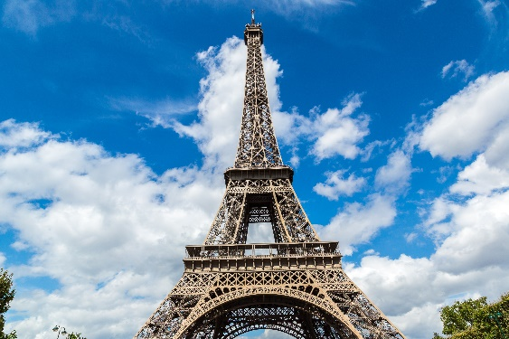
Merlion
Welcome to our class 6C
Big Ben
City landmarks
Sydney Opera
House
Eiffel Tower

Slide 3

Watch the video and tell the names of landmarks as much as possible

Slide 4

Period 73: UNIT 9: CITIES OF THE WORLD
Lesson 5: Skills 1

Slide 5
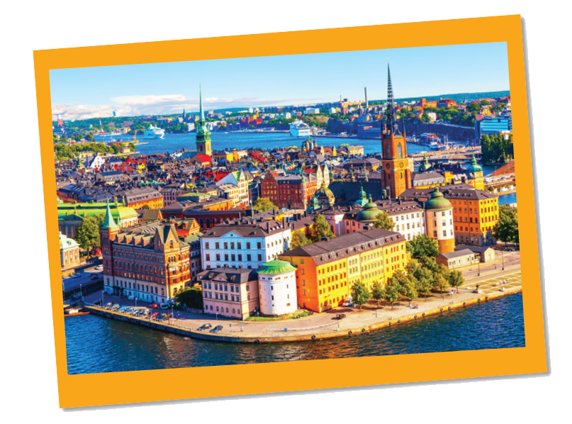
I. Reading
Task 1: Work in groups. Look at the postcard and discuss.
1. When do people write a postcard?
When they are away from home, often on holiday or business.
2. What do they often write on a postcard?
They often tell about the weather and what they do on their vacation

Slide 6
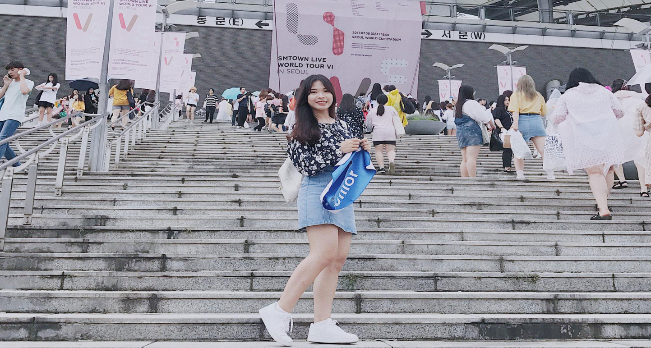
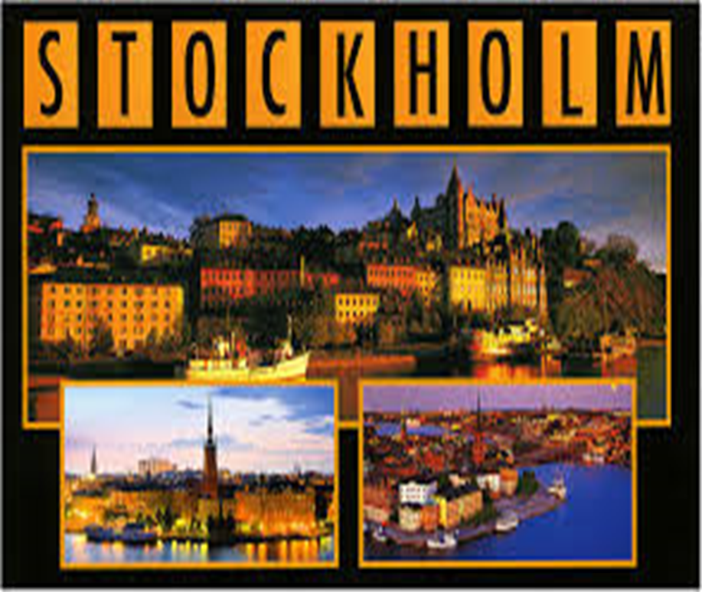
Unit 9: Cities of the world
Lesson 5: SKILLS 1
Answer the question
She is on holiday
What is she doing ?
“ What city is Mai in? “
Hanh Mai

Slide 7


Work in groups. Look at the postcard and discuss.
I. Reading
Love from Sweden
Do you know where this is?
It’s Stockholm , capital and largest city of Sweden.

Slide 8

Task 2: Read the postcard and answer the questions.
September 6
Dear Grandpa and Grandma,
To: Grandpa & Grandma
Hoan Kiem, Ha Noi, Viet Nam
Stockholm is fantastic!
Its weather is perfect, sunny all the time! Our hotel is good. It has a swimming pool and a gym. It offers delicious breakfast. Yesterday Mum, Dad and I rented three bikes and cycled to the Old Town. My parents wore their helmets and I wore mine. We visited the Royal Palace first. What a beautiful place! Mum loved it. She said, “Swedish art is amazing.” After that, we had “fika”, a coffee break, in a traditional café. Everything is so wonderful!
Wish you were here!
Love,
Mai

Slide 9
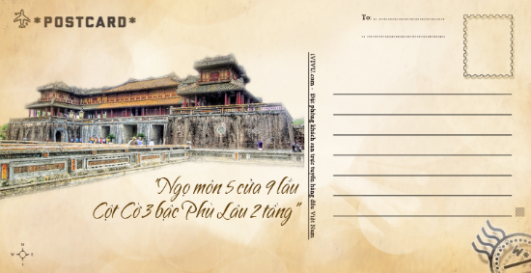
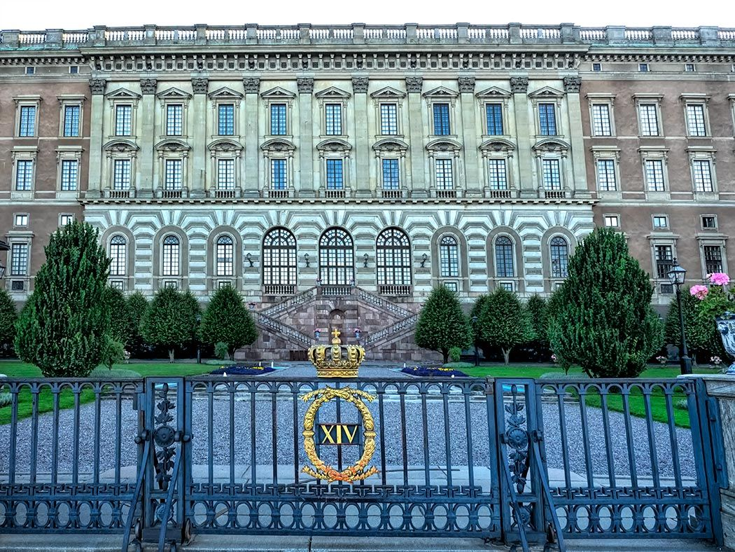
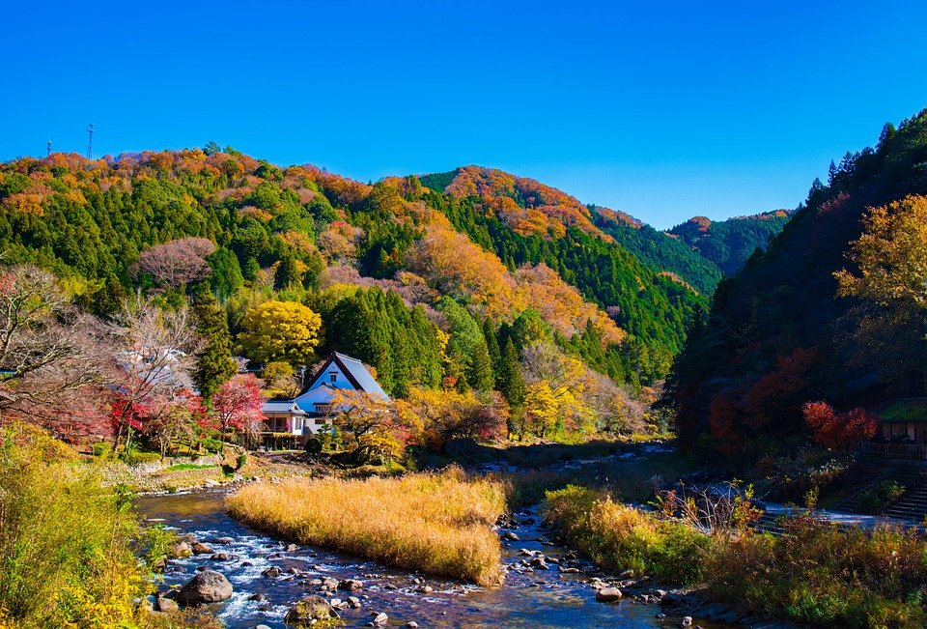
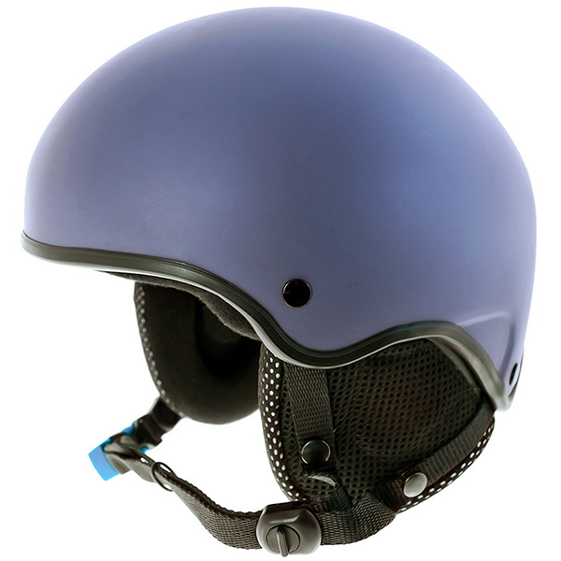
* New words
postcard (n) /ˈpəʊstkɑːd/
bưu thiếp
fantastic (adj) /fænˈtæstɪk /
tuyệt vời
perfect (adj) /ˈpɜːrfɪkt/
hoàn hảo
rent (v) /rent/
thuê
helmet (n) /ˈhelmɪt/
mũ bảo hiểm
Royal Palace /ˈrɔɪəl ˈpæləs/
Cung điện Hoàng gia
traditional (adj) /trəˈdɪʃənl/
thuộc về truyền thống
landscape (n) /ˈlændskeɪp/
phong cảnh

Slide 10
* Answer the questions.
September 6
Dear Grandpa and Grandma,
To: Grandpa & Grandma
Hoan Kiem, Ha Noi, Viet Nam
Stockholm is fantastic!
Its weather is perfect, sunny all the time! Our hotel is good. It has a swimming pool and a gym. It offers delicious breakfast. Yesterday Mum, Dad and I rented three bikes and cycled to the Old Town. My parents wore their helmets and I wore mine. We visited the Royal Palace first. What a beautiful place! Mum loved it. She said, “Swedish art is amazing.” After that, we had “fika”, a coffee break, in a traditional café. Everything is so wonderful!
Wish you were here!
Love,
Mai

Slide 11
1.This postcard is about __________ in Stockholm.
A. the weather B. a holiday C. landscapes
2.Guests can __________ in the hotel.
A. exercise B. cycle C. see Swedish art
3.Mai and her parents rented bikes to __________.
A. cycle around the hotel
B. visit the Old Town
C. go shopping
4.“Fika” is a __________.
A. traditional café B. palace C. coffee break

Slide 12


ANGRY BIRDS
Mystery Box

Slide 13

THE RULES
Choose an egg and answer the question.
You have 5 seconds to answer.
If you give the incorrect answer, another team can raise their hands to answer.
If you get it right, you will get a MYSTERY BOX.
The mystery box is good or bad.
You can keep it or give it to another team

Slide 14



MYSTERY BOX PRIZES
LOSE 100
GET 100
LOSE 200
GET 300

Slide 15




CHOOSE ONE
Team A
Team B
1
2
3
4

Slide 16
1. This postcard is about .... in Stockholm.
A. the weather B. a holiday C. landscapes
GOLDEN EGG
GET 300
Give it
or
Keep it?
H
O
M
E

Slide 17
2. Guests can __________ in the hotel.
A. exercise B. cycle C. see Swedish art
Give it
or
Keep it?
GET 100
H
O
M
E

Slide 18
3. Mai and her parents rented bikes to __________.
A. cycle around the hotel
B. visit the Old Town
C. go shopping
Give it
or
Keep it?
LOSE 100
H
O
M
E

Slide 19
4. “Fika” is a __________.
A. traditional café
B. palace
C. coffee break
Give it
or
Keep it?
LOSE 200
H
O
M
E

Slide 20
1.This postcard is about __________ in Stockholm.
A. the weather B. a holiday C. landscapes
2.Guests can __________ in the hotel.
A. exercise B. cycle C. see Swedish art
3.Mai and her parents rented bikes to __________.
A. cycle around the hotel
B. visit the Old Town
C. go shopping
4.“Fika” is a __________.
A. traditional café B. palace C. coffee break

Slide 21

SUGGEST
September 6
Dear Grandpa and Grandma,
Stockholm is fantastic!
Its weather is perfect, sunny all the time! Our hotel is good. It has a swimming pool and a gym. It offers delicious breakfast. Yesterday Mum, Dad and I rented three bikes and cycled to the Old Town. My parents wore their helmets and I wore mine. We visited the Royal Palace first. What a beautiful place! Mum loved it. She said, “Swedish art is amazing.” After that, we had “fika”, a coffee break, in a traditional café. Everything is so wonderful!
Wish you were here!
Love,
Mai

Slide 22
SUGGEST
September 6
Dear Grandpa and Grandma,
Stockholm is fantastic!
Its weather is perfect, sunny all the time! Our hotel is good. It has a swimming pool and a gym. It offers delicious breakfast. Yesterday Mum, Dad and I rented three bikes and cycled to the Old Town. My parents wore their helmets and I wore mine. We visited the Royal Palace first. What a beautiful place! Mum loved it. She said, “Swedish art is amazing.” After that, we had “fika”, a coffee break, in a traditional café. Everything is so wonderful!
Wish you were here!
Love,
Mai

Slide 23
SUGGEST
September 6
Dear Grandpa and Grandma,
Stockholm is fantastic!
Its weather is perfect, sunny all the time! Our hotel is good. It has a swimming pool and a gym. It offers delicious breakfast. Yesterday Mum, Dad and I rented three bikes and cycled to the Old Town. My parents wore their helmets and I wore mine. We visited the Royal Palace first. What a beautiful place! Mum loved it. She said, “Swedish art is amazing.” After that, we had “fika”, a coffee break, in a traditional café. Everything is so wonderful!
Wish you were here!
Love,
Mai

Slide 24
SUGGEST
September 6
Dear Grandpa and Grandma,
Stockholm is fantastic!
Its weather is perfect, sunny all the time! Our hotel is good. It has a swimming pool and a gym. It offers delicious breakfast. Yesterday Mum, Dad and I rented three bikes and cycled to the Old Town. My parents wore their helmets and I wore mine. We visited the Royal Palace first. What a beautiful place! Mum loved it. She said, “Swedish art is amazing.” After that, we had “fika”, a coffee break, in a traditional café. Everything is so wonderful!
Wish you were here!
Love,
Mai

Slide 25

Read the postcard and answer the questions.
September 6
Dear Grandpa and Grandma,
To: Grandpa & Grandma
Hoan Kiem, Ha Noi, Viet Nam
Stockholm is fantastic!
Its weather is perfect, sunny all the time! Our hotel is good. It has a swimming pool and a gym. It offers delicious breakfast. Yesterday Mum, Dad and I rented three bikes and cycled to the Old Town. My parents wore their helmets and I wore mine. We visited the Royal Palace f irst. What a beautiful place! Mum loved it. She said, “Swedish art is amazing.” After that, we had “fika”, a coffee break, in a traditional café. Everything is so wonderful!
Wish you were here!
Love,
Mai

Slide 26
Task 3: Read the text and match the places with the things they have.
a.
the Royal Palace
1.
The hotel in Stockholm
b.
delicious breakfast
c.
Swimming pool
2.
The Old Town
d.
‘fika’
e.
Swedish art

Slide 27
b.
delicious breakfast
c.
Swimming pool
a.
the Royal Palace
‘fika’
Swedish art
d.
e.
1.
The hotel in Stockholm
2.
The Old Town
?
?
b.
delicious breakfast
a.
the Royal Palace
c.
Swimming pool
d.
‘fika’
e.
Swedish art

Slide 28
SUGGEST
September 6
Dear Grandpa and Grandma,
Stockholm is fantastic!
Its weather is perfect, sunny all the time! Our hotel is good. It has a swimming pool and a gym. It offers delicious breakfast. Yesterday Mum, Dad and I rented three bikes and cycled to the Old Town. My parents wore their helmets and I wore mine. We visited the Royal Palace first. What a beautiful place! Mum loved it. She said, “Swedish art is amazing.” After that, we had “fika”, a coffee break, in a traditional café. Everything is so wonderful!
Wish you were here!
Love,
Mai

Slide 29
SUGGEST
September 6
Dear Grandpa and Grandma,
Stockholm is fantastic!
Its weather is perfect, sunny all the time! Our hotel is good. It has a swimming pool and a gym. It offers delicious breakfast. Yesterday Mum, Dad and I rented three bikes and cycled to the Old Town. My parents wore their helmets and I wore mine. We visited the Royal Palace first. What a beautiful place! Mum loved it. She said, “Swedish art is amazing.” After that, we had “fika”, a coffee break, in a traditional café. Everything is so wonderful!
Wish you were here!
Love,
Mai

Slide 30
II. Speaking
Task 4: Work in groups. Choose a city you know. Discuss and answer the questions below.
What city is it?
What is it like? (the weather, the food…)
What can you see and do there?
How do you feel about it?

Slide 31
Task 5: Share the information you have collected in 4 with your class.
You may start your talk with:
We’re going to tell you about …

Slide 32



- Learn new words by heart
- Practice reading the postcard again
- Practice speaking about the city you know
- Prepare : Unit 9: Skills 2

Slide 33


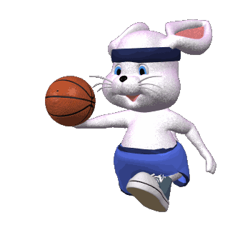



Thank you for your attention
Happy day!
Good Bye!

