Slide 1
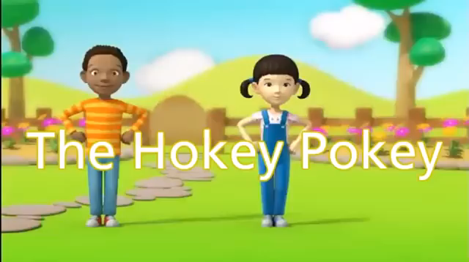

Slide 2


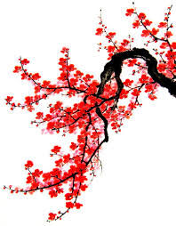
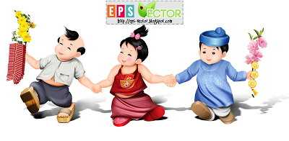

REVIEW 2
LESSON 2: SKILLS

Slide 3


Slide 4
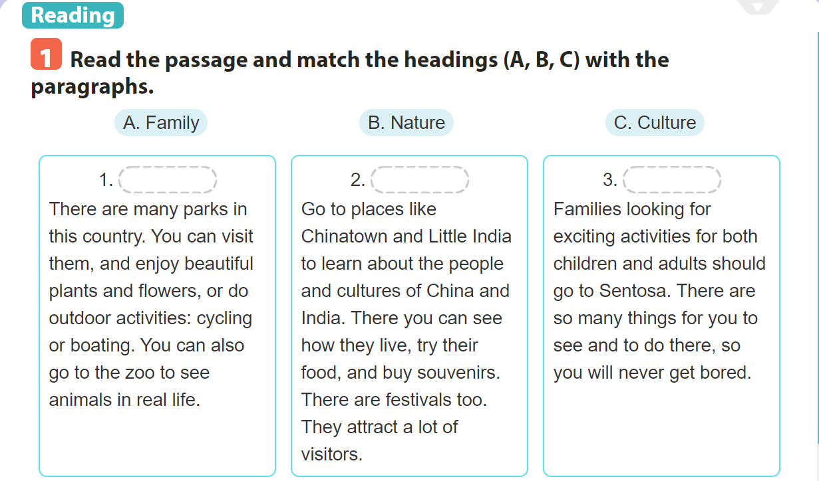
A. Family
B.Nature
C.Culture
B.Nature
C.Culture
A. Family

Slide 5
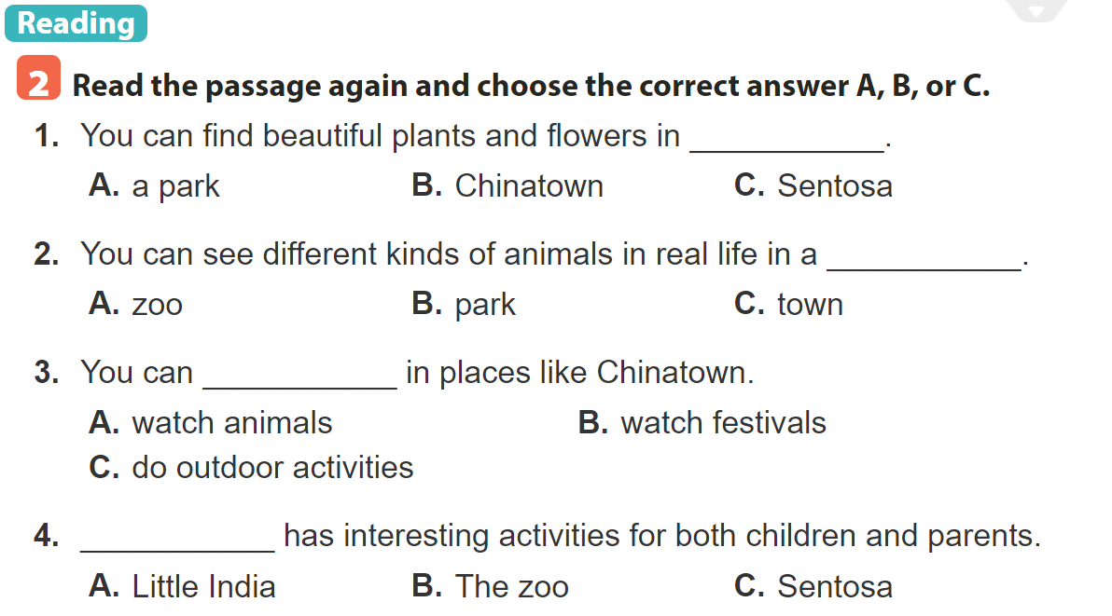

Slide 6


Slide 7
1. You can find beautiful plants and flowers in____________.
A. a park B. China town C. Sentosa

Slide 8
1. You can find beautiful plants and flowers in____________.
A. a park B. China town C. Sentosa

Slide 9
2. You can see different kinds of animals in a____________.
A. zoo B. park C. town

Slide 10
2. You can see different kinds of animals in a____________.
A. zoo B. park C. town

Slide 11
3. You can____________in places like Chinatown.
A. watch animals
B. watch festivals
C. do outdoor activites

Slide 12
3. You can____________in places like Chinatown.
A. watch animals
B. watch festivals
C. do outdoor activites

Slide 13
4. ________ has interesting activities for both children and parents.
A. Little India
B. The zoo
C. Sentosa

Slide 14
4. ________ has interesting activities for both children and parents.
A. Little India
B. The zoo
C. Sentosa

Slide 15
1.B There are many parks in this country. You can visit them and enjoy beautiful plants and flowers, or do outdoor activities: cycling or boating. You can also go to the zoo to see animals in real life.
2.C Go to places like Chinatown and Little India to learn about the people and cultures of China and India. There you can see how they live, try their food, and buy souvenirs. There are festivals, too. They attract a lot of visitors.
3.A Families looking for exciting activices for both children and adults should go to Sentosa. There are so many things for you to see and to do there, so you will never get bored.

Slide 16
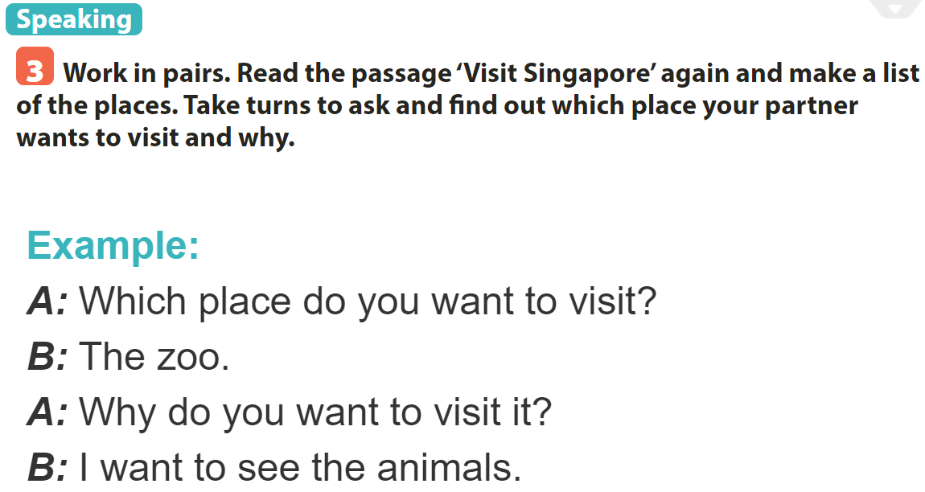

Slide 17


Slide 18
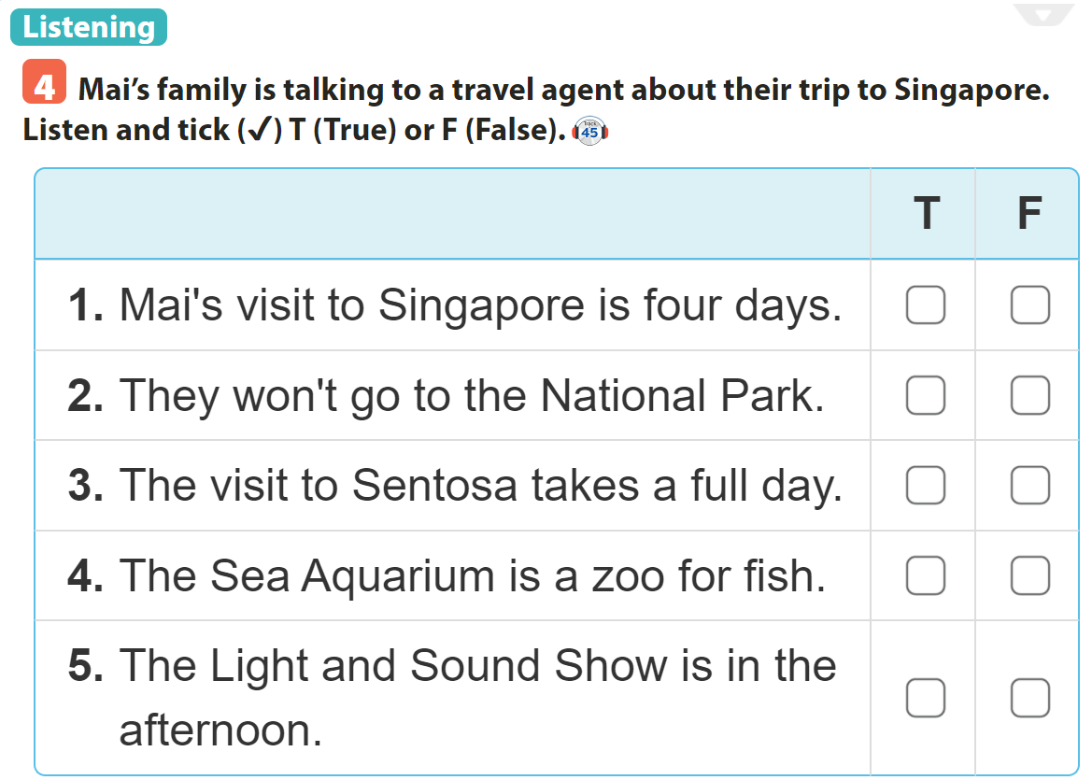

✓
✓
✓
✓
✓

Slide 19
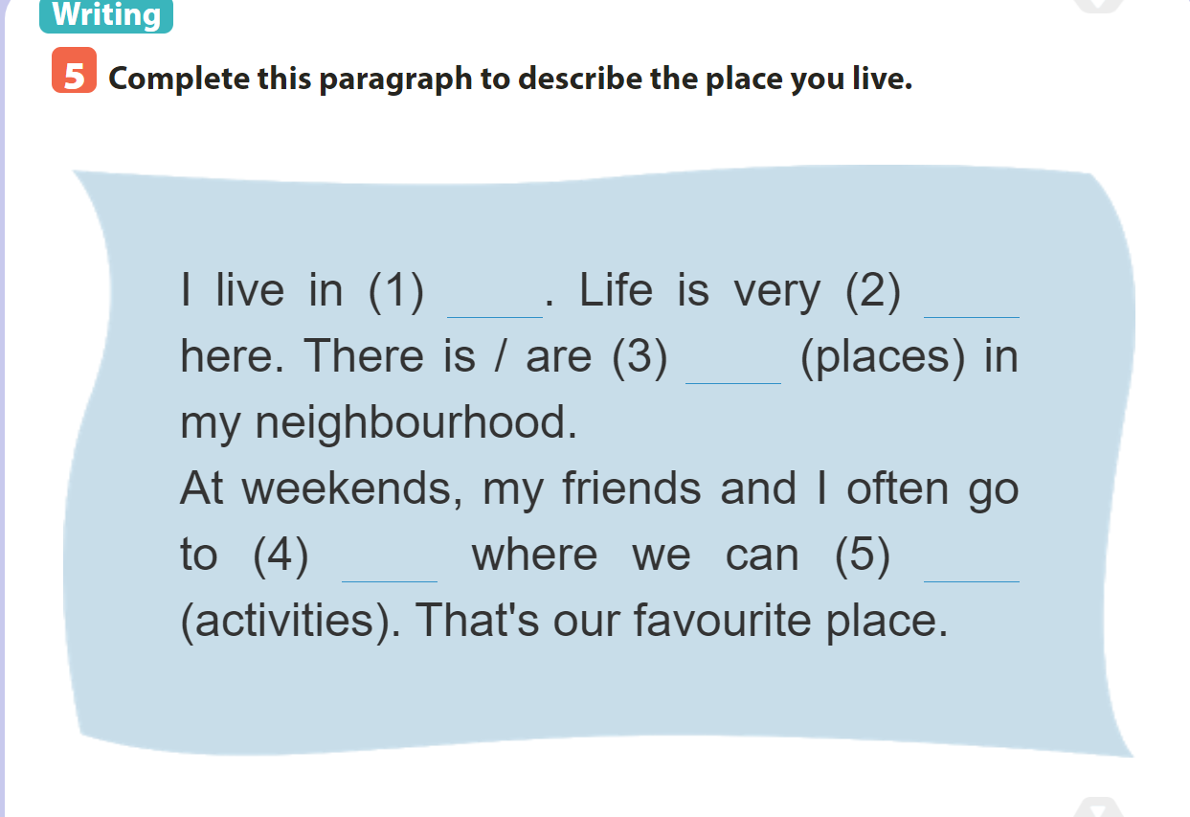
1. Hai Phong city
2. peaceful
3. many interesting places
4. the beaches
5. swim, sunbathe and play underwater games

Slide 20
I live in Hai Phong city. Life is very peaceful here. There are many interesting places in my neighbourhood like beaches, parks, supermarkets, restaurants and games centres.
At weekends, my friends and I often go to the beaches where we can swim, sunbathe and play underwater games. That’s our favourite place.

Slide 21

Thank you very much
for your attendance
GOOD BYE

