Slide 1
UNIT 11: FAMILY TIME
LESSON 2 ( 4, 5, 6)
Notes:
MADE BY FACEBOOK :TRAN THI THANH TAM

Slide 2
Warm - up
Notes:
MADE BY FACEBOOK :TRAN THI THANH TAM

Slide 3
PLAY GAME
WHISPER GAME
Notes:
Step 2: Have groups put the posters on the desk and practice the presentation. Encourage all members in the group to present. Go around the classroom and offer help where necessary.

Slide 4






I took a photo with my brother.
Notes:
Step 5: Invite a few pairs to point at the pictures and say the questions and answers in front of the class.

Slide 5
I swam with my father last Saturday.
Notes:
Step 5: Invite a few pairs to point at the pictures and say the questions and answers in front of the class.

Slide 6
I collected shells with my sister last Sunday.
Notes:
Step 5: Invite a few pairs to point at the pictures and say the questions and answers in front of the class.

Slide 7
I walked on the beach with my family yesterday.
Notes:
Step 5: Invite a few pairs to point at the pictures and say the questions and answers in front of the class.

Slide 8

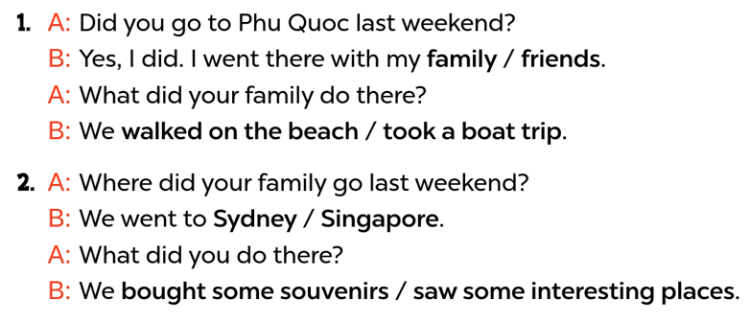

4. Listen and circle
Notes:
MADE BY FACEBOOK :TRAN THI THANH TAM

Slide 9
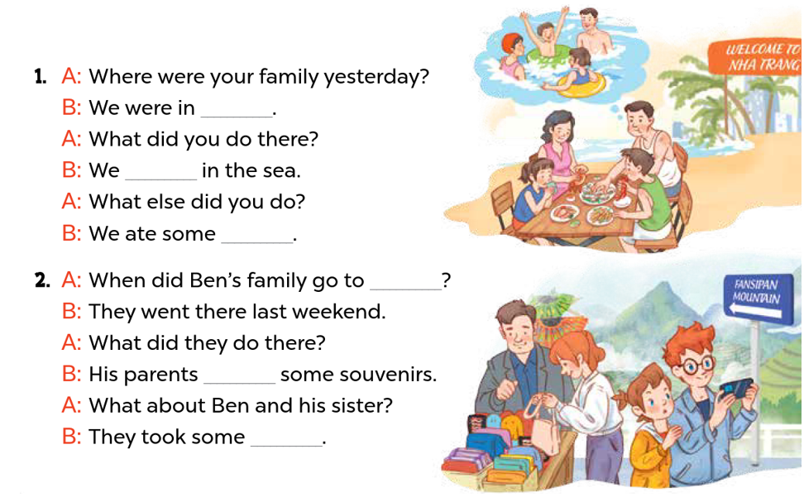
5. Read and complete
Nha Trang
swam
seafood
Sa Pa
bought
photos
Notes:
MADE BY FACEBOOK :TRAN THI THANH TAM

Slide 10
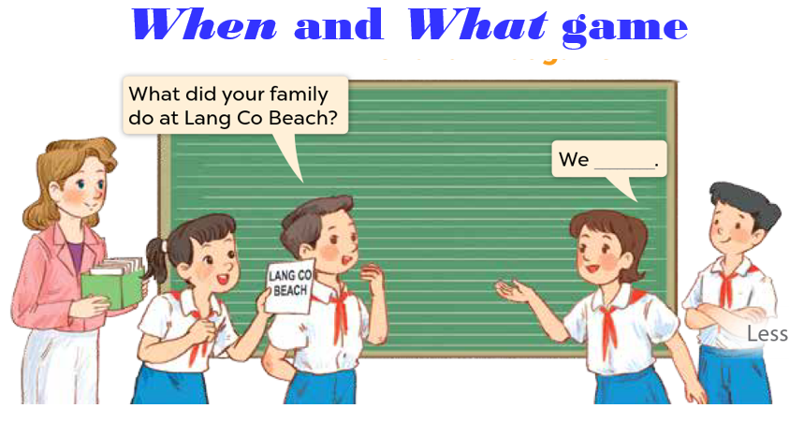
6. Let’s play
Notes:
MADE BY FACEBOOK :TRAN THI THANH TAM

Slide 11
PLAY GAME
Choose the best answer
Notes:
MADE BY FACEBOOK :TRAN THI THANH TAM

Slide 12
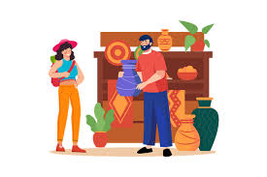




Question 1
buy food
buy souvenirs
buy school things
Notes:
MADE BY FACEBOOK :TRAN THI THANH TAM

Slide 13
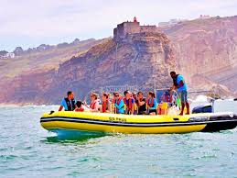
Question 2
buy food
buy souvenirs
took a boat trip
Notes:
MADE BY FACEBOOK :TRAN THI THANH TAM

Slide 14

Question 3
eat seafood
see some
interesting places
take a boat trip
Notes:
MADE BY FACEBOOK :TRAN THI THANH TAM

Slide 15
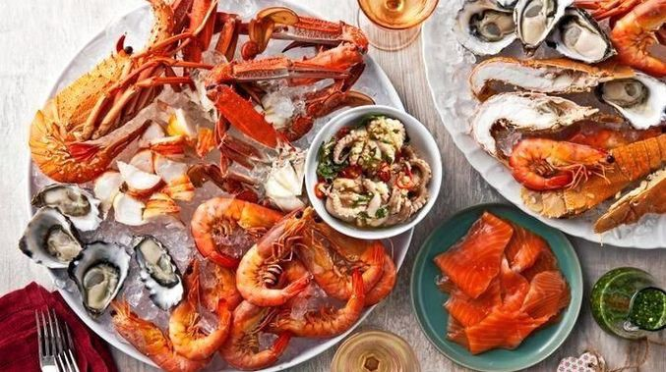
Question 4
eat seafood
eat fast food
eat chicken
Notes:
MADE BY FACEBOOK :TRAN THI THANH TAM

