Slide 1

UNIT 11:FAMILY TIME
LESSON 1 (4, 5, 6)
Notes:
MADE BY FACEBOOK :TRAN THI THANH TAM

Slide 2
Warm - up
Notes:
Made by Facebook: TRAN THI THANH TAM

Slide 3





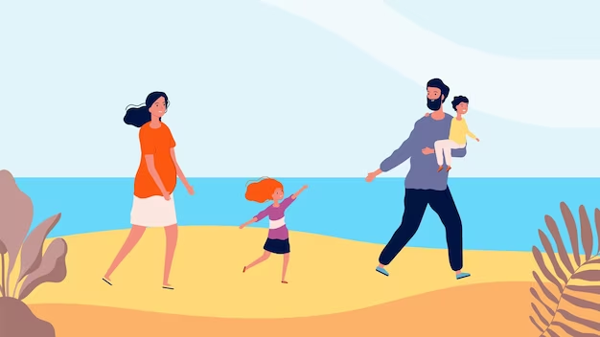




6
1
2
3
4
5
7
8
9
Choose a, b or c, then Say.
10
START
My family _______ on the beach yesterday.
a. walk
b. walked
c. walks
Notes:
*Key: 1. b, 2. a, 3. b, 4. c

Slide 4
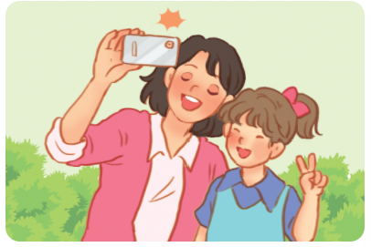
6
1
2
3
4
5
7
8
9
Choose a, b or c, then Say.
10
START
My mother and I _______ photos last Monday.
a. took
b. take
c. taking
Notes:
*Key: 1. b, 2. a, 3. b, 4. c

Slide 5
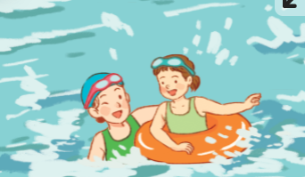
6
1
2
3
4
5
7
8
9
Choose a, b or c, then Say.
10
START
I _______ with my mother last Sunday.
a. swim
b. swam
c. swims
Notes:
*Key: 1. b, 2. a, 3. b, 4. c

Slide 6
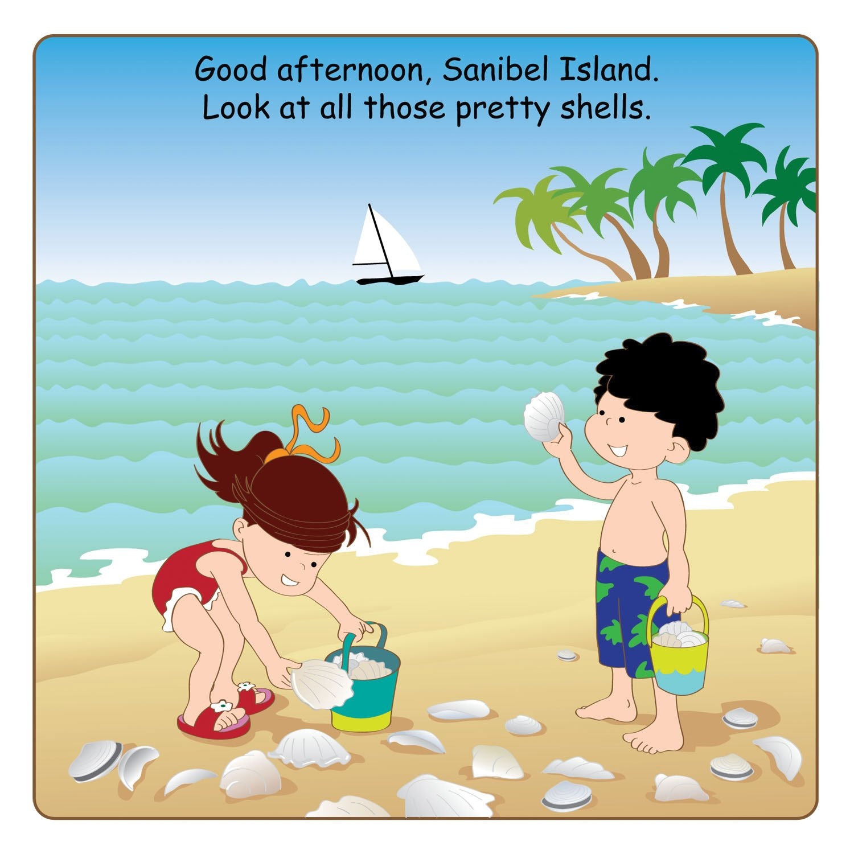
6
1
2
3
4
5
7
8
9
Choose a, b or c, then Say.
10
START
I _______the seashells with my brother yesterday.
a. collect
b. collects
c. collected
Notes:
*Key: 1. b, 2. a, 3. b, 4. c

Slide 7
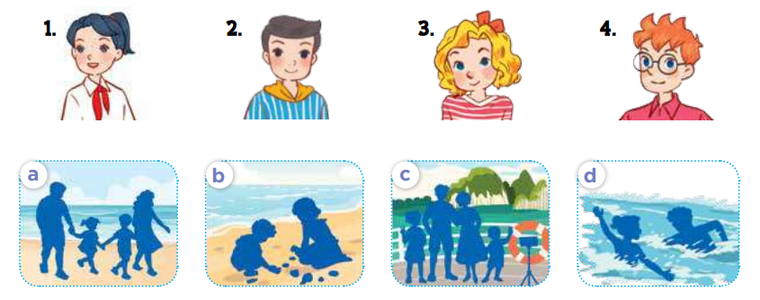
4. Listen and match
Notes:
MADE BY FACEBOOK :TRAN THI THANH TAM

Slide 8
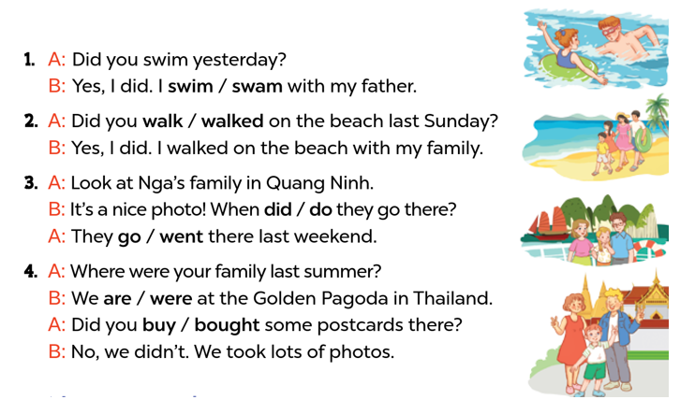
5. Read and circle
Notes:
MADE BY FACEBOOK :TRAN THI THANH TAM

Slide 9
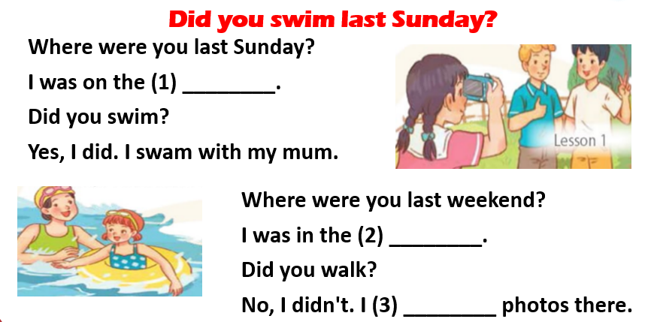
6. Listen, complete and sing
beach
park
took
Notes:
MADE BY FACEBOOK :TRAN THI THANH TAM

Slide 10


Thank you very much
Good bye! See you again!
Notes:
MADE BY FACEBOOK :TRAN THI THANH TAM

