Slide 1
Extension Activity
Teacher: Nguyễn Thị Thu Phương

Slide 2

What are they?
buildings
Next

Slide 3
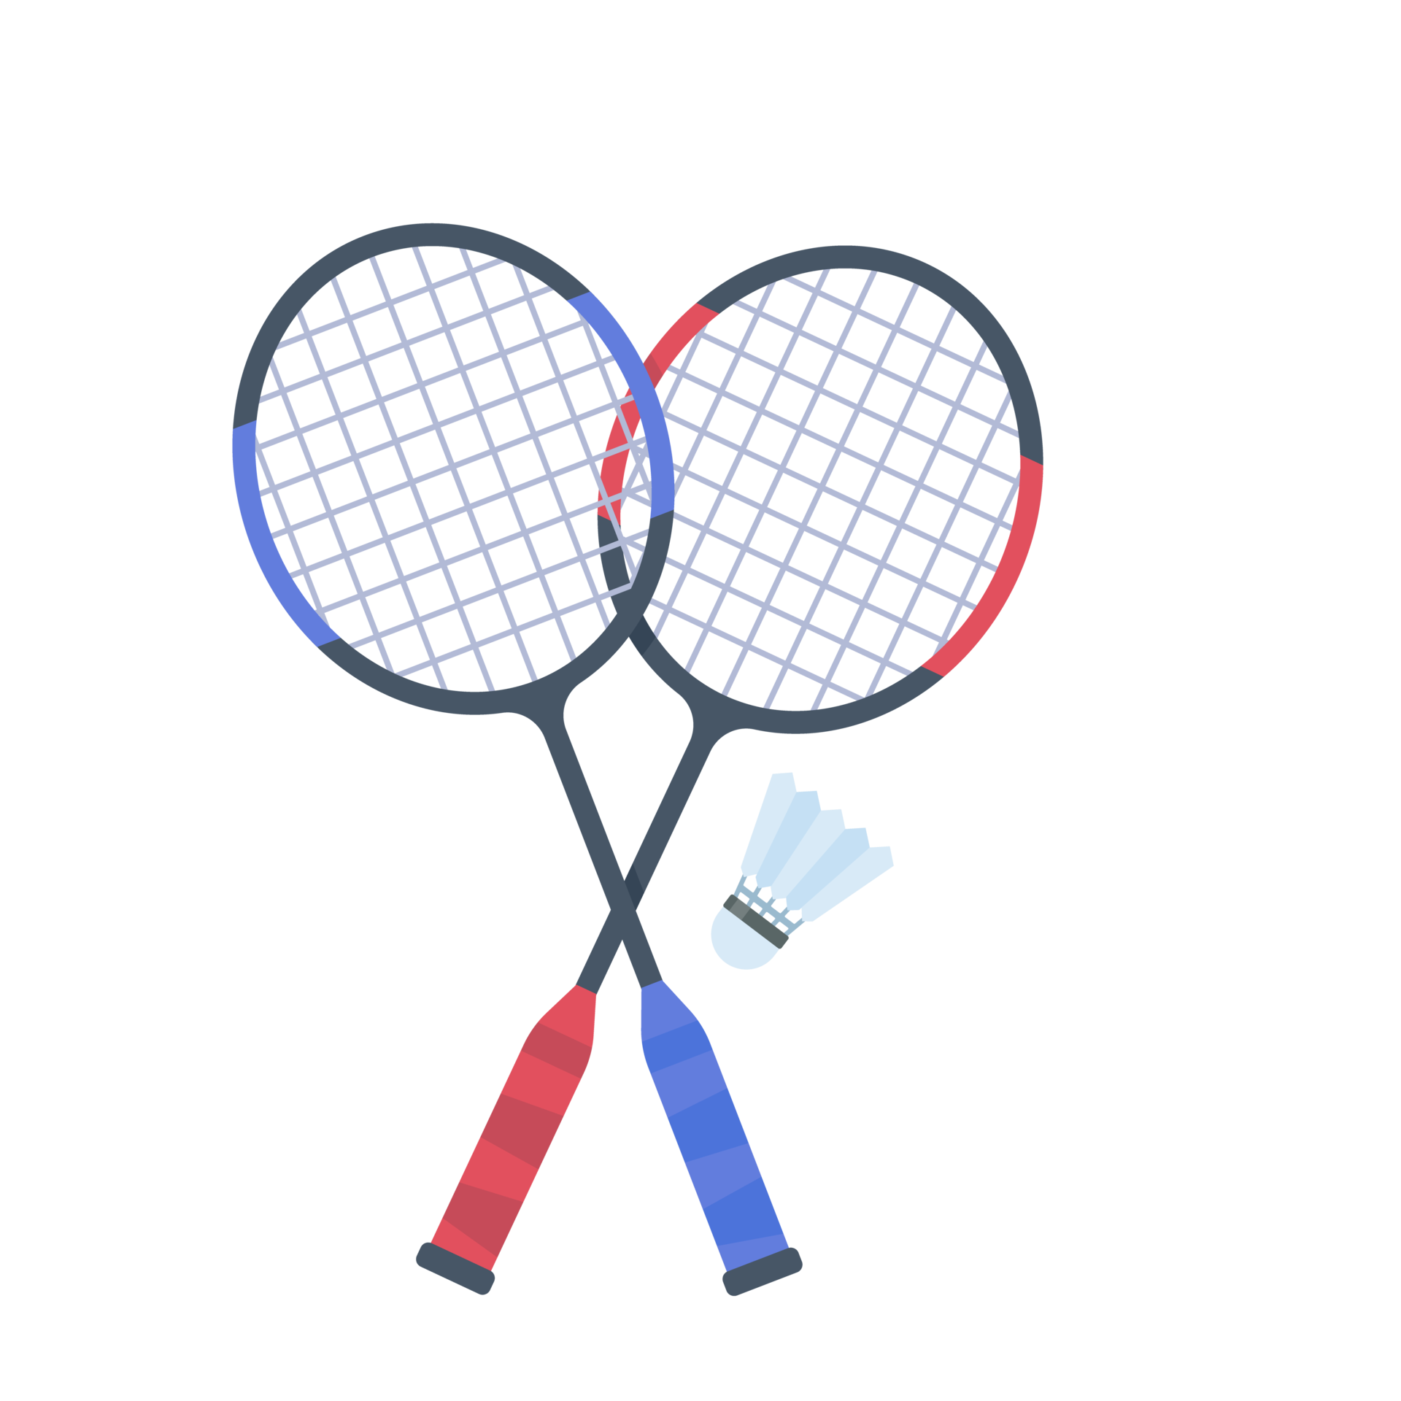
What sport is it?
badminton
Next

Slide 4
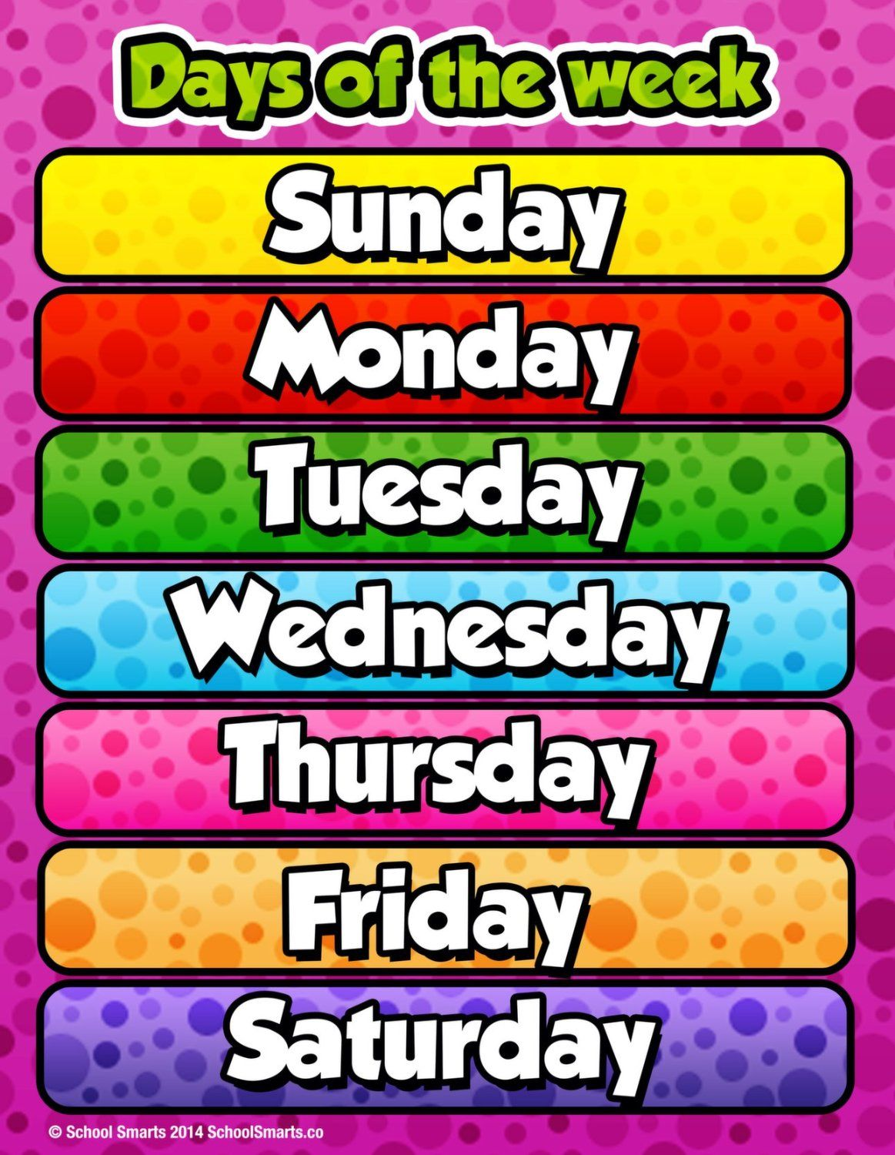
What is the sixth day of the week?
Saturday
Next

Slide 5
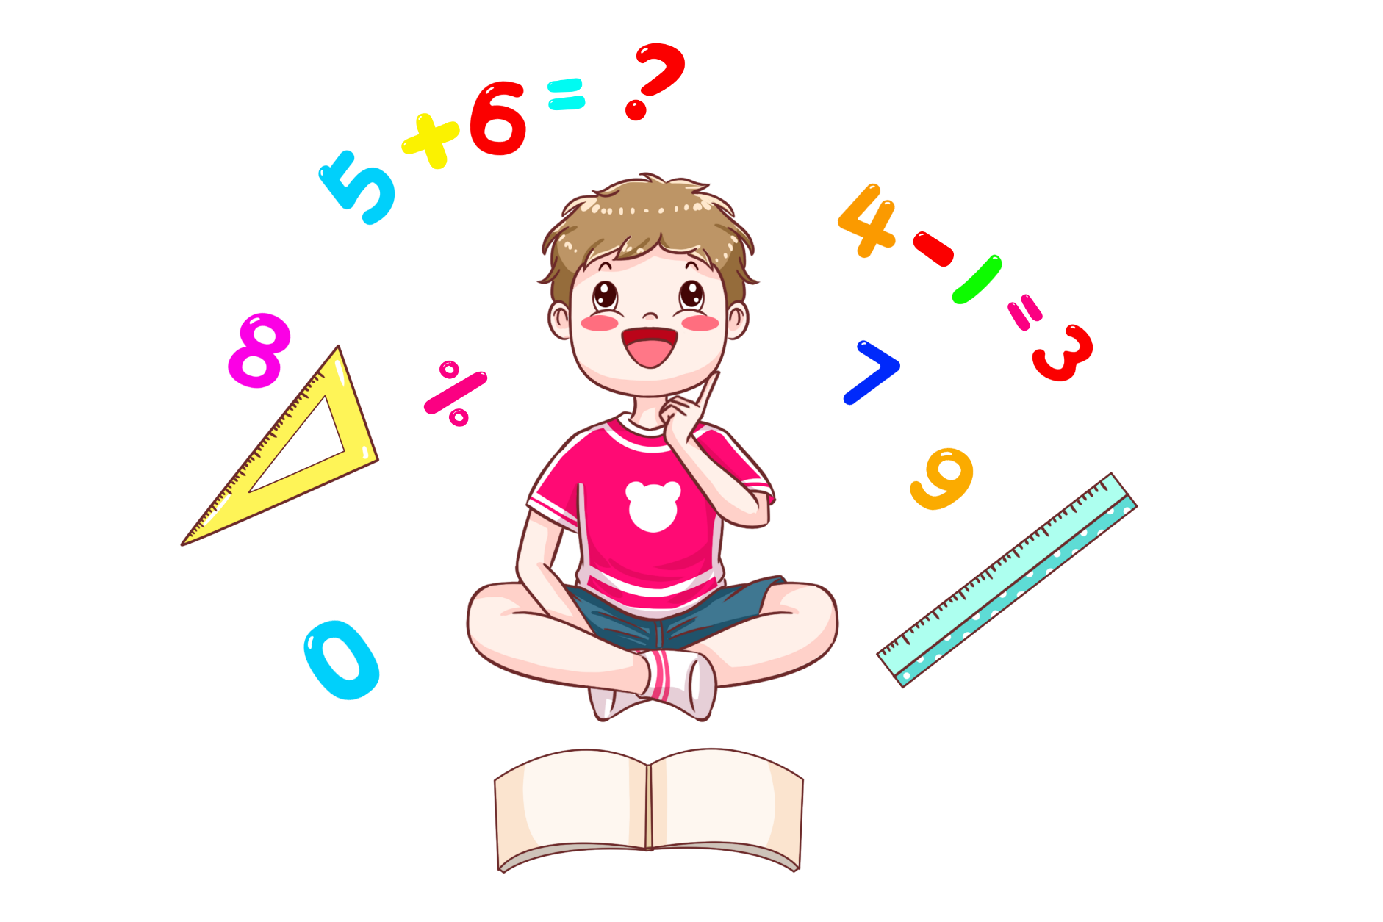
What subject is it?
maths
Next

Slide 6
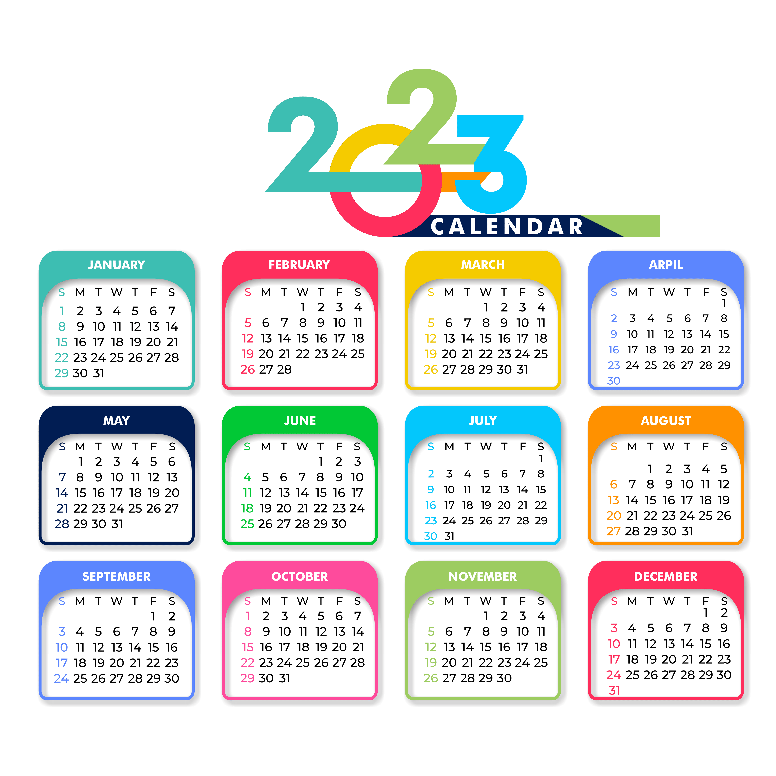
How many months are there in a year?
12
Next

Slide 7
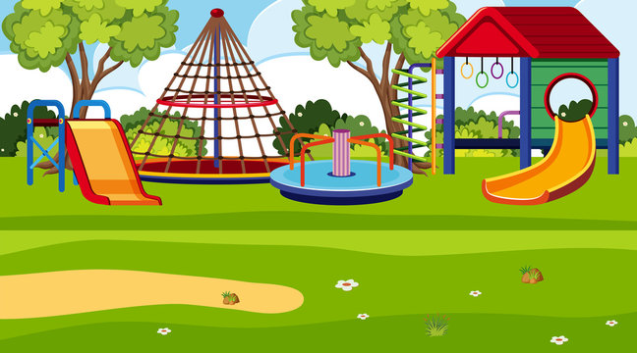
What is it?
playground
Next

Slide 8
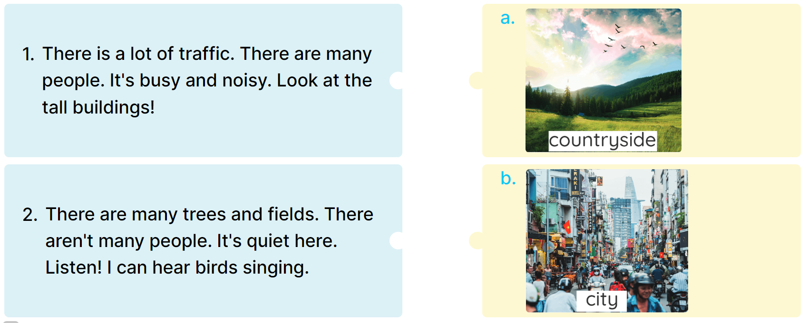
1
Read and match.

Slide 9
2
Write a for countryside or b for city.
1. tall buildings __________
3. a lot of trees __________
5. a lot of traffic __________
7. noisy __________
2. many people __________
4. many fields __________
6. busy __________
8. quiet __________

Slide 10
2
Write a for countryside or b for city.
1. tall buildings __________
3. a lot of trees __________
5. a lot of traffic __________
7. noisy __________
2. many people __________
4. many fields __________
6. busy __________
8. quiet __________
b
b
a
a
b
b
b
a

Slide 11
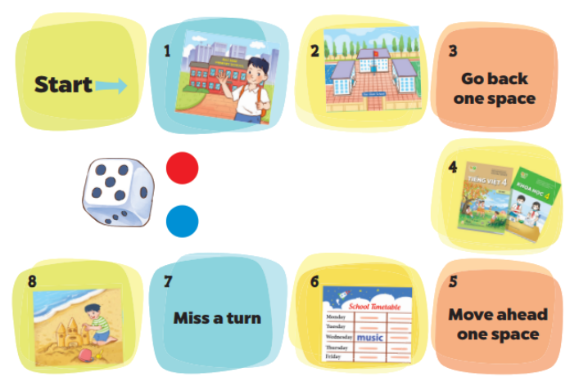
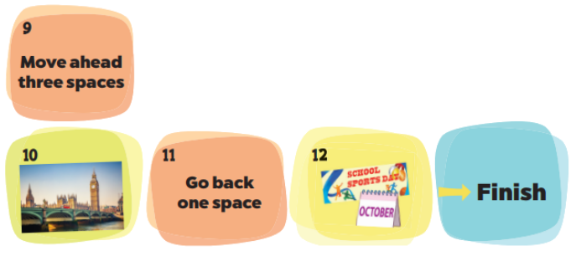
3
Board game. Roll a dice.
Listen and answer.
1. Where’s his school?
2. How many buildings are there at your school?
4. What subjects do you have today?
6. When does she have music?
8. Were you in the countryside last weekend?
10. Where were you last summer?
12. Is your sports day in June?

