Slide 1

UNIT 9:OUR OUTDOOR ACTIVITIES
LESSON 1 ( 1, 2, 3)
Made by: Nguyen Thi Thu Phuong
Notes:
MADE BY FACEBOOK :TRAN THI THANH TAM

Slide 2
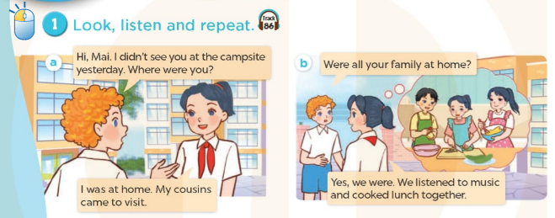

Notes:
MADE BY FACEBOOK :TRAN THI THANH TAM

Slide 3

campsite/ˈkæmpsaɪt/:địa điểm cắm trại
Notes:
MADE BY FACEBOOK :TRAN THI THANH TAM

Slide 4
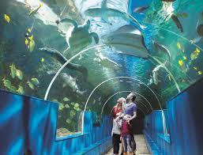
aquarium/əˈkweəriəm/thuỷ cung
Notes:
MADE BY FACEBOOK :TRAN THI THANH TAM

Slide 5
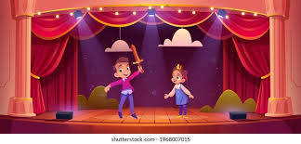
theatre/ˈθɪətə/nhà hát
Notes:
MADE BY FACEBOOK :TRAN THI THANH TAM

Slide 6
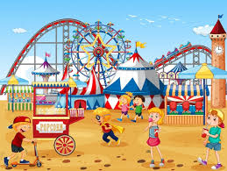
funfair/ˈfʌnfeə/hội chợ giải trí
Notes:
MADE BY FACEBOOK :TRAN THI THANH TAM

Slide 7
VOCABULARY
Campsite:địa điểm cắm trại
Aquarium: thủy cung
Theater: nhà hát
Funfair: hội chợ giải trí

Slide 8
Let's play
Check vocabulary
MATCHING
Notes:
Made by Facebook: TRAN THI THANH TAM

Slide 9
1.aquarium
A
2.theater
B
3.campsite
C
4. funfair
D
Notes:
MADE BY FACEBOOK :TRAN THI THANH TAM

Slide 10
Were you at the theater yesterday?
( Hôm qua bạn ở nhà hát phải không?)
Yes, we were.
No, we weren’t.

Slide 11
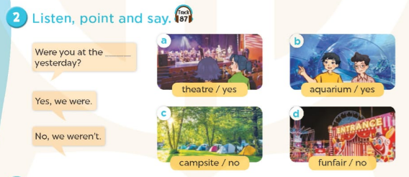
Notes:
MADE BY FACEBOOK :TRAN THI THANH TAM

Slide 12
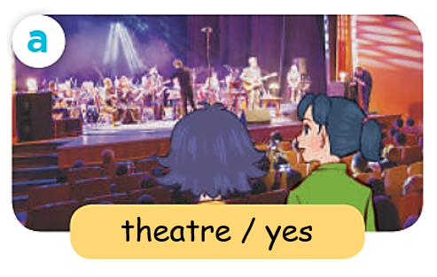
Were you at the……………………..yesterday?
theater
Yes, we were.
Notes:
MADE BY FACEBOOK :TRAN THI THANH TAM

Slide 13
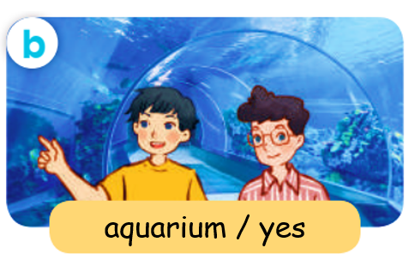
Were you at the……………………..yesterday?
aquarium
Yes, we were.
Notes:
MADE BY FACEBOOK :TRAN THI THANH TAM

Slide 14
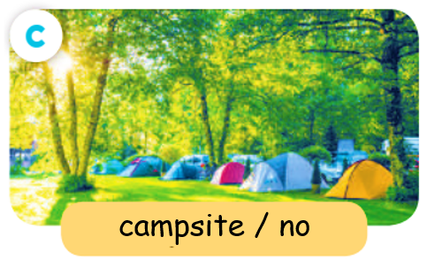
Were you at the……………………..yesterday?
campsite
No, we weren’t.
Notes:
MADE BY FACEBOOK :TRAN THI THANH TAM

Slide 15


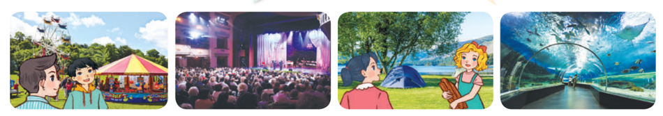
3. Let’s talk
Were you at the……………………..yesterday?
funfair
No, we weren’t.
Yes, we were.
Notes:
MADE BY FACEBOOK :TRAN THI THANH TAM

Slide 16

SUMMARY
1.Vocabulary:
Campsite:địa điểm cắm trại
Aquarium: thủy cung
Theater: nhà hát
Funfair: hội chợ giải trí
2. Sentence pattern:
-Were you at the theater yesterday?
(Hôm qua bạn ở nhà hát phải không?)
->Yes, I were. / No, I weren’t.

