Slide 1

UNIT 9:OUR OUTDOOR ACTIVITIES
LESSON 1 (4, 5, 6)
Made by: Nguyen Thi Thu Phuong
Notes:
MADE BY FACEBOOK :TRAN THI THANH TAM

Slide 2
Let's play
Kim’s game

Slide 3

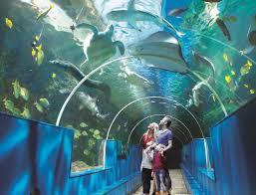
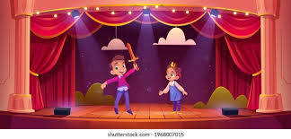
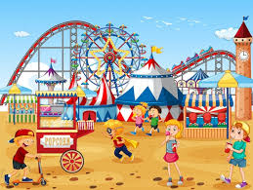
LET’S PLAY: KIM’S GAME
0:0
0:3
0:2
0:5
0:4
0:1
Start
campsite
aquarium
theater
funfair

Slide 4
Check and read
campsite
aquarium
theater
funfair

Slide 5
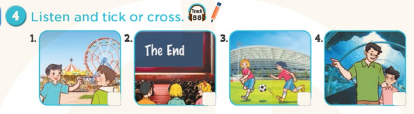



Notes:
MADE BY FACEBOOK :TRAN THI THANH TAM

Slide 6
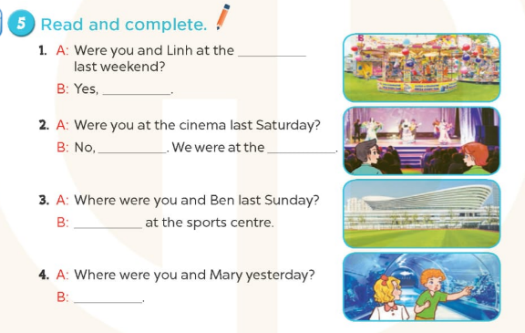
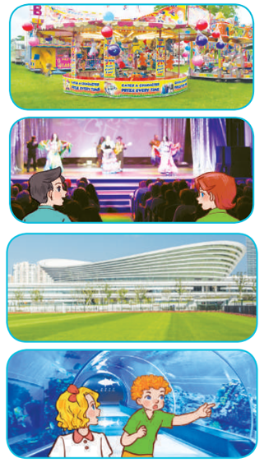
funfair
funfair
we were
we weren’t
theater
We were
We were at the aquarium.
Notes:
MADE BY FACEBOOK :TRAN THI THANH TAM

Slide 7
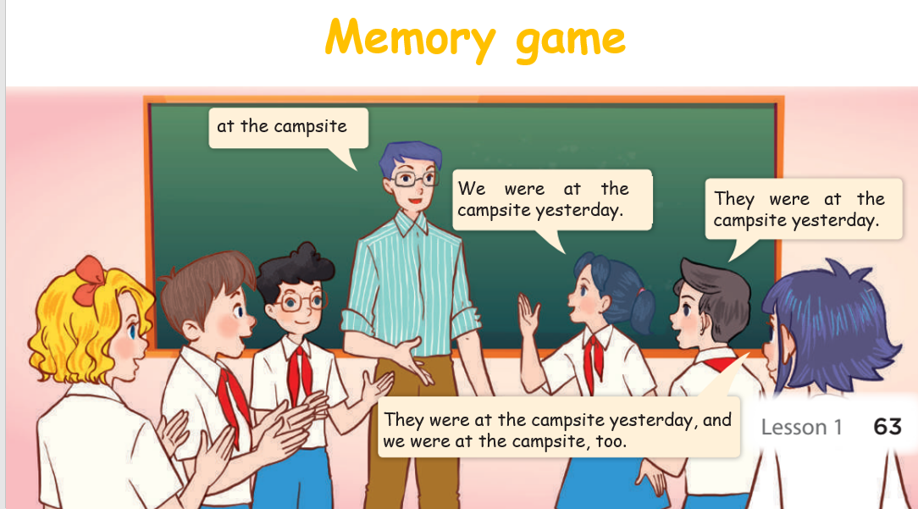
3. Let’s play
Notes:
MADE BY FACEBOOK :TRAN THI THANH TAM

Slide 8
Play game
Reoder the words

Slide 9
Were /theater / yesterday/ you/ at /the/?
Were you at the theater yesterday?

Slide 10
at/We/campsite/were/Sunday/last/ the/.
We were at the campsite last Sunday.

Slide 11
at/We/campsite/were/Sunday/last/ the/.
We were at the campsite last Sunday.

Slide 12
aquarium/Lan/yesterday/was/ the/.
Lan was at the aquarium yesterday.

Slide 13

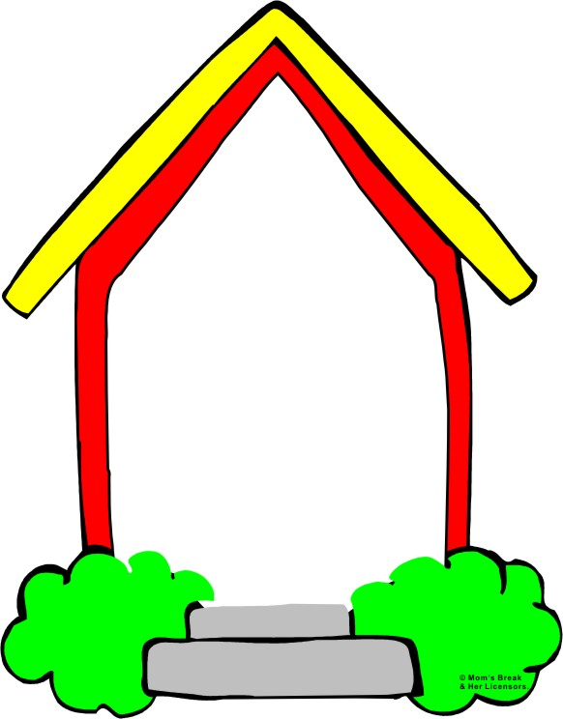
Homework:
- Practice more at home
- Prepare Unit 9- Lesson 2 ( 1, 2, 3)
Notes:
MADE BY FACEBOOK :TRAN THI THANH TAM

Slide 14



Thank you very much
Good bye! See you again!
Notes:
MADE BY FACEBOOK :TRAN THI THANH TAM

