Slide 1

UNIT 9: OUR OUTDOOR ACTIVITIES
LESSON 2 ( 1, 2, 3)
Made by Nguyen Thi Thu Phuong
Notes:
MADE BY FACEBOOK :TRAN THI THANH TAM

Slide 2
WARM-UP

Slide 3
PASSING THE BALL

Slide 4
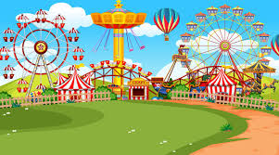
Were you at the _____________?
Yes, we were.

Slide 5
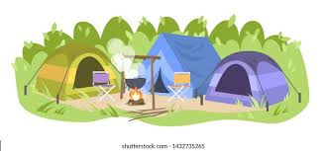
Were you at the _____________?
Yes, we were.

Slide 6

Were you at the _____________?
Yes, we were.

Slide 7

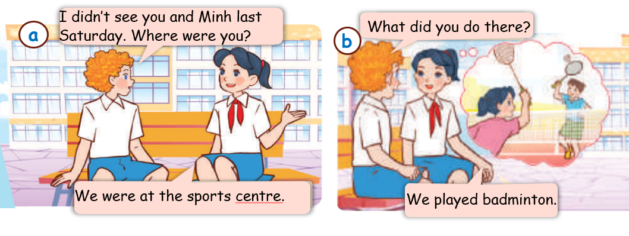
1.Look, listen and repeat
Notes:
MADE BY FACEBOOK :TRAN THI THANH TAM

Slide 8

listen (to music) /ˈlɪsn (tu ˈmjuːzɪk)/
:nghe (nhạc)
Notes:
MADE BY FACEBOOK :TRAN THI THANH TAM

Slide 9
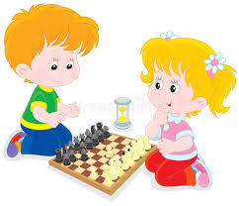
play (chess) /pleɪ (tʃes)/ chơi (cờ)
Notes:
MADE BY FACEBOOK :TRAN THI THANH TAM

Slide 10
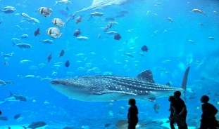
watch (the fish) /wɒtʃ (ðə fɪʃ)/
xem (cá)
Notes:
MADE BY FACEBOOK :TRAN THI THANH TAM

Slide 11

dance around the campfire:
nhảy, múa xung quanh lửa trại
Notes:
MADE BY FACEBOOK :TRAN THI THANH TAM

Slide 12

VOCABULARY
Listen to music: nghe nhạc
Play chess:chơi cờ
Wash the fish:xem cá
Dance around the campfire: nhảy , múa xung quanh lửa trại

Slide 13
PLAY GAME
GUESSING GAME

Slide 14
Guessing
Guessing?
Listen to music
Notes:
MADE BY FACEBOOK :TRAN THI THANH TAM

Slide 15
Guessing
Guessing?
Dance a round the campfire
Notes:
MADE BY FACEBOOK :TRAN THI THANH TAM

Slide 16
Guessing
Guessing?
Wash the fish
Notes:
MADE BY FACEBOOK :TRAN THI THANH TAM

Slide 17
Guessing
Guessing?
Play chess
Notes:
MADE BY FACEBOOK :TRAN THI THANH TAM

Slide 18

What did you do yesterday?
( Hôm qua các bạn đã làm gì vậy? )
We listened to music.
(Chúng tôi đã nghe nhạc.)
Notes:
MADE BY FACEBOOK :TRAN THI THANH TAM

Slide 19
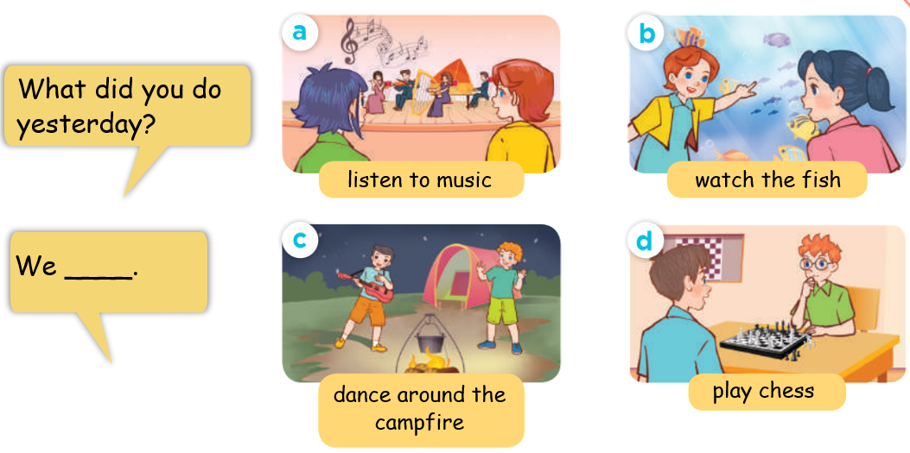
2. Listen, point and say
listened to music.
Notes:
MADE BY FACEBOOK :TRAN THI THANH TAM

Slide 20
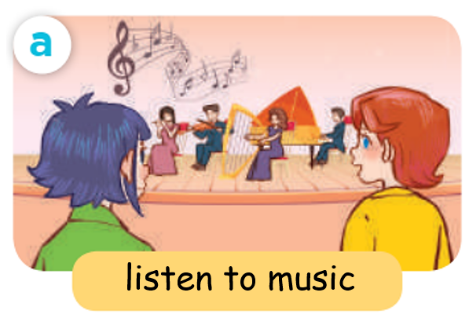
What did you do yesterday?
listened to music
We……..……. …............
Notes:
MADE BY FACEBOOK :TRAN THI THANH TAM

Slide 21
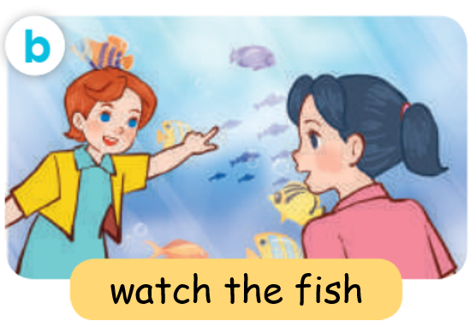
What did you do yesterday?
washed the fish
We……..……. …............
Notes:
MADE BY FACEBOOK :TRAN THI THANH TAM

Slide 22
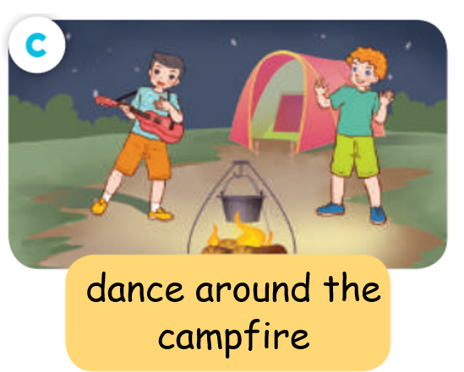
What did you do yesterday?
danced around the campfire
We….….……..……. …............
Notes:
MADE BY FACEBOOK :TRAN THI THANH TAM

Slide 23
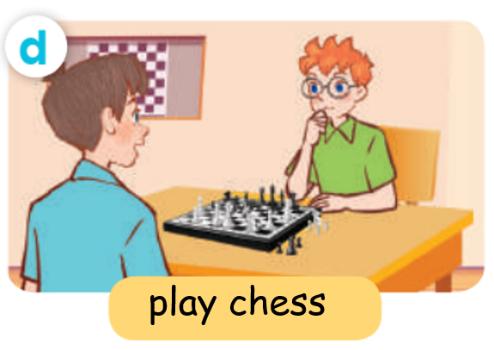
What did you do yesterday?
played chess
We……..……. …........
Notes:
MADE BY FACEBOOK :TRAN THI THANH TAM

Slide 24
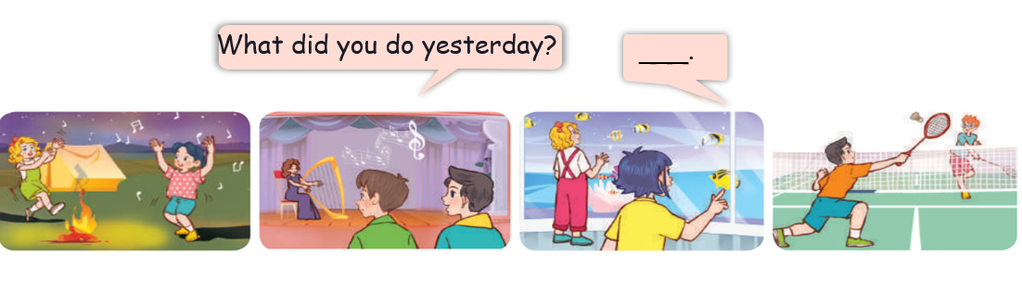
3. Let’s talk
Where were you yesterday?
What did you do there?
Notes:
MADE BY FACEBOOK :TRAN THI THANH TAM

Slide 25
SUMMARY
1.Vocabulary:
Listen to music: nghe nhạc
Play chess:chơi cờ
Wash the fish:xem cá
Dance around the campfire: nhảy , múa xung quanh lửa trại
2. Sentence pattern:
-What did you do yesterday?
(Bạn đã làm gì vào ngày hôm qua vậy?)
-> We listened to music.
(Chúng tôi nghe nhạc.)

Slide 26
Homework:
- Learn by heart vocabulary and sentence pattern
- Prepare Unit 9- lesson 2 ( 4, 5, 6)
Notes:
MADE BY FACEBOOK :TRAN THI THANH TAM

