Slide 1
UNIT 8: IN OUR CLASSROOM
LESSON 3 (1, 2, 3)

Slide 2





Warm-up

Slide 3
Game: LUCKY WHEEL
Notes:
MADE BY FACEBOOK :TRAN THI THANH TAM

Slide 4
SPIN AND SAY
under
over
above
on
In front of
Click the needle to start and then again to stop the wheel. Then READ ALOUD.
beside

Slide 5

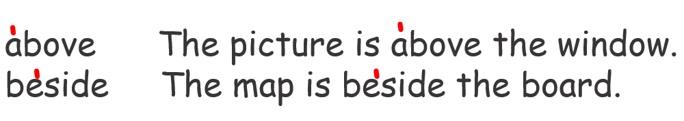
1.Listen and repeat

Slide 6
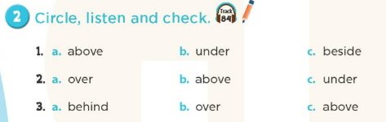

Slide 7
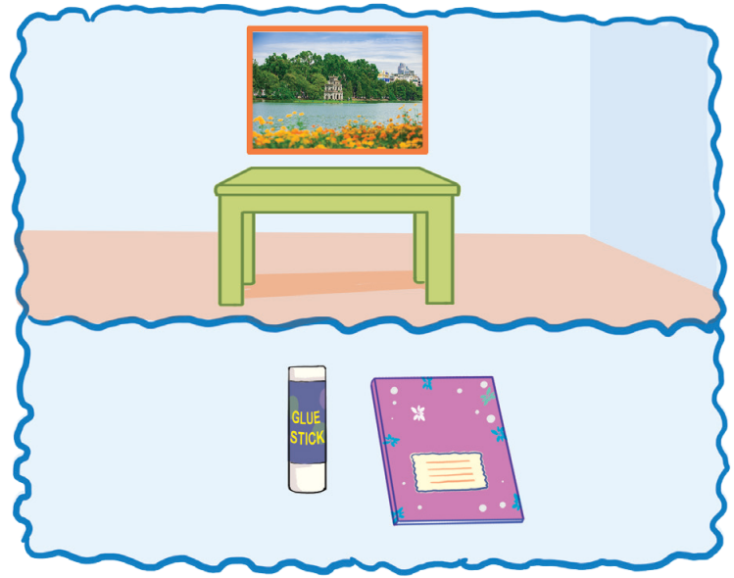
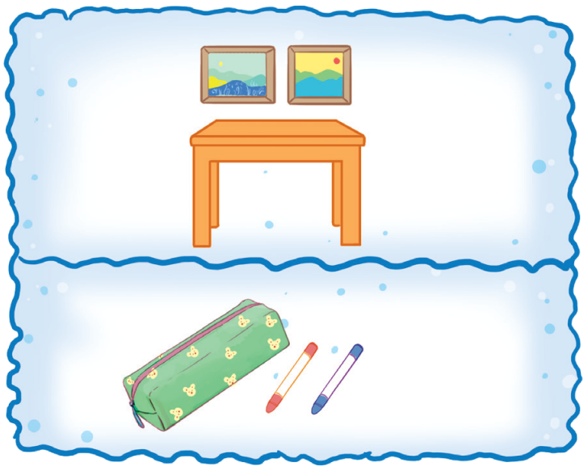
3.Let’s chant
Where is the photo?
It’s above the table. Where is the glue stick?
It’s beside the notebook.
Where are the pictures? They’re above the table. Where are the crayons? They’re beside the pencil case.

Slide 8

Game:
RING THE BELL!

Slide 9





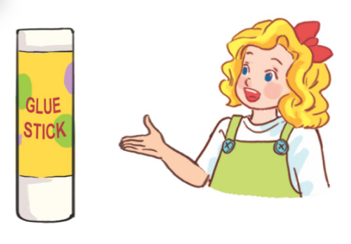


6
1
2
3
4
5
7
8
9
Choose a, b or c, then say.
10
START
Whose _______ this? It’s Mary’s.
a. glue stick
b. set square
c. pencil
Notes:
*Key: 1. b, 2. a, 3. b, 4. c

Slide 10

6
1
2
3
4
5
7
8
9
Choose a, b or c, then say.
10
START
The book is _______ the pencils.
a. on
b. beside
c. under
Notes:
*Key: 1. b, 2. a, 3. b, 4. c

Slide 11

6
1
2
3
4
5
7
8
9
Choose a, b or c, then say.
10
START
Whose _______ this? It’s Bill’s.
a. book
b. crayon
c. map
Notes:
*Key: 1. b, 2. a, 3. b, 4. c

Slide 12
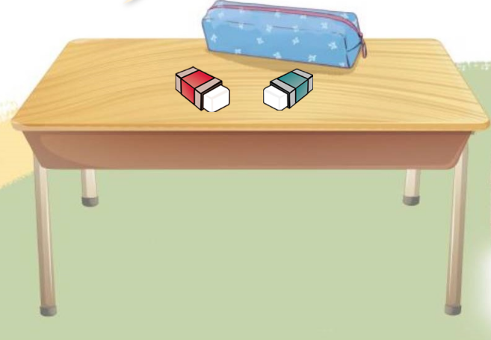
6
1
2
3
4
5
7
8
9
Choose a, b or c, then say.
10
START
The erasers are _______ pencil case.
a. above
b. over
c. In fron of
Notes:
*Key: 1. b, 2. a, 3. b, 4. c

Slide 13
Homework:
- Practice more at home
- Prepare Unit 8- lesson 3 ( 4, 5, 6)
Notes:
MADE BY FACEBOOK :TRAN THI THANH TAM

Slide 14




The bye bye song
Bye, bye.
See you tomorrow.
Bye, bye.
See you tomorrow.
Bye, bye.
See you tomorrow.
Bye, bye. Bye, bye.
The bye bye song

