Slide 1
UNIT 8:IN OUR CLASSROOM
LESSON 3 ( 4, 5, 6)

Slide 2





Warm-up

Slide 3
Sing and do actions

Slide 4
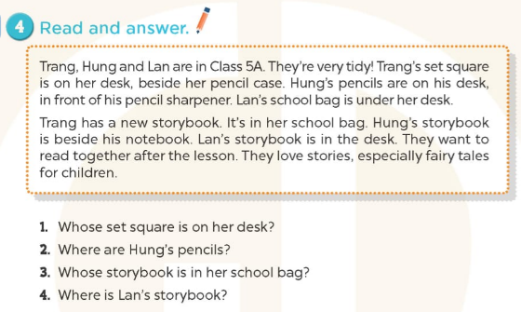



-> It’s Trang’s
->They’re in front of his pencil sharpener.
-> It’s Trang’s
-> It’s in the desk.

Slide 5
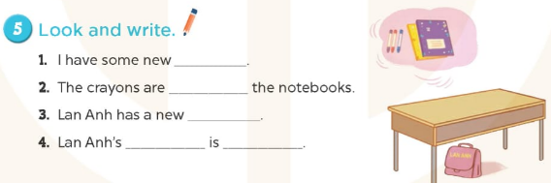
crayons
beside
school bag
school bag
under the desk

Slide 6
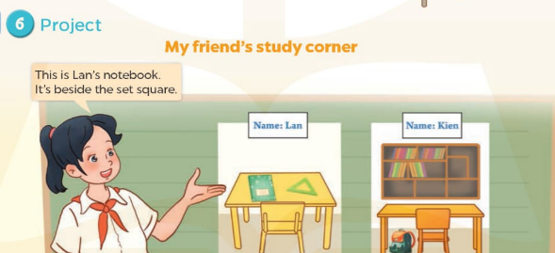

Slide 7

Let's play
LOOK AND SAY THE ANSWER

Slide 8


Question 1
The crayon is beside
the pencil case.

Slide 9



Question 2
The bike is on the tree.

Slide 10

Question 3
The books are in the school bag.

Slide 11
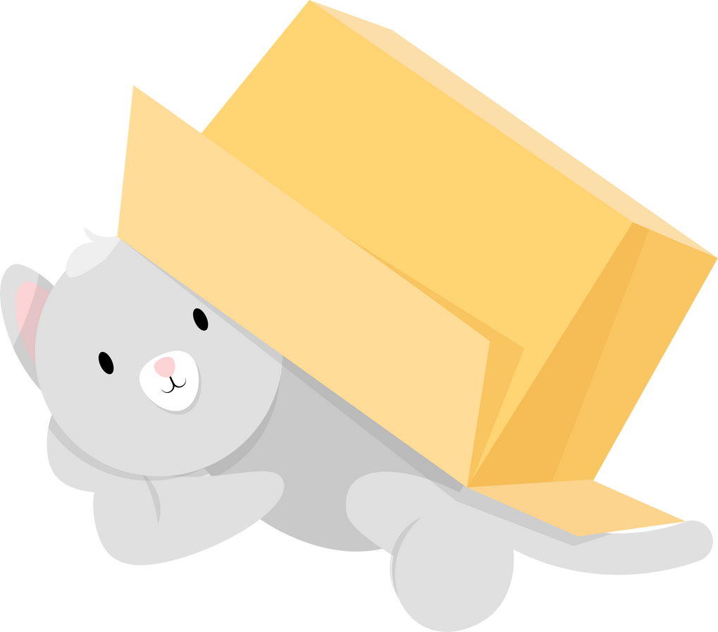
Question 4
The cat is under the box.

Slide 12

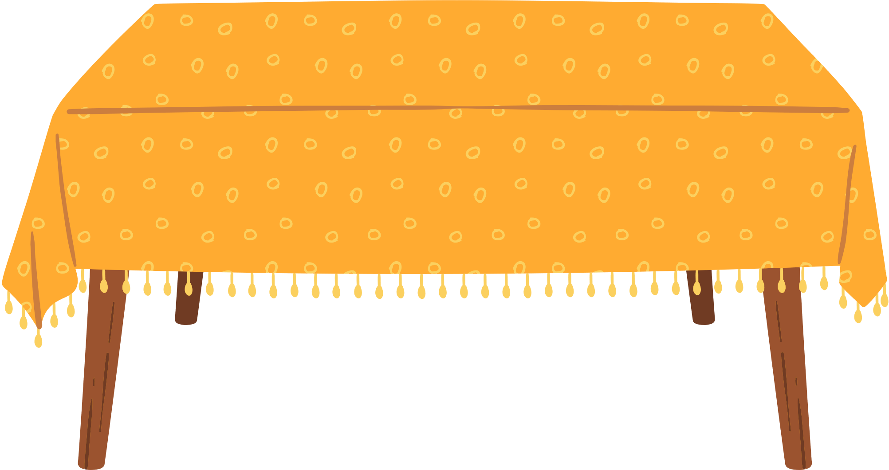
Question 5
The flowers are on the table.

Slide 13
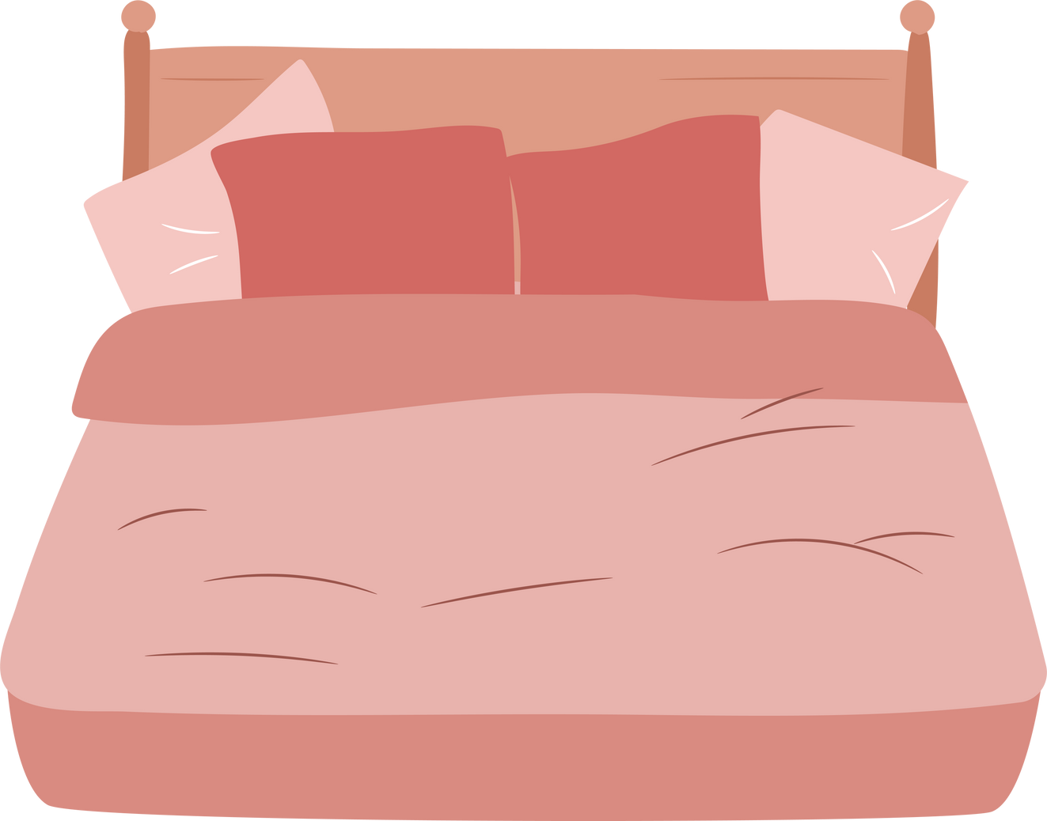
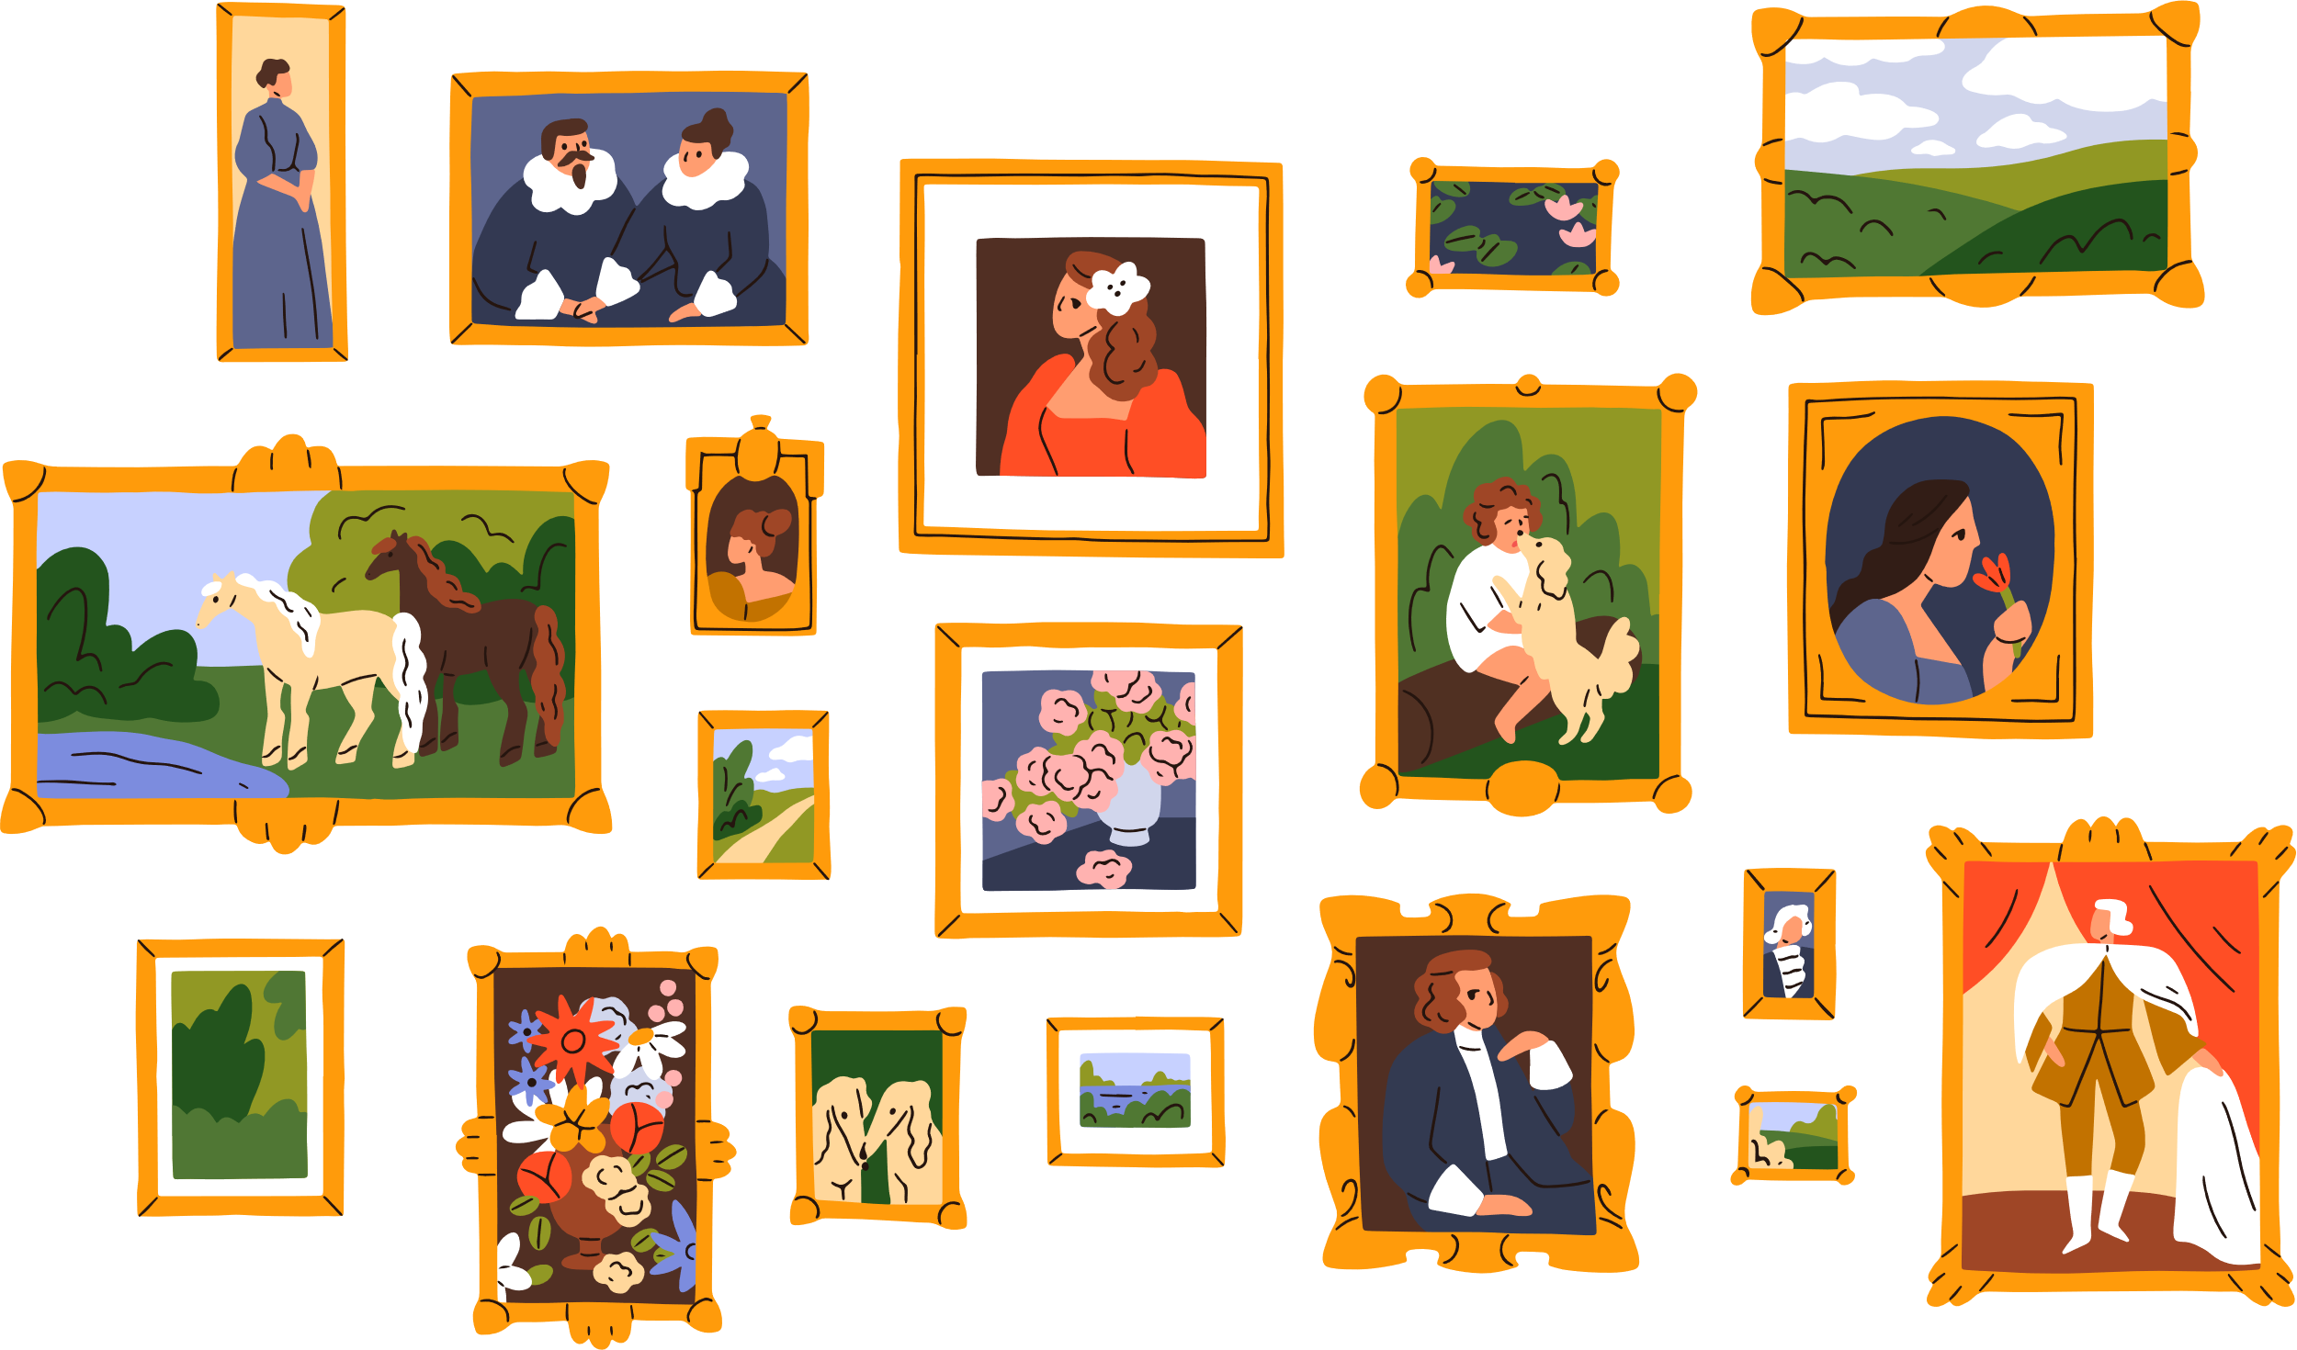
Question 6
The photos are above the bed.

Slide 14
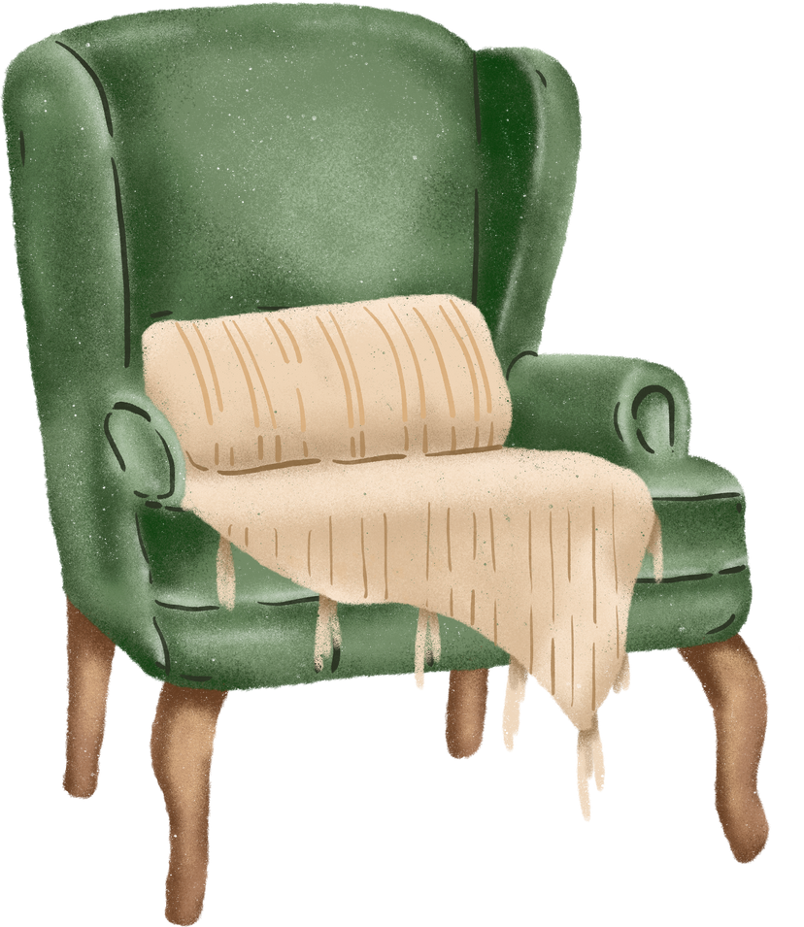
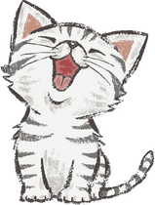
Question 7
The cat is beside the chair.

Slide 15
Homework:
- Practice more at home
- Prepare Unit 9 - lesson 1 ( 1, 2, 3)

Slide 16




The bye bye song
Bye, bye.
See you tomorrow.
Bye, bye.
See you tomorrow.
Bye, bye.
See you tomorrow.
Bye, bye. Bye, bye.
The bye bye song

