Slide 1

UNIT 12:OUR TET HOLIDAY
LESSON 1 ( 1, 2, 3)
Notes:
MADE BY FACEBOOK :TRAN THI THANH TAM

Slide 2
LET’S PLAY
GUESSING GAME

Slide 3
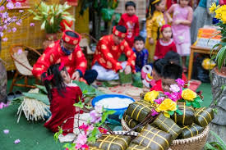
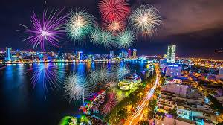
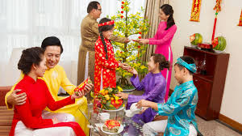
Look at these pictures and guess what festival is it
Notes:
Made by FACEBOOK: TRAN THI THANH TAM

Slide 4

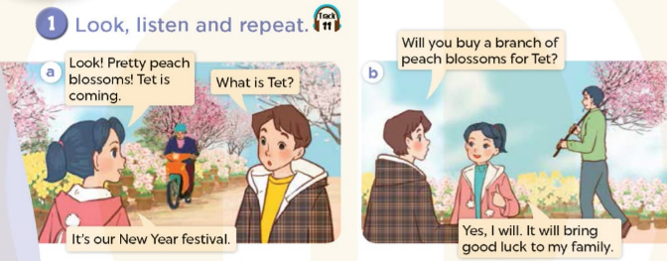
Notes:
MADE BY FACEBOOK :TRAN THI THANH TAM

Slide 5
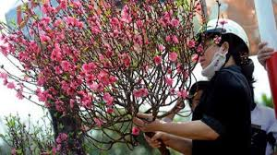
buy a branch of peach blossoms/ baɪ ə brɑːntʃ əvˌpiːtʃ ˈblɒsəm/ : mua 1 cành hoa đào
Notes:
MADE BY FACEBOOK :TRAN THI THANH TAM

Slide 6
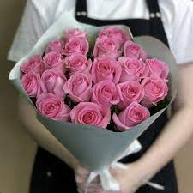
buy roses/ baɪ rəʊziz/: mua hoa hồng
Notes:
MADE BY FACEBOOK :TRAN THI THANH TAM

Slide 7
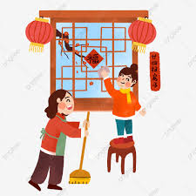
decorate the house / ˈdekəreɪt ðə haʊs/: trang trí nhà
Notes:
MADE BY FACEBOOK :TRAN THI THANH TAM

Slide 8
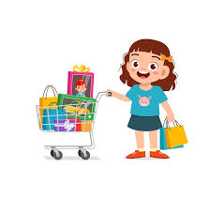
do the shopping/ duː ˈʃɒpɪŋ/
:đi mua sắm
Notes:
MADE BY FACEBOOK :TRAN THI THANH TAM

Slide 9
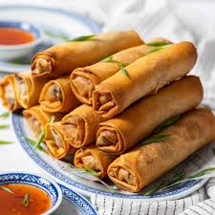
make spring rolls /meɪk ˌsprɪŋ ˈrəʊl/:
làm nem
Notes:
MADE BY FACEBOOK :TRAN THI THANH TAM

Slide 10
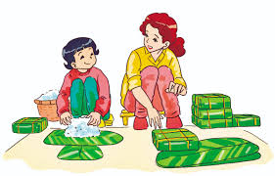
make banh chung/meɪk banh tʃʊŋ/
: làm bánh chưng
Notes:
MADE BY FACEBOOK :TRAN THI THANH TAM

Slide 11
VOCABULARY
Buy a branch of peach blossoms:mua 1 cành hoa đào
Buy roses: mua hoa hồng
Decorate the house:trang trí nhà
Do the shopping: đi mua sắm
Make banh chung: làm bánh chưng
Make spring rolls: làm nem

Slide 12
Let's play
Check vocabulary
Guessing game
Notes:
Made by Facebook: TRAN THI THANH TAM

Slide 13
Guessing
Guessing?
Buy a branch of peach blossoms
Notes:
MADE BY FACEBOOK :TRAN THI THANH TAM

Slide 14
Guessing
Guessing?
Do the shopping
Notes:
MADE BY FACEBOOK :TRAN THI THANH TAM

Slide 15
Guessing
Guessing?
Decorate the house
Notes:
MADE BY FACEBOOK :TRAN THI THANH TAM

Slide 16
Guessing
Guessing?
Buy roses
Notes:
MADE BY FACEBOOK :TRAN THI THANH TAM

Slide 17
Guessing
Guessing?
Make banh chung
Notes:
MADE BY FACEBOOK :TRAN THI THANH TAM

Slide 18
Guessing
Guessing?
Make spring rolls
Notes:
MADE BY FACEBOOK :TRAN THI THANH TAM

Slide 19
Hỏi và trả lời xem có phải ai đó có làm một việc gì vào dip tết không
Will you decorate the house for Tet?
( Bạn sẽ trang trí nhà vào dịp tết phải không?)
Yes, I will.
(Vâng, tôi sẽ.)

Slide 20
Hỏi và trả lời xem có phải ai đó có làm một việc gì vào dip tết không
Will you make banh chung for Tet?
( Bạn sẽ làm bánh chưng vào dịp tết phải không?)
No, I won’t. I’ll make spring rolls.
(Không, tôi sẽ làm nem.)

Slide 21
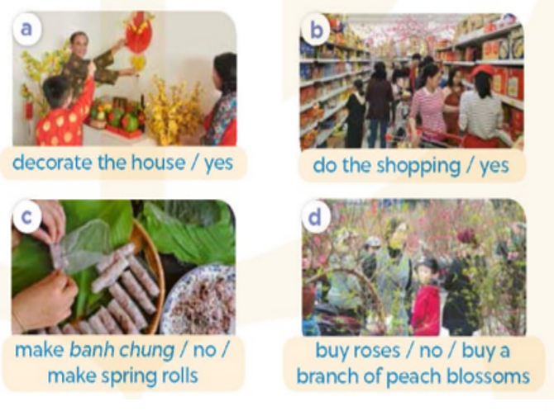
2.Listen, point and say
decorate the house
Will you.................................for Tet ?
make springs rolls.
Yes, I will.
No, I won’t. I’ll..............................
Notes:
MADE BY FACEBOOK :TRAN THI THANH TAM

Slide 22
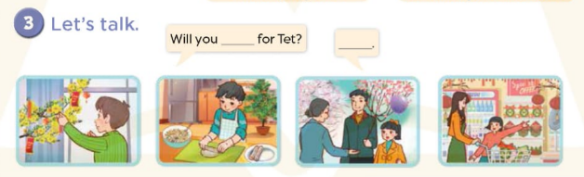
Notes:
MADE BY FACEBOOK :TRAN THI THANH TAM

