Slide 1

UNIT 12:OUR TET HOLIDAY
LESSON 1 (4, 5, 6)
Notes:
MADE BY FACEBOOK :TRAN THI THANH TAM

Slide 2

Let's play
LISTEN AND CHOOSE TRUE OR FALSE
Notes:
MADE BY FACEBOOK :TRAN THI THANH TAM

Slide 3



TRUE
FALSE
Notes:
MADE BY FACEBOOK :TRAN THI THANH TAM

Slide 4
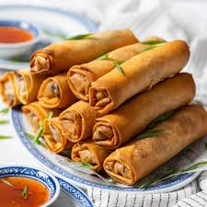
TRUE
FALSE
Notes:
MADE BY FACEBOOK :TRAN THI THANH TAM

Slide 5
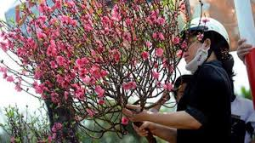
TRUE
FALSE
Notes:
MADE BY FACEBOOK :TRAN THI THANH TAM

Slide 6
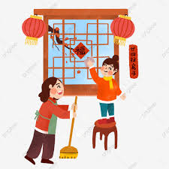
TRUE
FALSE
Notes:
MADE BY FACEBOOK :TRAN THI THANH TAM

Slide 7
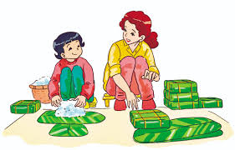
TRUE
FALSE
Notes:
MADE BY FACEBOOK :TRAN THI THANH TAM

Slide 8
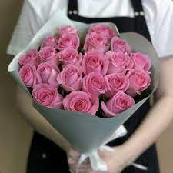
TRUE
FALSE
Notes:
MADE BY FACEBOOK :TRAN THI THANH TAM

Slide 9
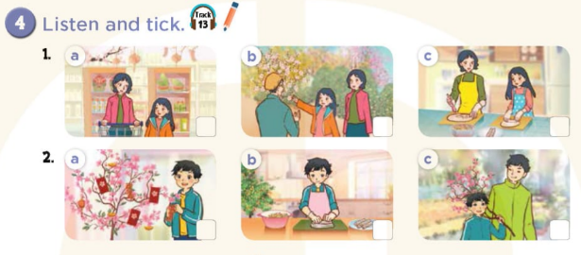

Notes:
MADE BY FACEBOOK :TRAN THI THANH TAM

Slide 10
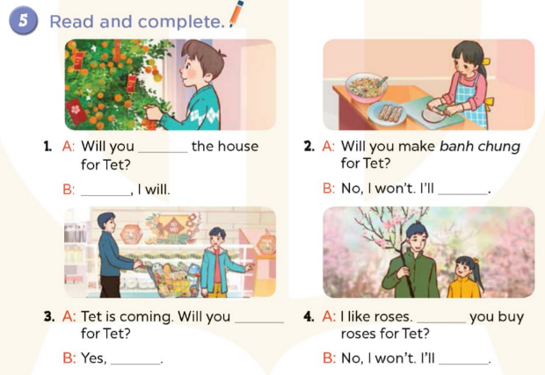
decorate
Yes
make spring rolls
do the shopping
Will
I will
buy a branch of
peach blossoms
Notes:
MADE BY FACEBOOK :TRAN THI THANH TAM

Slide 11
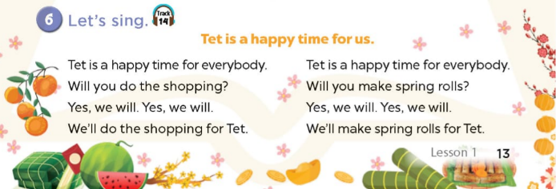
Notes:
MADE BY FACEBOOK :TRAN THI THANH TAM

Slide 12
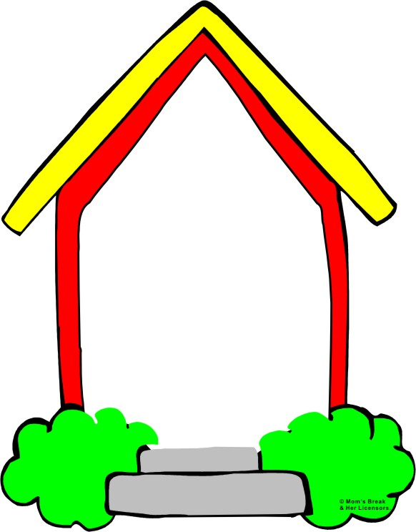

Homework:
- Practice more at home
- Prepare Unit 12- Lesson 2 ( 1, 2, 3)
Notes:
MADE BY FACEBOOK :TRAN THI THANH TAM

