Slide 1


Unit 11
Lesson 3 – Period 1

Slide 2
WARM UP

Slide 3
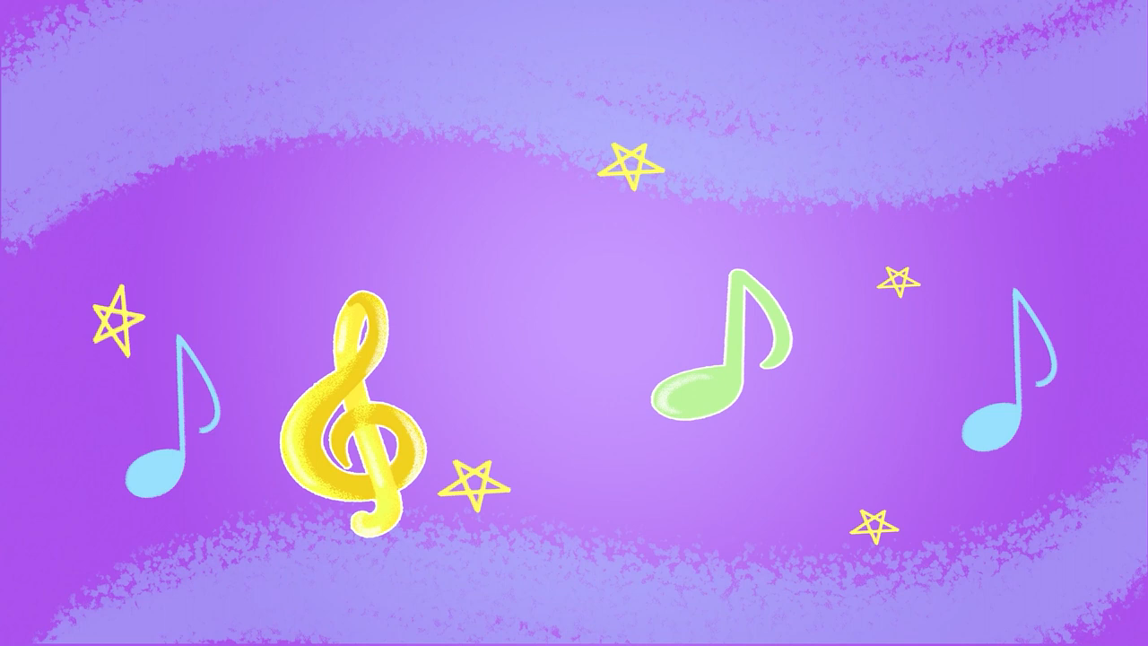

Slide 4
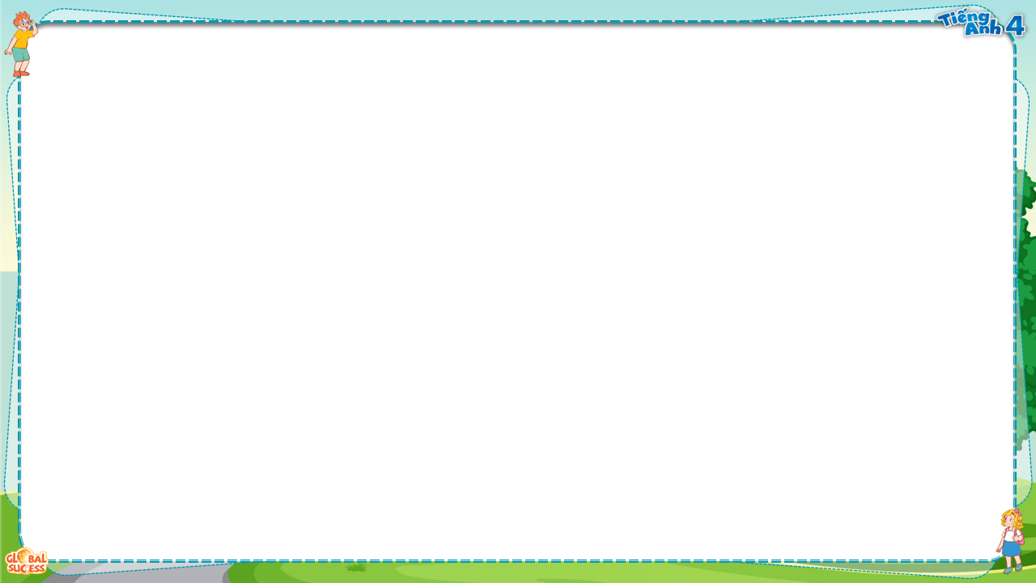
Phonics

Slide 5
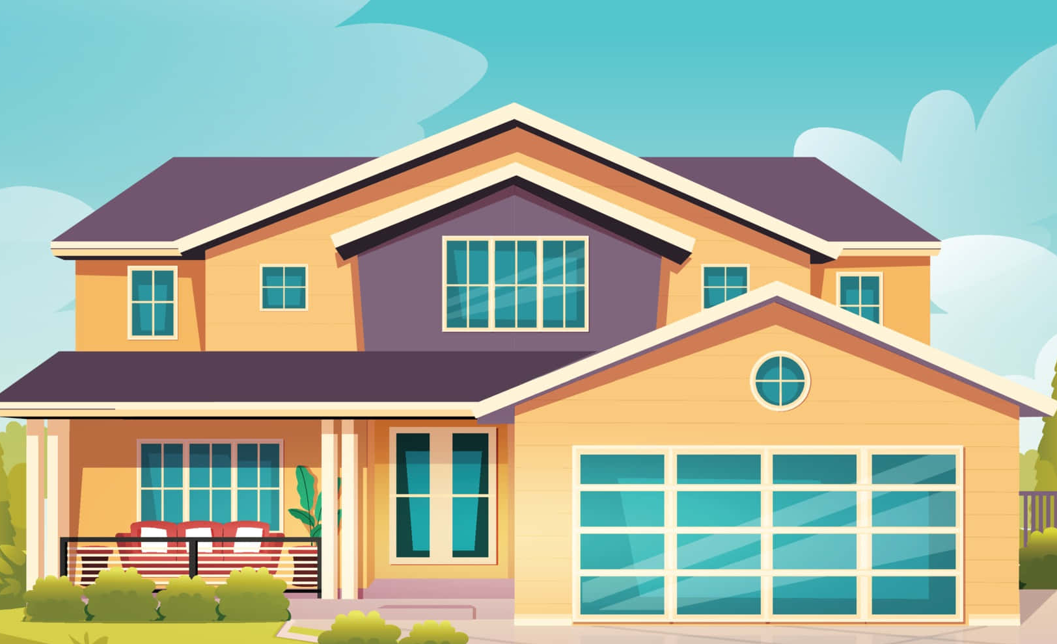
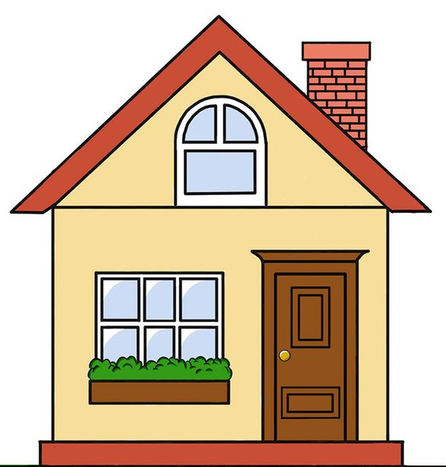
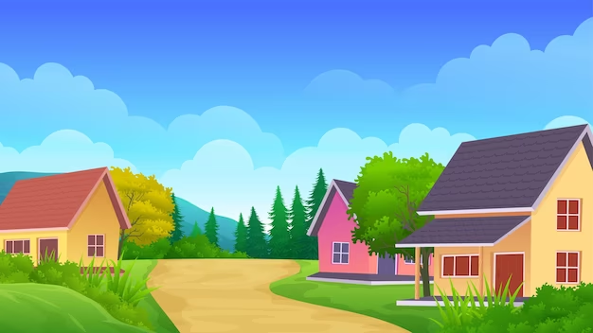
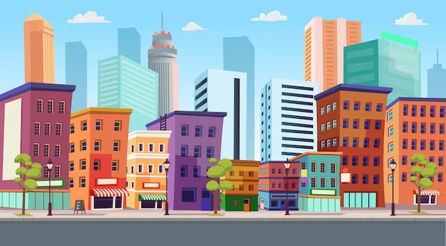
Phonics
big
i
/ɪ/
/bɪg/
village
/ˈvɪlɪdʒ/
city
/ˈsɪti/

Slide 6

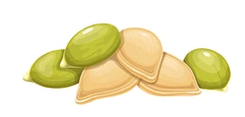
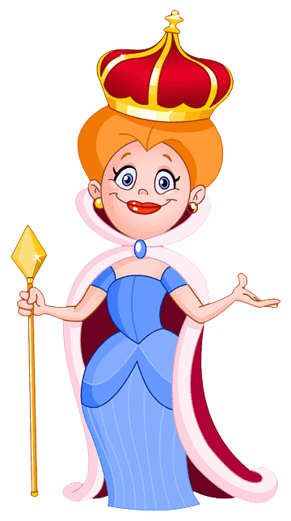
Phonics
street
ee
/i:/
/striːt/
seed
/siːd/
queen
/kwiːn/

Slide 7
Phonics
i
/ɪ/
ee
/i:/

Slide 8


LET’S PLAY!
Look and say
Play

Slide 9
Check
Next
village

Slide 10
is
Check
Next
seed

Slide 11
is
Check
Next
big

Slide 12
Check
Next
city

Slide 13
is
Check
Next
street

Slide 14
is
Check
Next
queen

Slide 15

1
Listen and repeat.
i
big
They live in a big village.
ee
street
They live in Green Street.

Slide 16
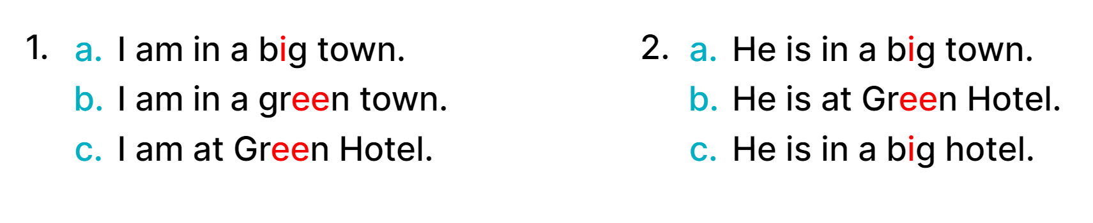

2
Listen and circle.
1.
2.
a. I am in a big town.
b. I am in a green town.
c. I am at Green Hotel.
a. He is in a big town.
b. He is at Green Hotel.
c. He is in a green town.

Slide 17


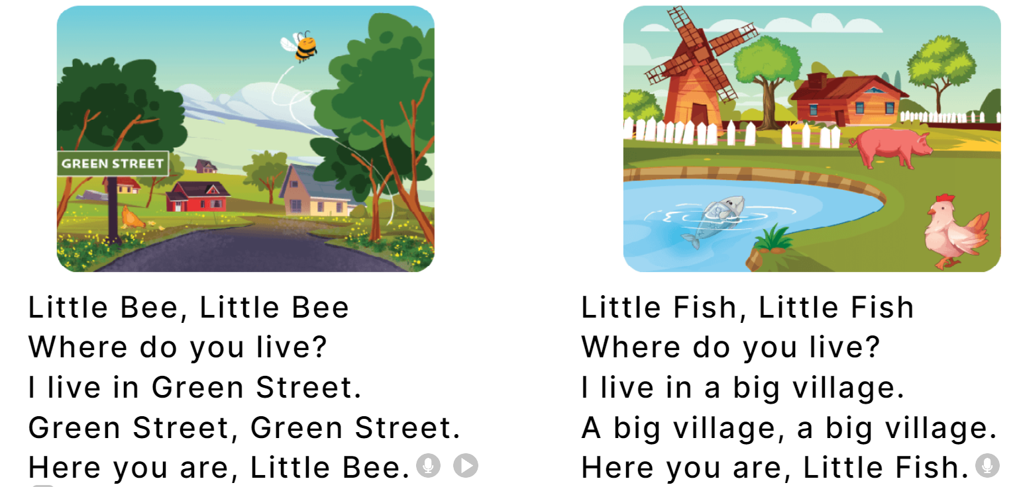
2
Let’s chant.
Little Bee,
Little Bee, Little Bee
Where do you live?
I live in Green Street.
Green Street, Green Street.
Here you are, Little Bee.
Little Fish, Little Fish
Where do you live?
I live in a big village.
A big village, a big village.
Here you are, Little Fish.
Little Bee
Little Fish,
Little Fish
Where do you live?
Where do you live?
I live
in Green Street.
I live
in a big village.
Green Street,
Green Street.
A big village,
a big village.
Here you are, Little Bee.
Here you are, Little Fish.

Slide 18

2
Let’s chant.
Little Bee,
Little Bee, Little Bee
Where do you live?
I live in Green Street.
Green Street, Green Street.
Here you are, Little Bee.
Little Fish, Little Fish
Where do you live?
I live in a big village.
A big village, a big village.
Here you are, Little Fish.
Little Bee
Little Fish,
Little Fish
Where do you live?
Where do you live?
I live
in Green Street.
I live
in a big village.
Green Street,
Green Street.
A big village,
a big village.
Here you are, Little Bee.
Here you are, Little Fish.

