Slide 1


Unit 11
Lesson 1 – Period 2

Slide 2
WARM UP

Slide 3

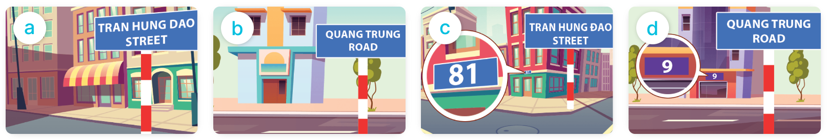
MsPham
0936082789
(Bạn sống ở đâu?)
Where do you live?
I live _________.
(Tớ sống ở____)
in Tran Hung Dao Street
in Quang Trung Road
at 81 Tran Hung Dao Street
at 9 Quang Trung Road

Slide 4


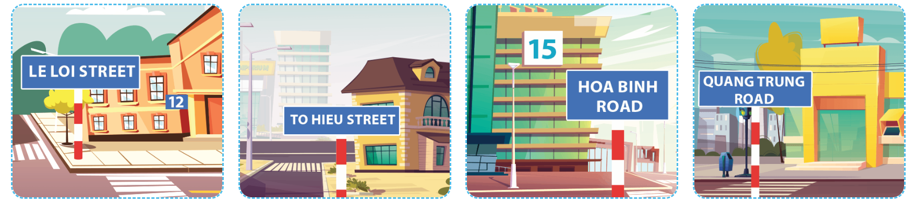
4
Listen and tick or cross.
1
2
3
4
✓
✗
✗
✓

Slide 5
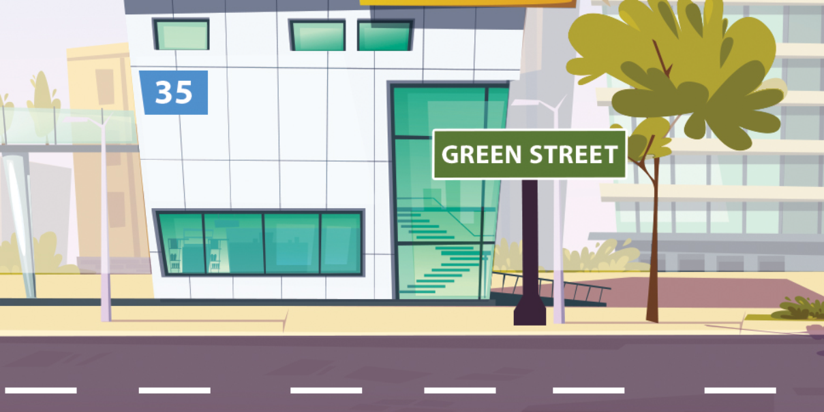
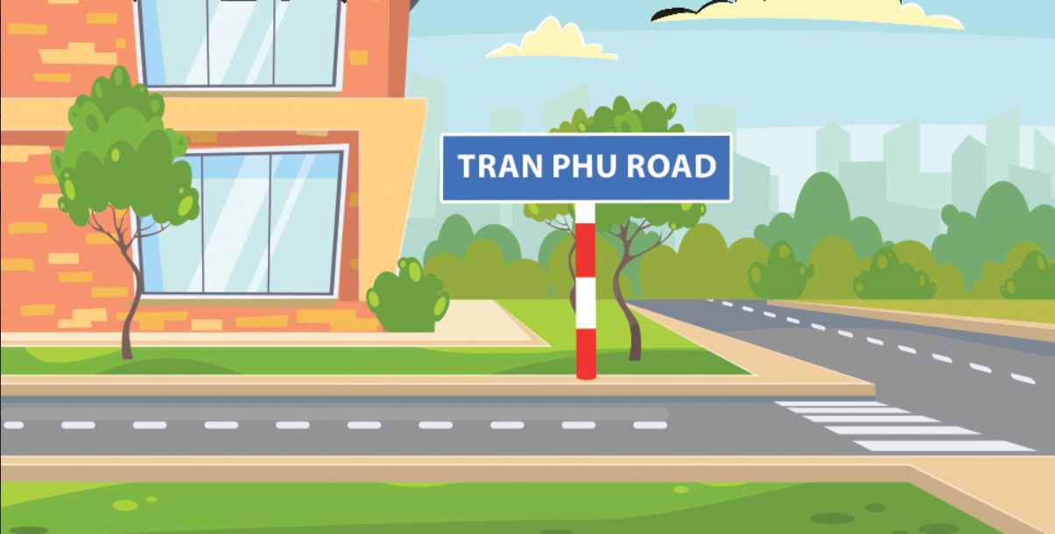
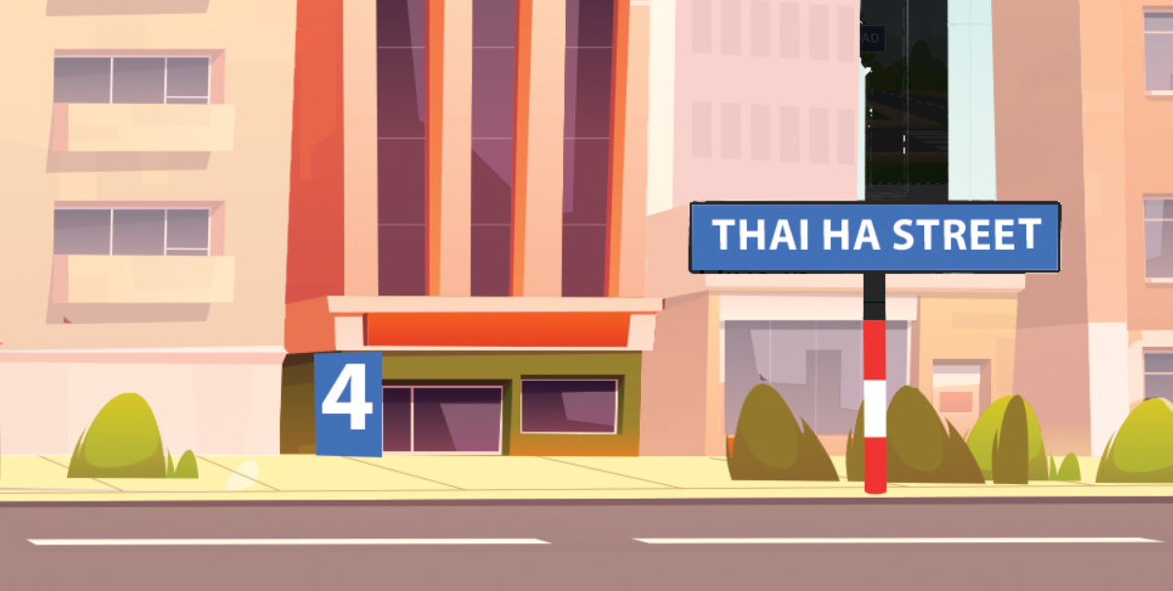
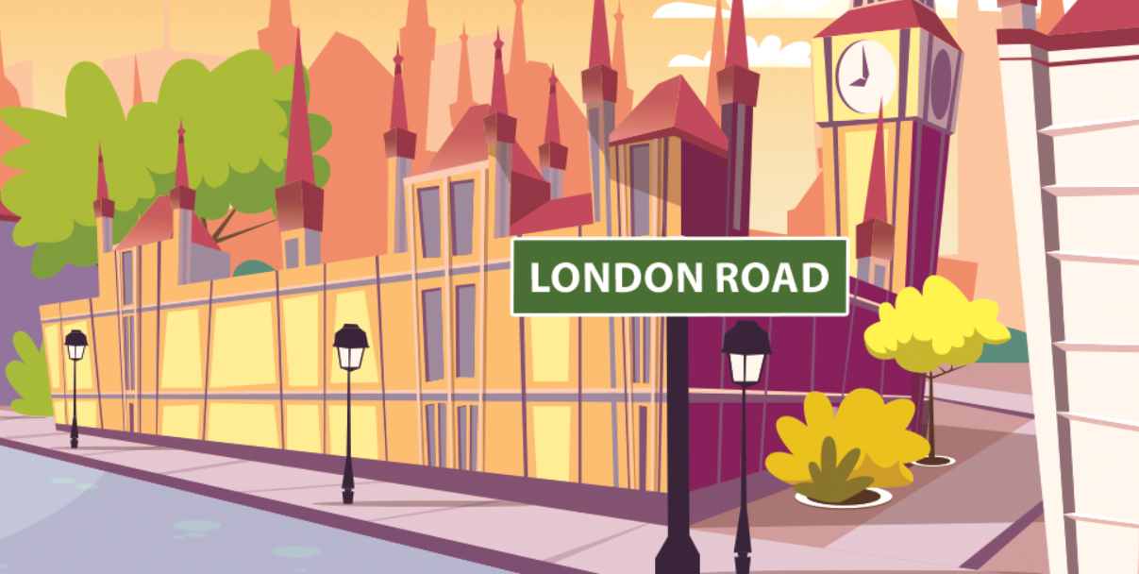
5
Look, listen and read.
1. Where do you live?
I live at ________________.
2. Where do you live?
I live in ________________.
35 Green street
Tran Phu road
Where
live
3. __________ do you live?
I live at ________________.
4. Where do you __________?
I live __________________.
4 Thai Ha street
in London road

Slide 6

6
Let’s play.
Whispering

