Slide 1


Unit 11
Lesson 2 – Period 1

Slide 2

https://www.youtube.com/watch?v=3EDzQeh7mWE

Slide 3


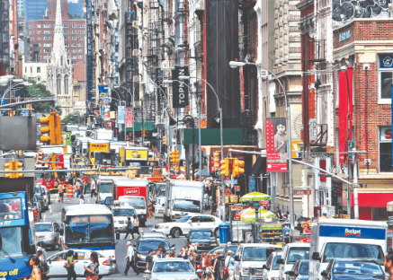
Vocabulary
busy
/ˈbɪzi/
bận rộn, nhộn nhịp
a busy street
Đường phố nhộn nhịp

Slide 4
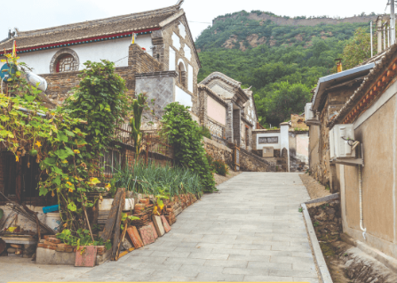
Vocabulary
quiet
/ˈkwaɪət/
Yên tĩnh
a quiet village
Ngôi làng yên tĩnh

Slide 5
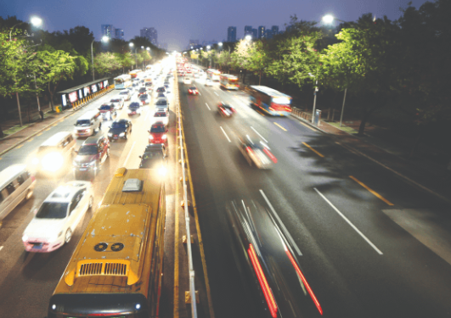
Vocabulary
noisy
/ˈnɔɪzi/
Ồn ào, huyên náo
a noisy road
Con đường ồn ào

Slide 6
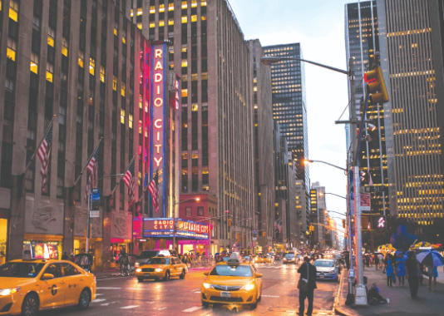
Vocabulary
big
/ˈbɪg/
To, lớn
a big city
Thành phố lớn

Slide 7
Vocabulary
busy
: bận rộn, nhộn nhịp
quiet
: Yên tĩnh
big
: To, lớn
noisy
: Ồn ào

Slide 8
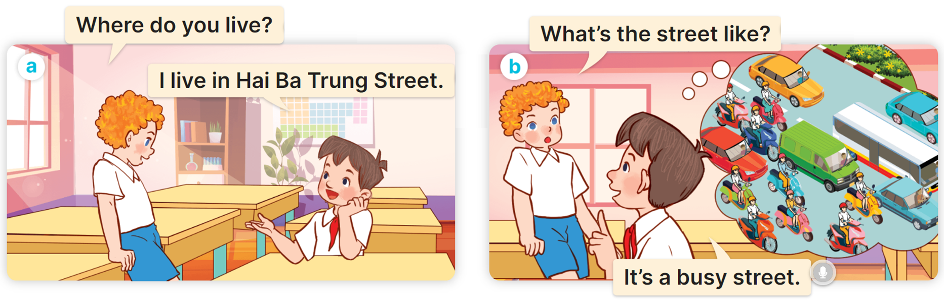

1
Look, listen and read.

Slide 9


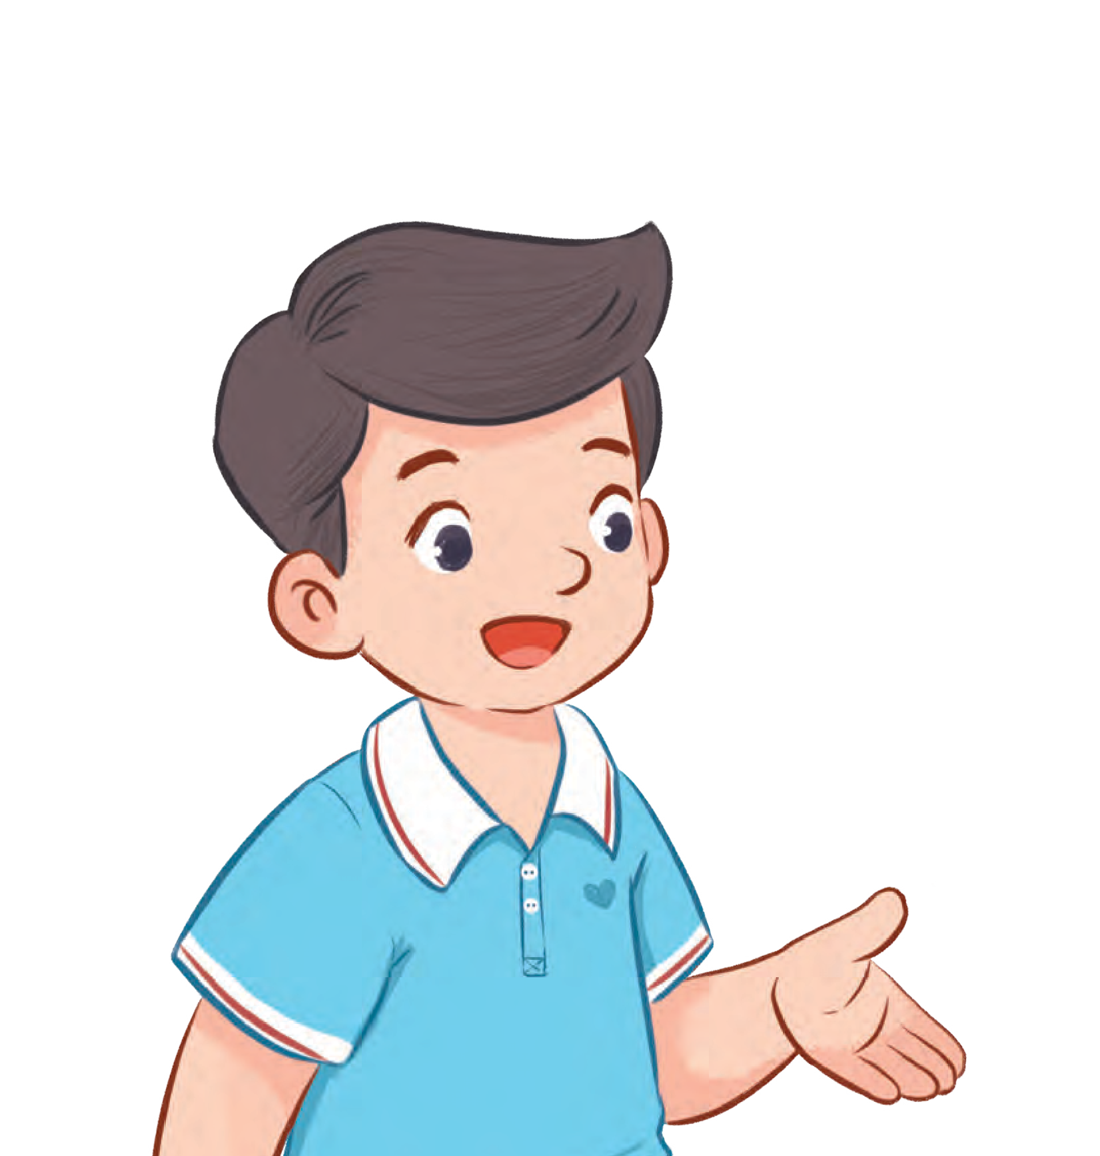
1
Cách hỏi đặc điểm một nơi nào đó như thế nào
What’s the ______ like?
It’s _________.
Ex:
What’s the road like?
It’s noisy road.

Slide 10
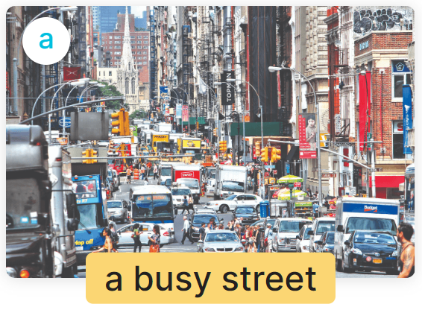
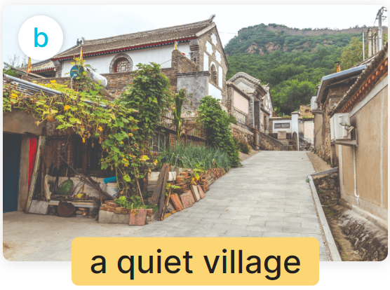
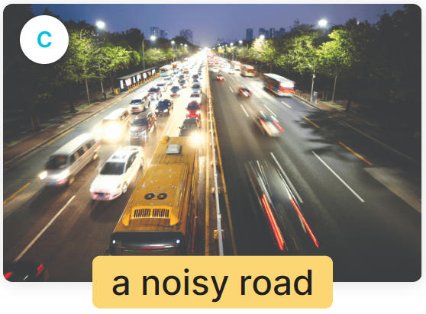
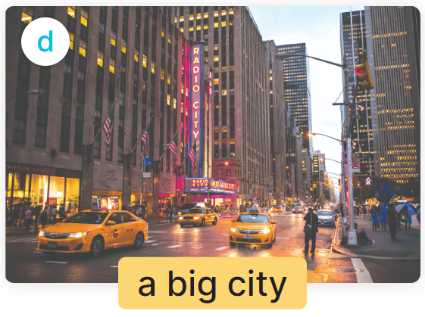
2
Listen, point and say.
What’s the ______ like?
It’s _________.

Slide 11

2
Listen, point and say.
What’s the street like?
It’s a busy street.

Slide 12
2
Listen, point and say.
What’s the village like?
It’s a quiet village.

Slide 13
2
Listen, point and say.
What’s the road like?
It’s a noisy road.

Slide 14
2
Listen, point and say.
What’s the city like?
It’s a big city.

Slide 15
2
Listen, point and say.
What’s the ______ like?
It’s _________.

Slide 16
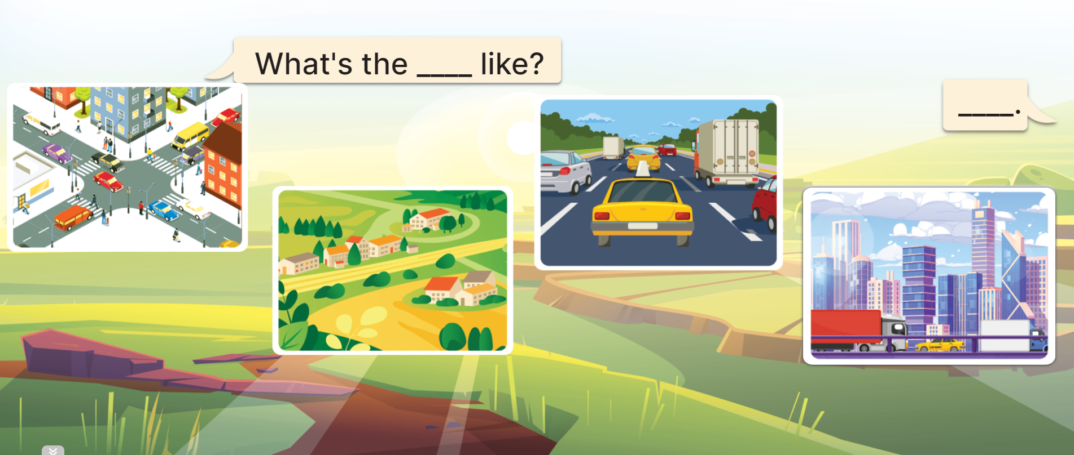
3
Let’s talk.
What’s the ____________ like?
road
It’s _____
_________.
a
noisy road

Slide 17
3
Let’s talk.
What’s the ____________ like?
city
It’s _____
_________.
a
big city

Slide 18

3
Let’s talk.
MsPham
0936082789
What’s the ____________ like?
It’s _____
_________.

Slide 19
MsPham
0936082789
(______ như thế nào?)
What’s the ______ like?
It’s _________.
(Đó là ____)

