Slide 1



Unit 11
Lesson 2 – Period 2

Slide 2

Review

Slide 3
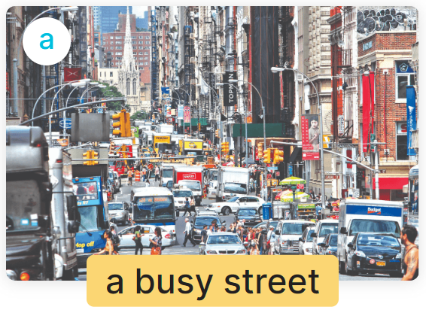
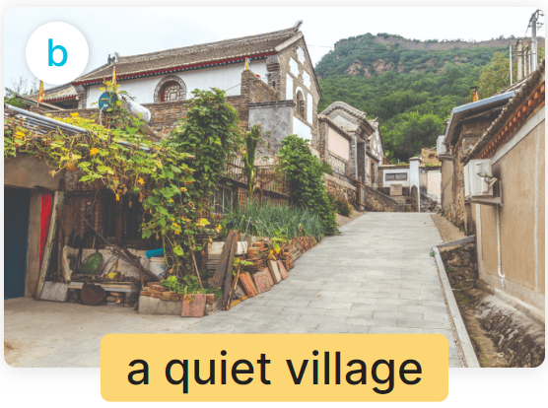
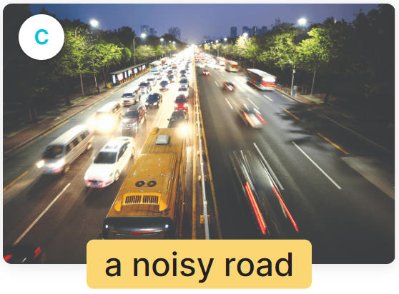
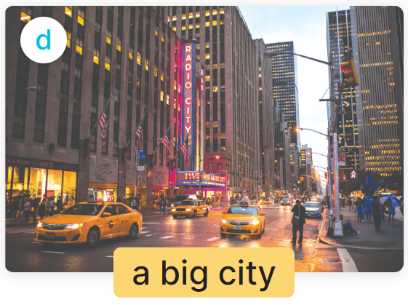
MsPham
0936082789
(______ như thế nào?)
What’s the ______ like?
It’s _________.
(Đó là ____)

Slide 4


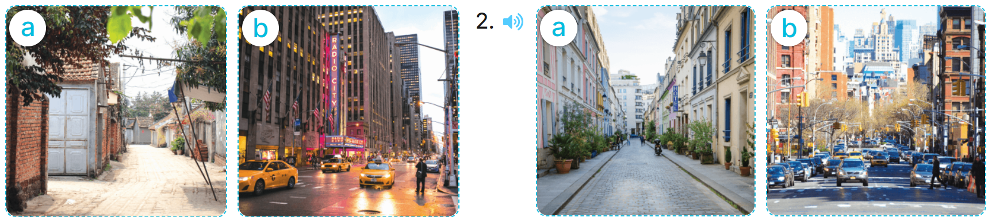
4
Listen and tick.
1
2
✓
✓

Slide 5
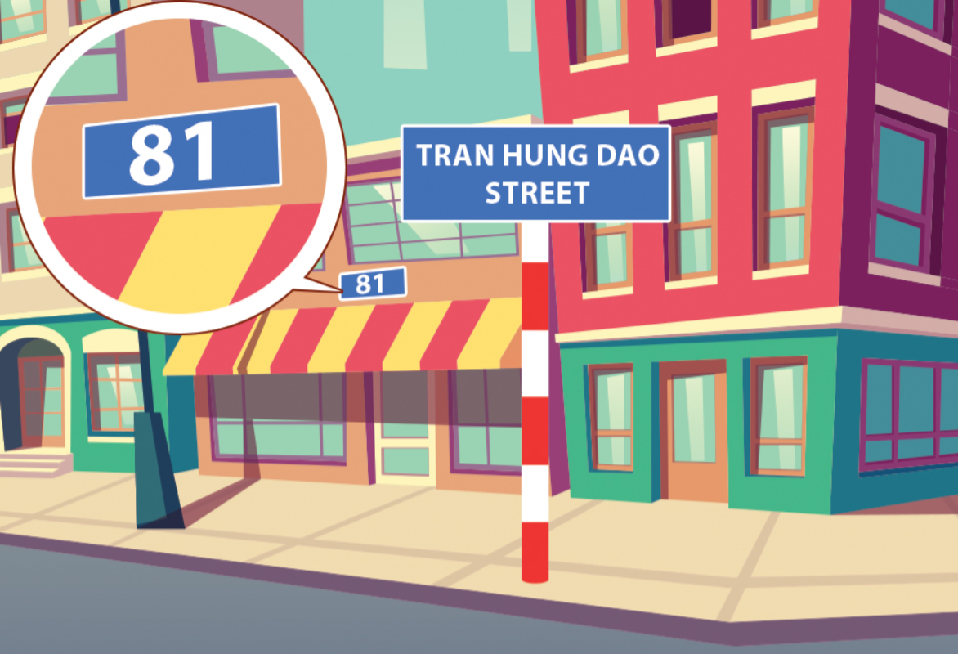
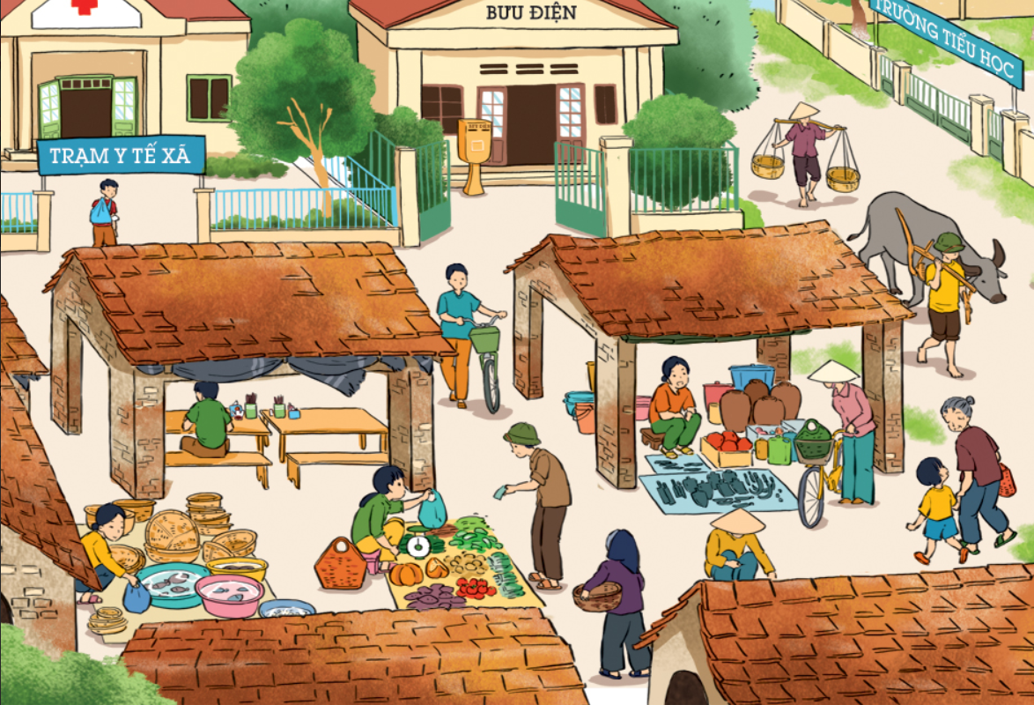
5
Look, listen and read.
A: Where do you live?
B: I live at ________________.
A: What's the street like?
B: It’s a ______________ street.
A: Where do you ____________?
B: I live in a ________________.
A: _______ the street ________?
B: It’s a busy village.
live
81 Tran Hung Dao Street
village
What's
like
quiet

Slide 6

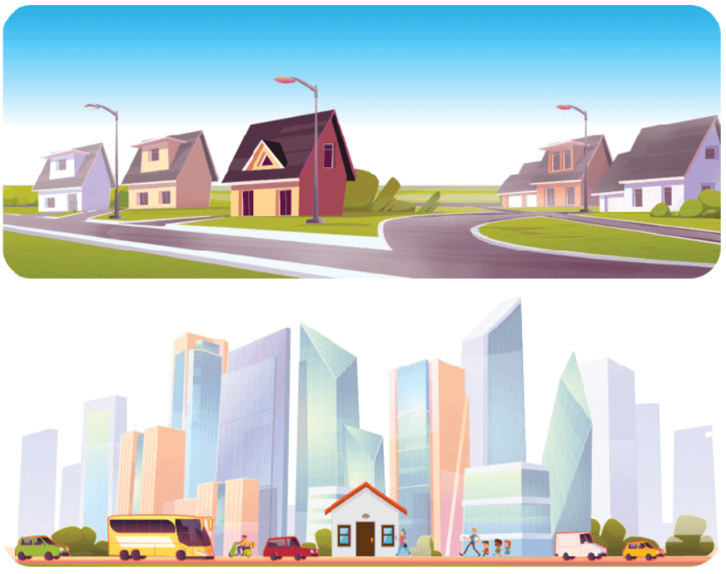
6
Let’s sing.
My house
I live in a house.
I live in a house.
It's a small house
In a quiet street
In a big town.
I live in a house.
It's a small house
In a busy street
In a big city.
It's a small house
In a quiet street
In a big town.
I live in a house.
It's a small house
In a busy street
In a big city.

Slide 7

6
Let’s sing.
My house
I live in a house.
I live in a house.
It's a small house
In a quiet street
In a big town.
I live in a house.
It's a small house
In a busy street
In a big city.
It's a small house
In a quiet street
In a big town.
I live in a house.
It's a small house
In a busy street
In a big city.

Slide 8

6
Let’s sing.
My house
I live in a house.
I live in a house.
It's a small house
In a quiet street
In a big town.
I live in a house.
It's a small house
In a busy street
In a big city.
It's a small house
In a quiet street
In a big town.
I live in a house.
It's a small house
In a busy street
In a big city.

