Slide 1


Unit 11
Lesson 3 – Period 2

Slide 2
WARM UP

Slide 3

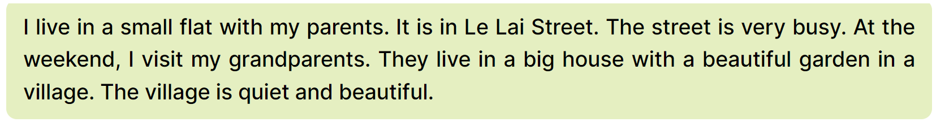
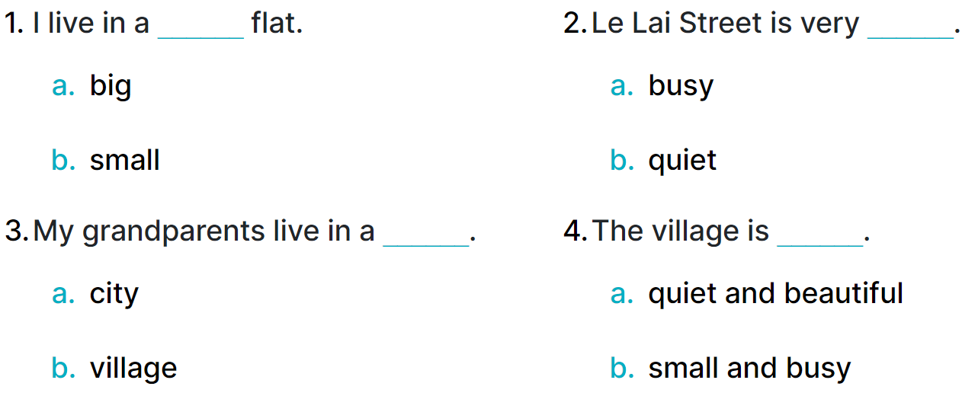

4
Read and circle.
MsPham
0936082789

Slide 4
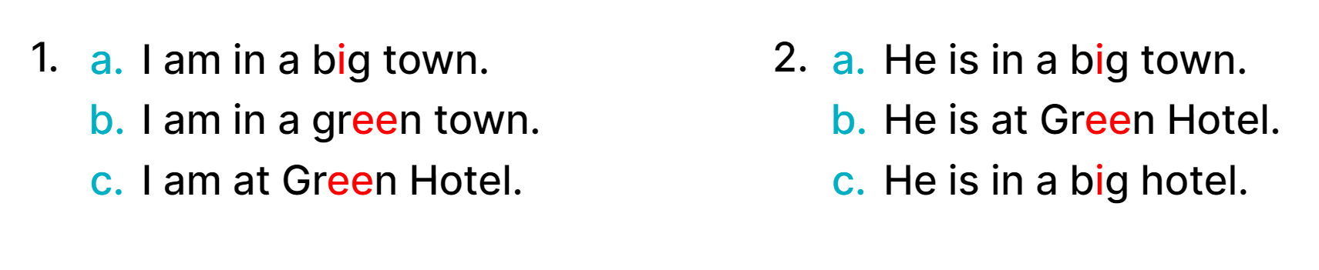
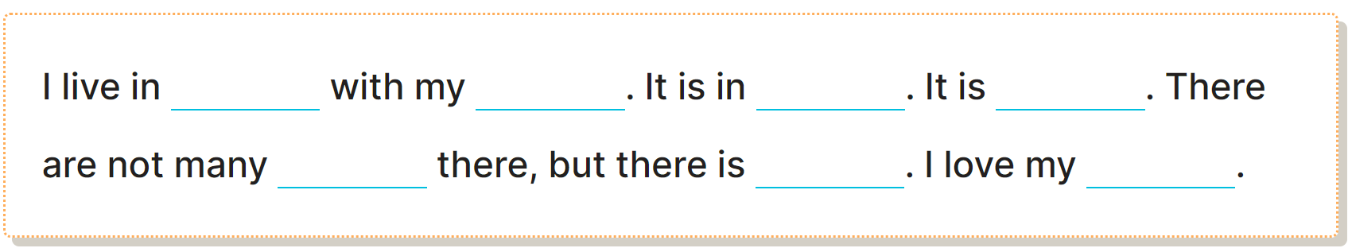
5
Let’s write.

Slide 5
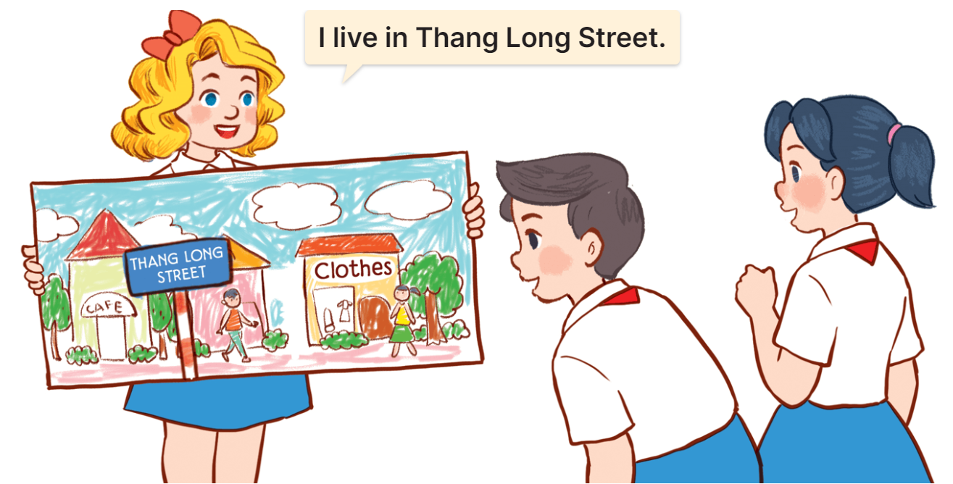
6
My beautiful home
Project

