Slide 1
UNIT 12: OUR TET HOLIDAY
LESSON 3 ( 4, 5, 6)

Slide 2
Let's play
WHAT’S MISSING?
Notes:
MADE BY FACEBOOK :TRAN THI THANH TAM

Slide 3

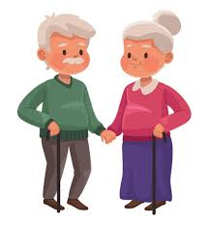

grandparents
?
Notes:
MADE BY FACEBOOK :TRAN THI THANH TAM

Slide 4
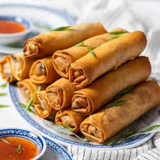
Spring rolls
?
Notes:
MADE BY FACEBOOK :TRAN THI THANH TAM

Slide 5
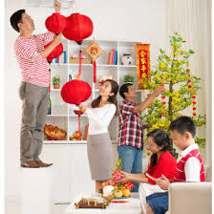
decorate
?
Notes:
MADE BY FACEBOOK :TRAN THI THANH TAM

Slide 6
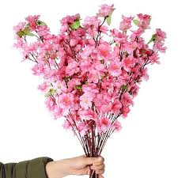
?
Peach blossoms
Notes:
MADE BY FACEBOOK :TRAN THI THANH TAM

Slide 7
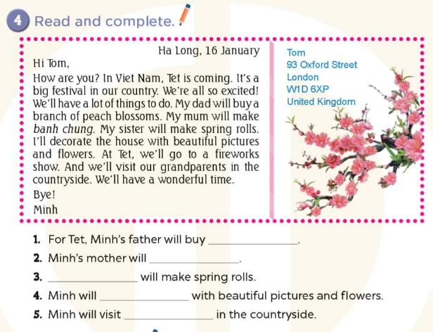





a branch of peach blossoms
make banh chung
Minh’s sister
decorate the house
his grandparents
Notes:
MADE BY FACEBOOK :TRAN THI THANH TAM

Slide 8
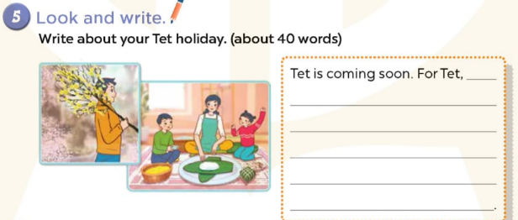
Notes:
MADE BY FACEBOOK :TRAN THI THANH TAM

Slide 9
5. Look and write
Write a bout you Tet holiday ( about 40 words)
Suggested answer:
Tet is coming soon. For Tet, I will buy a branch of peach blossoms. I help my mother to make spring rolls. My father and my mother make banh chung. My family decorate the house and have a New Year Party together.
Notes:
MADE BY FACEBOOK :TRAN THI THANH TAM

Slide 10
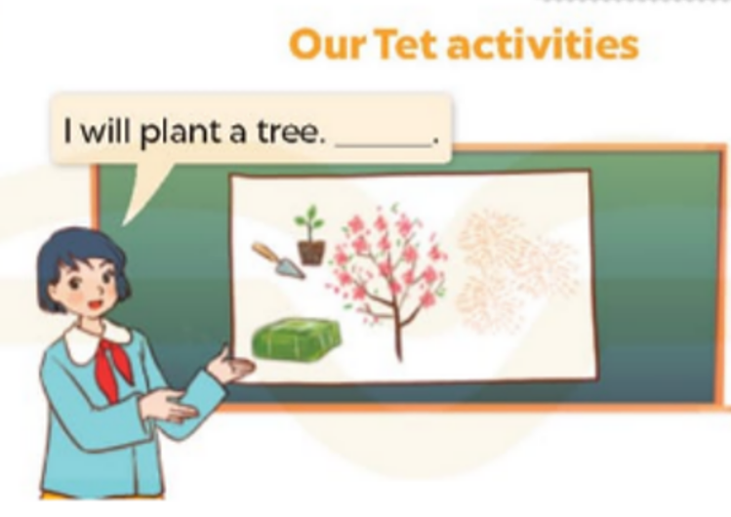
6. Project
Notes:
MADE BY FACEBOOK :TRAN THI THANH TAM

