Slide 1










Unit 12
Jobs
Lesson 1 – Period 1

Slide 2

a farmer
/ əˈfɑːmə/
Nông dân

Slide 3
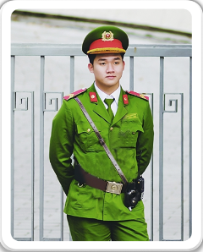
a policeman
/ə pəˈliːsmən/
Cảnh sát (nam)

Slide 4

a teacher
/əˈtiːtʃər/
Giáo viên

Slide 5

an office worker
/ ən ˈɒfɪs wɜːkə/
Nhân viên văn phòng

Slide 6
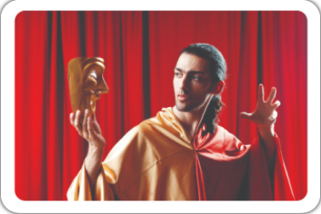
an actor
/ ən ˈæktə/
Diễn viên (nam)

Slide 7
Vocabulary
a policeman
: Cảnh sát
a teacher
: Giáo viên
a farmer
: Nông dân
an office worker
: Nhân viên văn phòng
an actor
: Diễn viên nam

Slide 8
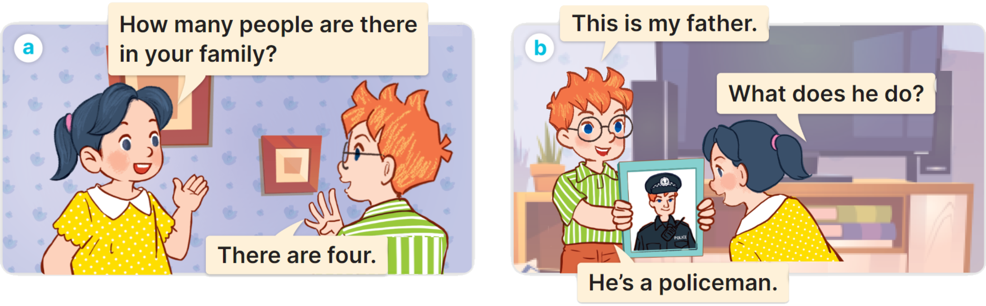

1
Look, listen and read.

Slide 9
1
Cách hỏi một người nào đó làm nghề gì:
What does he/she/name do?
(Anh ấy/cô ấy làm nghề gì?)
(Anh ấy / cô ấy là một ______)
He’s/She’s a/an + job.
Ex:

Slide 10

2
Listen, point and say.
What does he/she do?
He’s/She’s _____.
a farmer
a policeman
an office worker
an actor

Slide 11


2
Listen, point and say.
What does she do?
She’s a farmer.

Slide 12


2
Listen, point and say.
What does he do?
He’s a policeman.

Slide 13

2
Listen, point and say.
What does she do?
She’s an office worker.

Slide 14
2
Listen, point and say.
What does he do?
He’s an actor.

Slide 15
2
Listen, point and say.
What does he/she do?
He’s/She’s _____.
a farmer
a policeman
an office worker
an actor

Slide 16
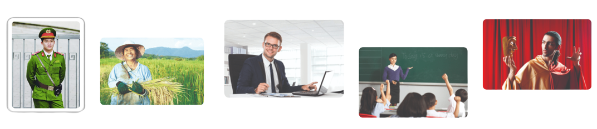
3
Let’s talk.
What does he/she/name do?
He’s/She’s _____.

Slide 17

What does he/she do?
He’s/She’s _____.
an actor
an office worker
a policeman
a farmer
a teacher

