Slide 1
UNIT 12: OUR TET HOLIDAY
LESSON 2 ( 1, 2, 3)
Notes:
MADE BY FACEBOOK :TRAN THI THANH TAM

Slide 2



PLAY GAME
WHISPER GAME
Notes:
Step 2: Have groups put the posters on the desk and practice the presentation. Encourage all members in the group to present. Go around the classroom and offer help where necessary.

Slide 3



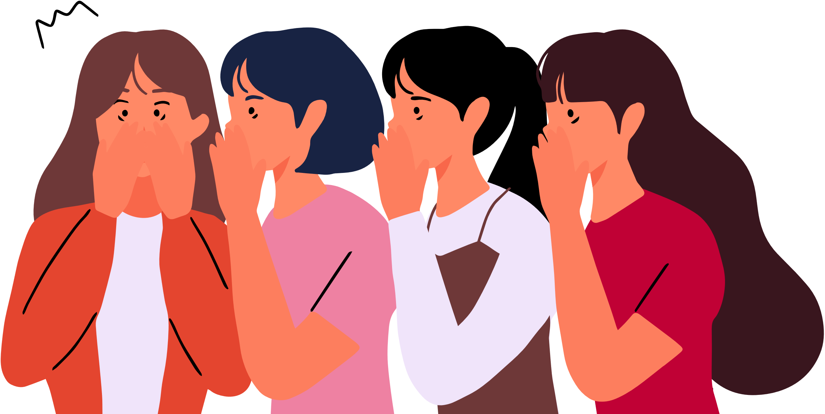

Will you make spring roll for Tet?
Notes:
Step 5: Invite a few pairs to point at the pictures and say the questions and answers in front of the class.

Slide 4

Will you do the shopping for Tet?
Notes:
Step 5: Invite a few pairs to point at the pictures and say the questions and answers in front of the class.

Slide 5
I will buy a branch of peach blossoms for Tet.
Notes:
Step 5: Invite a few pairs to point at the pictures and say the questions and answers in front of the class.

Slide 6
My father will make banh chung for Tet.
Notes:
Step 5: Invite a few pairs to point at the pictures and say the questions and answers in front of the class.

Slide 7
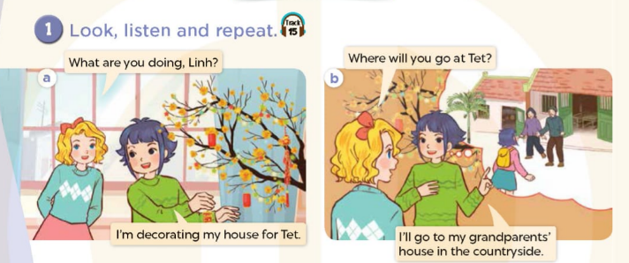

Notes:
MADE BY FACEBOOK :TRAN THI THANH TAM

Slide 8

fireworks show /ˈfaɪəwɜːks ʃəʊ/
: màn trình diễn pháo hoa
Notes:
MADE BY FACEBOOK :TRAN THI THANH TAM

Slide 9

New Year party /njuː jɪə(r) ˈpɑːti/
: tiệc năm mới
Notes:
MADE BY FACEBOOK :TRAN THI THANH TAM

Slide 10

flower festival /ˈflaʊə ˈfestɪvl/
: hội chợ hoa
Notes:
MADE BY FACEBOOK :TRAN THI THANH TAM

Slide 11
VOCABULARY
Fireworks show:màn trình diễn pháo hoa
New year party: tiệc năm mới
Flower festival: hội chợ hoa

Slide 12
1.New year party
A
B
2.Flower festival
C
3.Fireworks show
D
Notes:
MADE BY FACEBOOK :TRAN THI THANH TAM

Slide 13
Hỏi xem ai đó sẽ đi đâu vào dịp tết
Where will you go at Tet?
( Bạn sẽ đi đâu vào dịp tết? )
I’ll go to my grandparents’ house.
(Tôi sẽ đến nhà ông bà.)
Notes:
MADE BY FACEBOOK :TRAN THI THANH TAM

Slide 14
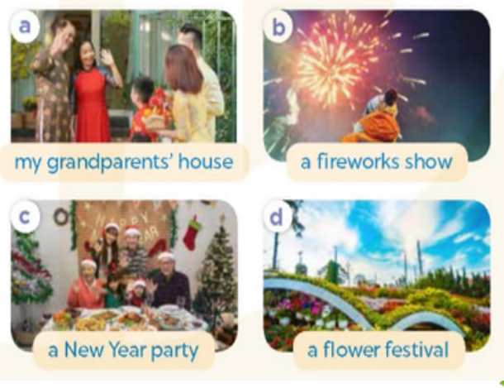
2.Listen, point and say
Where will you go at Tet?
my grandparents’ house
I’ll go to..................…..................
Notes:
MADE BY FACEBOOK :TRAN THI THANH TAM

Slide 15
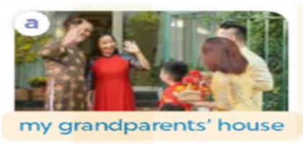
Where will you go at Tet?
my grandparents’ house
I’ll go to................…..................
Notes:
MADE BY FACEBOOK :TRAN THI THANH TAM

Slide 16
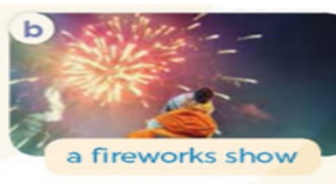
Where will you go at Tet?
a fireworks show
I’ll go to................…..................
Notes:
MADE BY FACEBOOK :TRAN THI THANH TAM

Slide 17
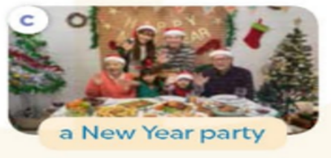
Where will you go at Tet?
a New Year party
I’ll go to................…..................
Notes:
MADE BY FACEBOOK :TRAN THI THANH TAM

Slide 18

Where will you go at Tet?
a flower festival
I’ll go to................…..................
Notes:
MADE BY FACEBOOK :TRAN THI THANH TAM

Slide 19
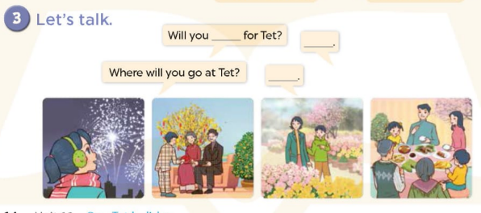
Notes:
MADE BY FACEBOOK :TRAN THI THANH TAM

