Slide 1
UNIT 12: OUR TET HOLIDAY
LESSON 2 ( 4, 5, 6)
Notes:
MADE BY FACEBOOK :TRAN THI THANH TAM

Slide 2

LET’S PLAY
Chinese Whispers

Slide 3
Chinese Whispers
Group 1
Group 2
I’ll go to my grandparents’ house.
I’ll go to a fireworks show.
Notes:
Made by Facebook: TRAN THI THANH TAM

Slide 4

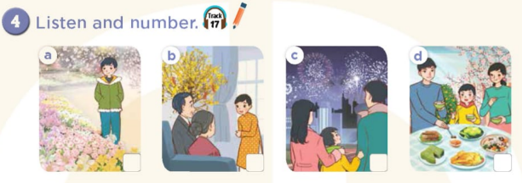
2
1
4
3
Notes:
MADE BY FACEBOOK :TRAN THI THANH TAM

Slide 5
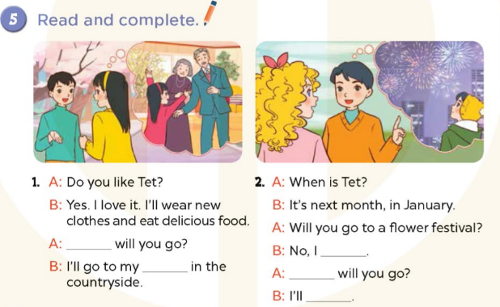
Where
won’t
grandparents’ house
Where
go to a fireworks show
Notes:
MADE BY FACEBOOK :TRAN THI THANH TAM

Slide 6
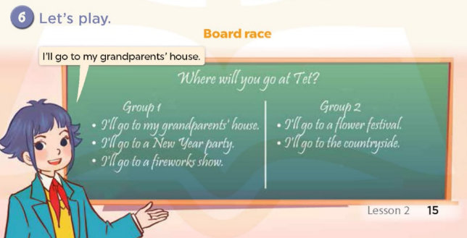
Notes:
MADE BY FACEBOOK :TRAN THI THANH TAM

