Slide 1

UNIT 12:OUR TET HOLIDAY
LESSON 3 (1, 2, 3)
Notes:
MADE BY FACEBOOK :TRAN THI THANH TAM

Slide 2
Game: LUCKY WHEEL
Notes:
MADE BY FACEBOOK :TRAN THI THANH TAM

Slide 3

SPIN AND SAY
house
party
shopping
fireworks
decorate
Click the needle to start and then again to stop the wheel. Then READ ALOUD.
flowers

Slide 4
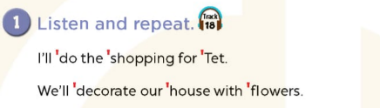

Notes:
MADE BY FACEBOOK :TRAN THI THANH TAM

Slide 5
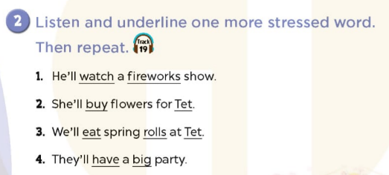
Notes:
MADE BY FACEBOOK :TRAN THI THANH TAM

Slide 6

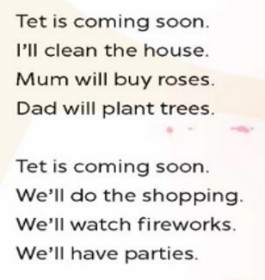
3. Let’s chant
Notes:
MADE BY FACEBOOK :TRAN THI THANH TAM

