Slide 1
Unit 13
Appearance
Lesson 1 – Period 1

Slide 2

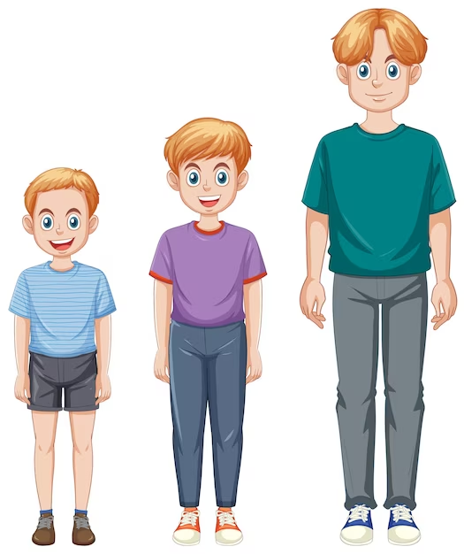

short
tall
/ʃɔːt/
/tɔːl/
thấp
cao

Slide 3
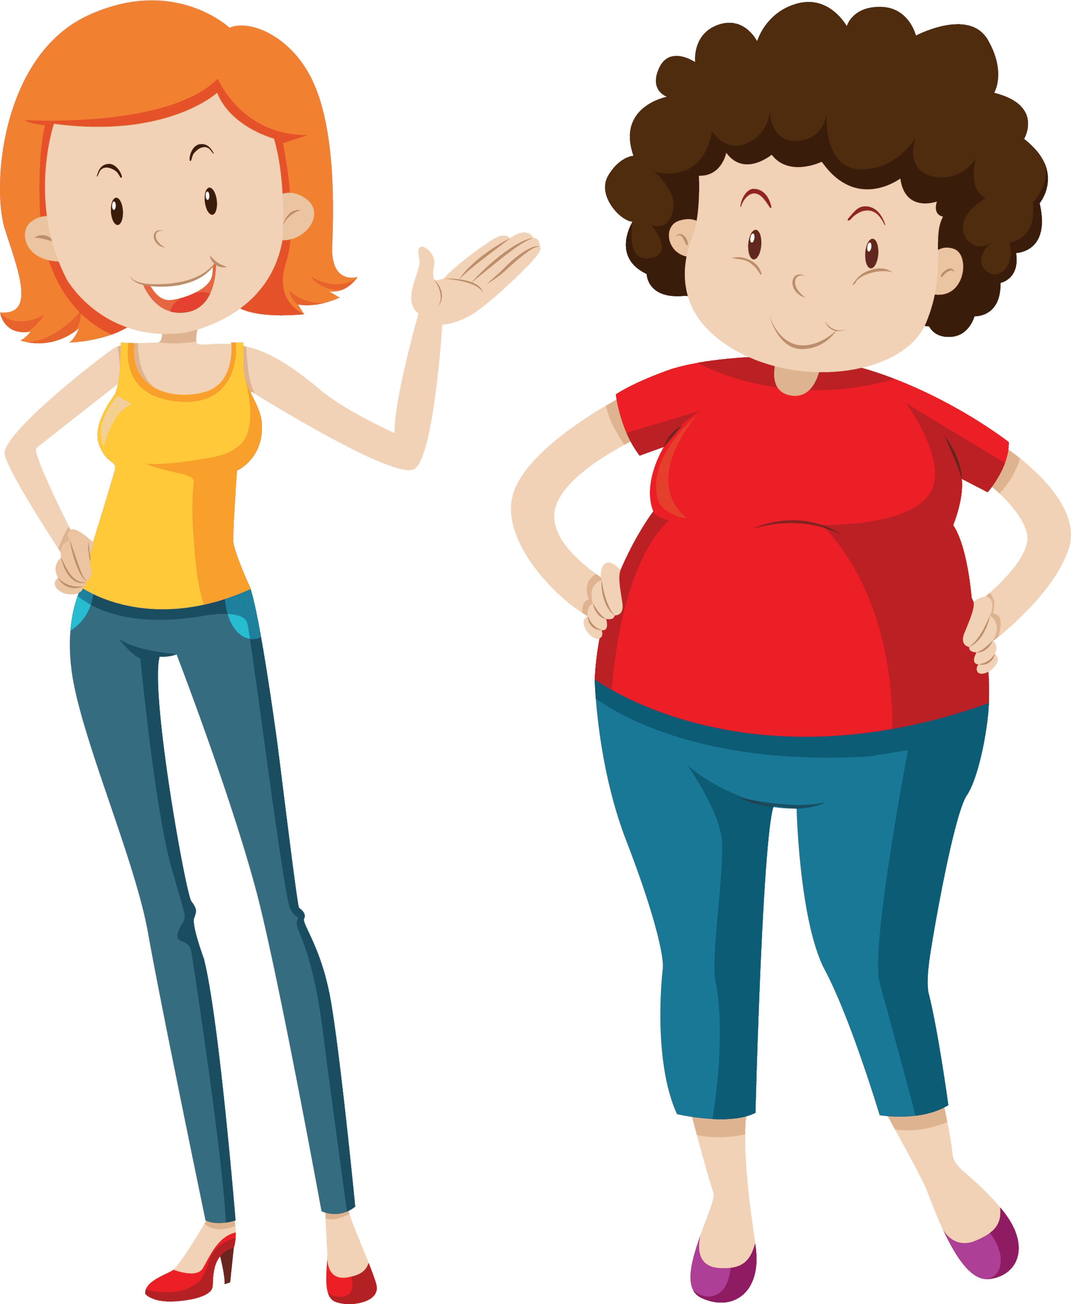
big
slim
/bɪɡ/
/slɪm/
to, lớn
mảnh mai

Slide 4

MsPham
0936082789
Vocabulary
tall
: Cao
short
: Thấp
slim
: Mảnh mai
big
: To, lớn

Slide 5
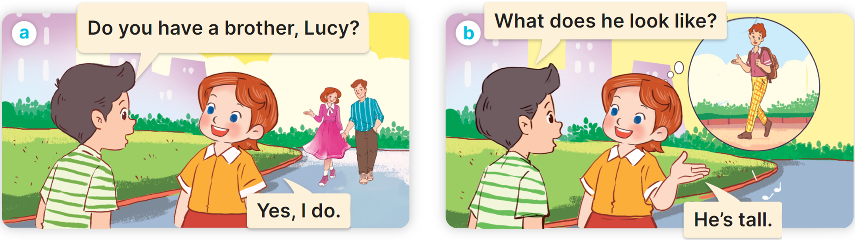

1. Look, listen and read.

Slide 6
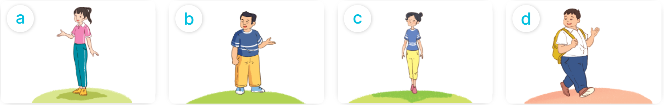
2. Listen, point and say.
What does he/she look like?
He’s/She’s _________.
tall
short
slim
big

Slide 7

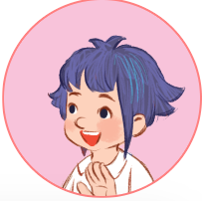
2. Listen, point and say.
tall
What does she look like?
She’s tall.

Slide 8
2. Listen, point and say.
short
What does he look like?
He’s short.

Slide 9


2. Listen, point and say.
slim
What does she look like?
She’s slim.

Slide 10
2. Listen, point and say.
big
What does he look like?
He’s big.

Slide 11

Read and choose.
请替换文字内容，添加相关标题，修改文字内容，也可以直接复制你的内容到此。请替换文字内容，添加相关标题，修改文字内容，也可以直接复制你的内容到此。请替换文字内容，添加相关标题，修改文字内容，也可以直接复制你的内容到此。
short
What does he look like?
He’s ________.
tall
Back

Slide 12
Read and choose.
请替换文字内容，添加相关标题，修改文字内容，也可以直接复制你的内容到此。请替换文字内容，添加相关标题，修改文字内容，也可以直接复制你的内容到此。请替换文字内容，添加相关标题，修改文字内容，也可以直接复制你的内容到此。
slim
What does she look like?
She’s ________.
big
Back

Slide 13
Read and choose.
请替换文字内容，添加相关标题，修改文字内容，也可以直接复制你的内容到此。请替换文字内容，添加相关标题，修改文字内容，也可以直接复制你的内容到此。请替换文字内容，添加相关标题，修改文字内容，也可以直接复制你的内容到此。
slim
What does she look like?
She’s ________.
big
Back

Slide 14
Read and choose.
does
What ______ she look like?
She’s short.
do
Back

Slide 15
Read and choose.
like
What does he ______?
He’s tall.
look like
Back

Slide 16
Read and choose.
She
What does your father look like?
______ is big.
He
Back

