Slide 1
Unit 13
Appearance
Lesson 1 – Period 2

Slide 2


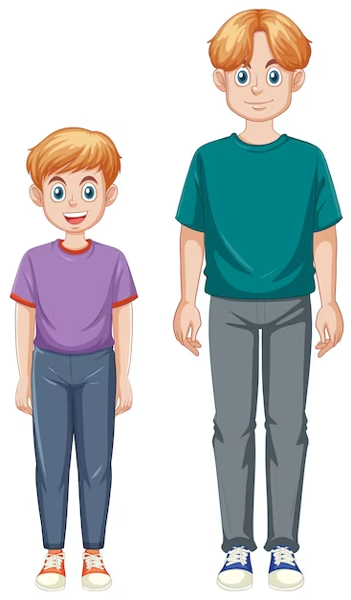
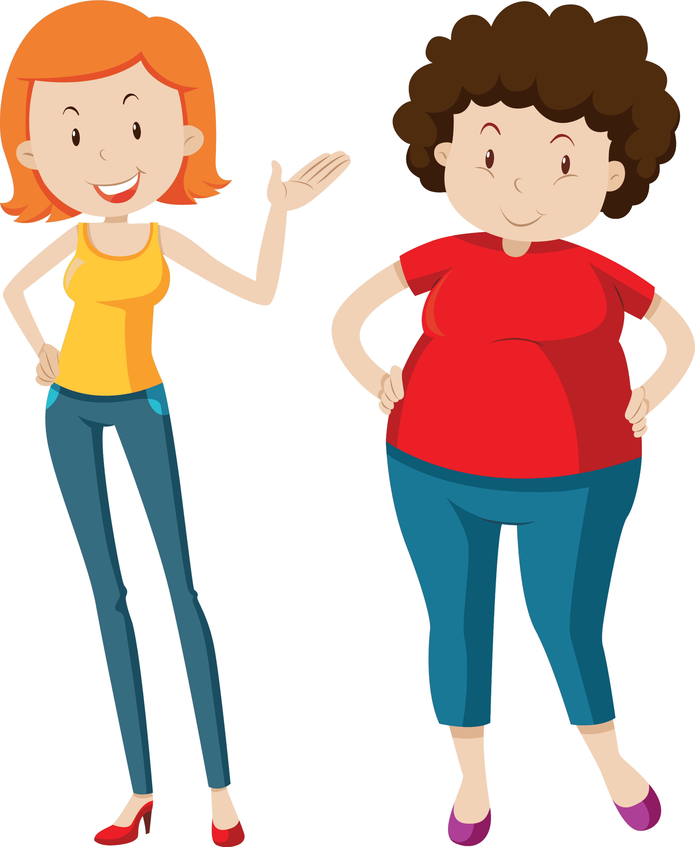
What does he/she look like?
He’s/She’s _________.
tall
slim
big
short

Slide 3

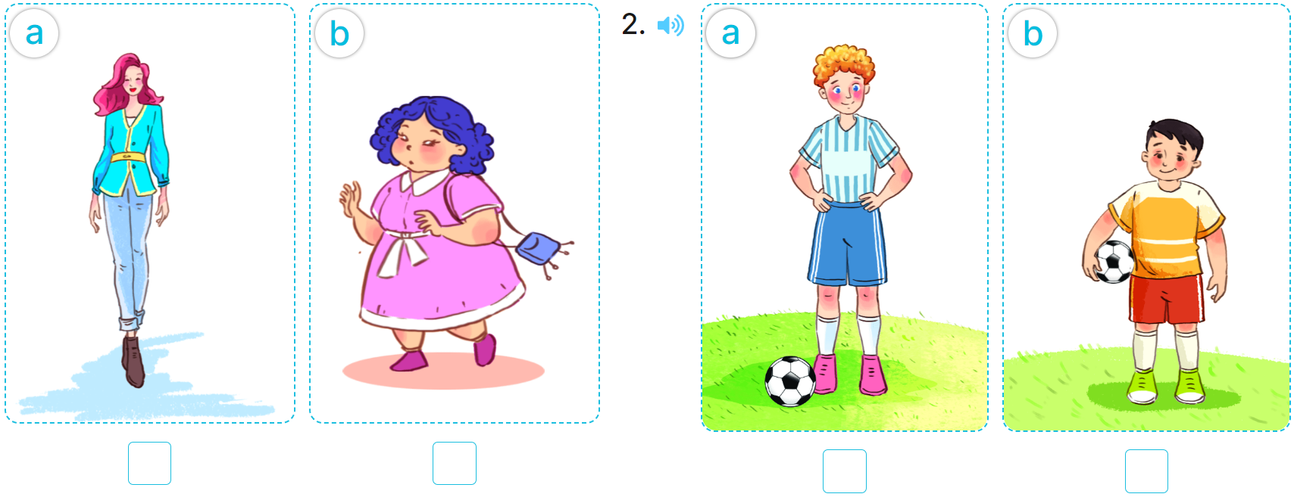
4. Listen and tick.
✓
✓
1
2

Slide 4
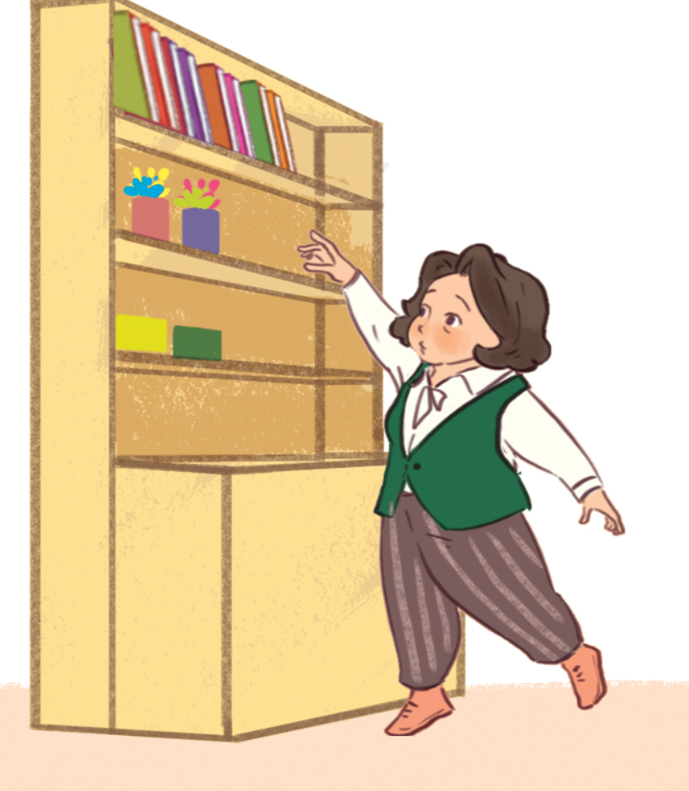
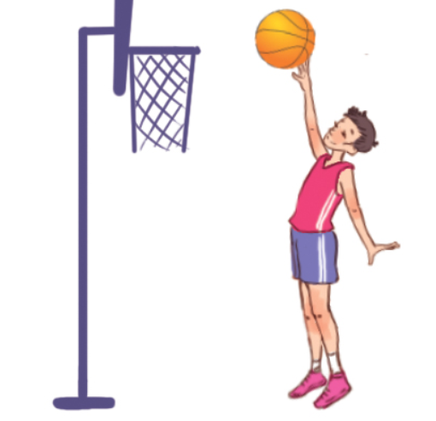
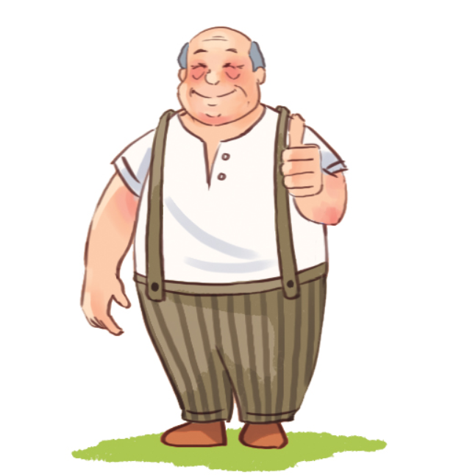
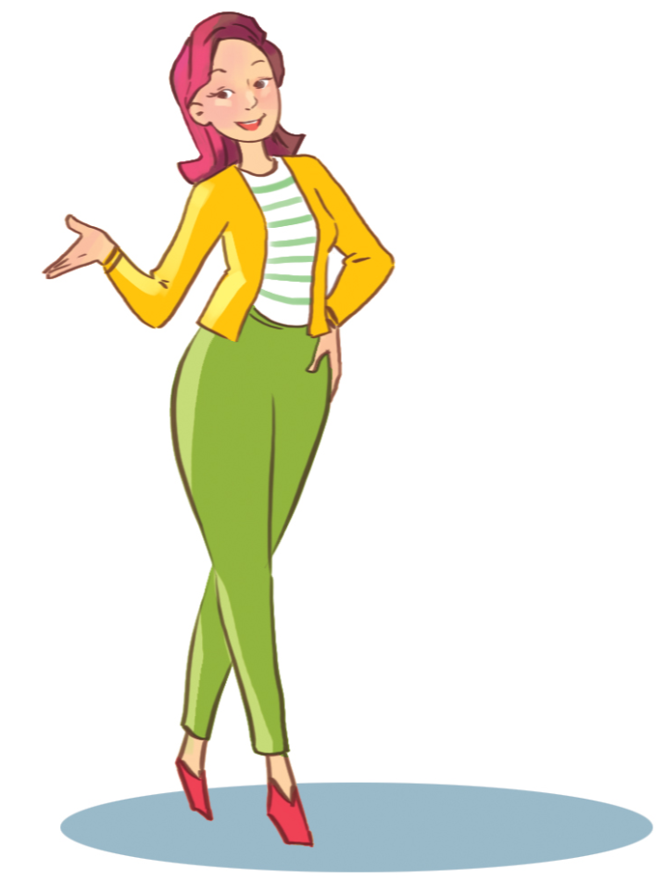
5. Look, complete and read.
1
2
A: What does your brother look like?
B: He’s ______________.
A: What does your grandmother look like?
B: She’s ______________.
tall
short
3
4
look
What
A: What does your grandfather _____ like?
B: He’s tall and ____________.
A: ______ does your mother look like?
B: _______________ and tall.
big
She’s slim

Slide 5
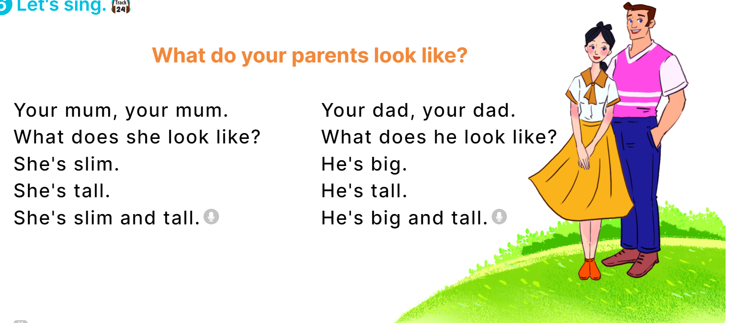
6. Let’s sing.

