Slide 1
Unit 13
Appearance
Lesson 2 – Period 1

Slide 2
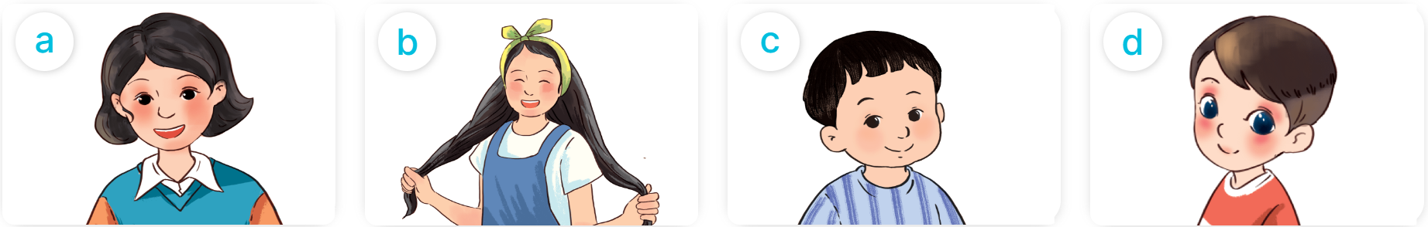
short hair
/ʃɔːt heə(r)/
Tóc ngắn

Slide 3
long hair
/lɒŋ heə(r)/
Tóc dài

Slide 4
a round face
/ə raʊnd feɪs/
Khuôn mặt tròn

Slide 5
big eyes
/bɪg aɪ/
Đôi mắt to

Slide 6

MsPham
0936082789
Vocabulary
short hair
: Tóc ngắn
long hair
: tóc dài
a round face
: Khuôn mặt tròn
big eyes
: Đôi mắt to

Slide 7
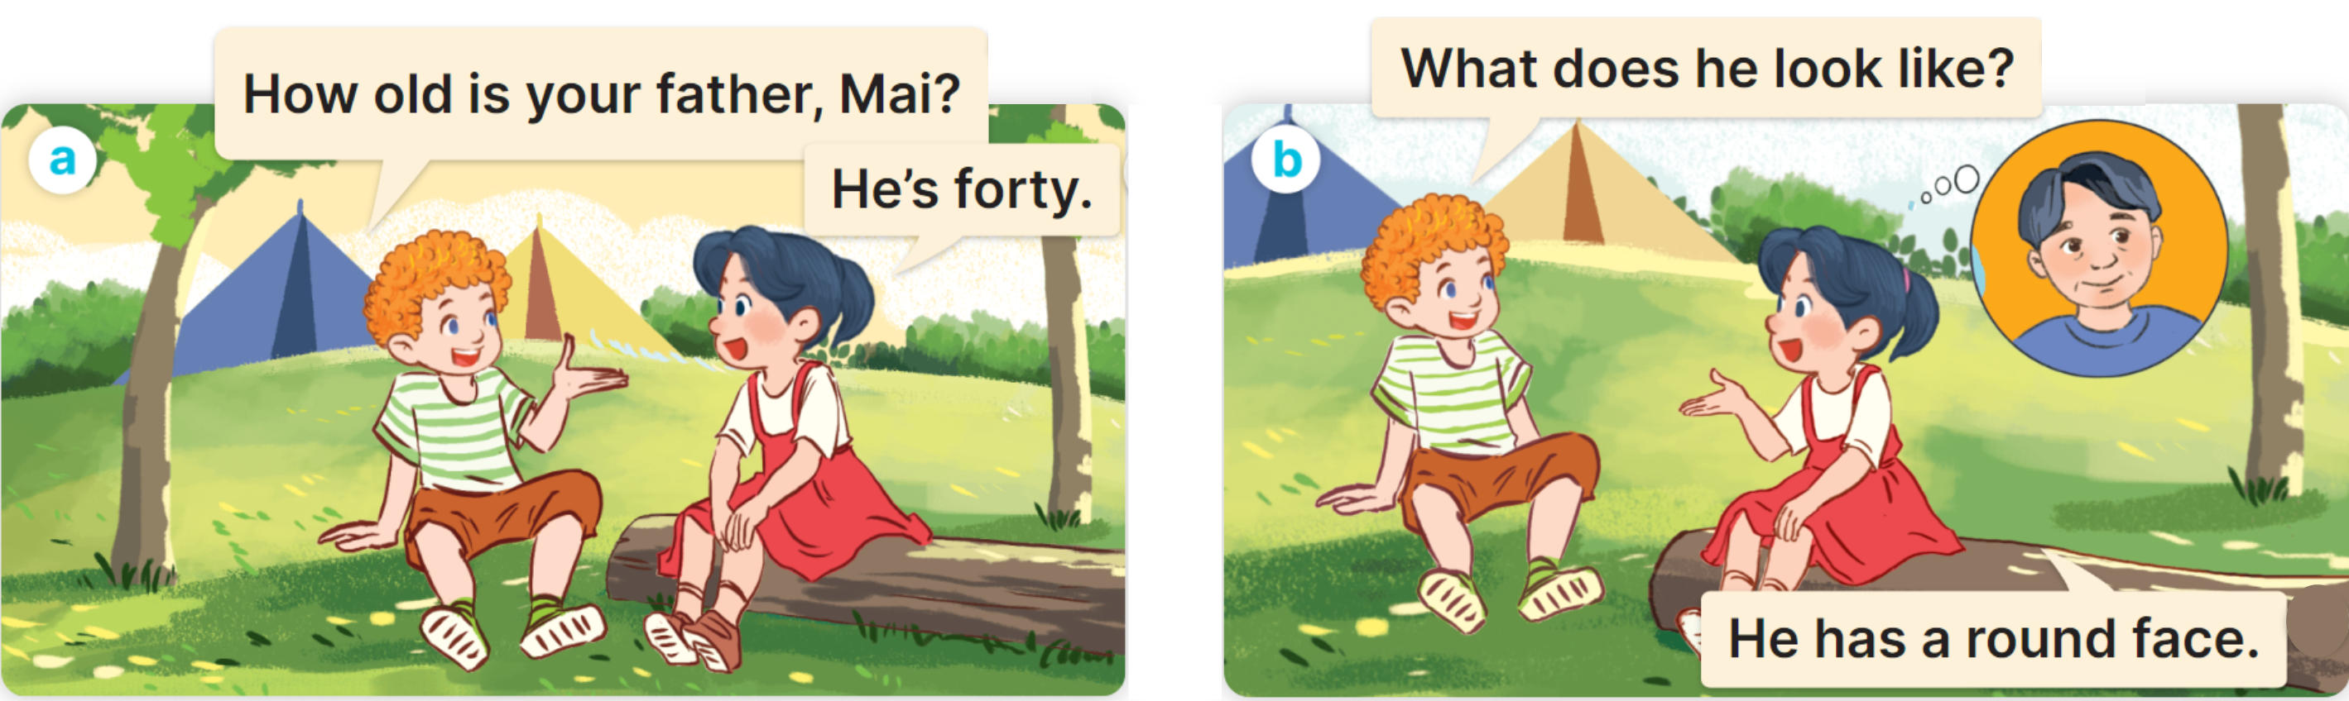

1. Look, listen and read.

Slide 8

Cách hỏi hôm nay là thứ mấy:
What does he/she/name look like?
He/She has _________.
Ex:

Slide 9
2. Listen, point and say.
What does he/she look like?
He/She has _________.
short hair
long hair
a round face
big eyes

Slide 10
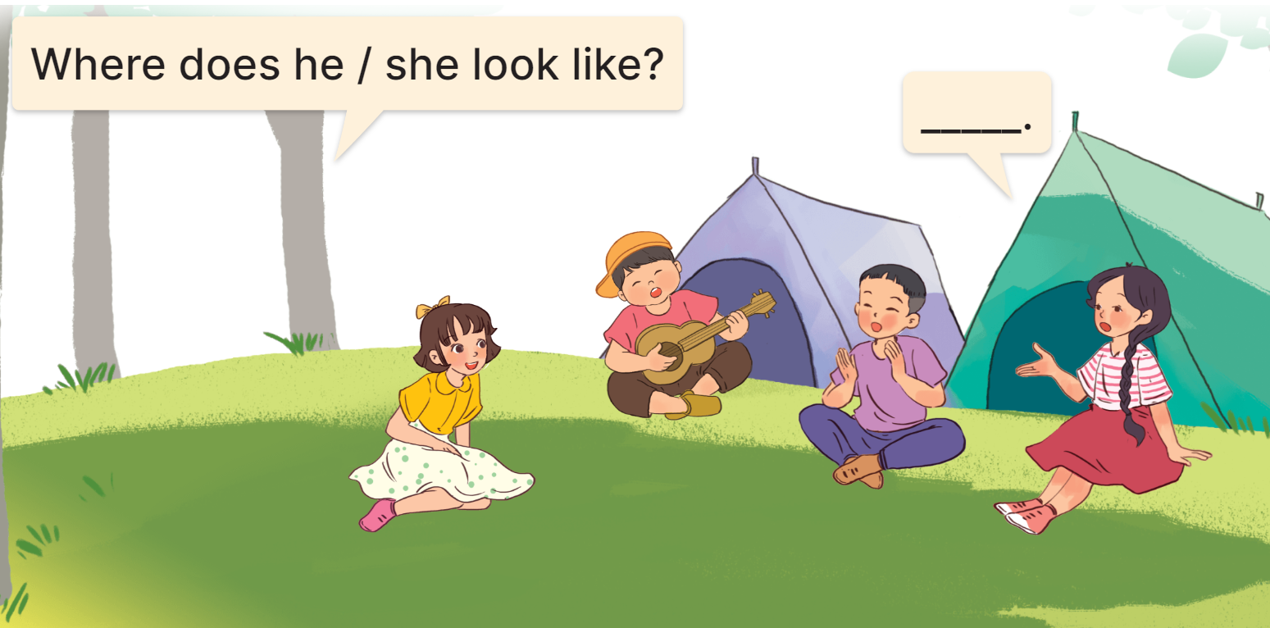
3. Let’s talk.
What does he/she look like?
He/She has _________.

Slide 11

What does he/she look like?
He’s/She has _________.
short hair
long hair
a round face
big eyes

