Slide 1
Unit 13
Appearance
Lesson 1 – Period 2

Slide 2

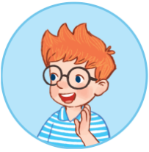
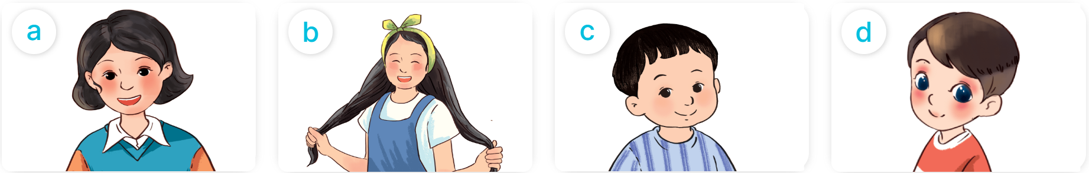
What does he/she look like?
He’s/She has _________.
short hair
long hair
a round face
big eyes

Slide 3
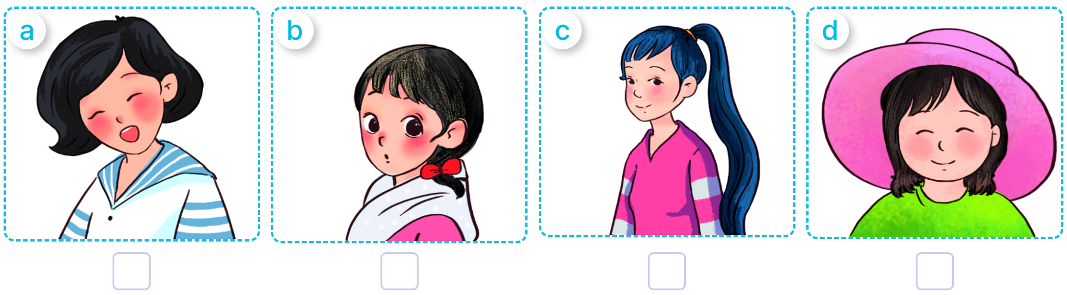

4. Listen and number.
2
4
3
1
1
2
3
4

Slide 4
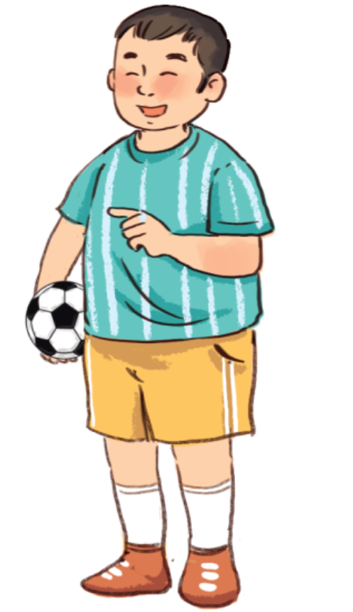
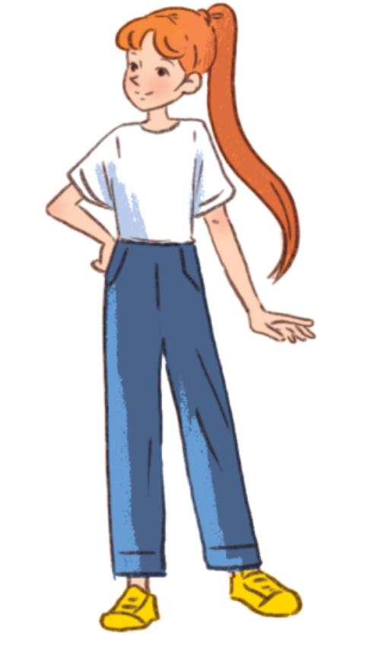
5. Look, complete and read.
1
2
A: Do you have a brother, Mai?
B: Yes, I do.
A: What does he look like?
B: He’s ______. He has a round ______.
A: Do you have a sister, Bill?
B: Yes, I do.
A: What does she ______________?
B: She’s slim. He has ____________.
look like
big
face
long hair

Slide 5
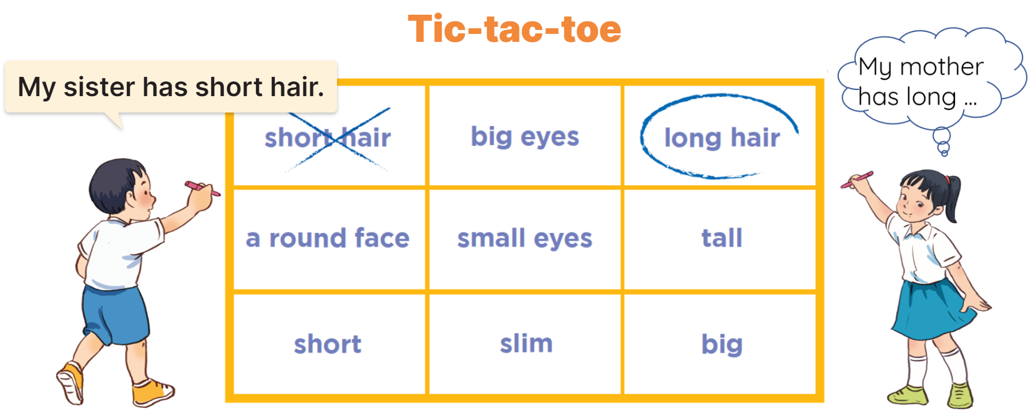
6. Let’s play.

