Slide 1
Unit 13
Appearance
Lesson 3 – Period 1

Slide 2



Phonics
long
l
/l/
/lɒŋ/
listen
/ˈlɪsn/
lemonade
/ˌleməˈneɪd/
Notes:
https://www.youtube.com/watch?v=8z3E7OM43gY&list=PL8_ETpRL2xNbJTjsq6q8ex0yMu7g61wrf

Slide 3


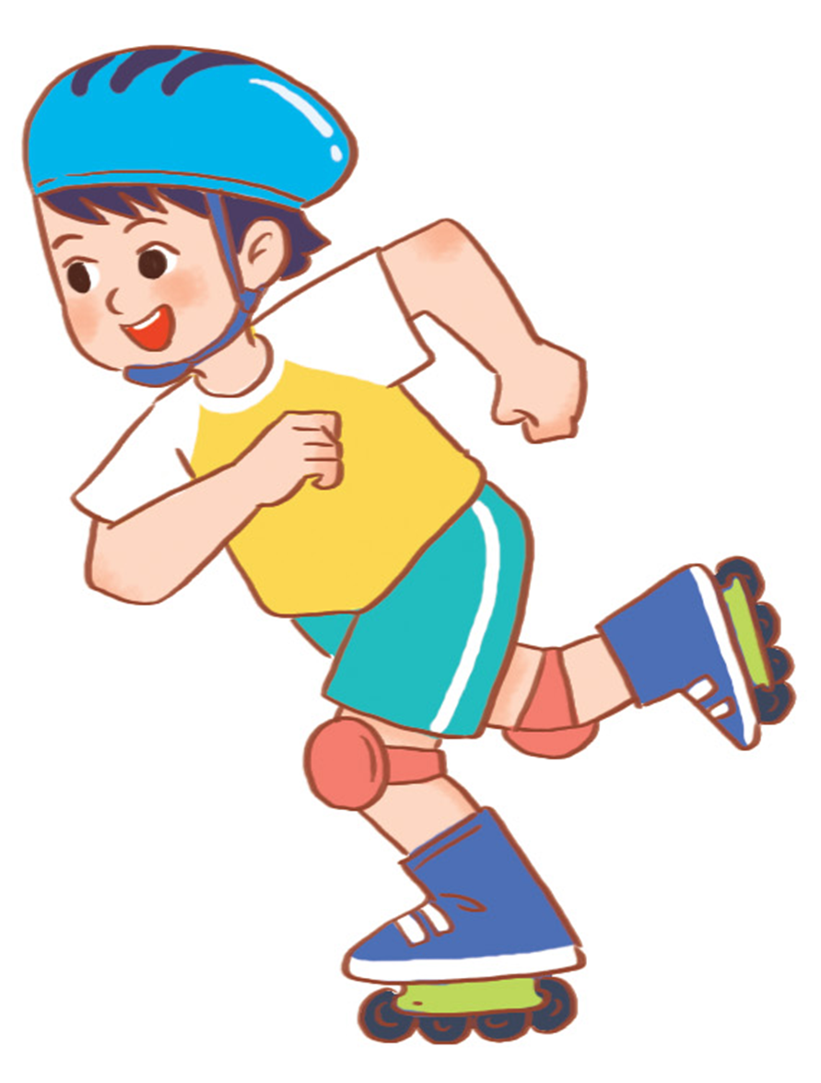
Phonics
round
r
/r/
/raʊnd/
road
/rəʊd/
roller skate
/ˈrəʊlə skeɪt/
Notes:
https://www.youtube.com/watch?v=8z3E7OM43gY&list=PL8_ETpRL2xNbJTjsq6q8ex0yMu7g61wrf

Slide 4





Click hình chú Thỏ hoặc chú Rùa khi chọn đáp án.
Notes:
Ms Huyền Phạm - 0936.082.789 – YOUTUBE: MsPham. Facebook: Dạy và học cùng công nghệ.

Slide 5


Listen and choose
long
long
listen
Notes:
Ms Huyền Phạm - 0936.082.789 – YOUTUBE: MsPham. Facebook: Dạy và học cùng công nghệ.

Slide 6
Listen and choose
listen
round
listen
Notes:
Ms Huyền Phạm - 0936.082.789 – YOUTUBE: MsPham. Facebook: Dạy và học cùng công nghệ.

Slide 7
Listen and choose
road
round
road
Notes:
Ms Huyền Phạm - 0936.082.789 – YOUTUBE: MsPham. Facebook: Dạy và học cùng công nghệ.

Slide 8
Listen and choose
round
round
read
Notes:
Ms Huyền Phạm - 0936.082.789 – YOUTUBE: MsPham. Facebook: Dạy và học cùng công nghệ.

Slide 9
Listen and choose
lemonade
listen
lemonade
Notes:
Ms Huyền Phạm - 0936.082.789 – YOUTUBE: MsPham. Facebook: Dạy và học cùng công nghệ.

Slide 10
Listen and choose
roller skate
roller skate
road
Notes:
Ms Huyền Phạm - 0936.082.789 – YOUTUBE: MsPham. Facebook: Dạy và học cùng công nghệ.

Slide 11
1. Listen and repeat.
l
long
My sister has long hair.
r
round
My brother has round eyes.

Slide 12

2. Listen and circle.
1. My grandfather has __________.
a. long hands b. a round face c. a long nose
2. My brother has __________.
a. long hands b. a round face c. round eyes

Slide 13
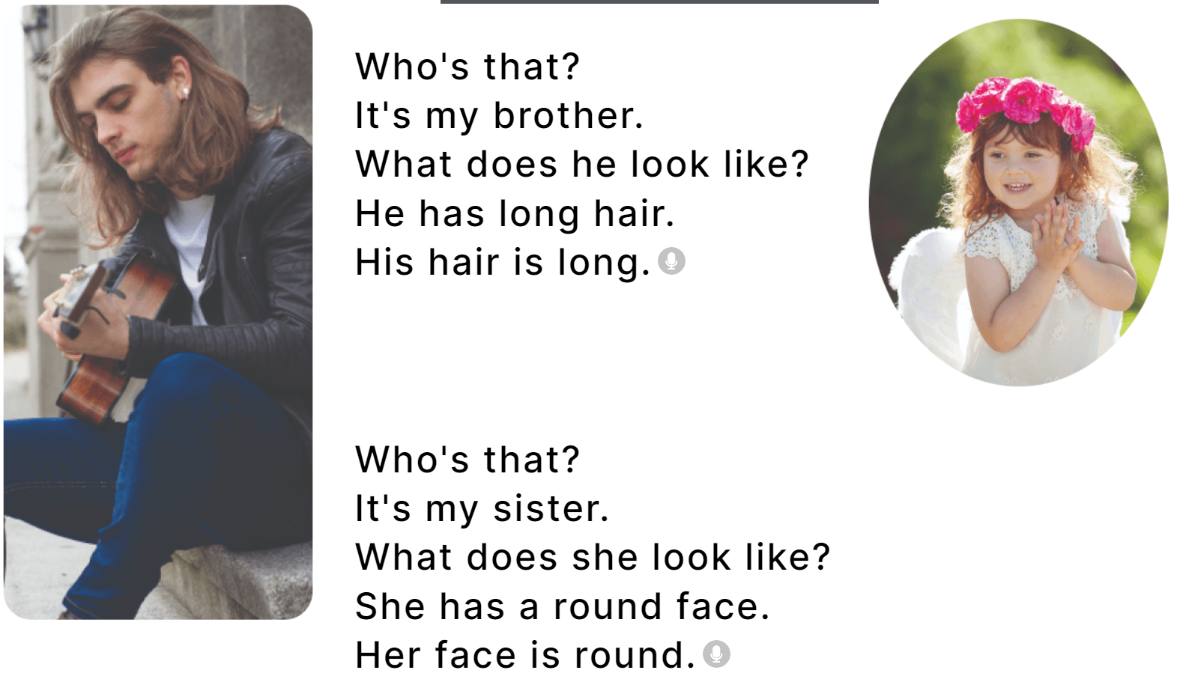
3. Let’s chant.

