Slide 1
Unit 13
Appearance
Lesson 3 – Period 2

Slide 2

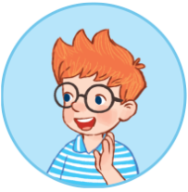
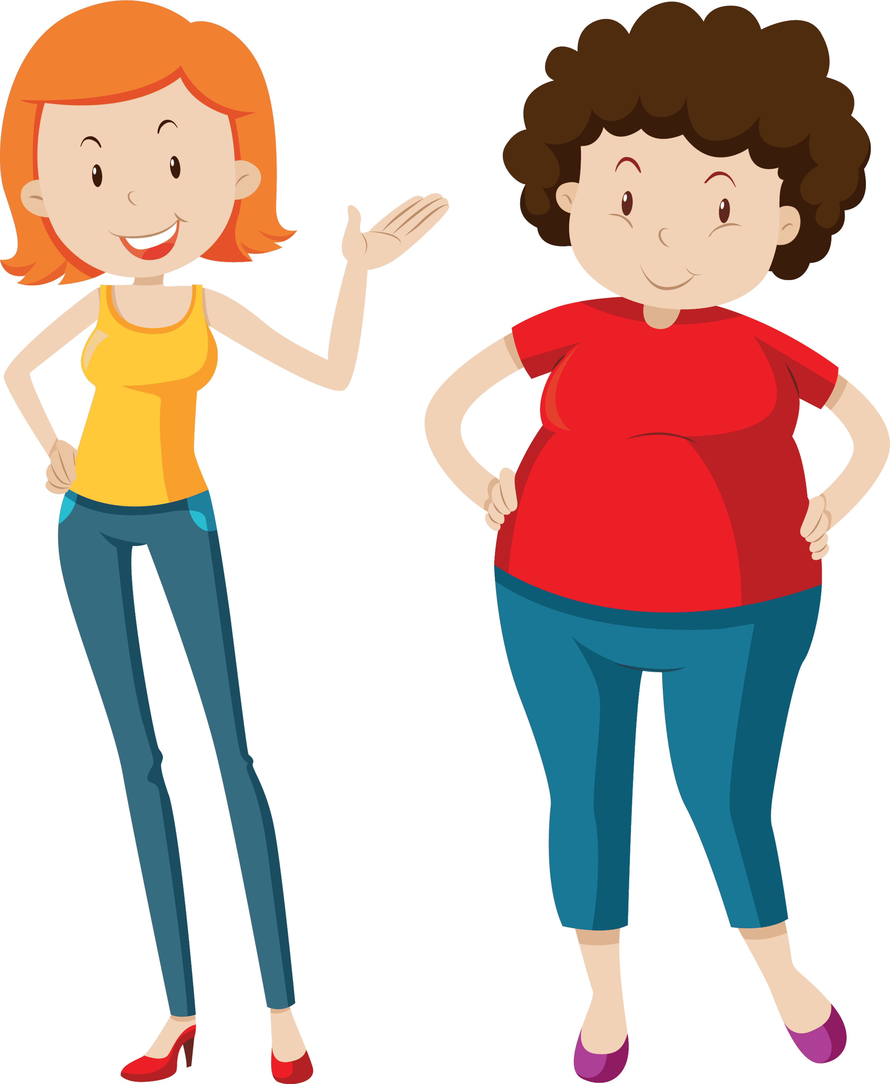
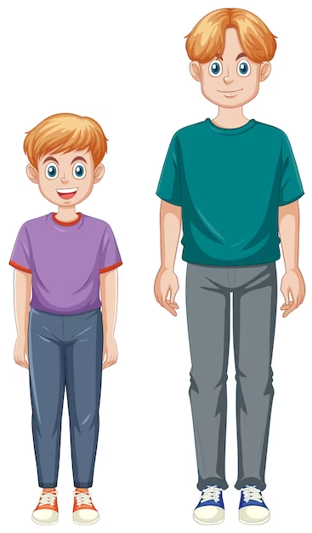
What does he/she look like?
He’s/She’s _________.
tall
slim
big
short

Slide 3
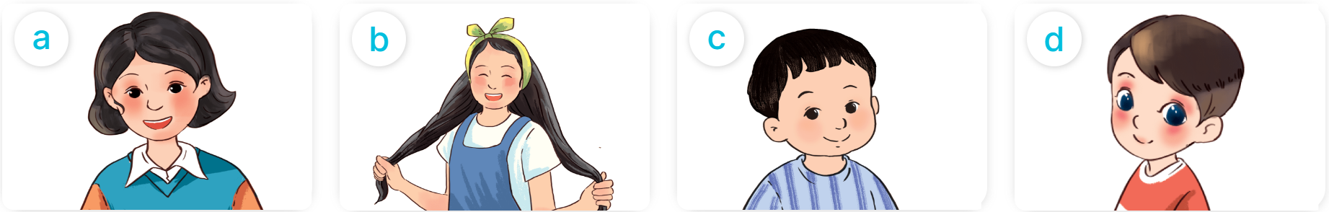
What does he/she look like?
He’s/She has _________.
short hair
long hair
a round face
big eyes

Slide 4
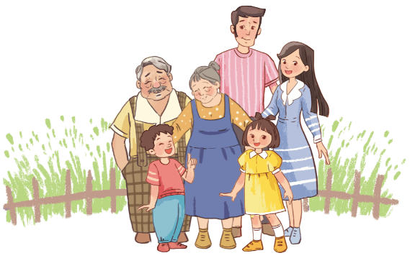
4. Read and complete.
I have a big family: my grandfather, my grandmother, my father, my mother, my sister and me. My grandfather is big. My grandmother is big, too. My father is very tall. My mother is slim. She has long hair. My sister has a round face and big eyes.
1. My grandfather and grandmother are big.
2. My father is very tall.
3. My mother has long hair.
4. My sister has a round face and big eyes.
____..
____..
____..
____..

Slide 5
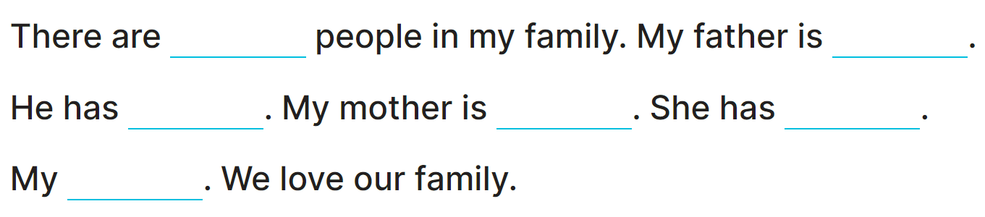
5. Let’s write.

Slide 6
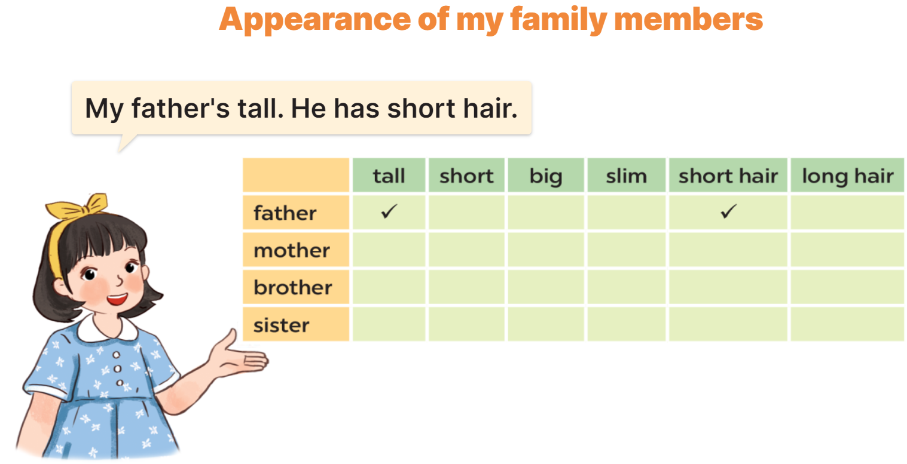
6. Project.

