Slide 1










Unit 12
Jobs
Lesson 2 – Period 1

Slide 2



He’s/She’s _____.
What does he/she do?
an actor
an office worker
a policeman
a farmer
a teacher

Slide 3

at a nursing home
/æt ə ˈnɜːsɪŋ həʊm/
Ở viện dưỡng lão

Slide 4

at a factory
/æt ə ˈfæktəri/
Ở nhà máy

Slide 5

at a school
/æt ə skuːl/
Ở trường học

Slide 6

on a farm
/ɒn əˈfɑːmər/
Ở trang trại/
Ở cánh đồng

Slide 7
Vocabulary
at a nursing home
: Ở viện dưỡng lão
at a farm
: trang trại
at a factory
: nhà máy
at a school
: Trường học

Slide 8
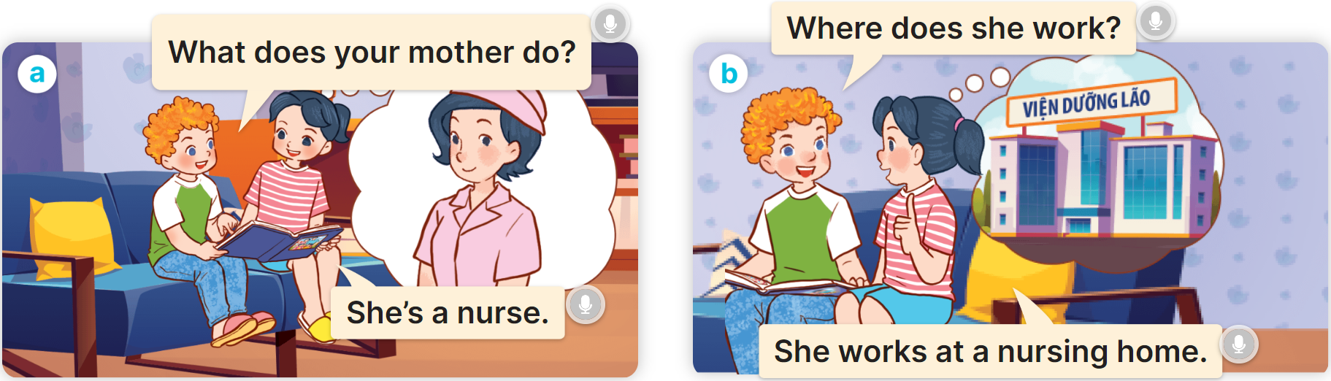
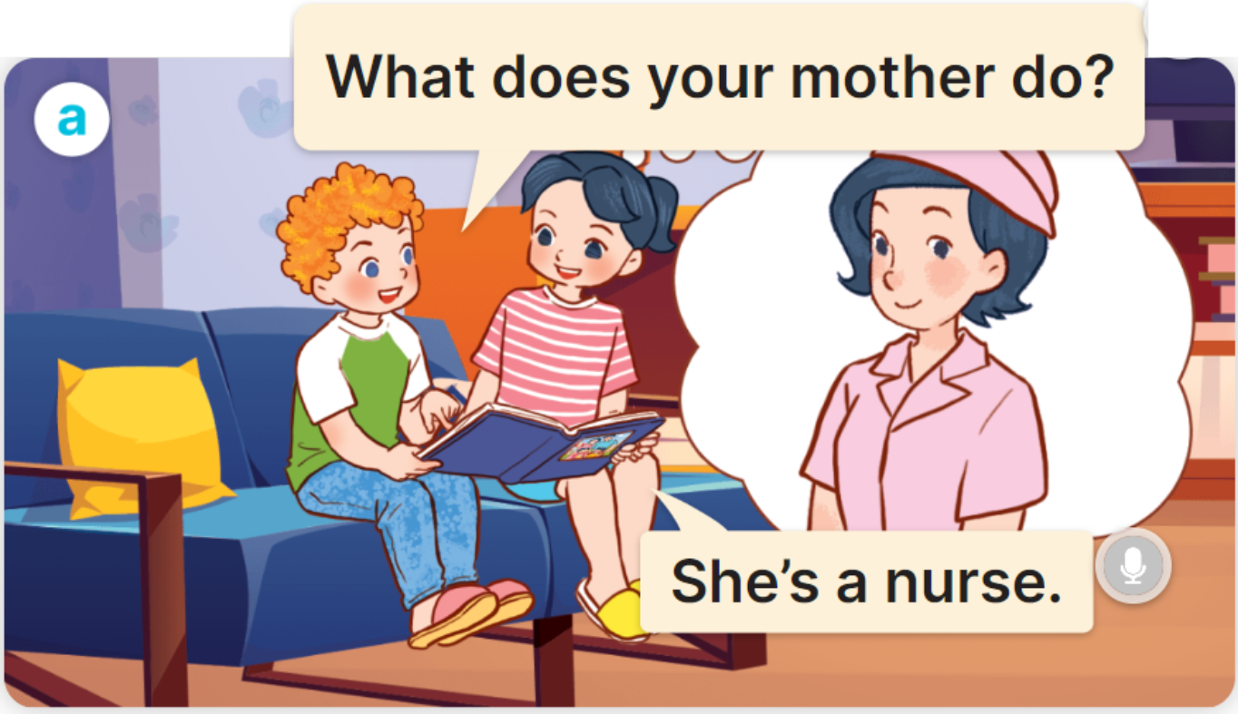
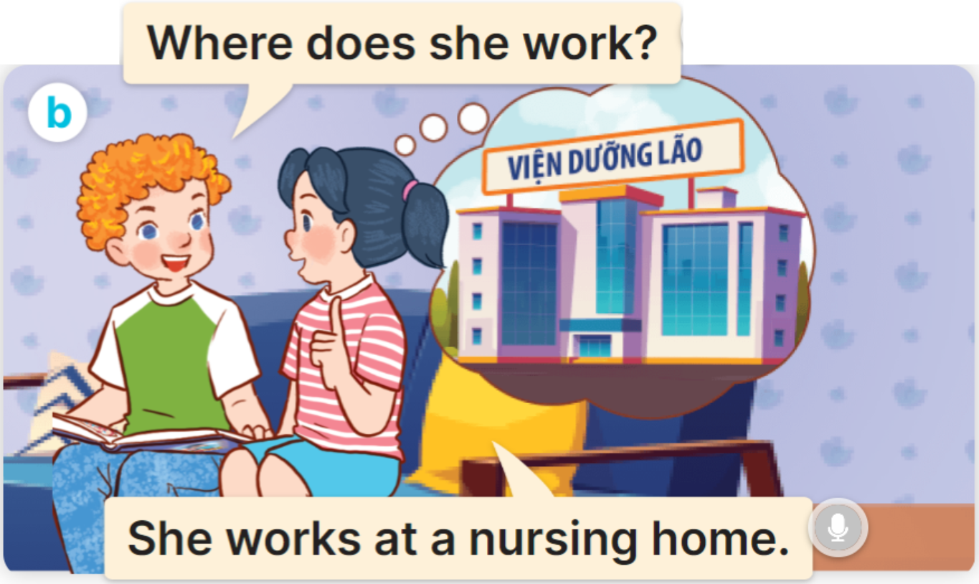

1
Look, listen and read.

Slide 9
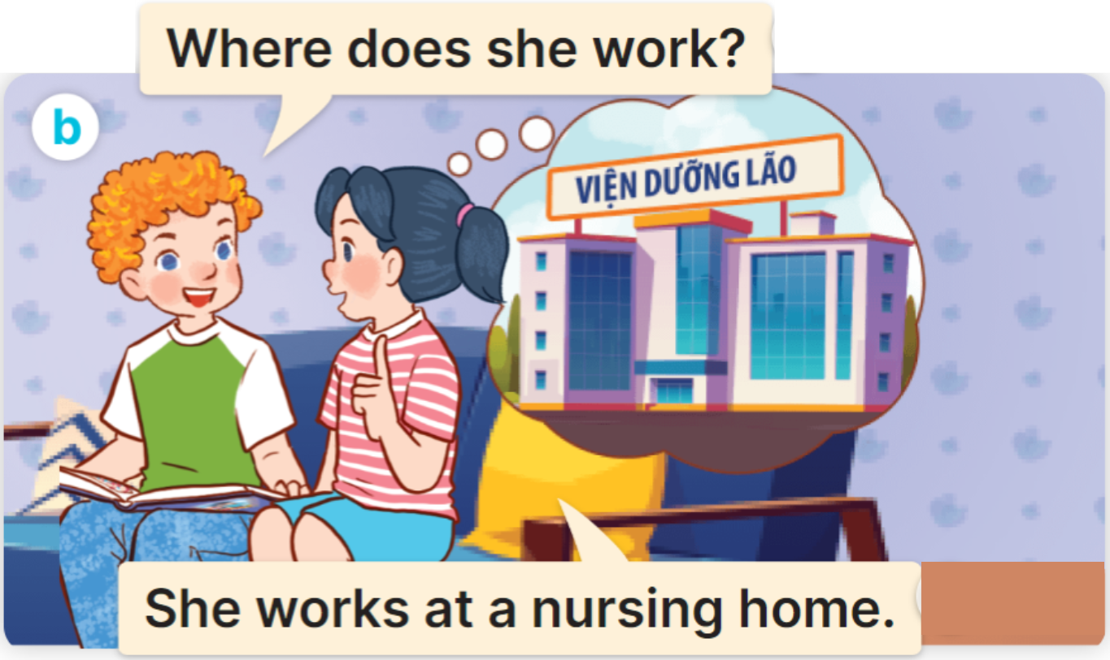
2
Cách hỏi một người nào đó làm việc ở đâu:
Where does he/she/name work?
(Anh ấy/cô ấy làm việc ở đâu?)
He/She works ________.
(Anh ấy / cô ấy làm ở ______)
Ex:

Slide 10

2
Listen, point and say.
Where does he/she work?
He/She works ___________.

Slide 11


2
Listen, point and say.
Where does she work?
She works a nursing home.

Slide 12
2
Listen, point and say.
Where does he work?
He works at a factory.

Slide 13


2
Listen, point and say.
Where does she work?
She works at a school.

Slide 14

2
Listen, point and say.
MsPham
0936082789
Where does he work?
He works on a farm.

Slide 15




3
Let’s talk.
Where does he/she work?
He/She works ___________.

Slide 16
3
Let’s talk.
Where does she work?
She works at a nursing home.

