Slide 1










Unit 12
Jobs
Lesson 2 – Period 2

Slide 2
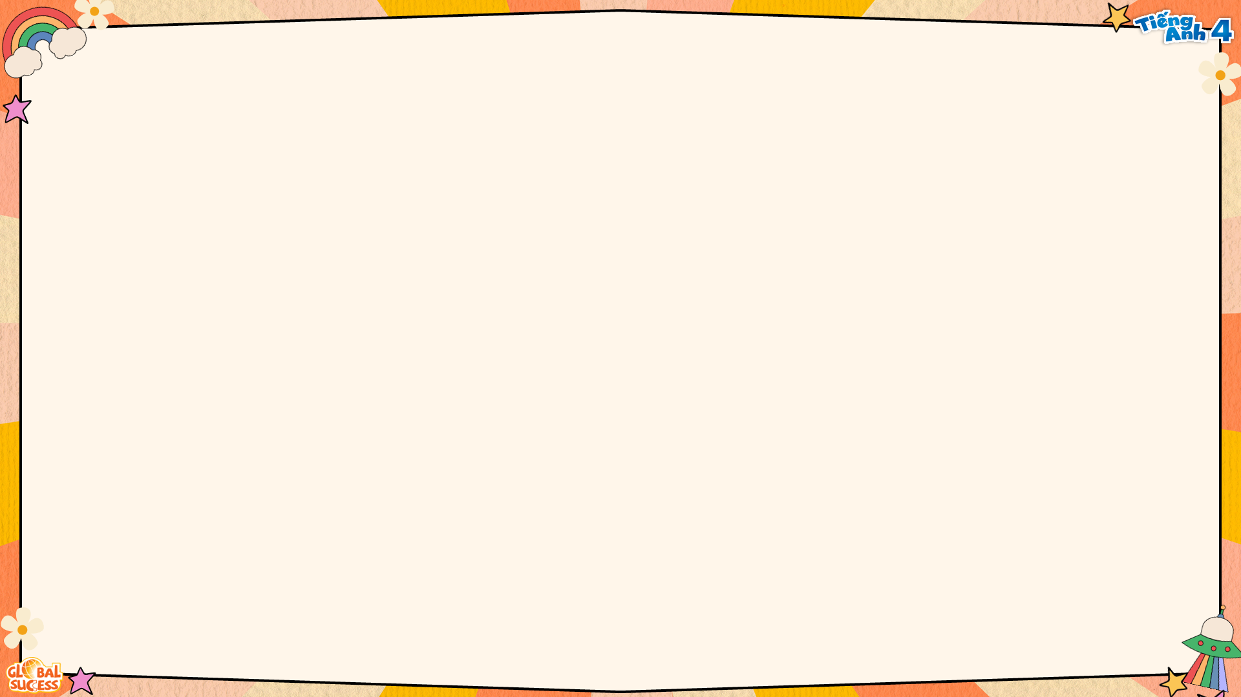





He’s/She’s _____.
What does he/she do?
at a
nursing home
at a school
at a factory
on a farm

Slide 3





4
Listen and tick.
1
2
a
b
✓
a
b
✓

Slide 4


5
Look, complete and read.
1.
2.
A: What does your mother do?
B: She's a _______________.
A: Does she ____________ a nursing home?
B: No, she doesn't. She works at a hospital.
A: What does your brother do?
B: He’s _________________.
A: Where does he __________?
B: He works _______________.
nurse
a worker
work
work
at a factory

Slide 5
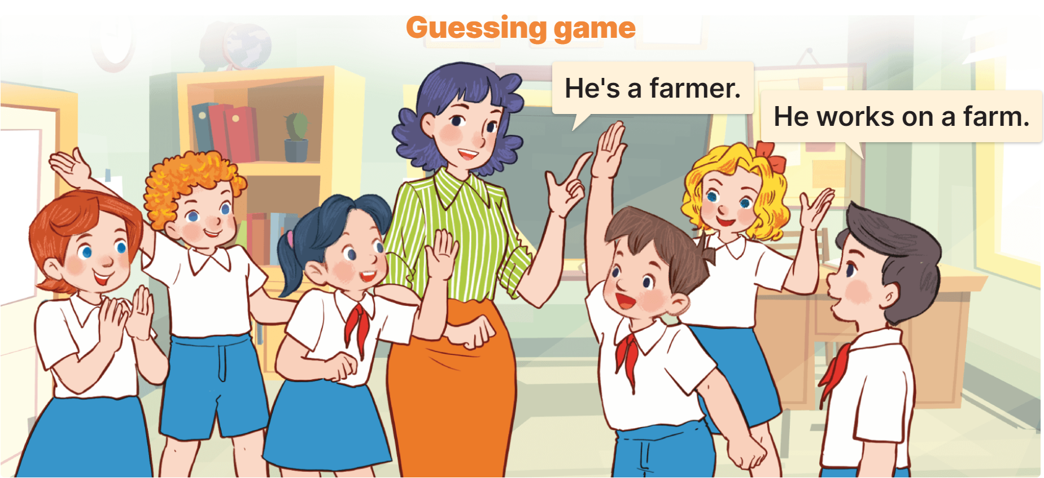
6
Let’s play.

