Slide 1










Unit 12
Jobs
Lesson 3 – Period 1

Slide 2




What does he/she do?
He’s/She’s _____.
MsPham
0936082789
an actor
an office worker
a policeman
a farmer
a teacher

Slide 3




What does he/she do?
MsPham
0936082789
He’s/She’s _____.
at a
nursing home
at a school
at a factory
on a farm

Slide 4

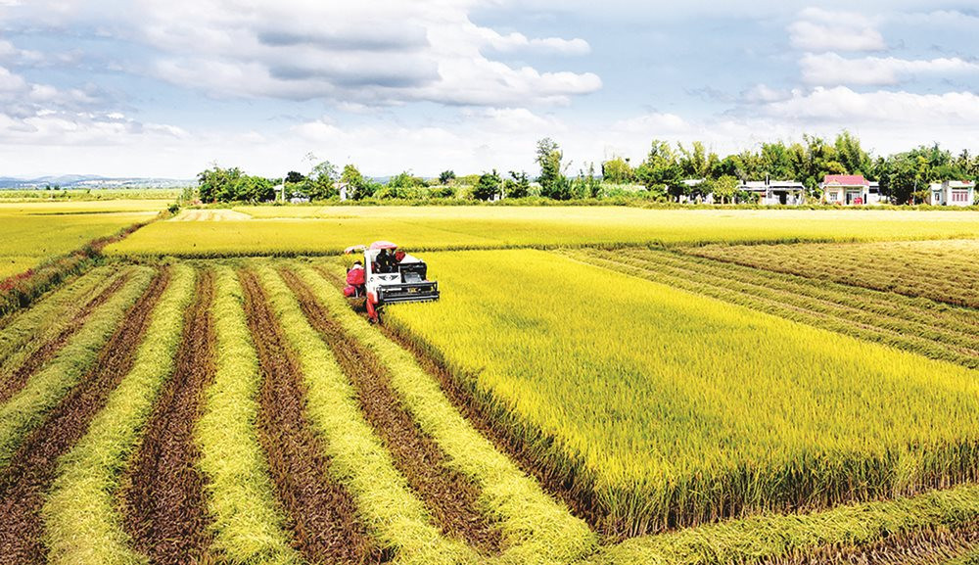


Phonics
ar
/ɜː/
farmer
/ˈfɑːmər/
farm
/fɑːm/
cars
/kɑː(r)z/

Slide 5



Phonics
ur
/ɜː/
nurse
/nɜːs/
nursing home
/ˈnɜːsɪŋ həʊm/
fur
/fɜː(r)/

Slide 6

1
Listen and repeat.
ar
farmer
My father is a farmer.
nurse
ur
My mother is a nurse.

Slide 7

2
Listen and circle.
1.
His mother is a ___________.
a. farmer b. nurse c. gardener
2.
Her father is a ___________.
a. nurse b. gardener c. farmer

Slide 8


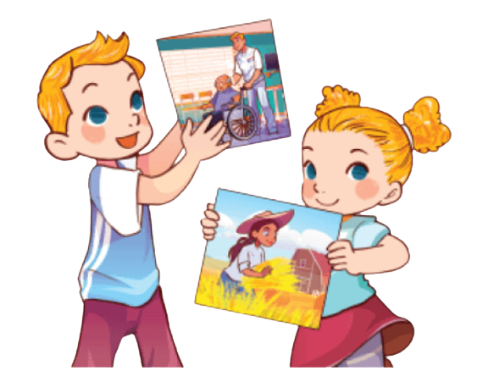
3
Let’s chant.
Our father is a nurse.
He works at a nursing home.
Our mother is a farmer.
She works on a farm.
My father is a farmer.
He works on a farm.
My mother is a nurse.
She works at a nursing home.

