Slide 1










Unit 12
Jobs
Lesson 3 – Period 2

Slide 2
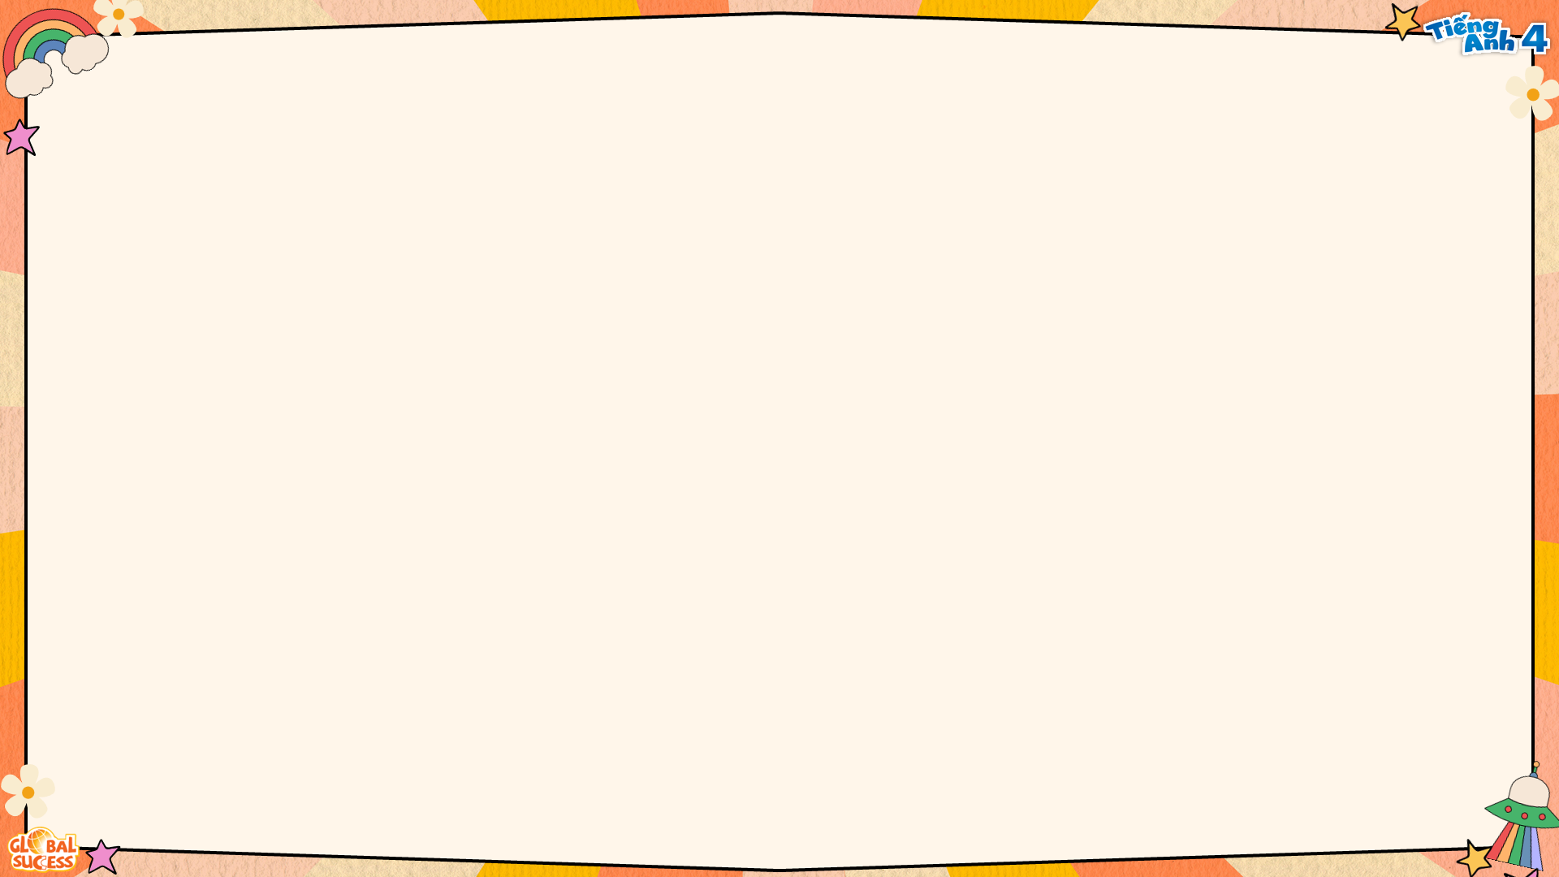

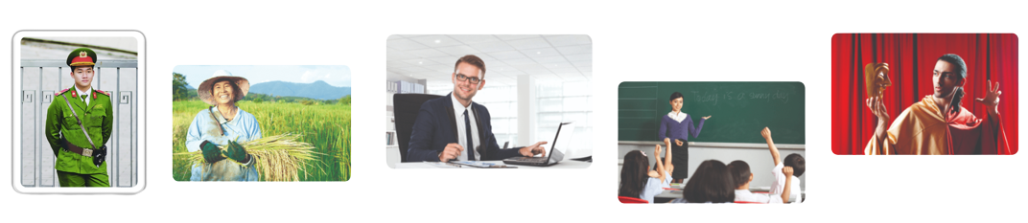

What does he/she do?
He’s/She’s _____.
MsPham
0936082789
an actor
an office worker
a policeman
a farmer
a teacher

Slide 3




What does he/she do?
MsPham
0936082789
He’s/She’s _____.
MsPham
0936082789
at a
nursing home
at a school
at a factory
on a farm

Slide 4
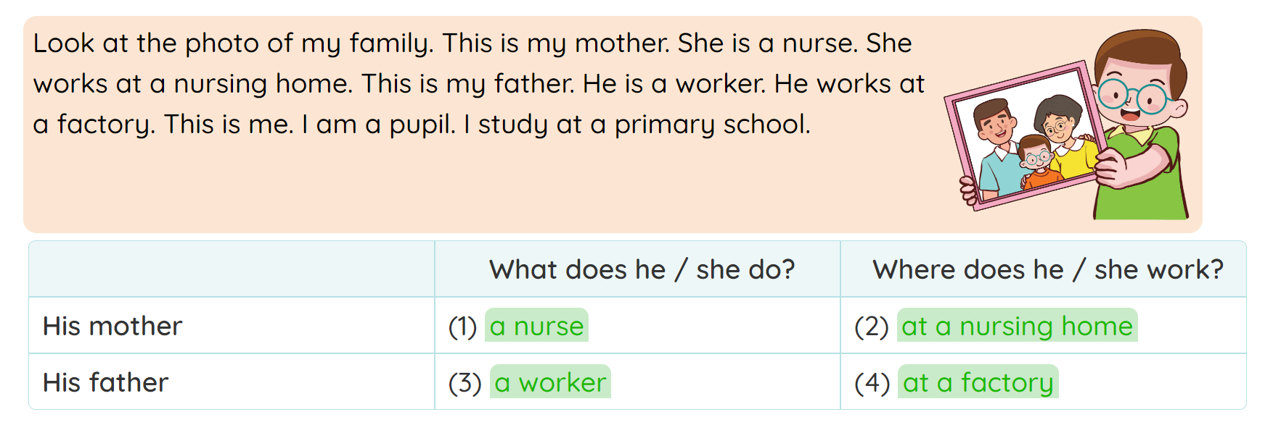
4
Read and match.

Slide 5
5
Let’s write.
There are _________ people in my family. My _________ is a(n) _________. She works ________. My is a(n) __________. He works ____________. My brother / sister and I are pupils. We study at school.

Slide 6
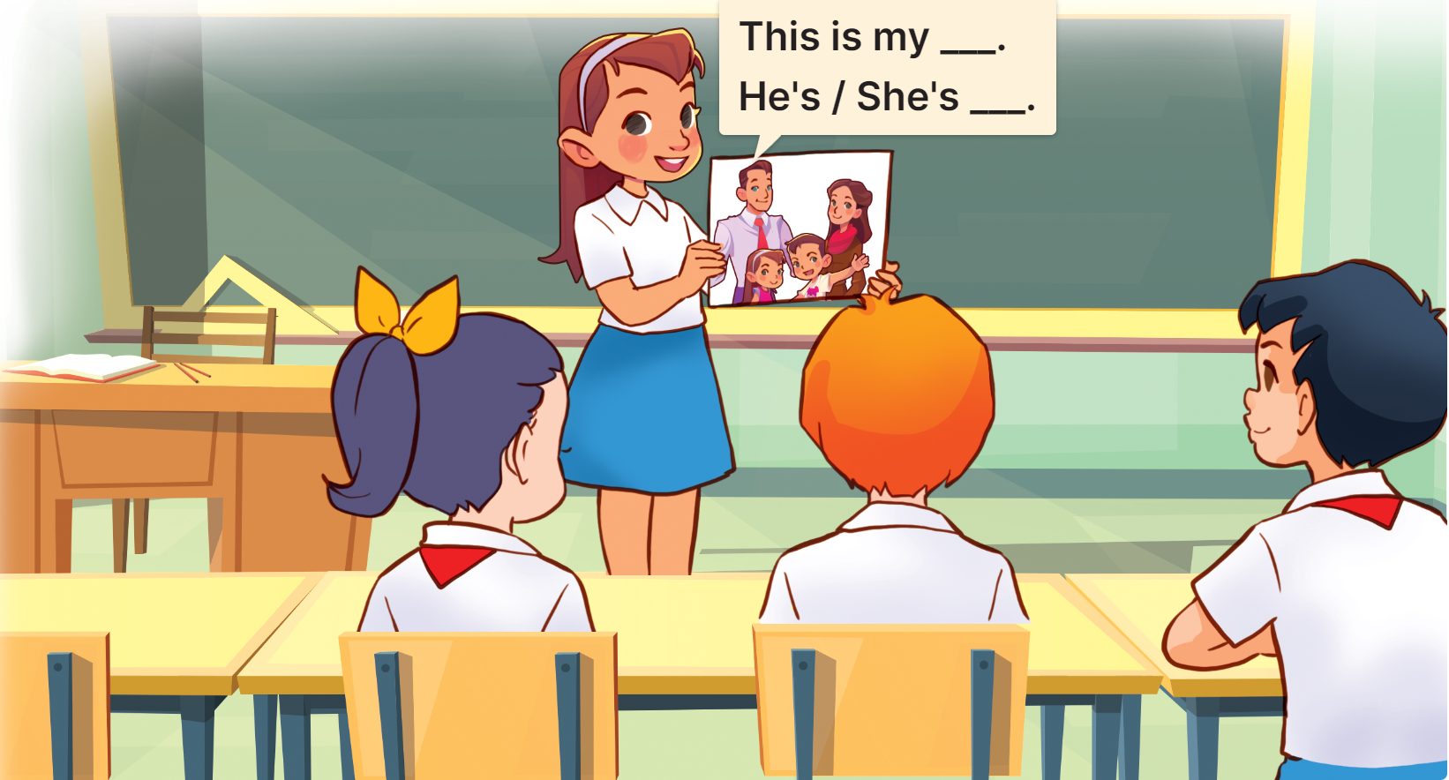
6
Project
Members of my family and their jobs

