Slide 1


UNIT 16 :SEASONS AND
THE WEATHER
LESSON 3 ( 4, 5, 6)

Slide 2



* Sing the song
How’s the weather in Ha Noi?
How’s the weather in spring?
It’s warm and rainy.
How’s the weather in summer?
It’s hot and sunny.
What’s the weather like in autumn?
It’s cool and cloudy.
What’s the weather like in winter?
It’s cold and dry.
Notes:
Nháy vào số để nghe lại âm thanh/

Slide 3



4. Read and complete
There are different climates in Viet Nam. In the north, there are four seasons: spring, summer, autumn and winter. Spring is warm and humid. It has blooming flowers and festivals. Summer is sunny and hot. It is ideal for holidays. Autumn is cool and cloudy. Many festivals are in autumn. Winter is cold and dry. It is ideal for indoor sports. In the south, there are two seasons: the dry season and the rainy season. In the dry season, the weather is dry and cool, but in the rainy season, it is rainy and humid.
Viet Nam | Seasons | Weather
In the north | – spring – summer – autumn – winter | – warm and humid – (1) _______________________ – (2) _______________________ – (3) _______________________
In the south | – (4) _______________________ – (5) _______________________ | – dry and cool – rainy and humid
sunny and hot
cool and cloudy
cold and dry
the dry season
the rainy season

Slide 4
5. Let’s write
Write about your local weather and typical outfits for each season.
(about 40 words.)
– How many seasons are there in your area?
– How’s the weather in each season?
– What do you usually wear in each season?
There are _____seasons _____. It’s ___________________.
__________________________
____________________.
Notes:
MADE BY FACEBOOK :TRAN THI THANH TAM

Slide 5
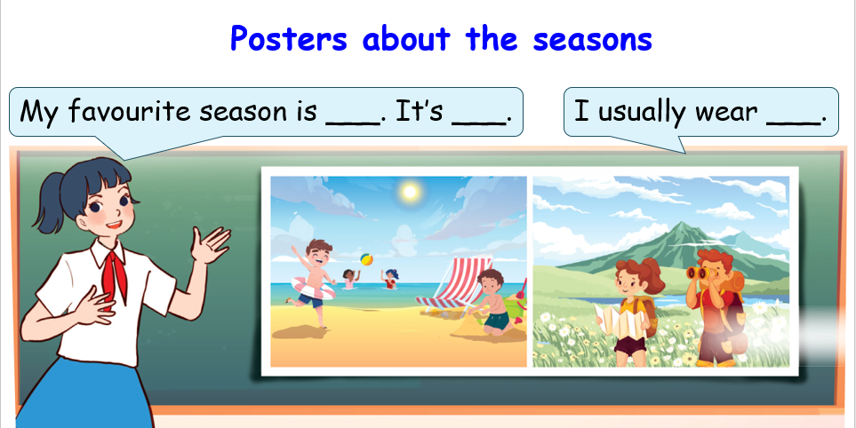
6. Project
Notes:
MADE BY FACEBOOK :TRAN THI THANH TAM

