Slide 1

UNIT 17:STORIES FOR CHILDREN
LESSON 1 ( 1, 2, 3)
Made by: Mrs Thu Phuong
Notes:
MADE BY FACEBOOK :TRAN THI THANH TAM

Slide 2

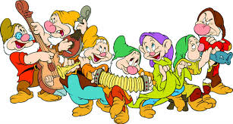
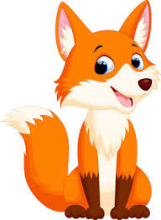
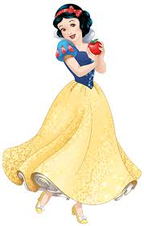
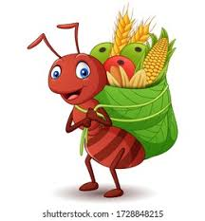
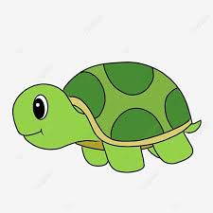
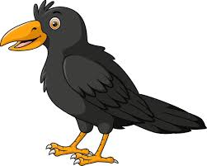
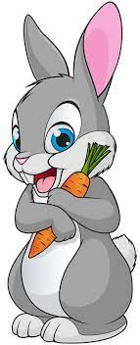
DO YOU KNOW THESE CHARACTERS?
Notes:
Made by FACEBOOK: TRAN THI THANH TAM

Slide 3

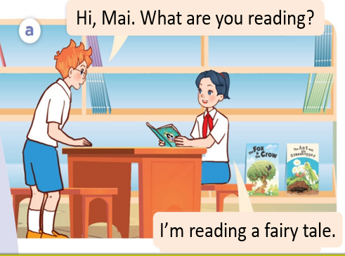
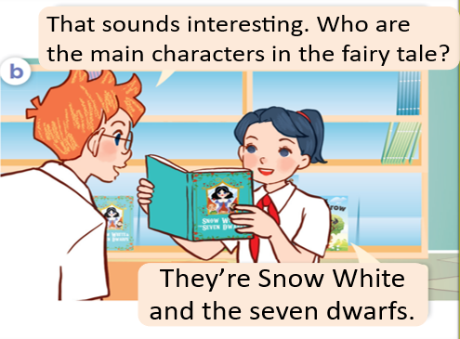
1.Look, listen and repeat
Notes:
MADE BY FACEBOOK :TRAN THI THANH TAM

Slide 4
Snow White /snəʊ waɪt/
:Nàng Bạch Tuyết
Notes:
MADE BY FACEBOOK :TRAN THI THANH TAM

Slide 5
Seven dwarfs /ˈsev.ən dwɔːfs/
: bảy chú lùn
Notes:
MADE BY FACEBOOK :TRAN THI THANH TAM

Slide 6
ant/ænt/ : con kiến
Notes:
MADE BY FACEBOOK :TRAN THI THANH TAM

Slide 7
Grasshopper/ˈɡrɑːshɒpə/: con châu chấu
Notes:
MADE BY FACEBOOK :TRAN THI THANH TAM

Slide 8
Tortoise /ˈtɔːtəs/ : con rùa
Notes:
MADE BY FACEBOOK :TRAN THI THANH TAM

Slide 9
Hare/heə/: con thỏ
Notes:
MADE BY FACEBOOK :TRAN THI THANH TAM

Slide 10
Fox /fɒks/ : con cáo
Notes:
MADE BY FACEBOOK :TRAN THI THANH TAM

Slide 11
Crow /krəʊ/ : con quạ
Notes:
MADE BY FACEBOOK :TRAN THI THANH TAM

Slide 12
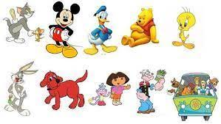
Characters /ˈkær.ək.tərz/: các nhân vật
Notes:
MADE BY FACEBOOK :TRAN THI THANH TAM

Slide 13
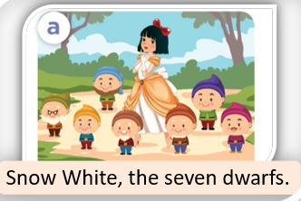
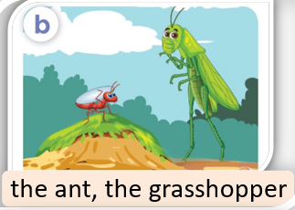
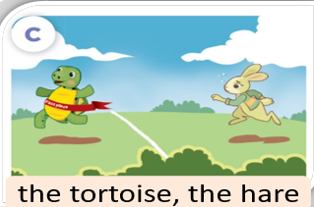
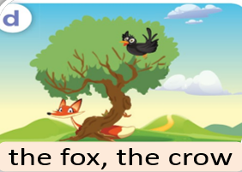
2.Listen, point and say
They’re …………………
Who are the main characters in the story?
Snow White and the seven dwarfs
Notes:
MADE BY FACEBOOK :TRAN THI THANH TAM

Slide 14
Hỏi và trả lời xem bạn đến từ đâu
Who are the main characters in the story?
( Ai là nhân vật chính trong câu truyện vậy?)
They’re Snow White and the seven Dwarfs.
( Họ là nàng Bạch Tuyết và 7 chú lùn.)

Slide 15
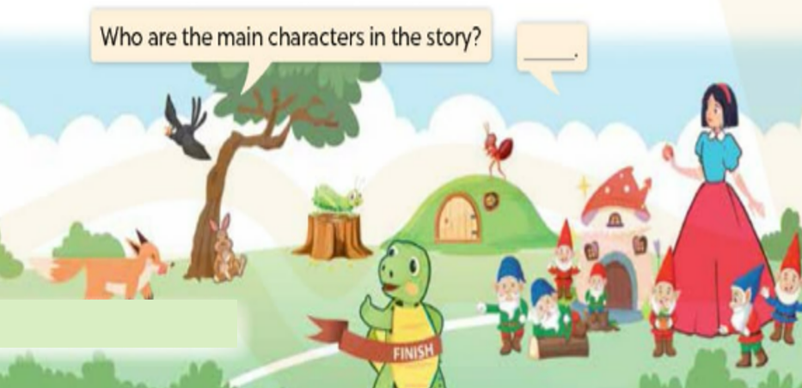
3. Let’s talk
Notes:
MADE BY FACEBOOK :TRAN THI THANH TAM

